Slide 1
People Management Training
Recruitment & Selection Essentials

Slide 2
Objective
After completing this training, you will understand the best practice which should be used at every stage of the recruitment process

Slide 3
Why good recruitment and selection practice is essential
The recruitment process is often an applicant’s first experience of NHS Greater Glasgow and Clyde
Recruiting suitable candidates is a critical activity for you as a line manager or supervisor
Everyone involved in the recruitment decisions must ensure the process followed is fair, legal ,open and transparent and is applied with consistency
Importance of Fairness - Recruitment is about getting the most suitable candidate into a role, however, it is not always clear what makes a candidate ‘suitable’, and there is potential for bias or discrimination to occur or to creep in recruitment and selection decision making
That’s why its important - to make recruitment decisions which are justifiable & objective that are clearly documented and in a Job Description and Person Specification and follow through to each stage in the recruitment process
NHS Greater Glasgow and Clyde’s Recruitment and Selection Policy

Slide 4
Recruitment Process Stages
Best Practice

Slide 5
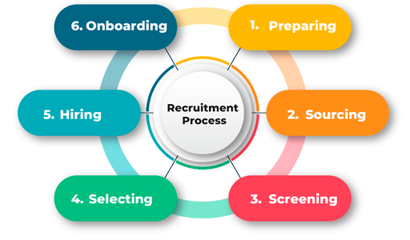
NHS Greater Glasgow and Clyde’s Recruitment Process Stages

Slide 6
Preparing – Advert and Job Description
When creating your advert and job description you should ensure that you:
Fully complete your Vacancy Request Form (VRF)
Define the vacancy and link this to the job description and person spec
Avoid jargon – not everyone knows what the NHS acronyms means
Are not focussing on NHS experience rather than demonstrated competency for the role
Are not focussing on professional and technical qualifications without considering previous experiences
Carefully consider the number of essential criteria for each job – as the more you have the more you exclude
Ensure that you are not using gender defining language or over use of enthusiastic language
Create adverts and job descriptions that welcome applicants
Keep language in your adverts neutral – check that words and phrases that may reinforce stereotypes are not used
This will ensure that you are not inadvertently attracting some demographic groups and deterring others

Slide 7
2. Sourcing – Advertising your Vacancy
When creating your advert you should note that you:
All adverts within NHS Greater Glasgow and Clyde are advertised via Jobtrain once they have cleared redeployment.
If your post is held you will be contacted by the Transition Service regarding this and next steps
If not held then your post will be released to advert
These adverts will be posts on NHS Scotland’s Careers, Google Jobs, Adzuna and MyJobsScotland.
They will also be advertised on NHS Greater Glasgow and Clyde's Recruitment Pages on Facebook, X (formally Twitter) and LinkedIn.
Give candidates sufficient time to apply
Ensure your informal contact is accessible via phone and email
Advertise flexible working arrangements
Gender Bias Decoder – this link will be included in your session toolkit

Slide 8
3. Screening – Shortlisting
When shortlisting you should ensure that you:
Are not filtering out good talent by focussing on qualifications only
Look beyond NHS experience
Are not time pressured when shortlisting as this increases the risk that you shortlist candidates based on stereotypes
Use Jobtrain as this ensures anonymised shortlisting
Fully review any candidates who are participating in the Job Interview Guarantee Scheme

Slide 9
4. Selection – Interviewing
When interviewing you should ensure that:
Candidates are given adequate time to prepare for interview; especially if you are asking the candidate to prepare a presentation or be ready for an exercise as part of the interview process
You ensure that all panel member have access, and have reviewed, the application forms prior to interview
Ensure if required reasonable adjustments are put in place for interview
Ensure your interview room is welcoming and you have signage for the candidates from entering the hospital to finding the interview venue
If using MS Teams for interviews all panel members have access to a laptop/PC, with camera, and have checked the Wi-Fi before the interview date
You have a structured interview questions
Questions asked and the candidate responses and score are updated on your interview paperwork
Remember that what you record about a candidate they have a right to see
You use a rating scale and carry out your scoring individually

Slide 10
Conducting an Interview

Slide 11
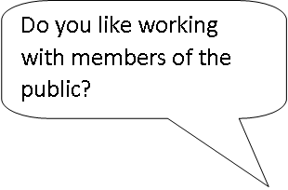
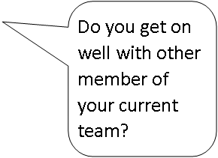
Turn these closed questions into open questions to avoid yes/no answers……..

Slide 12
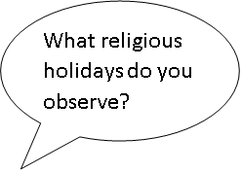
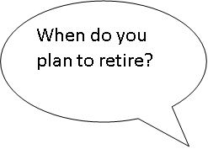
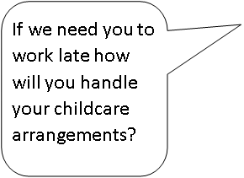
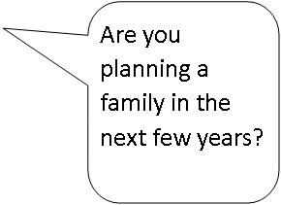
You are an interview panel member
How would you handle these questions which you are allocated to ask …….

Slide 13
5. Hiring – Making an Appointment
When selecting your appointable candidate you should ensure that:
All interview panel members have an equal say in the decision on who to appoint
Scoring is collated at the end of the interview
Decisions are based on the information provided during the interview
There is no person bias
You are not basing decision on who can ‘Hit the Ground Running’

Slide 14
6. Onboarding – Pre-Employment Checks
What are the pre-employment checks that are carried out:
Disclosure Scotland Check
Occupational Health Check
Right to Work Check in the UK
Immigration Visa Compliance
References
Qualifications /Professional Registration (if required)
How is an offer withdrawn due to failed pre-employment checks?

Slide 15
Next steps
Make sure you also complete:
Part 1 – Process, EDI, Bias
How to use Jobtrain - link

