Slide 1
People Management Training
Recruitment & Selection Essentials

Slide 2
Objective
After completing this training, you will understand the main components of the recruitment process, with a focus on equality and bias, including the main areas of risk in the process

Slide 3
Why good recruitment and selection practice is essential
The recruitment process is often an applicant’s first experience of NHS Greater Glasgow and Clyde
Recruiting suitable candidates is a critical activity for you as a line manager or supervisor
Everyone involved in the recruitment decisions must ensure the process followed is fair, legal ,open and transparent and is applied with consistency
Importance of Fairness - Recruitment is about getting the most suitable candidate into a role, however, it is not always clear what makes a candidate ‘suitable’, and there is potential for bias or discrimination to occur or to creep in recruitment and selection decision making
That’s why its important - to make recruitment decisions which are justifiable & objective that are clearly documented and in a Job Description and Person Specification and follow through to each stage in the recruitment process
NHS Greater Glasgow and Clyde’s Recruitment and Selection Policy

Slide 4
9 Key risks in the recruitment process
Discrimination – Under the Equality Act 2010, it is unlawful to discriminate against a candidate during the recruitment process, just as it is unlawful to discriminate against an employee in the workplace.
Job description wording – Any person specifications must relate to genuine occupation requirements essential to performing the role.
Job advert placement – Targeting job advertisement can lead to indirectly discriminating against individuals outside this group. Job adverts should be placed where there is a broad reach of candidates. – NHSScotland job portal – apply.jobs.scot.nhs.uk
Interview selection – You should make available any reasonable adjustments where a candidate request to allow them to attend the interview.
During the interview – Check you’re questioning does not open you to allegations of discrimination by moving into personal circumstances.

Slide 5
9 Key risks in the recruitment process cont/
6. Candidate selection – Basing your candidate selection on assessment on ‘hearsay’ or social media profiles would expose you to risk should you be challenged on the reason for your decision not to take the applicant to the next stage
7. Making the offer of employment – should be made clear that the offer is conditional on the applicant meeting the pre-employment check standards which includes checking they hold a valid right to work in the UK. Do not over promise when making an offer
8. Right to work in the UK – Before we can lawfully employ anyone in the UK, we must be satisfied that they have valid permission to do the work they have been offered- this is a legal requirement . Applies to all workers, regardless of nationality. If we fail to verify a person’s status and subsequently hire them unlawfully, then NHSGGC may be at risk of a fine of up to £15,000-£20,000 per illegal worker. These are being increased shortly to between £45,000-£60,000 per illegal worker. Recruitment service carry out the checks
9. Record keeping – If there is a claim for discrimination brought by a job applicant, evidence of our recruitment and selection process will be critical to our defence. Important to take detailed notes during interviews of the questions asked and the answers given. This includes reasons for or not shortlisting

Slide 6
Equality and Diversity Law
& Discrimination

Slide 7
Key Principles of Equality and Diversity Law – Advancing Equal Opportunity for all
The Equality Act became law in 2010 Contains 100 statutory instruments and 2,500 pages of guidance and statutory codes of practice Encourages people to do what is right and what is legal Everyone involved in recruitment and selection should be aware of the General Duties of its purpose : It legally protects people from Discrimination, Harassment and Victimisation in Employment and in wider society | Any form of discrimination against an employee or job applicant on any grounds relating to any characteristic protected by law is prohibited

Slide 8
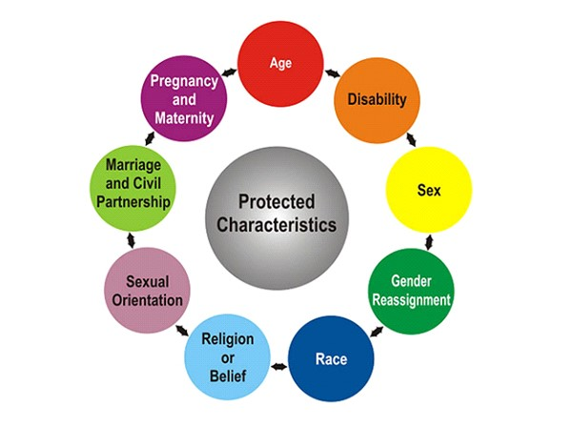
The Equality Act 2010 : Protected Characteristics
Under the Equality Act there are 9 characteristics classified as protected It is against the law to discriminate against anyone because of any of the Protected Characteristics You must not treat a job applicant worse than another because of a Protected Characteristic – this is Discrimination An individual who has been discriminated against whilst looking for a job may be able to bring a discrimination claim against NHSGGC if they can demonstrate they have been treated unfairly due to a protected characteristic

Slide 9
Equality Act 2010 : Disability Discrimination
Questions about health or disability
Except in very restricted circumstances you are not allowed to ask any job applicant about their health or any disability, until the person has been:
Offered a job –conditional job offer
Included in a talent pool of successful candidates to be offered a job when one becomes available
This includes asking such a question as part of the application process or during an interview
Questions relating to previous sickness absence count as questions that relate to health or disability
This is to make sure that all job applicants are looked at properly to see if they can do the job in question, and not ruled out just because of issues related to or arising from their health or disability, such as sickness absence, which may well say nothing about whether they can do the job now
Exceptions
Making reasonable adjustments to attend interview
To decide if a specific function of a job can be carried out
Equality and Diversity Monitoring

Slide 10
NHS GGC is a Disability Confident Employer
This means disabled job applicants who meet the essential criteria for a job will be given the opportunity to demonstrate their skills and abilities at an interview via the Job Interview Guarantee scheme. To be eligible the job applicant must: Have a disability , as defined by the Equality Act 2010 Have declared they have a disability in their application & they want to opt into the Job Interview Guarantee Scheme Meet the Minimum Essential criteria for the post they have applied for as set out in the Person Specification for the post

Slide 12
As a Hiring Manager or panel member making recruitment decisions you need to be aware of Bias - Conscious or Unconscious Bias
Hiring bias is a form of discrimination that may occur during the recruitment process
If left unchecked hiring bias can have a negative impact on the quality of candidates being hired
Recruitment of candidates to NHS Greater Glasgow and Clyde should be skills based and free from conscious or unconscious bias

Slide 13
What is the impact of unconscious bias?
Unconscious bias arises when we let them shape or affect decisions that we make
What does this unconscious bias look like?
Disability – making assumptions that a candidate would not be able to carry out a role due to a disability
Religion – preferring candidates who share the same religious beliefs as you
Racial – favouring candidates of a certain ethnic race over others
Gender – favouring male candidates over female candidates or vice versa
Ageism – making assumptions about a candidates abilities based on their age
Social class – looking at further education or postcodes

Slide 14
Next steps
Make sure you complete:
Part 2 – Recruitment Process
How to use Jobtrain - link

