Slide 1


Part 2-
Strategies to manage brain fog
Notes:
Welcome to the Long Covid self-management group and session on Brain fog. My name is Kirsty Hamilton and I am and Advanced Practice Occupational Therapist with Greater Glasgow and Clyde Long Covid service.
Today, we are looking at part 2 – strategies to manage brain fog.
This session will run a little differently from the others. We are going to use some of the strategies during our session today. I would encourage you to try and join in with all the strategies but if not please take the time to have a drink, stretch or rest your eyes.

Slide 2
What would help you engage today?
Notes:
Before we move on, can I ask everyone to stop and have a think about what would help you engage today?
Do you need to move spaces?
Change the lighting
Grab a blanket
Remember, you are not expected to learn everything after attending today's session. I hope you can chose 1 or 2 strategies that you may like to try. Also remember to come back to the presentation later, read over and allow yourself to take the time you need to try out any strategies you feel could work for you.

Slide 3

WAKE UP
Notes:
Many people with brain fog report sluggishness, difficulty concentrating and slowed processing which is worse in the morning. Its important to give yourself time to come to in the morning and wake up your brain, like our physical bosy and allow yourself to start any mental tasks.
Some practices that can be helpful include:
Drinking a glass of cold water to ensure you have not become dehydrated overnight.
Having something to eat that will slowly break down over the course of the morning, examples include porridge, oat based bars etc.
Grounding yourself in the day
possibly a morning meditation.
Using positive affirmations such as
Growth is sometimes bumpy and isn’t always linear, but I will stay the course
I love my body, my mind, my dreams, and my goals
There is some research which suggests a link to the vagal nerve connection with brain fog. As a result adding simple vagal nerve toning exercises may also be helpful. It's important to note that more research is needed into this area but some simple exercises include
Washing your face with cold water.
Humming and/or singing
For anyone with brain fog, I would encourage them to develop and practice a morning and sleep routine.

Slide 4


Structure, Organised and routines
Record appointments important details
Prepare
Create to-do-list(s)
Focus on 1 task at a time
Consider how you learn
Be realistic
Ask for help
Notes:
Change can be difficult and often it is easier to deal with 1 task at a time e.g.Instead of cleaning the whole,room, the aim could clear rubbish away.
Try to keep to a regular routine to reduce the demands on your brain. Our brain finds it much easier to do things that are familiar, practiced or part of a routine. Some tips to help you develop organisation and routine includes:
Use a diary/calender/ electronic device to record appointments and plan your rests etc.
Preparation, if you have appointment in the morning lay everything out the night before.
To do lists can be helpful, but try to limit how many as sometimes this can leave you overwhelmed. Multi-tasking is often challenging for those with brain fog, try to work on 1 task at a time.
Some people benefit from writing and then reading out loud instructions.
Remember to be realistic, as success feels better than failure.
Asking for help is not a failure but rather a support in helping you manage your health.

Slide 5

Talking
Helps
Notes:
We have spoken about acceptance and encouraged you to speak with family, friends or colleagues in our fatigue session. Talking is also important for those experiencing brain fog.
People with brain fog often report worry and embarrassment around this symptom and often, where possible try to mask issues. Often this is done due to fear of brain fog being something worse. Trying to hide cognitive difficulties uses energy that you don’t have spare and discourages you from making the changes you need.
An example is pushing through at work because you may fear losing your job but if your employer is unare how can help be offered. Coming together to discuss your symptoms can ensure the correct help at the right time.
Talking with people around you also allows them to develop strategies to help you and make your daily lives easier.

Slide 6


Consider the task
The type of task
How you do a task
When you do the task
With whom
Where you do the task
Notes:
Life is busy and often we expect to move from one task to another but how often do you stop to think about the tasks you want to complete. Thinking about the task is an important strategy for those with brain fog. Ask yourself what type of task is it? is it a physical, mental, emotional, social or mixed task?
How you do a task it can be helpful to consider a change of media to help with processing and allow a sensory rest. Other examples include moving to audio for screen work e.g. text to speech when reading or writing large or complex documents. This can be achieved through a number of programs including chrome extension, webplayer, android apps etc.
When you do a task is also important to consider. If you needed to read, understand and pay a bill in the evening, this may prove harder than earlier in the day. From your activity diaries you will hopefully see certain times in the day you are brighter, I would encourage you to use this time for any mental activities.
Whom - We spoke about energy vampires during our fatigue session but some people drain out energy or leave us feeling stressed and this can also impact your ability to achieve a task.
Where- Finally, I would encourage you to think about where. I am going to touch on this later on but a busy office versus a quiet space at home may help you to action certain tasks.

Slide 7

POSTURE RE-SET
Notes:
Research shows that limited spinal motion negatively impacts the brain. Maintaining a healthy posture is essential for good brain function. Postural awareness and re-set can be a helpful break and re-charge throughout the day. I have a short video to play, please try to follow along and consider your posture during tasks.
Posture For Energy And Well-Being | Jennifer Shutte

Slide 8
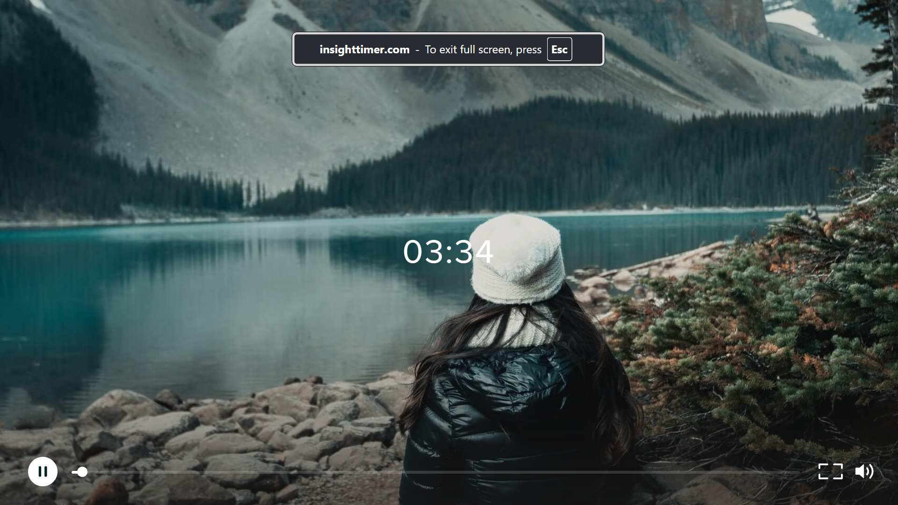
Posture For Energy And Well-Being | Jennifer Shutte
Notes:
Research shows that limited spinal motion negatively impacts the brain. Maintaining a healthy posture is essential for good brain function. Postural awareness and re-set can be a helpful break and re-charge throughout the day. I have a short video to play, please try to follow along and consider your posture during tasks.
Posture For Energy And Well-Being | Jennifer Shutte

Slide 9
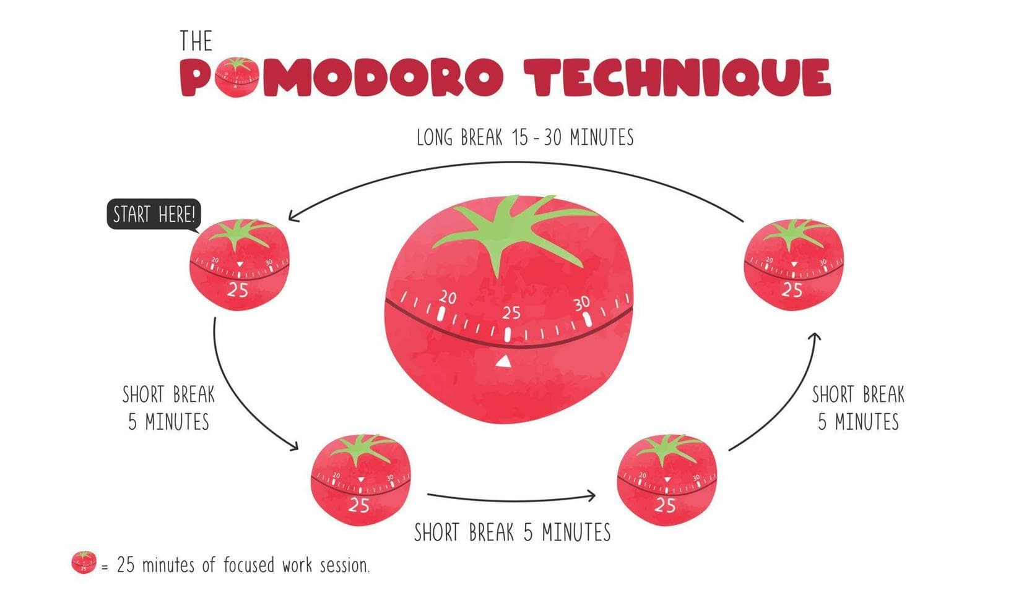
Notes:
The pomodoro technique is a time management technique. It identified that when someone works with clear tasks for a set time with regular rest, their productivity improves. At the heart of the pomodoro technique is pacing and it is for this reason that it can be helpful in managingyour rest and activity needs.
Before starting pomdoro you should identify the tasks you want to achieve. Remember it is important to be realistic, if you have a larger task to complete e.g. sorting a cupboard or filing, try to break the activity down into smaller tasks.
This picture demonstrates a 25 minute activity and 5 minute rest, it is likely that you will need more rest than this. Pomodoro can be adapted to suit your needs for example, some people can complete 30 minutes of activity with 10-15 minute rest period, others a lot less.
If you are currently managing 10 minutes of housework for example I would encourage you to start with 10 mins and 10 mins rest, sometimes the rest time needs to be higher, that’s ok.
Its also important to recognise that you may have different time capacity for different types of tasks and that this may change depending on the day. For those with brain fog, you may find that you can manage a little more physically than you can with a mental task, that’s normal.
Traditionally the pomodoro techniques talks about working in blocks of 3 tasks with the 3rd rest always longer. If you are back at work this can help you to continue to pace and prioritise your health. If you are starting out and are currently in bed for long periods then you may only manage 1 –2 periods of activity. I am using the word activity but this can be any task that requires effort, for example if you have been in bed for long periods you may be looking to achieve a couple of minutes sitting at the edge of the bed.
Using an alarm to ensure you stop at the right time can be helpful and can reduce the instinct/drive to keep going to complete a task or to prioritistise a task over managing your energy.
I have set up this presentation with these breaks to show how this technique can be used in practice.

Slide 10

Task effort
High effort/difficulty and may only be able to complete 1 of these tasks a day.
Consider the time you plan to complete.
Moderate effort/difficulty
Your abilities/tolerances may be different for different types of tasks e.g. physical, mental
Low effort/difficulty, these are tasks you should be able to complete fairly regularly.
Notes:
Alongside using the Pomodoro technique it can be helpful to consider the task effort, I call this the traffic light system. This encourages you to consider the tasks you complete everyday and what level of effort you need to complete them. As Long Covid fluctuates day to day this will impact this list and often people develop a 'good day' list and a 'bad day' list.
Green tasks are generally low effort/difficulty, these are tasks you should be able to complete fairly regularly.
Amber
Moderate effort/difficulty
Your abilities/tolerances may be different for different types of tasks e.g. physical, mental
Red tasks -
High effort/difficulty and may only be able to complete 1 of these tasks a day.
Consider the time you plan to complete.
Once this is review is completed I would then encourage you to start to build your day around the green tasks and consider when and how you will achieve amber and red tasks. I accept that some red tasks will be a pr

Slide 11

CHECK YOUR SPOTLIGHT
Notes:
Poor concentration is common in brain fog. If you imagine the spotlight is your concentration, as time moves on, noise in the background or even your thoughts interrupt this process. Suddenly you may find that although you think you are concentrating your spotlight is misaligned. Think about a time you were meant to be concentrating but found yourself daydreaming, this is an example of a loss of concentration.
The first step in managing this is to = Stop and check in with your spot light. Ask yourself where your concentration is at the moment? If its not where it needs to be, stop, take a breath and try to re-set your concentration. With practice this can become a routine.
Methods of re-focussing can include
Changing tasks
Changing your environment, possibly a quieter space
Taking a break
Grabbing some fresh air
Or movement can help you re-focus.

Slide 12
Managing impaired memory
Stop
Information chunking
Think, say and do
Repetition
    Say
    Think
    Do
Check your attention.
Use structure e.g. sub-headings for information but also places to leave items.
Write it down
Visualisation
Notes:
As discussed in part of the session changes in your memory are common for those with Long Covid.
To help manage changes in your memory we suggest
Stop and centre your attention.
Identify what is essential today, what can be left for tomorrow. Use and prioritise to-do-lists –using paper and pen, apps, share with someone, text, voice note etc.
Information chunking encourages you to break something you need to remember into manageable chunks. Think about how you would remember a phone number, for example 078555988800, may become 07855 988 800
Think, say and do encourages you to voice the steps/actions you plan to need to do and while you are doing them. With repetition you can start to add new learning this way.
Writing, drawing pictures or gesture are all helpful methods of helping your memory.
Visualisation is an important tool, think through the task you need to do, imagine yourself doing . This can help you build confidence and awareness of the steps and reduce any forgetfulness in the moment.
None of these strategies are a singlular fix for brain fog, repetition and practice of the strategies can help you to make improvements. When you are trying out a new strategy, stick with it for the month, research shows that it takes 66 days for something to become automatic. If you forget or the strategy drops off, restart as soon as you are aware.

Slide 13
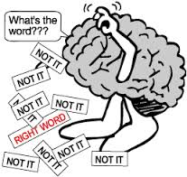
Word finding difficulties
Notes:
The best way to define a word-finding problem is to think how you feel when you can't remember someone's name or the name of a place you've visited. It's that “tip of the tongue” feeling that we all experience occasionally but for someone with word finding difficulties this problem presents throughout their daily lives.
Some people become frustrated or embarrassed, particularly if they have a tendency to replace the word they are searching for with one which is not correct.
93% of communication is non-verbal, therefore by using some of these strategies can help you manage any word finding difficulties.
Let's think about strategies to help.

Slide 14
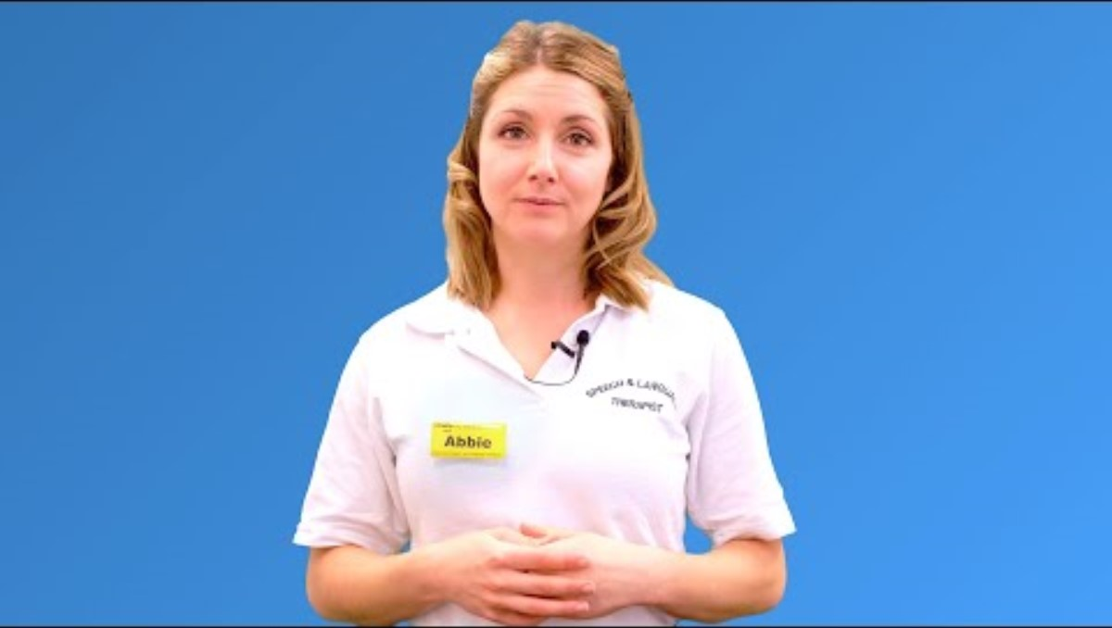
r
Notes:
People with a range of health conditions can experience word finding difficulties. This video is from a speech in language therapist at Guys and St Thomas' NHS who works in cancer care. She reviews a number of strategies for people with word finding issues which are also recommended for people with long Covid.

Slide 15
Word finding STRATEGIES
  Delay
  2. Describe
  3. Association
  4. Synonyms
  5. First Letter
  6. Gesture
  7. Draw
  8. Look it Up
  9. Narrow it Down
  10. Come back later
Word-Finding Strategies for Aphasia - A How-To Guide & Top 10 List
Notes:
I added our strategies for word finding difficulties below, some people find taking a picture using your phone can help practice some of the strategies when you are out and interacting with others.
Help with word-finding difficulties
Delay Sometimes giving yourself a couple of seconda the word may come back on its own. Remember to be patient.
Describe explain what they look like, what they are used for e.g. something can keeps my hand warm in winter when Im out – gloves. Carrying paper and pen can be helpful.
Association try to consider a related word, this may prompt you or improve understanding for the listener.
Synonyms Think of a word that means the same or something similar.“Do you have any…clippers?” instead of scissors.
First Letter try writing or thinking of the first letter.
Gesture use your hands/body to describe.
Use your hands or body to act out the word. Even gesturing with your hands in a non-specific way or tapping the table may help activate the brain.
Draw Sketch out a quick picture
Look it Up check if its written somewhere.
Narrow it Down describe general topic or category.
Come Back Later
If the word does come back write it down and read over and consider using the strategies to encourage learning for next time.

Slide 16
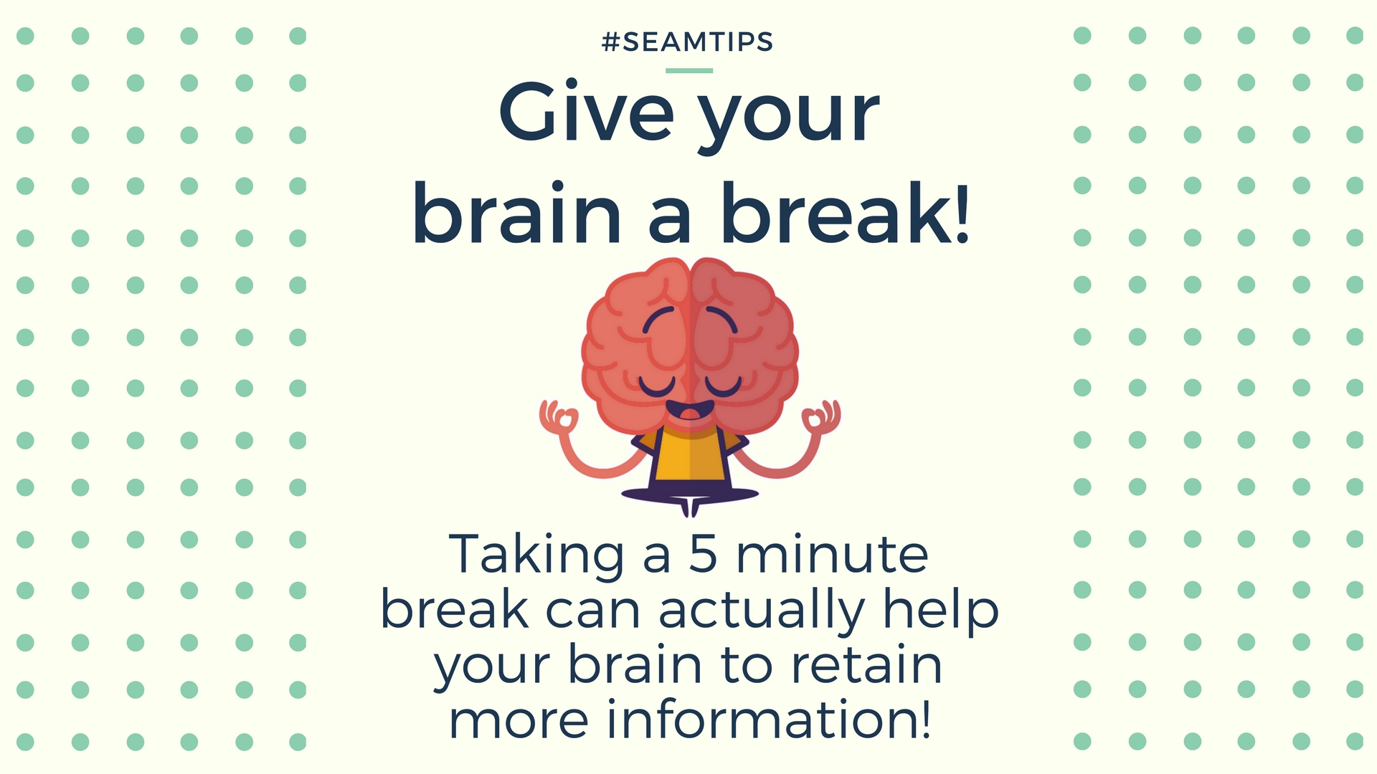
BRAIN
RE-CHARGE
Notes:
Pacing is important to manage your brain fog, having regular breaks allows your brain rest and time to re-charge. We are going to play a short relaxation which support. I would ask that you try out these techniques but also understand that not every relaxation will suit you.
If you don't wish to listen or its not working for you, please feel free to switch off your camera and possibly use the time for a drink or stretch.

Slide 17
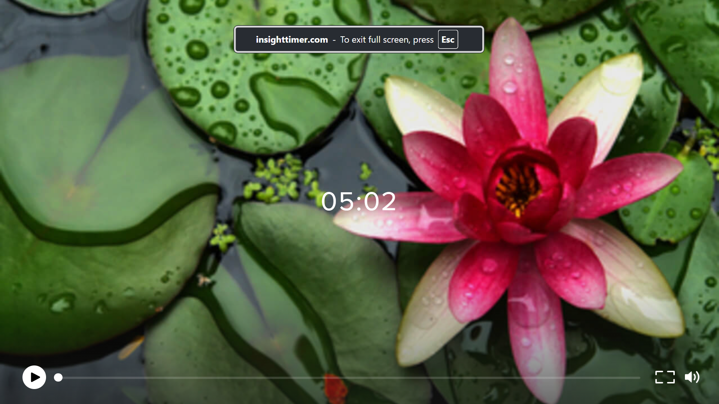
TAL RE-CHARGE
5 Minute Brain Recharge | Heidi Hanna
Notes:
5 Minute Brain Recharge | Heidi Hanna

Slide 18







PERSONAL STRENGTHS
"The secret of change is to focus all your energy, not on fighting the old, but on building the new." (socrates)
Notes:
Before the pandemic you will have worked hard to move through life. You may already be using information chunking to help you remember phone numbers or visualisation for a complex work task. Finding these strategies is important as alongside your personal strengths, preferences we can help you build brain fog strategies that work for you.
Your personal strengths, values and drivers are important and can act as a building block to manage your brain fog. Example across the bottom of the creen include:
caring/nurturing
Well supported
Chatty
Arty/crafty
Musical
Movement
if you have always been organised implementing organization based strategies will be easier for you to adapt that someone who has been disorganised. Or if you have an infinity with music you may be able to use this to with rest and/or to remember certain words/phrases.
How would you describe your strengths?

Slide 19
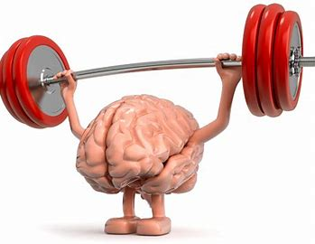
Brain training
Notes:
Cognitive function can be recovered through steady gradual practice. Completing brain exercises can challenge your mind, sharpen your cognitive skills improve your mental agility. I would encourage you to add cognitive exercises and intellectual challenges into your daily schedule . This has been shown to help stimulate the growth of neurons as well as strengthening interconnections and neural pathways within the brain.
Examples of activities include:
Games such as crosswords, sudoku, and jigsaw puzzles, as well as board games, group games using strategy and problems solving skills.
Reading out loud, start with a book that you know.
Learn something new e.g 1 new word every day.
Listen to a podcast, short story or article and then summarise it in your own words afterwards.
Use brain training apps and games: Researchers are currently exploring cognitive training through brain training apps played at home. A pilot study in 48 people recovering from Covid 19 suggests that puzzle-like cognitive games can improve attention and multi-tasking and are highly motivating. Brain training has its limits, but Produced by Kay Richardson, Occupational Therapist Salford Post-Covid Rehabilitation Service emerging evidence supports its value in building attention and processing skills which are at the heart of many post-Covid 19 impairments.

Slide 20
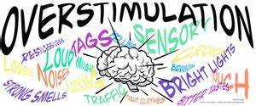
Sensory Overload
Notes:
Our sensory receptors (eyes, ears, tongue, nose, and skin) are receiving sensory stimuli (sights, sounds, tastes, odours, and textiles) constantly. If you stop for a moment and listen -
What can you hear?
What can you see?
What can you taste?
What can you smell
What are you touching?
Normally these receptors are working in the background and through our sensory and perceptual processes they decide on the important stimuli we need to be actively aware of. This process requires energy and eventually attention but if someone has fatigue and brain fog they are unable to fully process this stimuli and become sensory overloaded.
A sensory toolkit is a combination of sensory tools that can be used to calm and stimulate our sensory system.
Calming- if you are feeling overloaded, restless or anxious. you can use calming sensation to calm your nervous system.
Alerting- When you are feeling exhausted, you can use alerting sensation that can boost your nervous system.
The items that work for you are individual to you but examples of calming may be a weighted blanket, patting a pet or using noise cancelling headphone. For alerting you may cool your room, wash your face or wrists with cold water or smell a scent that boosts you as a person.
Be aware of your senses and take steps to calm or alert as needed.
In one study 91 % of respondents reported sensory changes due to Covid-19 infections.

Slide 21
Conclusion
Brain fog strategies include:
    Internal (e.g. checking your spotlight, neumonics
    External (e.g. calendars, technology, a key hook.
    Brain training works with your strengths and supports practice and repetition of cognitive skills.
Brain fog is complex but with support, the right strategies and practice improvements can be achieved.
Notes:
Memory strategy training works by either improving your cognitive skills with internal strategies or by compensating for your brain fog with external aids.
Internal strategies are those that affect your thinking and act as reminders- examples include checking your spotlight, using neumonics to help with communication.
External strategies are those that compensate. This includes alterations to your environment or routines that help you to function better by providing you with prompts. Examples include use of calenders, a key hook.
Brain training works because it tries to capitalize on what is already natural to you and encourages and supports the practice of cognitive skills.
We all use both internal and external strategies in daily life, so results are better if you work with what is already in your repertoire. For example, training to use a smartphone will likely work well for a tech savvy person. They probably have automatic skills using it. However, that might not work as well for someone who has never used a smartphone. That person, however, may already be in the habit of using a daily planner or other written aid.
Brain fog can be debilitating but with the correct strategies people can learn to manage their difficulties.

Slide 22
Thank you for listening
Any questions?

