Slide 1

CHEF Profile
Brought to you by NES and CHEFs Scotland Wide
Notes:
This presentation was originally created

Slide 2

What is a CHEF?
Care Home Education Facilitator
Notes:
Frequently get directed to the kitchen
Describe self as from NHS education, or nurse who supports the students
NHS has an SLA
CH - MOA

Slide 3
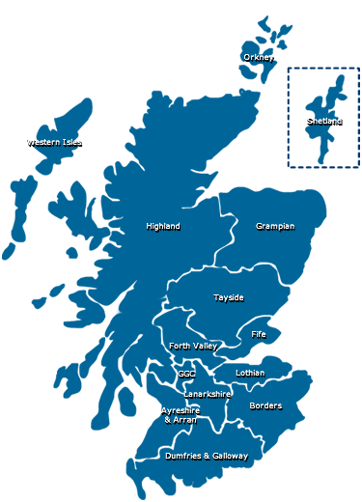
CHEFS are Scotland wide
Notes:
Team of 11 currently, but increase with uplift.
Supported directly by donna craig – senior educator at NES.
Funding stream

Slide 4
History of the CHEFs
The CHEF role was created by NES to support the Mentors who were supporting students on placement, the role has evolved since it first began in 2010.
Notes:
Massive drive nationally for nurse education to include more older adult care and more social care
Huge deficits in recruitment and retention in care homes
Inequity of access to training, resources,

Slide 5

Video from student Nurses in Edinburgh
https://www.ed.ac.uk/health/subject-areas/nursing-studies/news-events/care-home-nursing-film

Slide 6
The Role of a Care Home Education Facilitator (CHEF):
Signpost practice learning opportunities.
Provide continuing support to practice supervisors and practice assessors.
Contribute to collaborative working.
Promote the contribution that care homes make to the future nursing workforce.
Establish & develop positive learning environments.
Enhance the quality of the practice learning experience and positively contribute to the future nursing and midwifery workforce.
Notes:
Support the education and development needs of care home staff, to effectively support and enhance the student nurses experience within the Care home setting.
Contribute to the quality of care provided for the older adult through sign posting practice learning opportunities for the clinical teams, such as training courses, webinars and development events.
Support the development of both new and experienced practice supervisors and practice assessors and those in wider practice education support roles, by signposting Continued Professional Development opportunities (CPD) in line with the NMC Quality Standards for Practice Learning (2020).
By being the link between Care Homes, the NHS and Education Institutions, such as universities and colleges.
Maximise the contribution that care homes make to the development of the future nursing workforce across the sector.
The CHEFs are required to establish, develop and co-ordinate audit and evaluation of placement learning, and to ensure systems are in place to resolve emerging issues that may arise with student learning opportunities or interactions.
By collaborating on different work streams, such as developing a student resource to support digitally enhanced placements.

Slide 7
The CHEF role is:-
Challenging
Happening
Exciting
Fast – paced
Notes:
We’ll have a look at each of these in turn

Slide 8
Challenging
“Not having enough hours in the day.”
Dispelling the “Myths” of Care Home Nursing.
Notes:
In most care homes there are only one or two practice assessors or practice supervisors, and they generally work opposite shifts.
Lack of coordination, support for each other.
Most of the time students resent being allocated to a home for their placement – poor media representation, misconceptions.
Work of rashilee – 5 questions - see podcasts

Slide 9

Happening
Every day different things are “Happening” in a Care Home
Notes:
Admissions, Birthdays, Christmas, Dinner, Enjoyment, Family, Gardening, House-keeping, Interactions, Joy, Kindness, Love & Laughter, Memories, Nattering, Organising, Party, Quiet times, Restful, Sleeping, Trust, Understanding, Value, Welcoming, X-tra special, You, Zzzzz!
Where is there time to teach and support students? X 1 nurse, 30 residents.
Covid has huge impact – addinal 20 tasks for nurse each day.
Where is the time to meet with the CHEF?
Informal CS

Slide 10

Care home placement case study
Notes:
Case study 1 – paul – AD final PLE 2nd year.
X 1 Ps and x 2 PS all in different units.
Enhanced skills – intermediate care unit
Care planning – PS
CHEF try encourage more staff to undertake ps pa prep – capacity is a hige issue
Keep ps pa up t date with new PAD – has to be 1-1 as no IT and opposite shifts

Slide 11

Exciting
Every day is exciting-always someone new to speak to and something new to see.
Notes:
Stories to tell.
Memories to share
Things to learn
Food to enjoy
Songs to sing
Friends to make
Recently with the changes to the NMC SSSA, I have been supporting SSSC supervisors to become practice supervisors – they enthusiasm and dedication is fantastic. They really value the fact they are formally recognised have having all the knowledge and skills that we seek to instil into nurses.

Slide 12
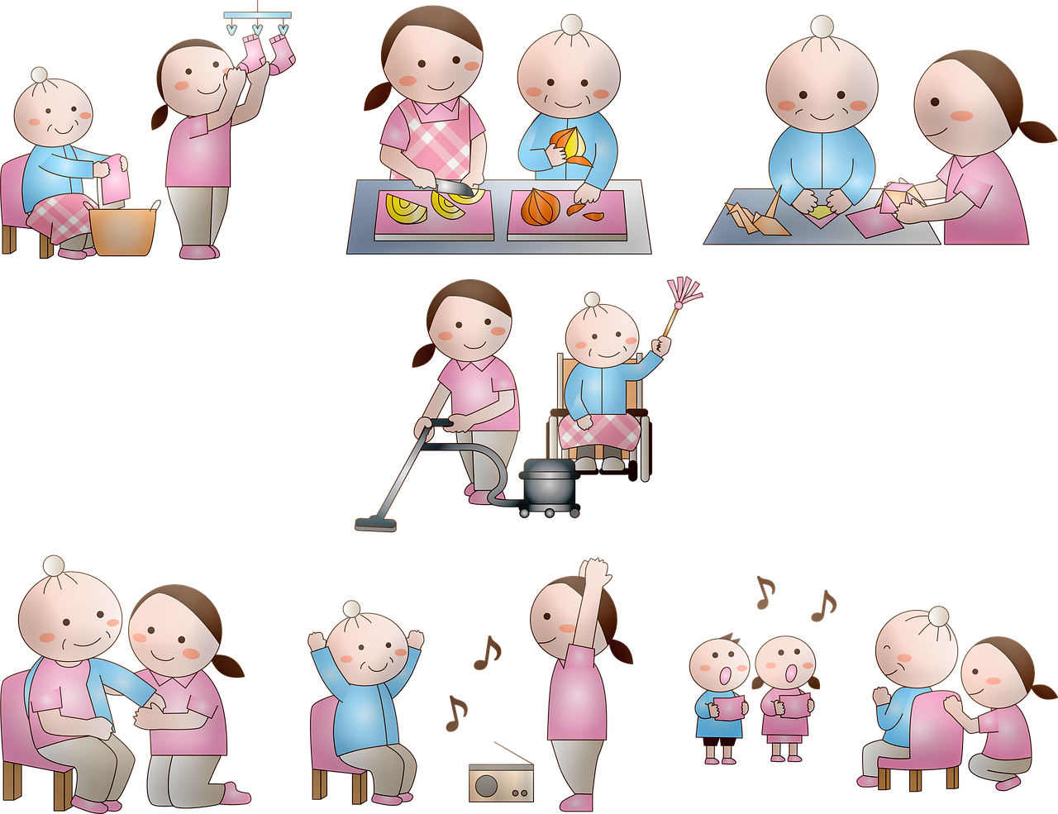
Fast-Paced
Notes:
Meals are served, morning tea and now it’s time for lunch, afternoon tea and then it’s dinner, supper time then bed
Time goes fast for all the staff but possibly stands still for the residents, who watch and smile and think that they themselves were once the staff running around?
I currently cover the whole of GG&C so it is very difficult to be present in the homes as much as before.
Describe normal working week

Slide 13

Networking
Notes:
HEIs – tripartite, auditing new homes
PEFs – pulled in different directions
National CHEF network and NES, support, teams channel
Scottish care – presentation and article

Slide 14
PS PA responses
“I very much appreciated our video call check ins which were really useful to catch up. It was such a great help to know if I had any questions etc that you would help me find the answer, thanks again.”

Slide 15
Students responses
I just wanted to express my sincere thanks for the last 19 weeks (can’t believe it’s been that long!) It has been such a pleasure to have someone who has always been there to support me, via WhatsApp or email, at any time I felt I needed it. It was so reassuring and comforting to know that if I had any issues I could get in touch. Thank you again”
Notes:
Some health boards directly support the students on placements.
I tend to chat to them when I drop in (pre pandemic)

Slide 16

Questions ??

