Slide 1


Long COVID Service
Self-Management Group
Week 8
Planning for the Future
Notes:
Welcome to the final group session. This session should round up all you have learned from the last 7 weeks and give advice on where to go next and what to do.
My name is Lily and I am one of the physiotherapists in the team and I am joined by Claire who is the Team leader and also a physiotherapist by trade.
After the group sessions have ended, you should have a 1:1 review with your key worker to discuss what the plan is next – time to continue with the strategies or need further support from the team.
Tailoring goals

Slide 2
Aim of session
The Corona-coaster
Returning to work and study and discussion
10 minute break
Goal setting
Set back management
Self-management toolbox and discussion
3-minute Meditation
Room open at the end for peer support

Slide 3
Rollercoaster video from Leeds Long COVID Service
Long COVID: Next Steps https://youtu.be/npj8EWUrMhs
Notes:
This comic strip was produced by the guardian and described in this video by one of the Leeds Long COVID service. We have been lucky that we have liaised with lots of different Long COVID services throughout the UK and our sessions have become an amalgamation of these. The Leeds service was one of the first services to start a Long COVID team and I'm going to play the first part of their final session as we felt that it describes the journey quite well.
Play video
The previous groups we have played that video to felt they could relate to that analogy. I’m hoping that you feel better prepared and have the right people in your corner to help support you. Maybe you have met some people in this group. If any of you do want to start a WhatsApp group (if you have not already) then you could email us or pop your number in the chat if you are willing to start it up for the group.

Slide 4
Work and Study
Notes:
This session is about where to go next and how to make plans. For a lot of you that will be thinking about work. This next section is a little heavy but hopefully you find some useful information.
Some of you may be retired or not in employment or study, so the next section may not be as relevant for you. You may choose to take a wee extended break if this information would be irrelevant for you and return after the break. However some of the advice could be useful for planning return to a hobby or other activity.

Slide 5

Long COVID and the Equality Act
For a condition to be described as a disability 3 conditions need to be met:
Length of time – likely to exceed a year
Significant impact on Activities of Daily Living
Requiring treatment / medication / surgery
(or one of the chronic episodic conditions like Rheumatoid Arthritis or conditions like Cancer or HIV)
People with long COVID are now ‘living with a long-term condition’. It is likely most will be protected by the equality act due to the duration of symptoms.
Notes:
I'm going to start off by telling you about the equality act. The Equality Act 2010 (EqA) is designed to address the disadvantage and discrimination experienced by particular groups of people and to provide a legal framework for addressing these inequalities.
Having a condition described as a disability under the equality act gives you some degree of protection and may entitle you to certain benefits.
For a condition to be described as a disability in this way it would need to be longstanding– has exceeded or is likely to exceed a year, has a significant impact on your daily life (washing, cooking, dressing etc) and requires some kind of treatment, which may be medication, therapy, surgery etc.
There are other conditions which are automatically included like cancer and Rheumatoid arthritis also which may not need to meet the above criteria. Due to how long people have been symptomatic with Long COVID and the fact that it can be in episodes and varied, in a lot of cases, you will likely be in this category and covered.
Clinicians like ourselves can advise you if you are likely to be regarded as having a disability based on this which is enough to allow you to use this "title" to assist in certain situations
One is relating to work – if you have a disability, your employer should not discriminate against you because of this condition. That is not to say that they need to action every recommendation for your work, but they have to have a good reason why not. For example – we may suggest that an adjustment may be that you start an hour later at work and finish an hour later, say 9-5 instead of 8-4) to avoid rush hour traffic and therefore conserve time driving. If you didn't have a disability, your manager may say – I can't let you do that – everyone will want that and I need someone starting early, ...if you have a disability, they do need to consider adjustments which might be different to those without a disability. However, it has be deemed reasonable in relation to your role. Eg – if the clinic only runs 8-4 and the service would be unmanned 8-9 and you would be lone working in a high risk area from 4-5 then that may be appropriate to decline that recommendation. All these things would be on a case by case basis and dependent on your team and role.

Slide 6
Barriers to Return to Work / education
Symptoms
Work environment
Work life balance
Notes:
What would be the barriers to returning to work
I'll leave this up to give you ideas – maybe write in the chat box what are your particular barriers,
For most it will be fatigue – not just physical but Mental and emotional fatigue also. You may not have the physical or emotional strength to manage your role fully
Anxiety – the isolation / being around people / risk of reinfection and further absence / what others are thinking of them /
Breathlessness – limiting their stamina
Brain fog – not being able to remember things, focus long enough, the confidence of performing at your previous level or risks of mistakes
Masks – less of an issue for most places now
Shift work, or even returning to a 7.5 hour working day
The travel in
The dread of knowing your work are short staffed, not being able to do a phased return or feeling guilty to leave work on time
Changes to life – caring responsibility, kids not going to afterschool clubs anymore, previous arrangements not an option after a long period off work.

Slide 7
Indicators of being ready to return
Medically fit
Improvement in symptoms
Able to manage activities similar to work for longer periods (for at least 2-4 hours). Including getting dressed and out the door
Able to travel into work / work from home
Symptoms stable – less “bad days” or more manageable
Risk assessment
Notes:
How do you know you are nearing a stage of going back to work?
First that you are medically fit – this may mean different things to different people – may be different for someone in a physical Vs sedentary role. It may not mean that you have had all investigations (if you are waiting on a neurology / orthopaedics / respiratory appointment, it may be months or years to be seen. But if your GP or one of us is confident that work is unlikely to impact on the problem then they will indicate that on your fit note.
Improvement in symptoms – if things are getting worse then adding more exertion, activity and stress into the mix is unlikely to help
Able to manage activities similar to work for 2-4 hours - Similar to work may be being up and alert for 2-4 hours as a starting point, don't forget the added tasks of getting ready and travelling in.
Able to travel in or work from home.
Having more bad days and less good days – may lead to recurrent absences and worsening of symptoms
You may need a risk assessment for fire safety, lone working, and going back to the first point, how your ongoing symptoms could be a risk in your particular role and environment.

Slide 8
What can be recommended?
Adjustments
Redeployment
Pausing work / career break
Terminating contract on grounds of ill health
Notes:
If you are ready to return, then the priority is almost always to return to your previous role but to consider adjustments – I am going to describe some of these in the next few slides.
If this option has been exhausted or deemed unlikely, then if the organisation has the capacity, you could be redeployed or moved to another area / different tasks. This may be permanent or temporary until you are fit. Smaller companies may not be able to offer this
Pausing work or taking a career break / sabbatical – you can request this. It may not be an option for some. Will obviously impact on income but means the door is not closed on that role.
If none of these options are possible or have not worked then it may be that the decision is made to end the employment. Some employers can accommodate longer sick leave, others not, some will be dependent on your contract.
If this is the case then I would advise that in most cases you should not be handing in your own notice, it should be a dismissal or termination of contract due to capability (ill health) so that you are entitled to benefits (and depending on your contract, may be due a small amount of pay – eg NHS it is 3 months and any unused holidays paid. This will vary dependent on your contract. If you are unsure if your employer is acting lawfully with this then I would advise you contact the citizens advice or an employment lawyer or union. Look at your contract and check what your entitled to.
If you have been paying into a superannuation scheme or private insurance, you could look into applying for ill health retirement...recently I have been hearing of more people who have been awarded this, but if there has been evidence of permanent damage (eg – a stroke, heart attack, significant lung changes, was in ICU / hospital longer term with COVID and have a significant impact on ADLs) you stand a better chance. It’s a difficult position because although there is no guarantee that your symptoms will resolve, it is also possible you will fully recover (which is great, but means you may not be permanently unfit for work, which is what the pension agencies are assessing for.)
I always advise to appeal the decision if rejected the first time.
If your capability to do your role exceeds your ability to do it – it creates instability, worry and stress for you.

Slide 9
Adjustments – Phased Return
Length of phased return
Length of shift Vs how many shifts
Start and finish times
Review
Best if flexible
Notes:
A good phased return: unlikely less than 12 weeks if has fatigue or Post Exertional Symptom Exacerbation
Local arrangement: decide locally how you record the reduced hours.
Length of shift and how many shifts – I often recommend doing more short shifts, spreading the exertion across more days (pacing), rather than working a few long days with rest days between as this leads to boom and bust and is hard to build from. More short days makes it easier to make the increases more gradual too – add an hour per day / more gradual than a jump to increasing by a day . Your plan may change once started back to work.
Start and finish times; avoiding rush hour, link in with public transport or colleagues.
Review often – have it in the diary with your manager. It is easy to fall under the radar and slowly decline.
Be flexible - Symptoms may vary – may impact on attendance and progress (may need to pause or rewind to previous hours during a flare)
It may be that you struggle to get back to your previous hours – you have the right to request a change in your hours but your manager also has the right to decline this if not feasible in the team. If it is accepted then you may be able to supplement some of this loss with benefits – Adult disability payment or Employment support allowance. I will detail how to access this help in a few slides

Slide 10
Adjustments – Duties
Duties
Grade duties
Induction
Supernumerary
Delegation
Types of duties
Supervision
Varying tasks / limiting time
Notes:
You know your body and job best. What do you think management could offer.
Consider:
Grade duties: what are the less physical, cognitive and emotionally demanding tasks: start with these . build in the others.
Types of duties: what can you manage and not end up with exacerbation of symptoms. cognitive / physical (what is more suitable for your symptoms?)
Varying tasks / limiting time doing one task / may take longer to do some tasks
Regular supervision in phased return to manage issues as they arise and to monitor hours they can work (drug rounds etc)
An induction again if been off for a long time / new systems
Supernumerary – share tasks or step in as needed but observe otherwise
What can be delegated in exchange for other roles at their level of ability.

Slide 11
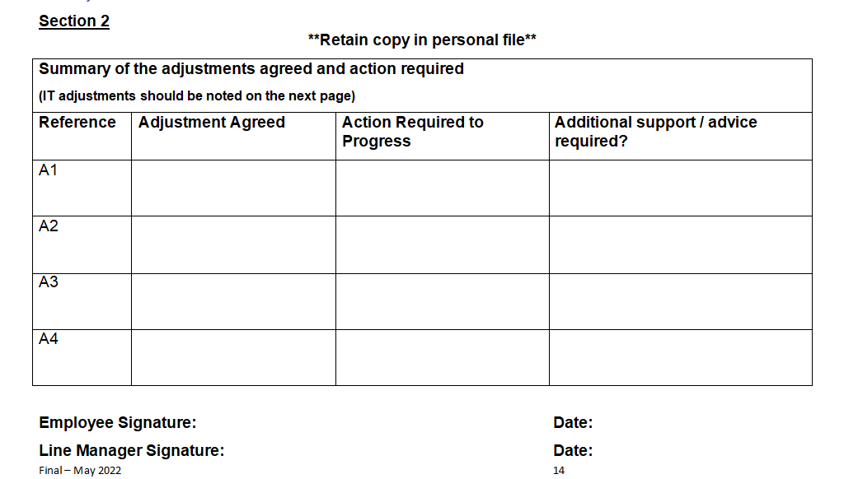
Passport
workplace-adjustment-passport-with-guidance-notes-final-may-2022.doc (live.com)
Notes:
This is a document we use in NHSGGC. I can share it and can be used as a document to share with your manager.
You complete it together with the adjustments which have been agreed.
It is helpful if there is another supervisor on – keep it on your person – means you don’t have to explain the whole history with that person it just shows them what adjustments are in place for you.

Slide 12
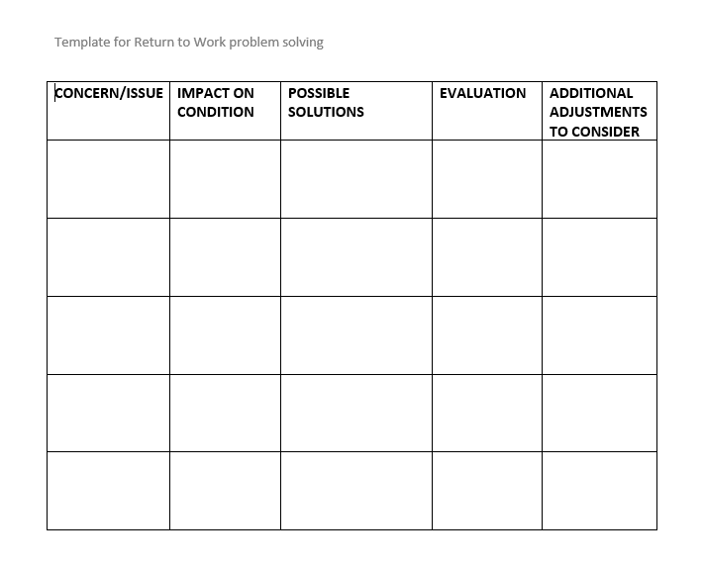
Notes:
This is a template that one of my Occupational Health colleagues used to problem solve what adjustments were needed.
It may be a good way for you to work through the potential problems and find ways to solve them.

Slide 13









Financial / Vocational Support
NHS
Support and Information Services
Occupational Health
Human Resources
Local
Social Work
Notes:
We can assist with writing a letter to your manager to make recommendations, but there are also other agencies which can play a part in your return to work:
Support and Info services – this service is based in the main hospitals but can also be accessed digitally or by tel. They can provide so much information – financial advice, info on conditions, form completion, smoking cessation, signposting to appropriate 3rd sector agencies. If in doubt ask – they are really helpful.
They can signpost you to any of the agencies on this page so if in doubt contact them.
Jobcentre – can help to re-enter the workplace, help with employability, applying for new roles etc and benefits.
Citizens advice – as stated before for legal advice etc. But if you a member of a union they can also help
Money matters – benefits, debt management, budgeting etc
OH – bigger companies may have OH departments to help plan your return to work. The priority of OH is your health – ensuring that your work is not of detriment to your health. They make recommendations and also opinion of fitness to work. The advice should be taken, however it is not mandatory. Some recommendations may not be deemed appropriate for the individual workplace and the manager makes that decision.
HR – they will be advising your manager on policies and involved in the absence process – likely to be at your attendance meetings. They can also advise (in larger companies) on redeployment.
Access to work – If classed as having a disability, can help financially to get into work, assess your set up and contribute to more expensive equipment. In Long COVID, the most useful service has been assisting with travel into work – money towards taxis to streamline travel in (taxi to the train station rather than a 30 min walk). They will consider the most financially appropriate option and length of travel based on your disability.
ACAS, the advocacy projest and Govan Law Centre can help with legal advice and respresentation.
Federation of small businesses for those self employed or running a business – some support from others in similar areas
https://www.actionforme.org.uk/uploads/me-and-work.pdf - this is a useful link which gives working examples of return to work scenarios and more information on the equality act.

Slide 14

Discussion
Share your experiences of work – good and bad
Those in work – share your experience of sharing your concerns and limitations with your colleagues – has it been helpful?

Slide 15
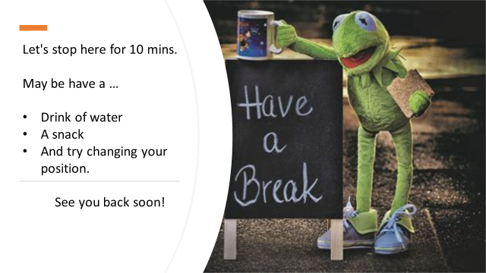

Slide 16
Goal Setting
Short Term Goals
Long Term Goals
What are the things you can do just now?
Structure but flexible
Small activities
Helps to build tolerance
Adjust to help achieve Long Term Goals
What do you want to be able to do?
Is it a good idea to set a timeframe?
Be flexible
The small activities will help you achieve the larger goal
Be prepared for setbacks
Keep your eye on your end goal
Notes:
Welcome back after the break, I hope you managed to get something to drink and move around a bit. My name is Claire Roux, I am a physiotherapist and the Team Lead of the service and I will be doing this second session. The session is focused on Goals, Set backs and the tools and strategies you have learnt over the last 8 weeks.
Goals allow us to create a focus to achieve a particular activity or function, we often associate goals with being somethings physical but it doesn’t have to be, any task that you would like to achieve, big or small can be a goal. Achieving a goal can increase your confidence and give a sense of achievement, it often gives us a purpose. In order to successfully achieve goals and grow in confidence goals need to be realistic and achievable. This can be done, by setting small targets, by breaking down the bigger picture, into small steps towards that long term goal. Ask yourself what can I do just now, what would be the next step I need to achieve? It is important to be structured but flexible, if a barrier arises to your goal, ask yourself, what can I do to overcome this?
Recognise progress & small improvement as you make these small changes and achieve your short term goals.

Slide 17

Setbacks
They will happen
How would you recognise a setback?
Can you differentiate between normal fluctuations and a set back?
How will you feel about it?
How will you manage the setback at the time?
How will you overcome or re-direct your setback?
Notes:
Setbacks will unfortunately happen, accept this and keep it in mind for when they do occur. Think about the following in advance, how would you recognise a setback? Would you be able to differentiate between normal fluctuations and a setback?
•How will you feel about a setback?
•How will you manage the setback at the time?
•How will you overcome or re-direct your setback?
Think about what the warning signs of a setback would be, write them down, and try to recognise them as they occur.
Some setbacks are normal, others can be triggered by the actions you take. You can learn to manage or avoid certain events and situations. You can also begin to gain control over setbacks by identifying the factors that intensify your symptoms.
It is important to also consider the difference between your Long Covid Symptoms and non Long COVID related symptoms. Don’t just automatically assume a change in symptoms is just a flair or setback of your Long COVID. If your situation feels new and different, it maybe that something else is going on, so consider seeing your GP. Gather your thoughts before an appointment, make notes of symptoms so you can clearly explain to them what has changed and why you are concerned.
Try to identify and respond to warning signs, think of it like driving in a car with a sharp bend in the road approaching, as you approach the bend, various warning signs appear, such as slow down, change your speed or large chevron signs as you get closer to the bend. All of these warning signs make sure that you make changes as you approach the bend, without those changes, going around the bend would be detrimental. But with recognition of the warning signs and implementing the needed changes, you can safely maneuver around the sharp bend.
It might seem odd but try to start to link this analogy to your symptoms. These warning signals are more often that not the things you are doing that aren't helping when for example, pushing through or ignoring them, may in turn trigger a setback.
What about over doing it? This maybe as a result of doing too much or simply engaging one activity for too long. A setback can also be triggered if you fail to pace yourself properly. In the above scenario that would be similar to increasing your speed for going around the bend, which would be detrimental to you.
Think about stress, a period of stress in your life positive or negative will trigger that increased surge in adrenaline, winding up that fight flight response which, may also provoke a setback. Be aware of those things that upset you and spot the signs you are becoming stressed.
When you notice an increase in symptoms use this as a warning or trigger sign and maybe consider slowing down. Try to remember to implement some of the things that we have discussed in this programme to help sooth the alarm system in your body, engaging with the rest and digest principles we discussed, for example proactive rest and tackling unhelpful thoughts. Listen to those close to you, ask them to tell you if they notice changes – it maybe nothing but always worth considering their point of view – they will see thing your don’t.

Slide 18
Setback Plan
1. Go back to the beginning
2. Revisit activity diaries
3. Review sleep
4. Increase your use of rest periods and relaxation
5. Review your pain and physical symptoms
6. Consider your mood
7.Think about a ‘setback box’
Notes:
A setback plan should come into place during times when you don’t feel so well. When you notice an increase or change in your symptoms, start to use this as a sign to look at what activities you are doing throughout the day and how you are managing your Long COVID. As we've discussed setbacks, can occur for many reasons, if you are able to identify the trigger, it can be used as a learning tool to prevent a similar one in the future.
Although set backs and relapses can be upsetting and frustrating having a plan ready will help you cope whilst you are having an increase in symptoms. Then put the plan into action ….
Its about being aware of what has worked in the past so when the warning signs appear rather than ignoring your body's signals, you can be responsive to them. Your response can include reducing activity level.
1.Go back to the beginning- read slide
I had a patient who had a ‘setback box’ and it contained all the things that gave her comfort like eye mask, hot chocolate, soothing music, meditation, hot water bottles, hand written affirmations of how far she had come in her journey, hand writing plan i.e. strategies that helped her like the 5Ps, restorative rest breaks
There maybe things you can learn from each setback which will help you manage your Long COVID in the future. This may also help reduce the number and severity of further setbacks. It can be helpful to do some reflection when the setback has settled
Ask yourself
What did I do that helped? or what did I do that didn’t help
Did I listen? To the warning signs? to the people around me? Did I ask for help?
Did I notice my warning signs? Did I take action early enough?
Did I reduce or rebalance my activities
Did I stay positive? did I stay relaxed
Or did I just try and plough on through? did I get caught up in unhelpful thoughts and feelings?
Did I follow my setback plan and if not why not, do I need to change it? If so change or adapt your plan where necessary.

Slide 19

What Next?
Mental health
National Long COVID support
Physical health
Social support
Local services
Online support
Your GP
Research studies
Notes:
3rd sector
Mental health – mindfulness, breathing space, lifelink, Samaritans, silver cloud CBT, daylight app,
Dedicated national Long COVID support – Asthma UK, CHSS, Nuffield Long COVID course
Physical health – Suzi Bolt yoga, NHS pilates pages, live active, Nuffield Long COVID programme, CISCO-21
Social support – Community connectors (in some areas of GGC),
Local services – checking library for what is available in your area (eg – Inverclyde Long COVID group)
Online support – facebook groups, twitter, advocacy
Your GP – onwards referrals to secondary care if appropriate
Research studies – CISCO-21, Derby study, Visible etc.
Links to some of these are on the webpage

Slide 20

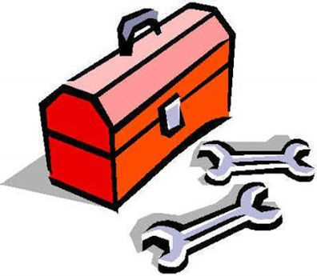
Long Covid Self Management Tool box
Notes:
The next few slides are a summary of the various tools and strategies that you have learnt over the 8 weeks, this will be sent out to you as a separate resource, and at any time you will be able to refer to the resource and if needed go back to the slides of that week to refresh the strategy needed.

Slide 21
Week 1-
Positive Mindset and Change
Solution focused mindset
The cycle of change: small changes lead to big changes, turning vicious cycles into virtuous cycles
Mindset of self-compassion
Mindfulness practice
Notes:
In week 1
We introduced the
Solution focused mindset: look for what is working, to help you move forward, thinking about what isn't working will not help you move forward, it might help you identify the areas to avoid, and in doing so provide solutions, but focus on the problem with a solution focused mindset.
We introduced the idea of the cycle of change
The Importance of a mindset of self compassion and the benefit of mindful Practice

Slide 22


Week 2
Dysautonomia, PESE, Activity
Bottom Up
Top Down
Hydration
Compression
Activity balance
Physical counter measures
Sleep hygiene
Breathing control
Diet
Education
Meditation / mindfulness / Yoga
Reducing anxiety of condition
Notes:
In Week 2 the fight or flight and rest and digest response was introduced. with the various tools and strategies to assist you in managing these responses, including Bottom up and Top down Strategies like
Breathing control,
Hydration
Diet
Activity Balance
Compression
Physical counter measures
Sleep hygiene
Mindfulness/ meditation, yoga

Slide 23

SELF-MANAGEMENT TOOLBOX
Improved understanding of Fatigue.
Improved awareness of energy.
Acceptance exercises that promote realistic thinking
and encourage self-management skills.
Awareness of the benefits of an activity diary and how
to complete.
Skills to make small changes applying energy conservation strategies.
Notes:
Week 3 addressed Fatigue introducing the following tools and Strategies
Greater understanding about possible cause of Long Covid Fatigue.
Awareness of the different ways a person uses energy
Acceptance exercises that promote realistic thinking and encourage self-management skills.
Awareness of the benefits of the activity diary and how to complete it, use it and identify areas that could be improved
Skills to make small changes applying energy conservation strategies.

Slide 24
Self-management toolbox
Breathing exercises
  Diaphragmatic breathing
  Blow as you go et
How to apply energy conservation.
How to use different activities to help
your breathing and links to local groups. ​
Use mindful breathing
Recognise the link between your emotions
and thoughts
Notes:
Week 4 ‘ the Breath’
Breathing exercises to help correct any changes in your breathing pattern and to use during activity.
The knowledge of how to apply energy conservation to your day-to-day life to help your breathing.
How to use different activities to help your breathing and links to local groups.
How to use mindful breathing and understanding the link between emotion and thought. The importance of checking in.

Slide 25

Week 5
Brain Fog
The Bucket and Water analogy
  Strategies to improve attention
  Memory Strategies
  Executive Function strategies
Notes:
Week5 Brain fog
A bucket and water analogy was used, highlighting
Strategies to improve attention,
Memory in Strategies
Executive Function Strategies
All feed into the others and improving one will benefit the others

Slide 26
Week 6
Fatigue And Sleep
How to break the boom and bust cycle
The power of no
Sleep
Imagery
Muscle relaxation
Supportive Apps: sleepio, better sleep
Putting the day to rest
Thought blocking
The 15 minute rule
The 5 Ps principle
Notes:
Week 6, Fatigue ( was addressed for a second time, rightly so, as the most prominent symptom of Long covid , together with sleep
The strategies from this week include
How to break the boom and bust cycle,
The power of saying no
The 5 Ps principle
And various strategies for sleep, including
Imagery
Muscle relaxation
Supportive apps, such as Sleepio, better sleep
Putting the day to rest,
Thought blocking
The 15 minute rule

Slide 27
Week 7 Wellbeing
Understanding your stress
  Journalling/mood diary
  Worry tree
  Talking with someone
Coping with Stress
  Grounding techniques
  Breathing exercises
  Relaxation e.g. Inner Smile relaxation
Notes:
Week 7 addressed the concept of Well being, the impact stress can have on your daily life and the importance of understanding your stress and using journaling, the worry tree or talking with someone as a way of dealing with your stress.
Grounding techniques, breathing exercises and relaxation was introduced as tools and strategies to assist with coping with your stress.

Slide 28
Week 8
Planning for the future
Remember the Corona Coaster
Clarity on your options with regards to your rights at work
Set your goals as well as your setback plan
Summary of all the Tools and strategies you have learnt over the 8 weeks
Resource list of available support regarding work and finances
Notes:
Remember that Corona Coaster,
Clarity on your options with regards to your work situation,
Setting your goals and your setback plan
Summary of all the tools in your toolbox

Slide 29
Discussion
Where are you going to start?
Notes:
We are going to open up to the group for a discussion around where you are going to start, what small goal will be the one you leave here today set on achieving?
End of discussion summary, thank you to those of you for sharing, and hopefully everyone can take something from that discussion as they move forward in their long COVID journey.

Slide 30
Insight timer
3 Minute Mindful Breathing Anchor | Glenn Harrold, Insight Timer

Slide 31

Notes:
Does anyone have any questions?
Please could you take the time to complete the Webropol survey with feedback that is available in the chat.
For those of you that would like to stay on for discussion amongst yourselves without the Long COVID team present, please do.
As we finish the course, remember managing your Long Covid is a skill, the more you practice the better you will become at it and in turn your confidence will increase. Be kind to yourself, reflect and try to learn from each experience to help you next time.
Start with small changes
Thank you and Goodbye.

