Slide 1

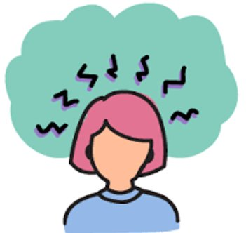
STRESS AND WELLBEING
Notes:
Hello and welcome to session 7 of our 8-week Long Covid self-management course. This week we are going to be talking about stress and wellbeing.
We all have different stressors in our life, whether this is how we will pay a bill, get a child to school or something bigger such as bereavement. We deal with stressors everyday but how we manage these can be impacted how our health and wellbeing is. As a result,it is widely recognised that people with long term health conditions can be more effected by stress.

Slide 2
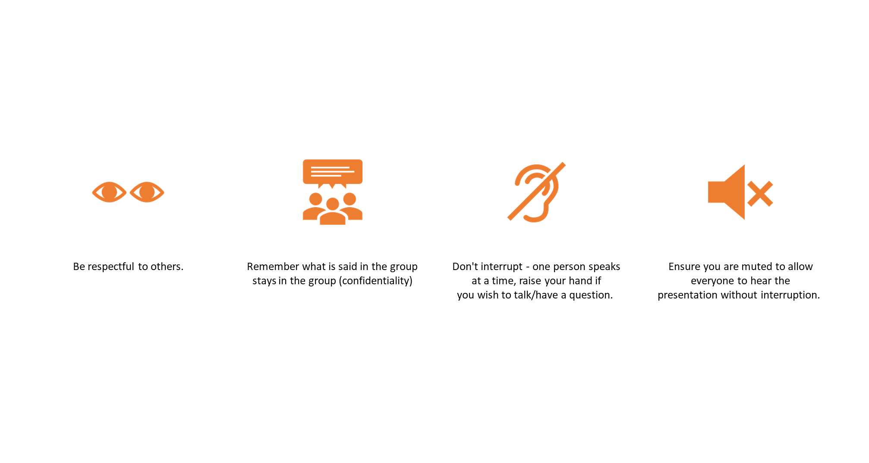
"IT'S NICE TO BE NICE"
Notes:
Please remember our group rules, which are therefore to help improve your comfort and experience.
As always please be respectful to other, don’t interrupt (raise your hand or pop a question in the chat box) and try to keep yourself on mute if you are not talking.
Finally please remember confidentiality- what what is said in the group stays in the group.

Slide 3
SESSION AIMS
Introduce the concept of wellbeing.
Discuss stress and the impact this can have on daily life.
Explore possible coping strategies to manage stress.
Notes:
We are going to explore the issue of stress and wellbeing through a case study. Often people are great at giving advice to family/friends but struggle to recognise and/or talk about how they are and what their needs may be. We hope that a case study may tap into this.

Slide 4
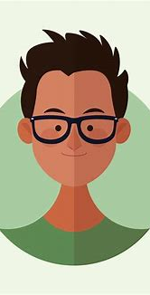
Hello,
My Name is Ben!
I was happy and healthy before I caught Covid in January 2022. Since then, I have had symptoms of fatigue, all over body pain and brain fog.
I live with my wife and 2-year-old son in a privately rented house. Before I became unwell, I enjoyed football, meeting with friends, spending time with my family and playing with my son.
I worked for a start-up computer company, which I really enjoyed. I liked being able to use my brain and felt I contributed to the company. Long Covid has changed my life!

Slide 5
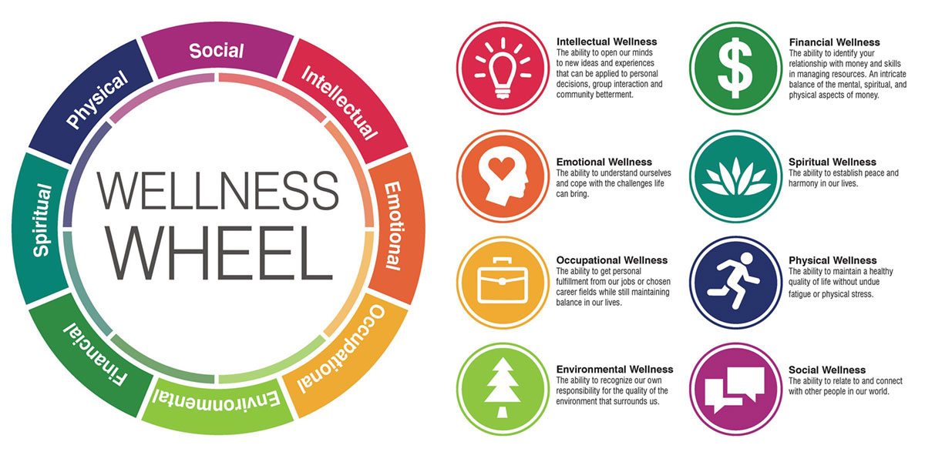
Wellbeing, what does it mean to you?
Have a warm and safe home where my family and I can be together.
Be able to follow and participate fully in a discussion about every- day life.
Understand my condition and manage the symptoms.
Spend time with my family and friends.
Care for my loved ones, the way they care for me.
Have enough money to ensure our home is not under threat.
Play with my son on the floor of his bedroom.
Notes:
Wellness: "Wellbeing is not just the absence of disease or illness. It's a complex combination of a person's physical, mental, emotional and social health factors."

Slide 6

Notes:
When we think about health we may jump to physical health but physical health is just one part of our wellness or health. There are different theories of wellness but the above wellness wheel identifies 8 components to our wellbeing. Let's consider these dimensions and long covid.
Physical health- this will include your physical symptoms, including pain, fatigue and breathlessness.
Occupational – the ability to engage in an activity
Intellectual - Being able to use our minds and engage.
Environmental – where we live, our home and our wider environment can and does effect our health
Financial – We all live life within financial constraints however illness can impact this further. This can be due to a loss of job, reduction in pay (sick pay) or the cost of living crisis.
Social – engaging and connecting with others. A shared story or that feeling of not being alone.
Spiritual- we often jump to religion but being spiritual is about inner harmony/sense of self. This can include our drivers and our beliefs.
Emotional- understanding and accepting our emotions and how we respond/manage when we experience distress.

Slide 7
WHAT IS STRESS?
Our body’s response to pressure.
Stress can give the sense of little or no control.
Stress is a normal reaction, and we often use stress to motivate and be productive.
We will have all developed coping strategies that have helped us manage stress.
Illness can impact our ability to implement our coping strategies.
Notes:
Illness, loss of job, bereavement, changing relationship may disrupt our bucket. You may not be able to use the same coping strategies or feel that you have lost your ability to cope with life stressors. As a result stress builds and starts to effect your thinking, feelings, experiences and actions. This is called stress.
Stress becomes problematic when it starts to effect our daily lives.

Slide 8
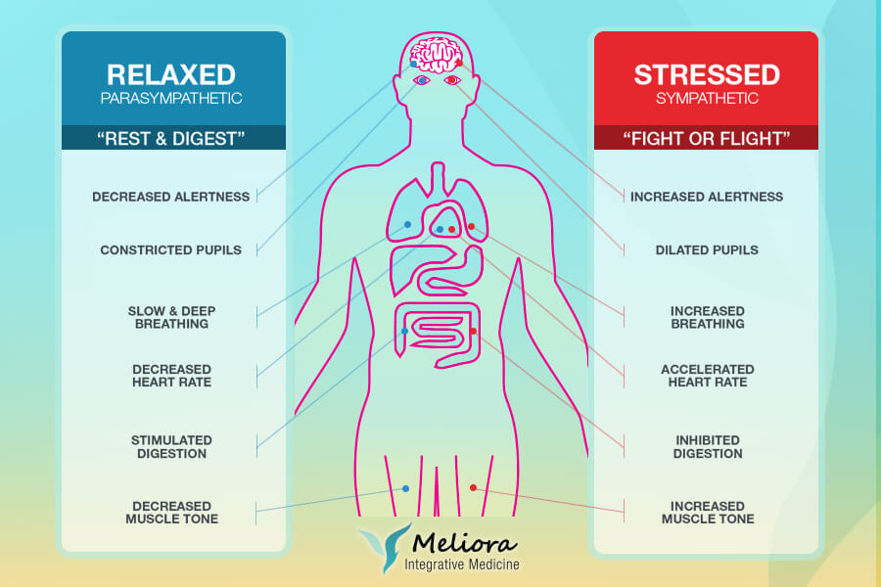
Rest and Digest / Fight or Flight
Notes:
If we imagine a lion was to enter the room, how would you feel?
We would move from our current state of “rest and digest” into a “fight or flight” response. This increases our breathing, we become more alert and improved chance at running to safety. This is a normal and health reaction to a perceived threat. Life has changed and tthreats are no longer lions but life events such as bereavement, loss of your job, illness etc.
Research has suggested that Long Covid has causes your body to spend more time in this heightened state. Recovery and rest only occurs when you are in “rest and digest”. This was discussed in more detail in session 2.

Slide 9
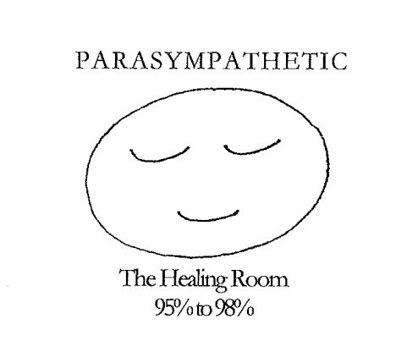
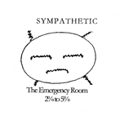
Mind Body Effects of Stress
Healing Room
Emergency Room
Dis-ease

Slide 10
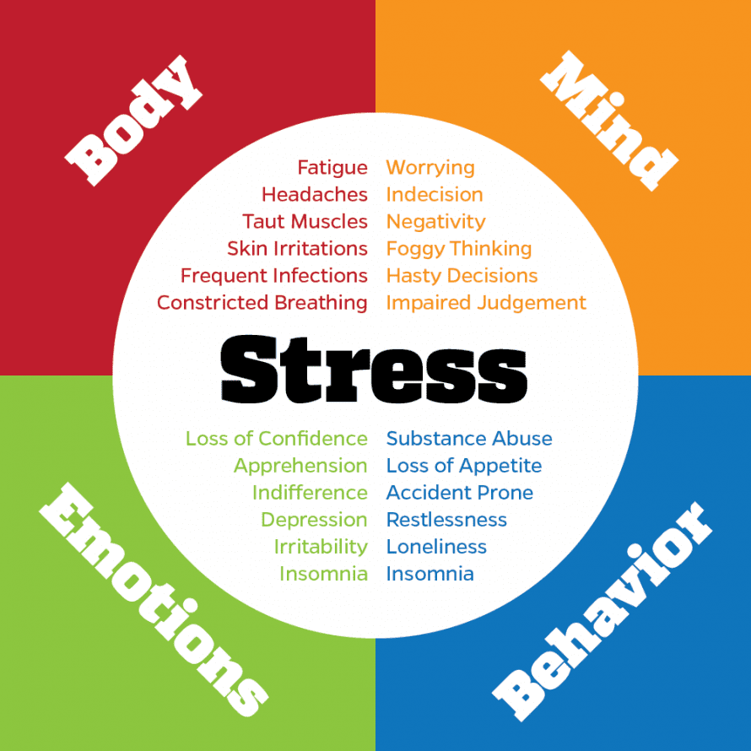
SYMPTOMS OF STRESS
Notes:
How often do we stop and check-in with how we feel?
We are often busy or caught up in our daily lives, our relationships and our health that we don’t allow or give ourselves the time to stop.
It is important to allow yourself the time to think about how you are feeling?
Sometimes that can be hard, may be you don’t really know or you cope by keeping on going. However, when illness occurs often our physical health will no longer support this coping strategy. It is then that stress starts to develop.

Slide 11
Judgement
Catastrophising
Constant
MIND
Worry
Negativity
BODY
Headaches
Fatigue
Breathlessness
Stomach upset.
BEN'S
Dis-ease/
STRESS
SYMPTOMS
EMOTIONS
Lost
Sad
Frustrated
Low mood
BEHAVIOUR
Withdraw
Unable to sleep
Stop eating
Drink alcohol
Notes:
If we think about Ben and how he may respond to such a question.
If you were to write this down for you, what may it look like.

Slide 12
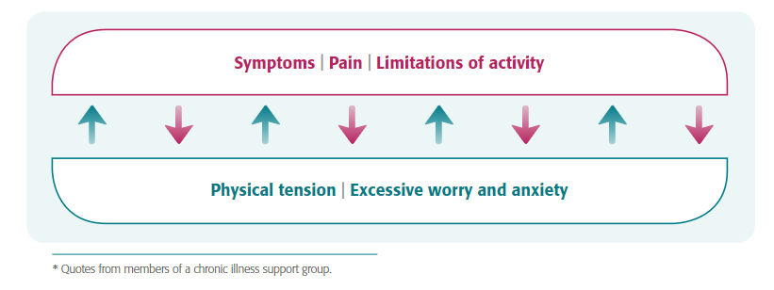
Notes:
It is important to remember mind body link e.g.
Pain increases
Reduced activity
Which may cause anxiety and worry.
Increased tension within your body.
Which increases your pain.
Self-management must include not only management of your pain but also your response to your pain. This is true for any symptom. Our body and minds are inter-linked and it is important that this is considered when developing your self-management plan.

Slide 13
“While living with this relentless condition, I just don’t feel myself. It’s like everything affects my sense of self and I always feel different. That is really tough to deal with because I don’t know if I will ever feel normal again. It really hits you emotionally as you just want to get better, and I always worry about another relapse as I often think to myself ‘I can’t do this again’.
Shereen's story: my experience of long COVID | Mental Health Foundation
LONG COVID AND STRESS

Slide 14

Stress is an energy vampire
Invest your energy wisely
Your healing requires it

Slide 15
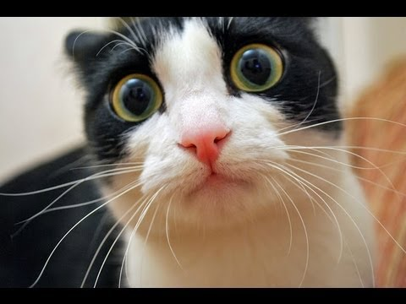
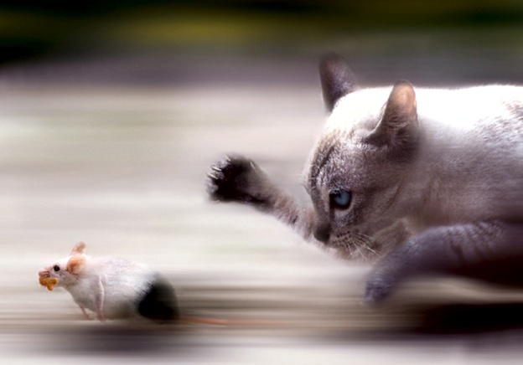
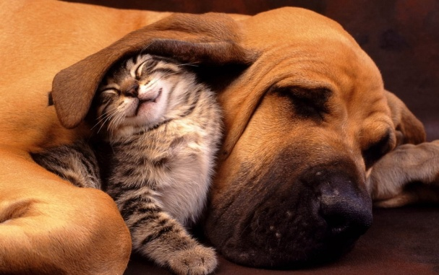
EMOTIONAL REGULATION
THREAT
DRIVE
SOOTHE

Slide 16
sTRESS
I was the sole wage earner in my family but now my wife is needing to get a job. This is hard and currently we are surviving on the little sick pay I get. Money is tight and it's going to get worse. I feel like I have let my family down.
I don’t recognise myself; I can't play with my son the way I did, and I don’t have the energy to help- out at home.
I used to go out with friends to the cinema or play football, I don’t do anything anymore. My friends still visit when they can, I do have my mum and dad who also help -out where they can. I'm very close to my wife who is very supportive and understanding.

Slide 17
BREAKOUT ROOM -
If you were Ben's friend what advice/support would you give him?

Slide 18
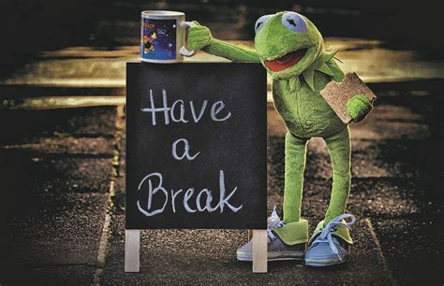
Let's stop here for 10 mins.
May be have a …
Drink of water
A snack
And try changing your position.
See you back soon!
Notes:
Time for a 10 minute break now.
In keeping with the theme of Fatigue, you may wish to grab a snack for energy and a glass of water to keep hydrated. And you may wish to change position or stretch to remove stress from body parts.

Slide 19
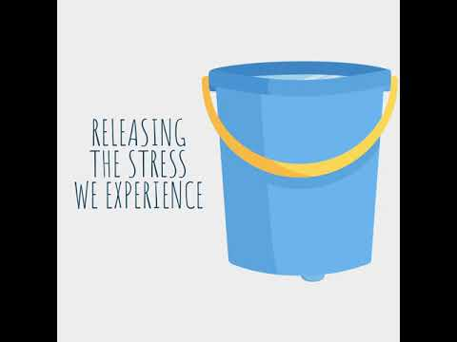

Slide 20


How to get from the Emergency
to the Healing Room

Slide 21
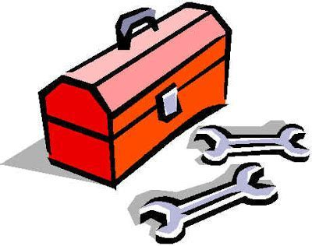
Wellbeing Toolbox

Slide 22
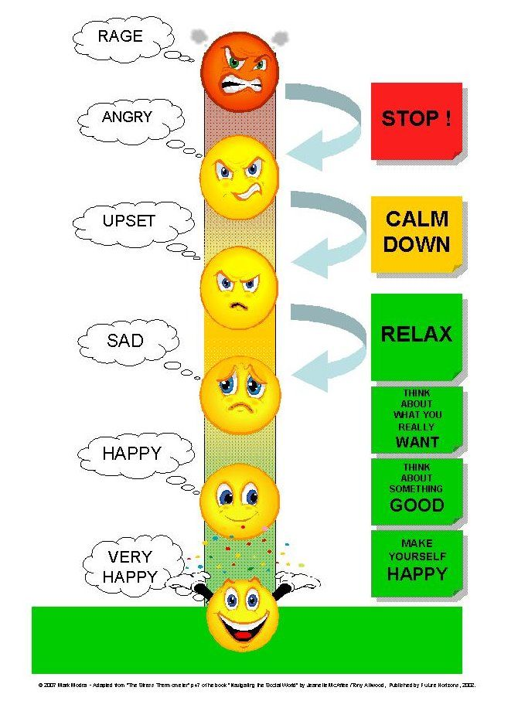
Stop & Check-in
Ask yourself –
how am I feeling today?
Pushing through a problem does not allow you the time to understand nor consider how you make a change.
Complete an online wellbeing tool -samh.org.uk/about-mental-health/self-help-and-wellbeing/wellbeing-assessment-tool

Slide 23
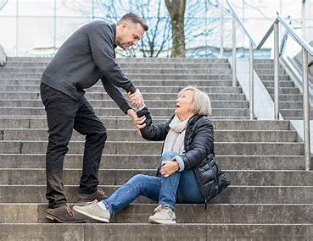
Connection- reaching out
'A problem shared is a problem halved.'
Remember who your support network is?
FAMILY FRIENDS CLINICIAN GP COLEAGUE ON-LINE SUPPORT GROUP

Slide 24
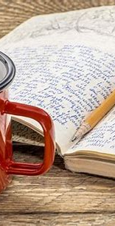
Journaling
Journalling allows you to clarify your thoughts and feelings.
Emotionally cathartic (venting).
Offer a coherent record of your thoughts.
Can be used to celebrate achievements.
Offer a creative outlet.
It can also be a good problem-solving tool.

Slide 25

Letter to Covid

Slide 26
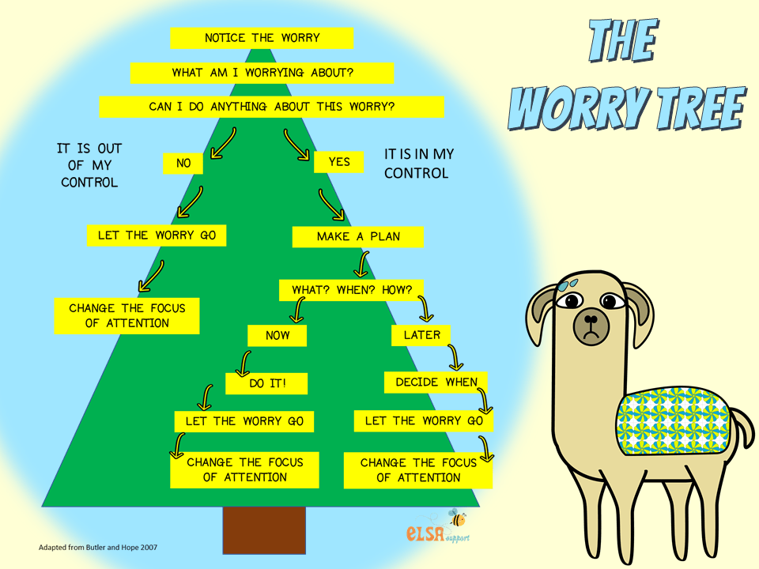

Slide 27




How To UNDERSTand THE PROBLEm
STOP
CONNECT
DIARY
WORRY TREE
Notes:
Journalling
Mood diary

Slide 28




healthy HABITS
Notes:
Relaxation
Over the course of the group we have given you a number of short relaxation videos. Today we wanted to give you the chance to try one technique for longer. We plan to trial the inner smile at the end of the session for those who are interested.

Slide 29
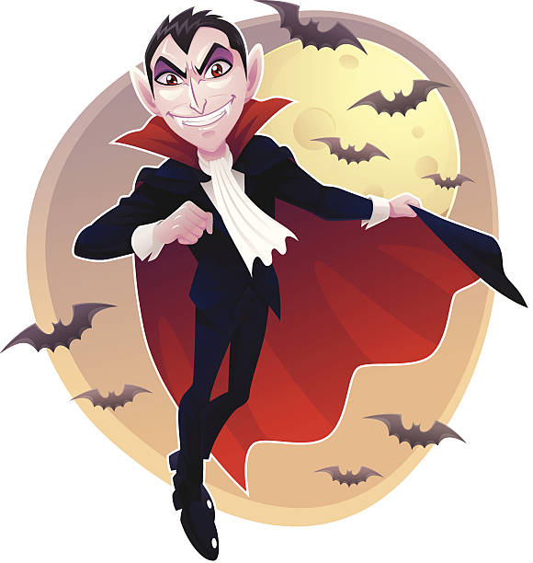

CONNECTION
Family and friends can offer this outlet but not always.
Ask yourself:
Who are your supporters?
And are they:
        turbo boosters
        energy vampires?

Slide 30
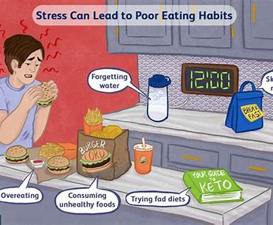
DIET
Am I eating to support my healing and wellbeing?
We typically use between10-30% calories on digesting food
Eating the wrong foods can be a poor investment in our healing
Notes:
Routine:
Eat regularly
Stay hydrated
5 a day
Dark chocolate-lower stress hormone
Calming drinks – warm milk, tea
Avoid nicotine, alcohol, caeine and refined sugar products They are all stimulants, which prevent you from feeling calm. If you are stressed, steer clear of them. This can be dicult if you associate them with relaxation or comfort. However, you can benefit from the sense of relaxation without relying on the stimulant. For example: When you go for a cigarette you usually walk outside and away from anything that may be stressing you out — try going outside for a fresh air break instead When you go for an alcoholic drink after a long day, you also socialise with friends/family and talk about what has bothered you throughout the day. Talking about your stressors can help get things out of your system and in turn help you relax. Try changing the setting and sit down with a cup of tea to discuss whatever is bothering you Going to make a cup of coee or going to the cupboard for a chocolate bar also gives you a break from work, especially if you spend a lot of time at your desk staring at a screen. Try grabbing for fruit instead of biscuits or chocolate, so you still give yourself a short break without the negative eects of refined sugar and caeine

Slide 31
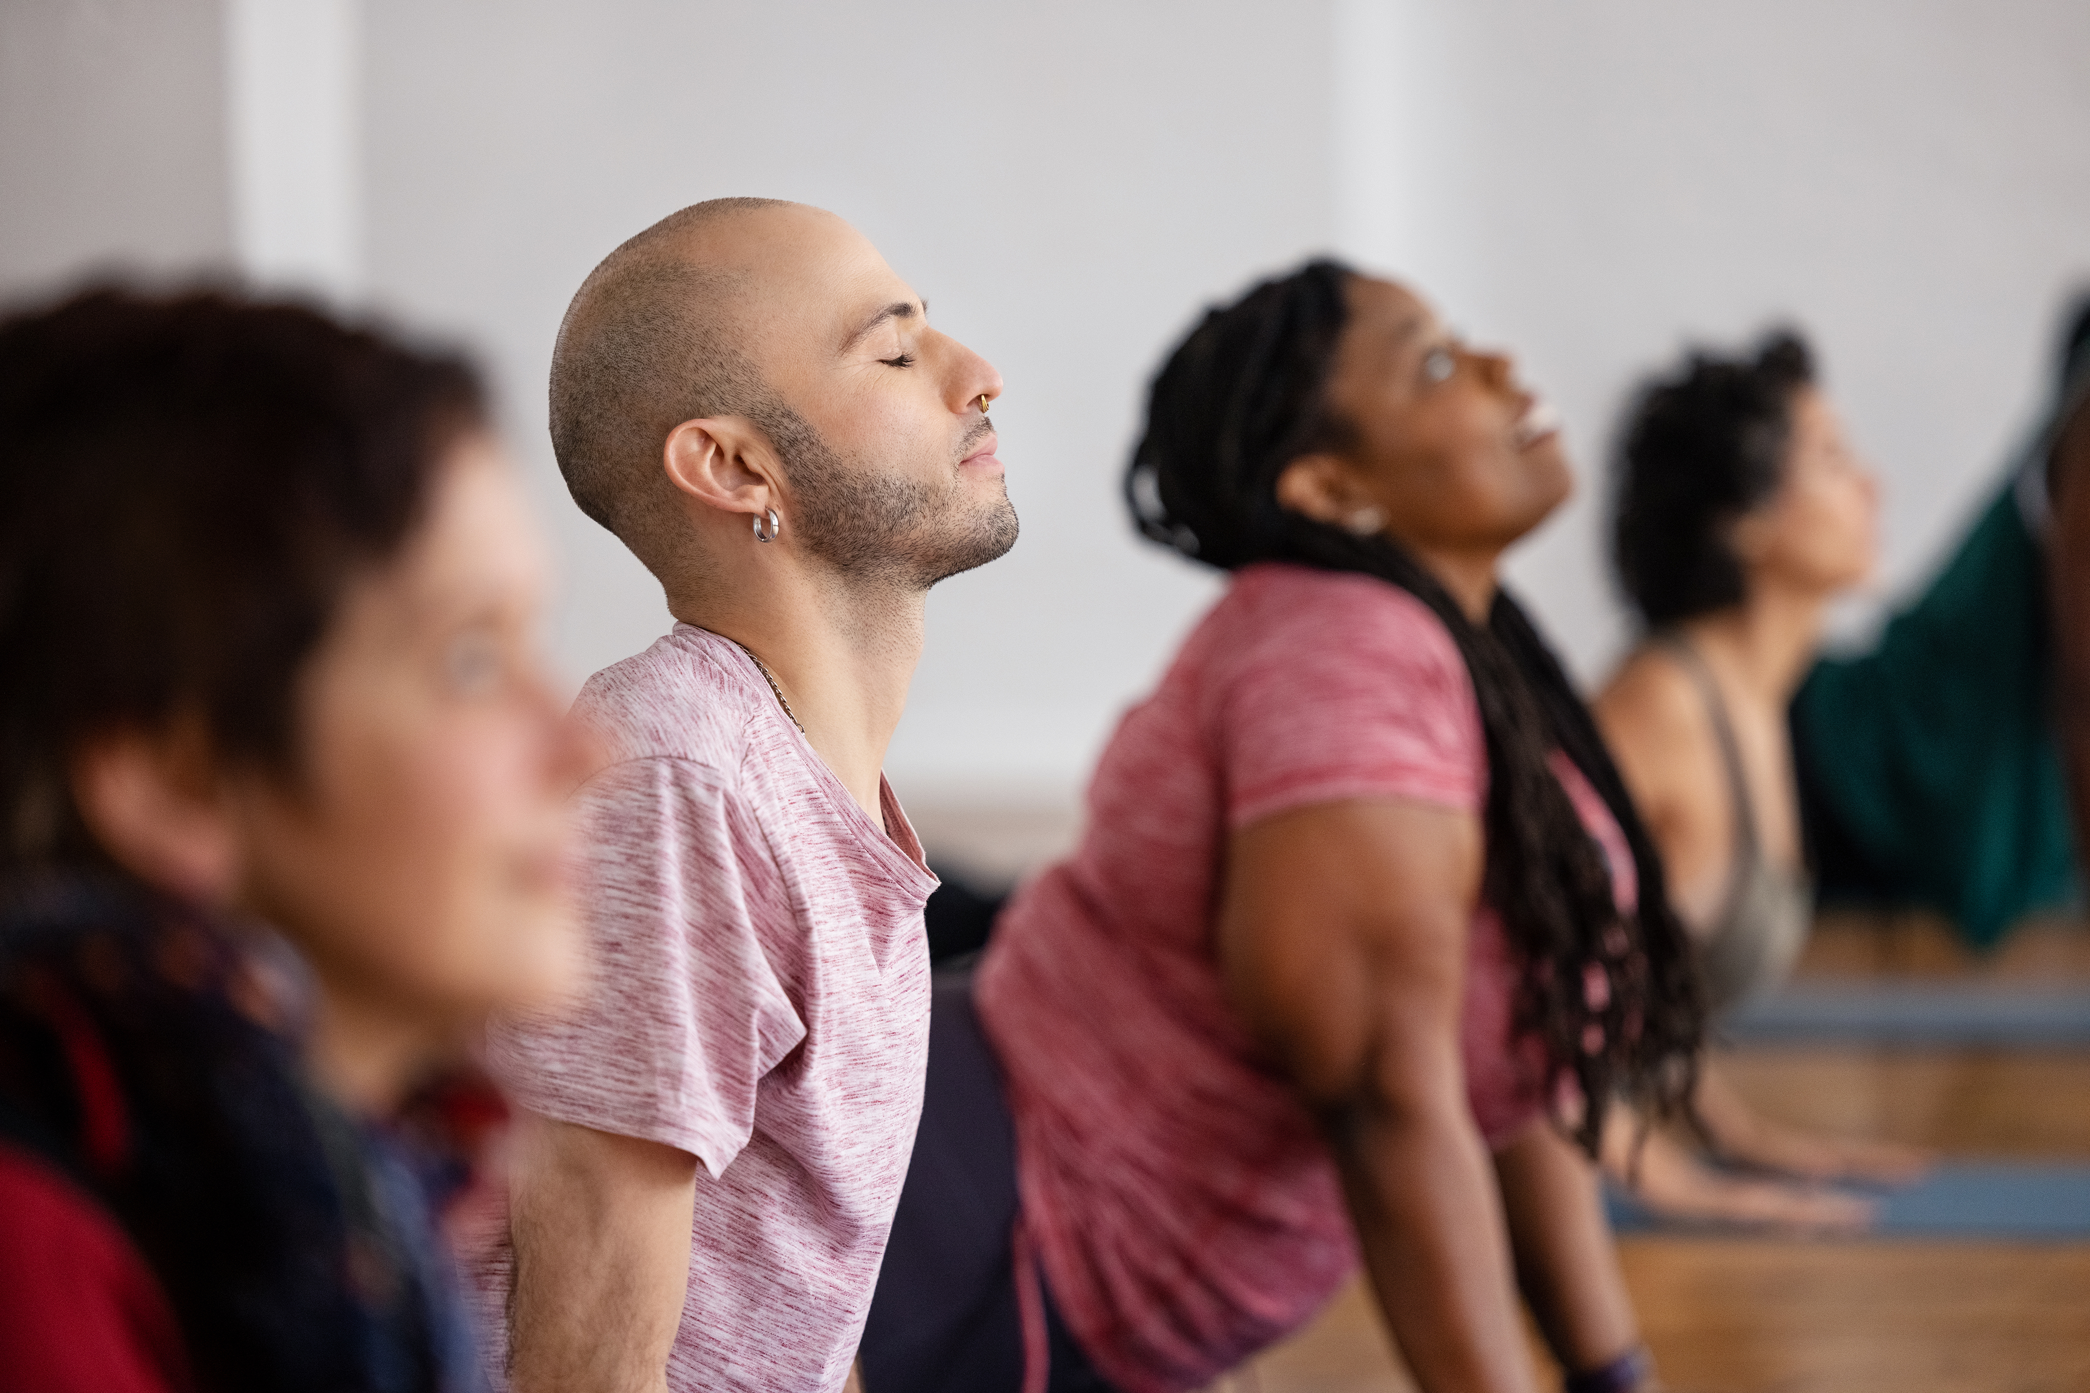
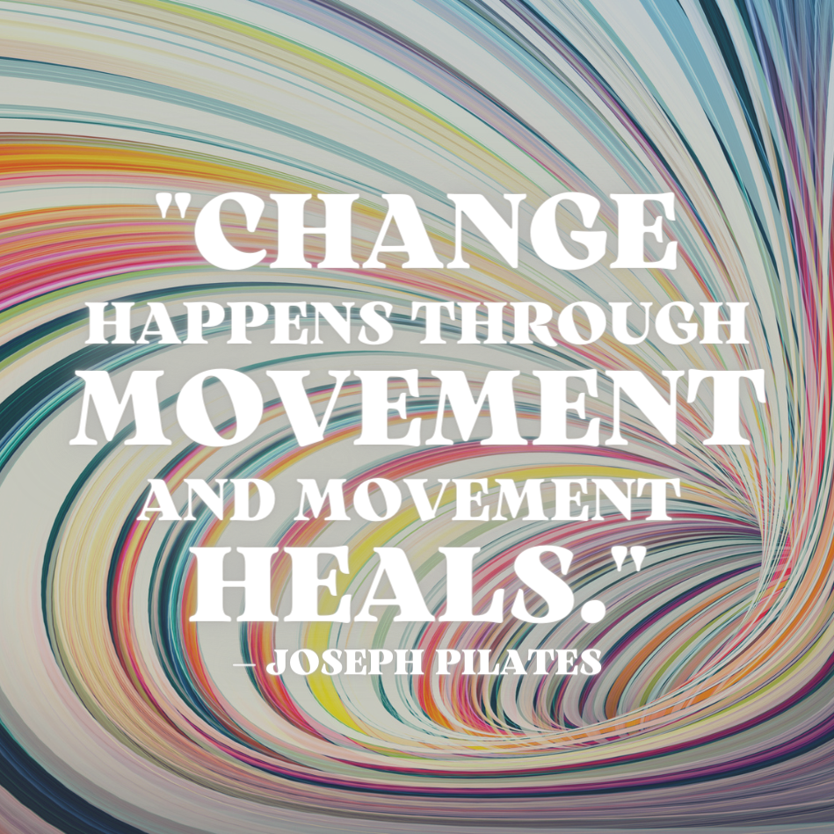
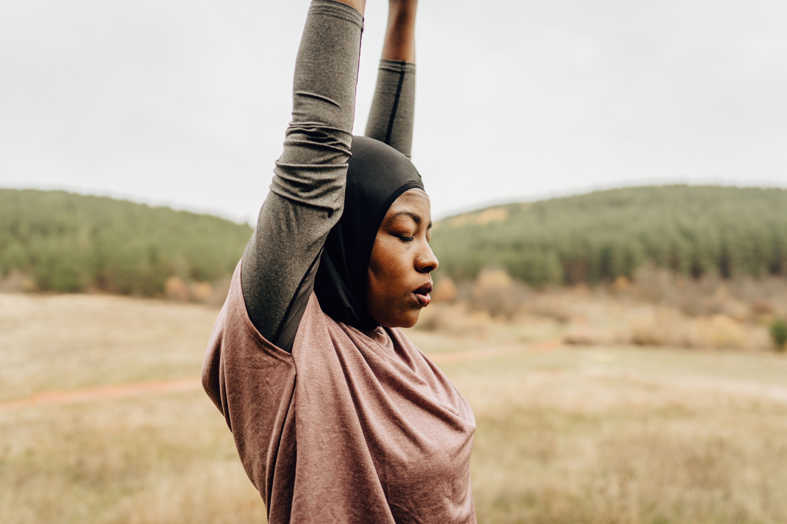

Slide 32
Movement / Exercise for stress
It's a scientific fact that regular physical activity and exercise can make us healthier and happier.
When we're active, the body releases feel-good hormones that can improve our mood and boost our energy.
Movement can help to detoxify waste products and oxygenate cells thus promoting healing.
Exercise can also:
  Boost your self-esteem and confidence
  Increase motivation and focus
  Calm the mind, especially when dealing with difficult
  emotions like anger, frustration and sadness.

Slide 33
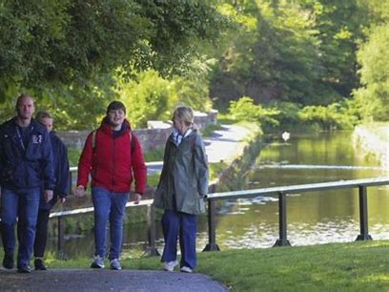
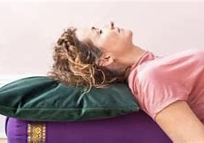

Exercise examples
Health Walks
Good Move — Glasgow Life
Yoga- Suzy Bolt
https://youtu.be/JQOG2aB00aw?si=b1Y0fhysfE9palXF
NHS Pilates
Sitting exercises - NHS (www.nhs.uk)
Start Small and set goals
Notes:
"The slow, calculated movement of stretching is calming to the mind and relieves tensions..."
Exercise releases 'happy hormones'
Low-impact activities like yoga, Tai-Chi and Pilates can relieve stress, depression and anxiety. They also help with balance and core strength, and suit any age or ability.
Gentle stretching
Going for a short walk
Suzy Bolt Yoga
https://youtu.be/6MQO8YGC6PM
Mindful walk

Slide 34
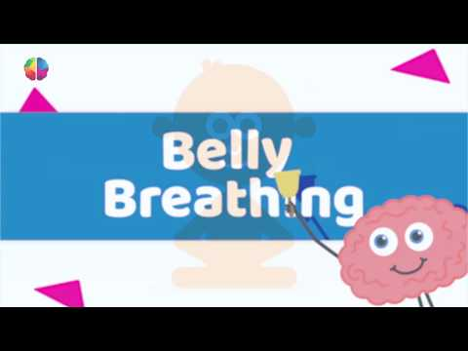

Slide 35

Establishing a new habit
Make it a regular practice e.g. first thing in the morning
Dot prompt
Door frame analogy
How can you make a change?

Slide 36

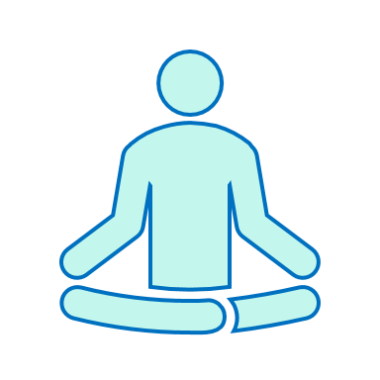
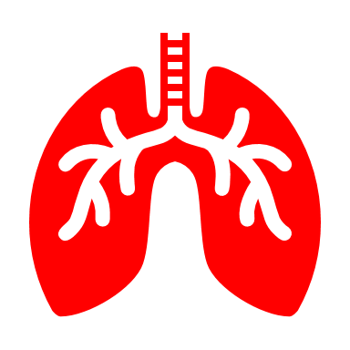

Recovery from stressful moments
DISTRACT / CREATE
CALMING HAND
REATHING
RELAXATION
Notes:
Belly breathing
Calming hand
Distraction – creating/engaging
Relaxation

Slide 37
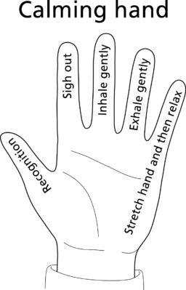
Recovery BREATHING
Notes:
It is well known that exercise is good for our physical health but do we think about exercise as being useful to our mental health.
Stretching can have a positive impact on mental health12345. Here are some benefits of stretching for mental health:
Regular stretching can help release tension and stress from the body.
Promotes relaxation
Increases blood flow to the brain, which can help improve mood.
reduce
Regular stretching can help release tension and stress from the body, promote relaxation, and increase blood flow to the brain, which can help improve mood, reduce anxiety, and alleviate symptoms of depression1.
Stretching helps relieve tension and ease muscle stiffness. By releasing tension, stretching can improve your mood and reduce your chances of developing certain health conditions such as migraines, hypertension, and insomnia2.
Stretching can help to lift our mood and calm our minds. For these reasons, consider adding stretching to your daily arsenal of tools to battle those long, hard days3.
The slow, calculated movement of stretching is calming to the mind and relieves tension. This makes stretching a very simple but effective way to reduce stress45.

Slide 38
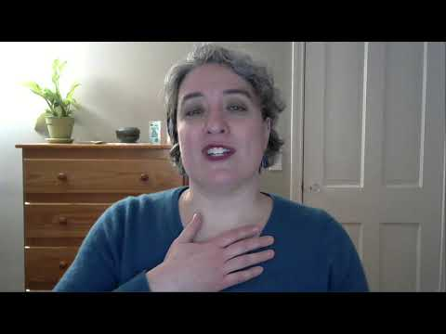
https://youtu.be/2-WMJpoi8Qo

Slide 39
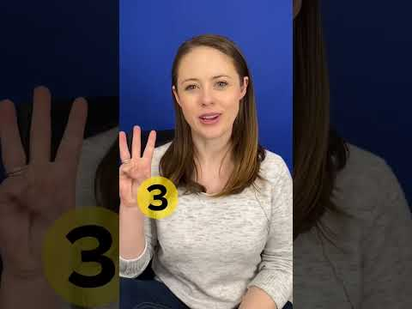
Notes:
Re-focusing
Being mindful can also be helpful if you are experiencing panic or feel you are becoming lost in your thoughts and emotions.
Grounding

Slide 40
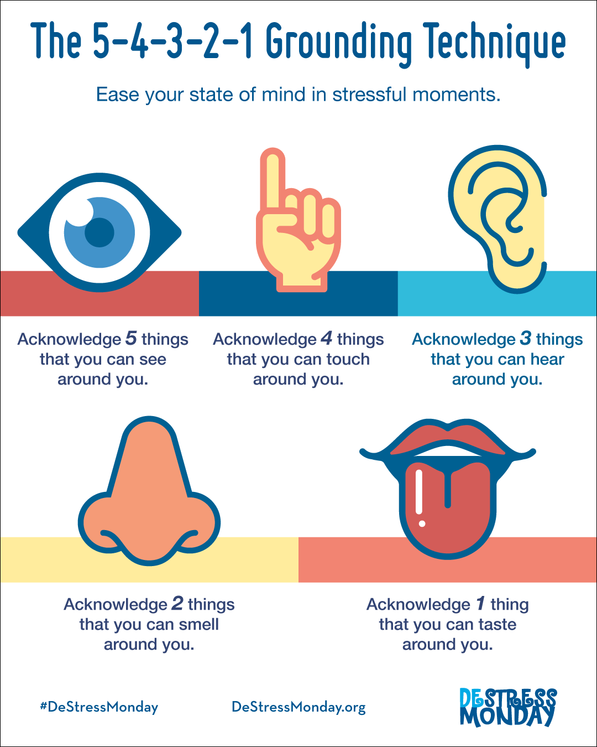

Slide 41
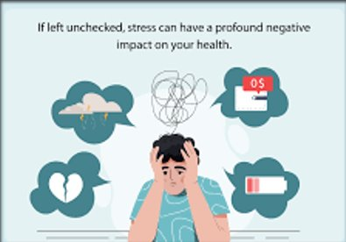
Stress can affect your mental health

Slide 42
Stress or mental health issues
What is STRESS?
"Stress is something everyone feels at times, especially when dealing with change or life challenges,"
What is ANXIETY?
" ...defined by persistent, excessive worries that don't go away even in the absence of a stressor.
What is DEPRESSION?
"Depression is a low mood that lasts for weeks or months and affects your daily life."
Stress - Every Mind Matters - NHS (www.nhs.uk)
Notes:
By the end of the 8 week program we hope that you will have learnt new tools that you can use to manage your day-to-day symptoms.
This week we hop you will have or at the very least trial the following:

Slide 43
Anxiety and depression
My mental health has changed over the last year.
I have been nervous most days for at least 6 months.
I can't sleep and when I do sIeep, I wake up with a jolt and very negative thoughts.
My symptoms are worse, in particular my pain.
I am tense and snappy.
About Anxiety - Anxiety UK

Slide 44
Concerned – What to do next?
Speak with someone about your mental health.
Contact your GP to discuss support. This could be in the form of:
  Someone to listen
  Referral to local mental health support services
  Medication
  Arranging counselling
  Directing you to virtual CBT
REMEMBER: YOU ARE NOT ALONE AND SUPPORT IS AVAILABLE

Slide 45
Support
Speak with your GP or your clinician if you are concerned about stress or your mental health.
It can be useful to develop a wellness plan which helps you to remain well (WRAP).
NHS 111
Talk with family / friends
Self-help resources
Third sector services such as Samaritans, breathing space – HUB of HOPE

Slide 46
Self-management toolbox
Understanding your stress
  Journalling/mood diary
  Worry tree
  Talking with someone
Coping with Stress
  Grounding techniques
  Breathing exercises
  Relaxation e.g. Inner Smile relaxation
Notes:
By the end of the 8 week program we hope that you will have learnt new tools that you can use to manage your day-to-day symptoms.
This week we hop you will have or at the very least trial the following:

Slide 47

Inner Smile Meditation
Notes:
Traditional Inner Smile Meditation Practice
This is a variation of the traditional inner smile practice, which helps you direct the energy of a smile into any part of your body.
You can either read through the instructions and meditate on your own or listen to Amy’s guided audio version of the inner smile meditation in you’ll practice internalizing the smile, then directing the essence of the inner smile to various organs.
Audio Player
Amy Pattee ColvinInner Smile Meditation
Use Up/Down Arrow keys to increase or decrease volume.
0:00 / 8:27
Inner Smile MeditationAmy Pattee Colvin8:27
1. Sit at the front edge of a chair with your feet flat on the floor. Close your eyes and feel connected to the earth through your feet. Your spine is straight yet relaxed, and your tailbone extends to the ground with the crown of your head reaching up into the sky.
If it is helpful, stretch your neck side to side, or roll your shoulders before you get settled.
Smile gently. Let your lips feel full and smooth as they spread to the side and lift just slightly. This smile requires nothing extreme; instead, it is just the kind of thing that relaxes your entire face and head.
Breathe fully, deeply, and slowly. While wearing this smile, consciously relax other areas of the body that may be holding tension.
2. Bring your attention to the space between your eyebrows. Visualize energy settling there like a warm shallow pool. Imagine settling into that pool, feeling comfortable and warm, slowly let your awareness sink deeper into the center of your head as if you are in a cozy and comfortable cave.
Then, imagine a smiling face in front of you—it could be your face or that of a loved one. Don’t put too much effort into picking just the right face; you can choose another one the next time you practice this meditation.
3. Draw the smile and the joyful energy it portrays into this space in the center of your head. Let your forehead relax. Let your face and body relax. Feel the warm and joyous essence from this smile begin to cascade through your entire body. If you’d like, visualize the smile surrounded by warm golden light. This light warms you on the inside as the smile moves through your body.
4. Visualize this smiling, warm energy moving throughout your entire body. It comforts and heals your muscles, joints, and internal organs. Take your time. Visualize each organ being soothed by this smiling, warm energy.
5. After you have spent time connecting with and smiling into your organs and muscles, notice the sensations in your body. Perhaps you feel energized, content, warm. Allow the smile to drift where it wants, or direct it to any place you’re feeling discomfort.
6. Continue visualizing the warm and golden essence of that smile within your body. Bring your awareness back to any place you may have missed, or any place you’d like to linger, and let it flow over and through your organs and soft tissue. Imagine this warm, smiling energy spreading throughout your entire body.
7. When you’re ready to bring the meditation to a close, anchor this feeling of peace and contentment into your body by placing your hands over your heart. Take several deep breaths and simply relax. Release any visualizations, or thoughts, and simply be, without thinking or doing.
Maintain a balance between effort and relaxation. If you notice a sensation of stress or exertion, relax, take a few deep breaths, then return to the practice. If your mind wanders, know this is human and totally okay. Gently and kindly bring your awareness back to your breath, body, and smile.
Take this smiling energy with you throughout your day. Observe your levels of internal awareness and calm as stress and anxiety ebb and flow during daily life.
Inner smile meditation is a simple practice that you can use at any time. No matter where you are, if you find yourself sliding into a negative mindset or feel physical discomfort, imagine the smiling energy in front of you again and draw that energy into your body.
Explore more free guided Taoist meditations.
Related posts

Slide 48
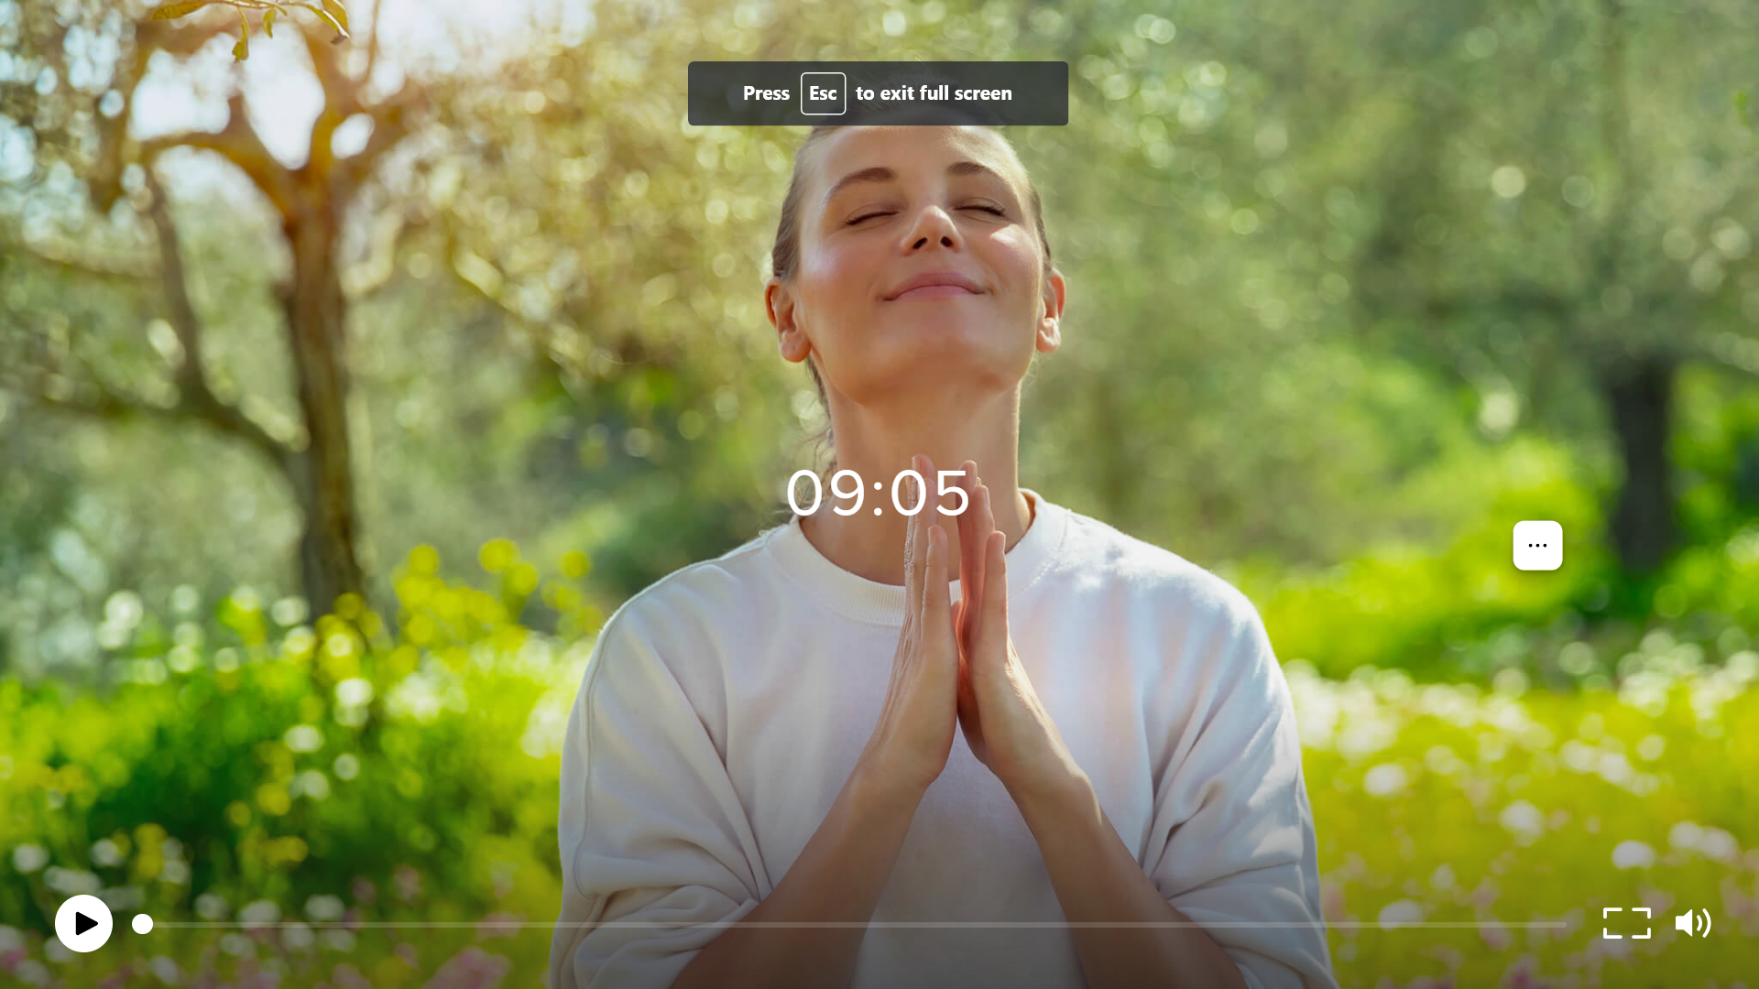
Inner Smile Meditation To Bring Joy And Relieve Stress | Mariellen VanDyke Brown, Insight Timer

Slide 49
SUPPORT
5 steps to mental wellbeing - NHS (www.nhs.uk)
The Stress Management Society - From Distress to De-Stress
Glasgow | Wellbeing Services | NHS (wellbeing-glasgow.org.uk)
Contact (wellbeingscotland.org)
Breath works -https://youtube.com/shorts/jlufY_GZQeY?si=XjBUs0J1UwdfpoPE
Free Breathwork Sessions - Alchemy of Breath
Taoist Inner Smile Meditation - YouTube
Home - The Wellbeing Thesis
Developing a positive outlook when living with a health cond... -
Counselling Directory (counselling-directory.org.uk)

Slide 50
SUPPORT
What Is the Fight-or-Flight Response? (verywellmind.com)
Shereen's story: my experience of long COVID | Mental Health Foundation
Inner Smile Meditation To Bring Joy And Relieve Stress | Mariellen VanDyke Brown, Insight Timer
7 Quick Stress Relieving Stretches - Ben's Natural Health (bensnaturalhealth.com)
CALM app
Headspace app
Relaxation Techniques for Stress Relief - HelpGuide.org

