Slide 1

The Breath
Working together to manage how you breathe
NHS Greater Glasgow & Clyde
Long Covid Service
Notes:
Welcome to todays session on breathlessness and breathlessness management. Breathlessness is a common complaint for people with Long Covid, todays session will hopefully give you some explanations as to why you get breathless and some tips as to how you can help control your breathing.

Slide 2
"It's nice to be nice"
Be respectful to others.
Remember what is said in the group stays in the group (confidentiality)
Don't interrupt - one person speaks at a time, raise your hand if you wish to talk/have a question.
Ensure you are muted to allow everyone to hear the presentation without interruption.
Notes:
Just some reminders for the session ...

Slide 3
Session
Explore reason why breathlessness occurs in Long Covid?
Discuss normal breathing
Understanding changes to breathing patterns
Tips for breathlessness
Breathing exercises
Notes:
A quick summary of what we will cover today.

Slide 4
The Breath
Breathlessness is one of the more common issues people with Long Covid have been experiencing.
Breathlessness is normal and being breathless in isolation is not harmful
If we become unable to control breathing, this can feel uncomfortable and distressing making us tired, anxious and frightened.
Notes:
As already mentioned, breathlessness is one of the more common issues for people with Long Covid.
It is important to remember breathlessness is normal and being breathless in isolation is not harmful. We will all get breathless at times, for some that could be doing chores or climbing a few steps, for others that could be much higher intensity exercise. Feeling breathless can be very uncomfortable and frightening, but how we control our breathlessness, and how we recover our breath is a big factor in how bad we feel our breathing is in the first place.

Slide 5
Why are we breathless after Covid?
Please put your thoughts into chat box
Notes:
Please take a minute to think of the reasons we are breathless after covid infection and put you had up or add some words in the chat.

Slide 6
Covid is a virus that first affects the respiratory system
Inflammation in the lungs (and other body systems)
Breathlessness when acutely unwell / active infection
Dysfunctional breathing
Deconditioning
Change to muscle strength / weakness including breathing muscles
Anxiety
Weight change
Why are we breathless after Covid?
Notes:
There’s several reasons that we can be breathless after covid, in the first instance it is a respiratory virus, it causes inflammation in the lungs and can affect other parts of the body. It is normal, and most people (but not all) are likely to have been breathless at the time of your active infection. After a respiratory infection we would normally expect breathlessness to improved within a couple of weeks, however for a lot of people with long covid this has not been the case and it has been much longer lasting. This can also cause changes to our breathing pattern, causing us to feel breathless and this is known as dysfunctional breathing which I will talk more about later.
When we are unwell our physical fitness will be affected and this can have a longer lasting effect, the less active we are the more our body will decondition. The body can decondition very quickly, and it takes longer and is more difficult to regain our physical fitness. This can also be a factor in making us feel breathless.
Being less active and unwell also causes us to lose strength in our muscle, you may have noticed you don’t feel you have the same power in your arms and legs but it is not only those muscles that are affected, the muscles around our chest that are used for breathing can also become less strong.
Anxiety and our mood can also cause breathlessness. In response to how we are feeling our bodies can subconsciously change the rate at which we breathe. Feeling breathless in its self can be a frightening experience and some people can get into a vicious cycle with breathlessness and anxiety. How we are feeling and breathlessness will be covered a little more in the session later today.
Last point on the screen is weight change, this can be gaining or losing weight. More people do complain of breathlessness if they have put on weight, more weight causes your body to work harder and this can result in breathlessness. An increased weight of one stone, is the same as carrying around a 5kg dumbbell or 5 bags of sugar or a small dog such as a Jack Russell, just imagine how much more effort that would take and why you would feel breathless carrying that around all day.

Slide 7
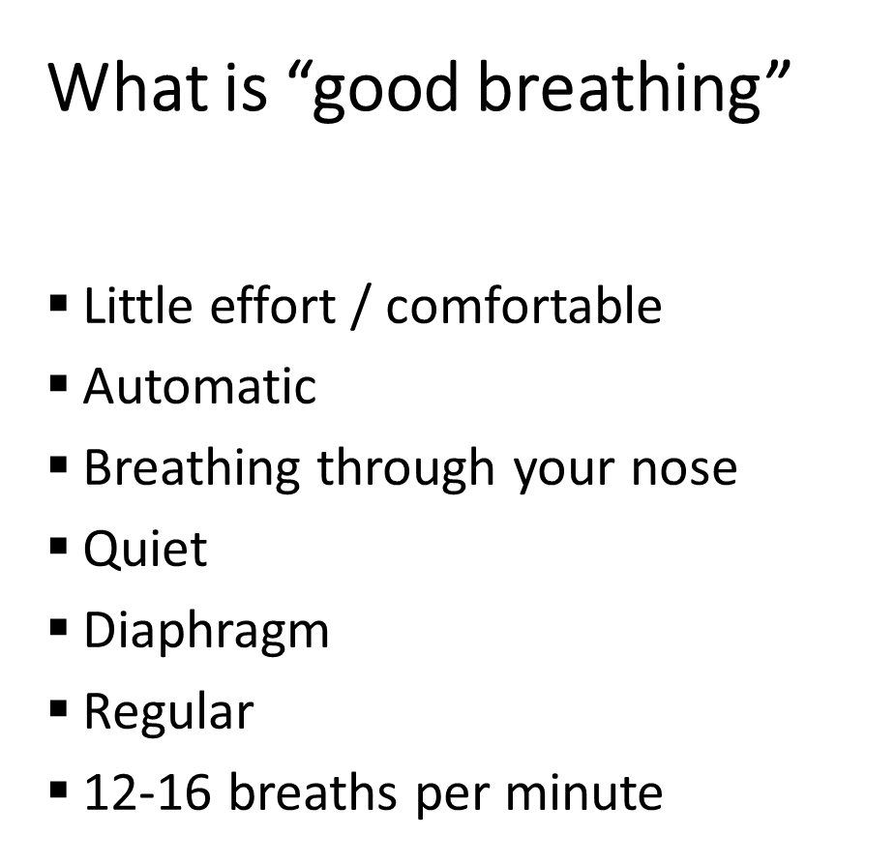
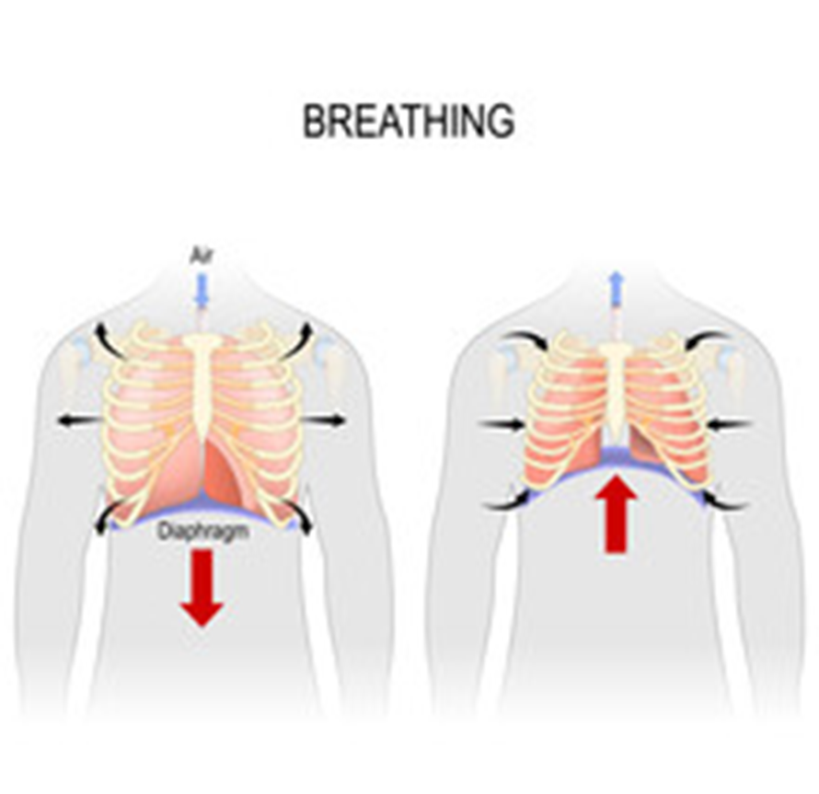
Notes:
We will all have slightly different patterns in which we breathe but here are the things that should be included in a good breath.
It shouldn’t take much effort to breathe and it should be automatic, we shouldn’t feel like we’re having the force air in or out of our chest or lift our shoulders up and down.
We should breathe through our nose, for most people this should be normal. Some people might find they breathe through their mouth instead of their nose because of allergies or previous damage. But for a lot of people who breathe through their mouth this is something that we have simply adapted to doing and its become a bit of a habit. Changing back to breathing through our nose doesn’t happen over night and just because you have closed your lips, its likely you will still want to breathe through your mouth but this can be switched with a bit of time and training.
The diaphragm is a big and important muscle at the bottom of our ribs, on the diagram the diaphragm is the purple arch above the red arrows. As we breathe in the diaphragm lowers and flattens out, this is to allow you lungs to expand to the best that they can, allowing air to move in. As you breathe in your tummy should gently rise. As you breathe out the diaphragm rises again, back to more of an arch and your tummy will relax. There shouldn’t be much movement around your chest as you breathe. If taking a big breath in mean to you that you suck in your tummy, puff up your chest and lift your shoulders, this is an inefficient breathing pattern, it requires more effort and you are not getting the right distribution of air into your lungs.
*** Let’s have a practise at some belly breathing ***
Our normal resting breath should be quiet, you or others shouldn’t be able to hear you breathing in and out. If you can hear your breath it is likely you are using too much effort to breathe through your nose or you are breathing through your mouth.
Last couple of points, our breath should be regular and at a rate of 12-16 breaths in a minute, it shouldn’t bee too fast and we shouldn’t be taking big gasping breaths or sighing.

Slide 8
How does your breathlessness feel to you?
Please enter text into the word cloud

Slide 9

Descriptions of Breathlessness
Can't take full breath in / out
Effortful
Heaviness
Tight chest
Tight throat / Choking
Yawning / sighing / coughing
Air hunger satisfied / unsatisfied
"Need more oxygen"
"Need inhaler / medication"
Notes:
All the boxes on the screen show how people would describe breathlessness.
You might feel that you cannot take a full breath in or out and that each breath is an effort.
You might feel that there's pressure on your chest in that it feels heavy or tight, this sensation may also be in your throat and you feel you have difficulty with each breaths.
The pattern in which we breathe can change, signs that this has happened would be yawning or sighing more frequently and not because you feel tired or are fed up. Taking bigger breaths every now and again is also common but you might feel unsatisfied and you still need to take more and bigger breaths, this is also in keeping with a change to your breathing pattern.
Being breathless is not necessarily a sign that you are not get enough oxygen or that you need medication, in fact most people with a change to their breathing pattern complain that when the use their inhalers they don’t work.

Slide 10
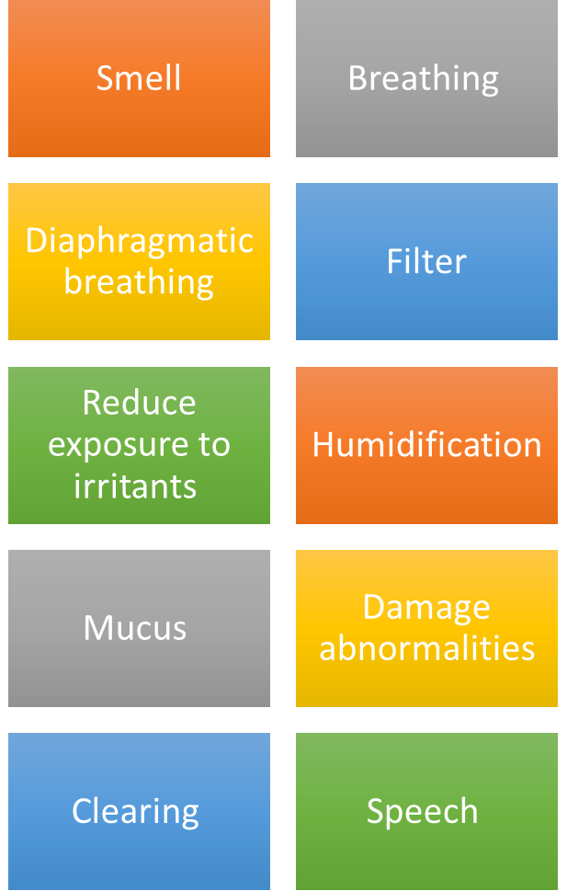

The Nose
&
Upper Airway
Notes:
Smelling is often the first thing we think about in relation to the nose, but I am going to talk about other aspects of the nose. I’ll just briefly mention about loss of smell as this has affected some people after their Covid infection. You may not have any sense of smell or your sense of smell has changed, some people have also complained of “phantom” smells. Unfortunately we don’t have a quick fix to change this, however some people who have previously attended the Long Covid groups have had some success with smell retraining, this is normally done by regular practice of small sniffs of 4 distinct smells (lemon, rose, clove, eucalyptus), the links to smell training websites are on the NHSGGC Long Covid website.
Our nose is not just for smelling, it also has a very important part in how we breathe. I already mentioned the diaphragm earlier, it moved better when we breathe through our nose that our mouth. Try taking as big a breath as you can, breathing in through your nose, now try taking the same size of breath just breathing through your mouth. You should feel that you manage a bigger breath through your nose.
The nose is also an important filter to our body. Along with mucus produced by the nasal passages, particles can be trapped when trying to enter the respiratory system. However, the nose can also be very sensitive when expose to some allergens and irritants, this might make us feel we can’t breathe properly through our nose and we can become congested.
Humidification is an important role of the nose. The air we breathe in in the atmosphere is much cooler than the temperature that the air needs to be by the time it reaches the lungs, so the nose does a good job to warm it up.
Movement of air through our nose is also important for speech, just listen to the difference if you try to talk while pinching your nose.
As already mentioned the nose is a filter and it's important that we keep filters clean and clear, I'll discuss some options to do this next

Slide 11
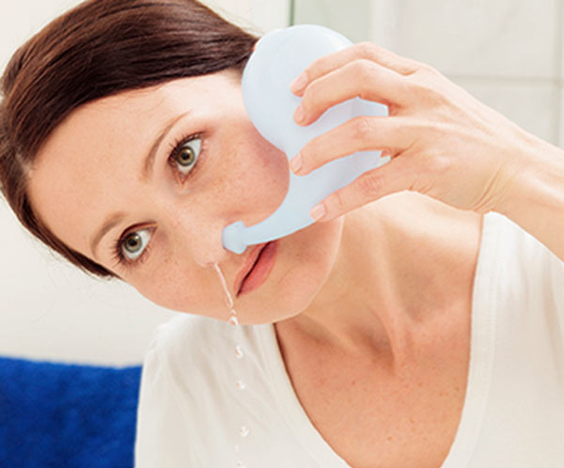
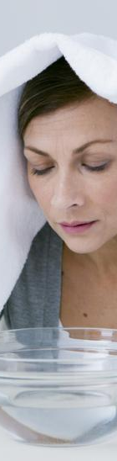
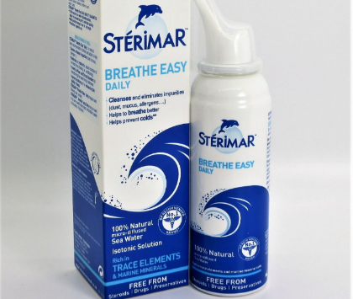
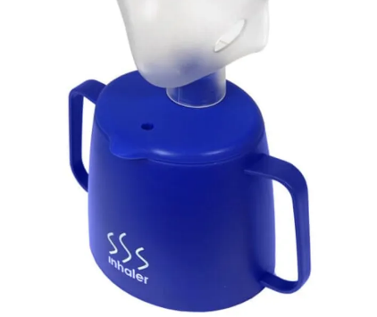
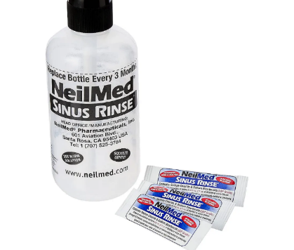
Notes:
Sinus rinsing, nasal douching or snot washing are the same name for flushing the nasal passages with a low flow of water. This is what we can see in the top left and bottom right.
Saline spray is in the top right, this is a spray that creates a fine mist in the nose and allows for additional moisture in the nasal passages which you gently blow out again after spraying.
Good old fashioned steam is also a great way to humidify the nose, this can be done with a bowl and towel or you can purchase steam inhalers for £5-10 where you put the hot water in the breaker and hold the mask to your face to breathe in the steam.

Slide 12
Breathing at Rest and Activity
40
Activity
Recovery
20
Activity
Rest
Rest
Recovery
Rest
Rest
0
Notes:
I'm now going to talk you through some differences in breathing patterns.
At rest we should breathe 12-16 breaths in a minute, that’s what we can see on the blue line. As we exert ourself the rate at which we breathe increases, this could be around 20-25 breaths in a minute, we maintain that increase while we are active. When we stop the activity the rate at which we breathe reduces relatively quickly back to our resting rate of 12-16 breaths per minute.
The red line will now show a altered or dysfunctional breathing pattern. To start, the breathing rate at rest is higher than the blue line and be around 20 breaths per minute, this leaves you at a disadvantage. When we exert ourself the rate at which we breathe ramps up much more quickly, breathing possibly around 30 breaths per minute. We will feel breathless and uncomfortable, breathing at this rate can't be maintained as long, and when we stop the activity it takes longer for us to regain our breath back to our resting rate. To correct a dysfunctional breathing pattern it is important that we try to correct the rate at which we breathe at rest, before we can address breathlessness with any exertion or activity.

Slide 13
“Normal Breathing Pattern”
IN
OUT
Notes:
This slide shows what an normal or ideal breathing pattern should be like. We start by taking our breath in, then we breathe out before having a natural pause at the end of our breath out before we start to breathe in again. This pattern keeps going for our 12-16 breaths in a minute.

Slide 14
“Altered / dysfunctional Breathing Pattern”
Notes:
We can see a difference in this slide, you can still see the blue “normal” pattern in the background. The red line shows the breathing pattern as being, breath in, breath out, breath in, breath out and some big breaths in and out. You can see that this means taking more breaths each minute, it requires more work, and is an inefficient pattern.

Slide 15
Let’s try a breathing exercise
Top tips !
Keep your shoulders down and relaxed
Breath in and out through your nose
Breath to your tummy
Let your tummy rise as you breathe in
Try lying on your side / reclined / sitting
If you get it wrong just start again
Practice little and often
Practice makes permanent
Practice correct technique to make changes
Notes:
To try to correct our breathing pattern it’s important to practise a correct pattern and this is what I will talk you though now. This is a training should be done when you are at rest and comfortable.
To start drop your shoulders down, focus on breathing through your nose and letting your tummy rise and fall.
You will see the triangle on the screen, we will start at the bottom left corner, the first line will turn green and follow the line as your breathe in, next follow the blue line as you breathe out, pause on your breath out following the orange line before breathing in again.
Lets give it a try, the triangle will repeat 3 times and follow it as best as you can.
You might have found that hard or wanted to take a large breath in at the end, this is because your breathing is out of sync with a normal pattern, it wont change overnight so this does take time and regular practice.
1 demo then 2 repeats of triangle

Slide 16
Three more breaths …
Top tips !
Keep your shoulders down and relaxed
Breath in and out through your nose
Breath to your tummy
Let your tummy rise as you breathe in
Try lying on your side / reclined / sitting
If you get it wrong just start again
Practice little and often
Practice makes permanent
Practice correct technique to make changes

Slide 17
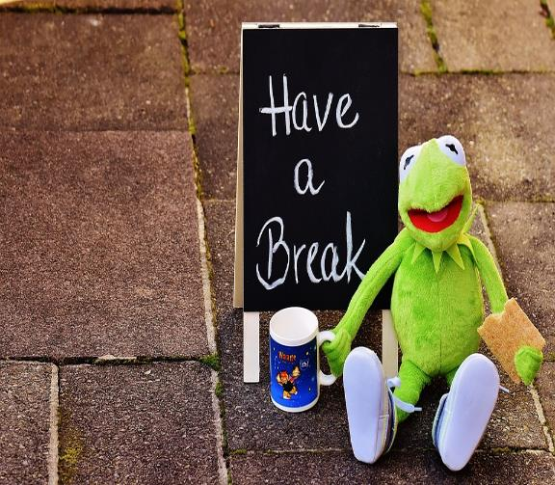
During the break please try to …
(10 minutes)
Change position
Stand up and move around a little
Have a gentle stretch
At least roll your shoulders and paddle your feet to move a part of your body.
Have a drink
Notes:
Welcome back!
We have spoken about how we breathe and got some hints on breathing exercise.
In the second half we are going to explore hints and tips on how to manage your breathlessness.
You will be given the chance to chat with each other about your breathlessness.

Slide 18
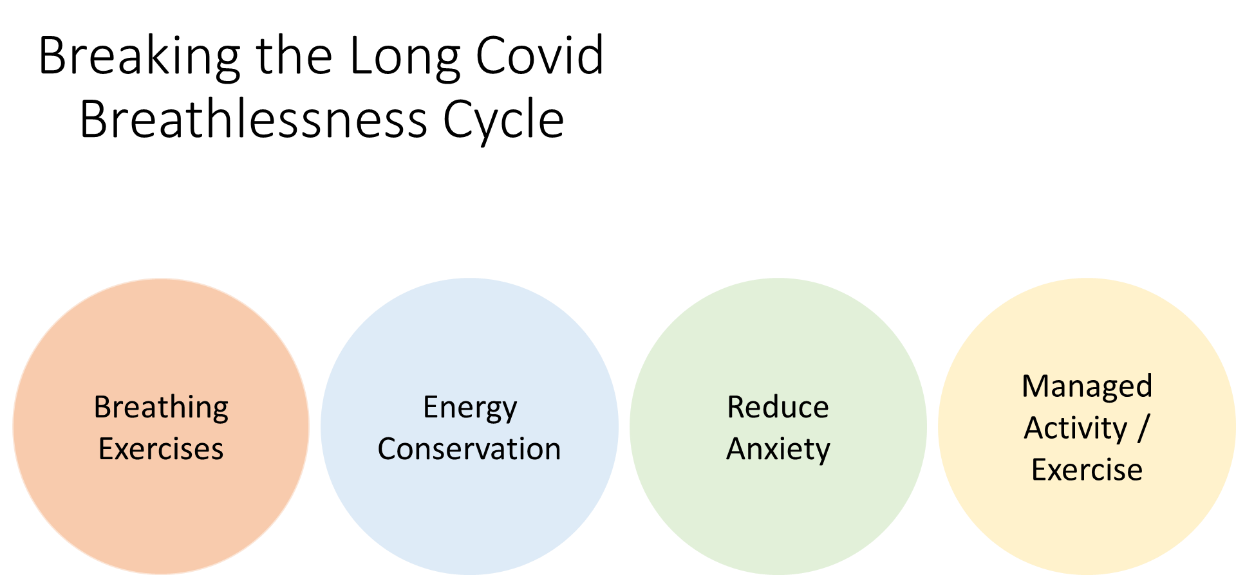
Notes:
The second part of our session is going concentrate on adding tools into your 'management toolbox'. We have already spoken about triangular breathing exercises which are a useful exercise and tool to improve your breathing pattern. Education in its self is also an important tool – we hope you now have a better understanding of how we breath, 'good breathing' and what causes breathlessness in Long Covid.
We hope to add more tools to your 'management toolbox' by looking at:
Breathing exercises that you can use during movement or activity.
Energy conservation (which we will explore in greater depths in out fatigue session next week) but it is important that we look at how to conserve your energy to reduce any exertion or activity related breathlessness. Some of these tips can also be useful in breath recovery
Anxiety - There are many research papers alongside anecdotal evidence to support that anxiety can and often does play a part in our breathlessness. This does not mean that everyone who is breathless is anxious or that everyone who is anxious is breathless. However if we consider what happens when we become breathless – gasping, feeling as though you can't catch your breath, it is a natural response for our thoughts to take over. You might think ' I'm going to die', or 'this will never end' but it does, and using anxiety management techniques can help manage your breathlessness and help you to stay calm if you become breathless.
Activity/exercise - Finally we are going to talk about activity/exercises that can help your breathlessness. We are not suggesting that you go off and exercise but there are exercises that you can use to help your breathing. We will look at these tips, give you a chance to practice some and we will give you links to these resources.

Slide 19
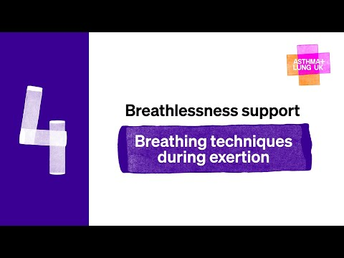
Notes:
On exertion
We are going to watch a 2 minute video on some breathing exercises that you can use during activity. We have a resource sheet with more information on this which we will also send out.
Pursed lip breathing to be used during recovery not as a day-to-day technique.
Paced breathing – the idea of slowing your breathing down sounds easy but its not and people often voice their frustrations when advise this.
Simply paced breathing allows you to break your breathing down. E.g.
You may have taken one breath and run up the stairs, now you may need a breath for every step.
Outside you may use every lamp post to stop, check in and breath. Within the house use your doorways. Stop, check in and breath.
By creating a visual reminder you will learn the skills to help you to apply to any task you may be working towards. E.g a longer walk. After time you may move from every lamppost to every second. Don’t dismiss starting, that first stop and check is a step in the right direction.

Slide 20
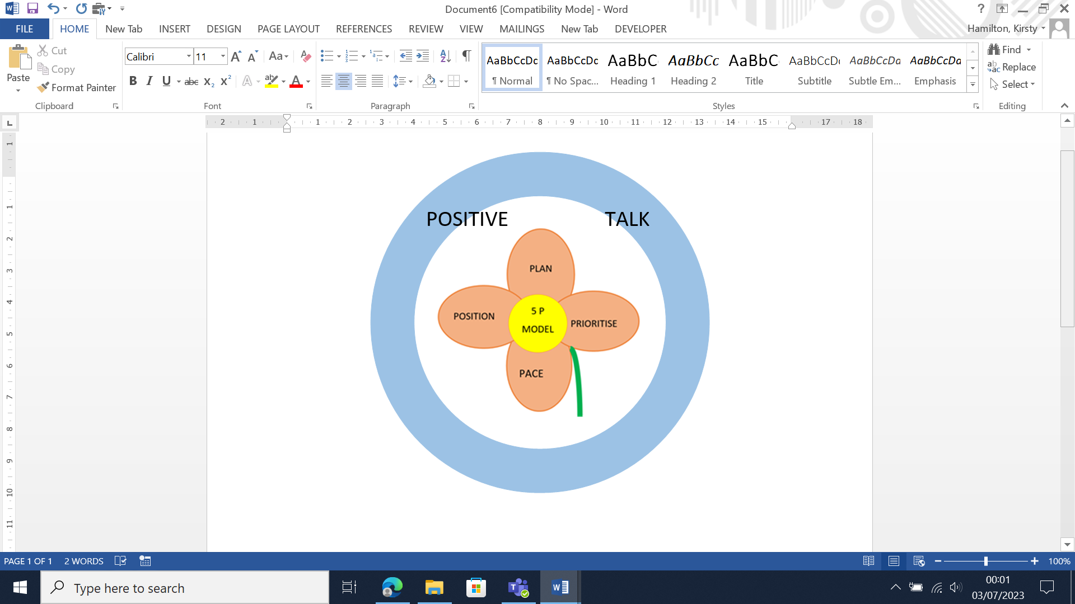
Energy Conservation (activity)
Energy Conservation (activity)
Notes:
5 P model is the basis of fatigue management but is also useful managing breathlessness.
Plan
Position/posture
Prioritise
Pace
The Stalk (your support network) they may be family, friends or acquaintances through online forums or whatsapp chat groups.
Positive talk-
Its important to remember we had strengths and coping mechanisms before you had Long Covid. You were able.

Slide 21
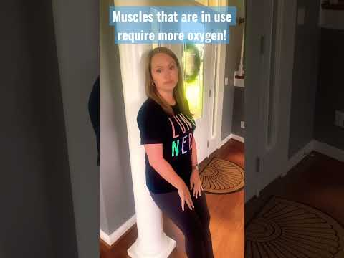
Energy Conservation (recovery)
Stop
Think
Position
Pursed lip/recovery breathing
Self-talk
Share with friends/family
https://youtube.com/shorts/TyqXzLAF6Ow

Slide 22
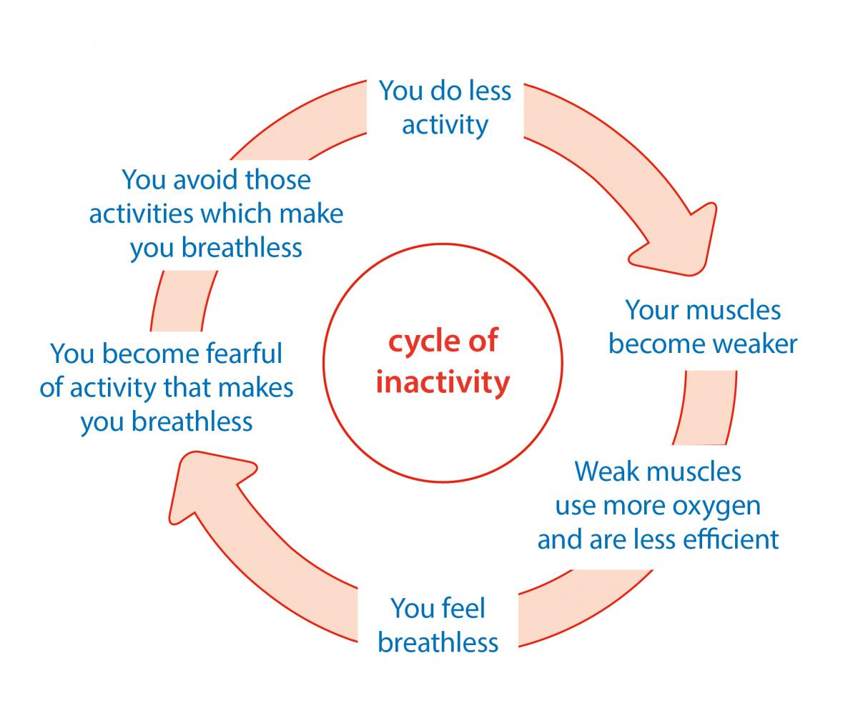
Movement/Activity/ Exercise
Stretching
Short walk
Singing
Reading out loud
Functional goals
Relaxation
Notes:
Muscles in the body like and need to be move but sometimes we become fearful and start to avoid or remove an activity from you to day to day life, this can become a cycle of inactivity.
Often with breathlessness you can become fearful that an activity can worsen your breathing.
As a result you naturally start to avoid those tasks.
Your activities reduce and your muscles weaken.
When you try to do an activity your muscles are now weak and use more oxygen, in turn increasing your breathlessness.
When we think about exercise you may think about a gym but you can help your breathing through movement or activity. Just like pre-covid some people manage more energetic activity than others, the same is true for you now.
It is important when you think of activity/exercise you start at a level that you are comfortable with, you do what you can. Don’t put yourself under pressure, lots of small steps forward can, and does make a difference.
Examples of activities that you can try to help with your breathlessness include:
Singing – both the Scottish and English national operas developed singing groups for those with long Covid breathlessness. Within the groups they teach the importance of posture and how to improve your breath. You do not need to have a good singing voice nor any experience. The Scottish national opera offers virtual group session alongside on demand videos that you can try at home. There are also a number of choirs that have opened their doors.
Reading out loud, particular children’s book which have shorter sentences can be helpful in practicing your breathing while you are talking.
Be active at a level that’s right for you – use the talk test to check.

Slide 23
Reduce Anxiety
We are hardwired to breathe, when we struggle to breath, we naturally become frightened.
Our instincts kick in and we start to experience negative thoughts and emotions.
"...this will never stop"
PANIC
"I'm going to die!"
FEAR
Notes:
Group question: What do you think and feel when you are breathless?
We expect to breathe.
We know what is normal and when something goes "wrong" it is natural for our thoughts to run away.
With every symptom/experience/activity we will have a thought and a feeling, all of which can and often effect out behaviour.
E.g.
Activity- slowly climbing the stairs, increasing breathlessness as this continues.
What feelings would you have?
Feeling- scared, sad, anxious, fearful
Thoughts- "I'm not going to make it?", " this is my last breath", "help"
Behaviour- sweaty, fearful, anxious, tremble,
Our thoughts, feelings and emotions are interconnected but we can learn to manage some of this.
Challenge those thoughts,
Voice those thoughts
Accept your feelings don’t try to fight them

Slide 24
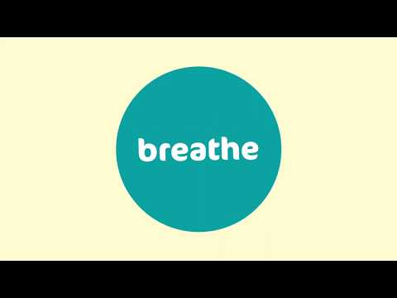

Slide 25
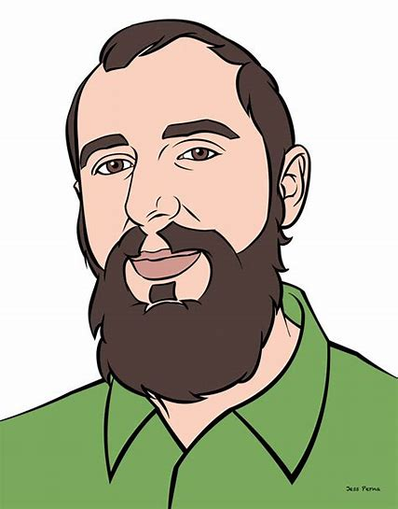
Stop and check in
Check your body (think about your breath, posture, muscles and other symptoms?
Check your mind?
Check your comfort
Notes:
Learning to stop and 'Check in' on yourself is an important skill and I would encourage you to try this after today. We so often have a list of priorities as long as our arm or don’t have the energy to stop and actually check in with ourselves. This is an important self-help technique and can be very useful.
Check your body?
Check your breathing?
Have you noticed any changes e.g. is your breath faster and harder to catch?
Is your breathing inefficient and very tiring.?
Has your 'normal' changed – this may identify an improvement but also catch an infection etc?
Check your mind?
Are you anxious and panicky? - possibly try a simple grounding exercise (5 things you see, 4 things you can feel, 3 things you can hear, 2 things you can smell and 1 thing you can taste?)
If your thoughts are negative, try to challenge them – you have got through this breathlesssnes before.
Consider distraction, listen to music or read a book.
Finally check your comfort?
Are you doing too much?
Is the goal unrealistic and needs changed?
Are you too hot? (remove some layers of clothing, loosen your tie/remove your lanyard if at work)
Use a cool flannel to cool your face
Use a fan (handheld /desk), open a window or step outside.
So, we went you to Stop, check your body and breath, check your thoughts and check your comfort?

Slide 26
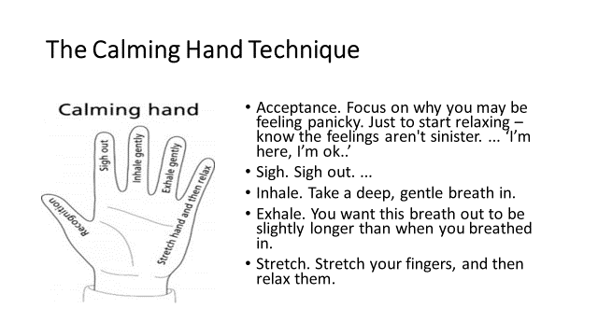
<iframe width="560" height="315" src="https://www.youtube.com/embed/0y1lt-vTIzY?si=YnqO00mmkRD3x2S2" title="YouTube video player" frameborder="0" allow="accelerometer; autoplay; clipboard-write; encrypted-media; gyroscope; picture-in-picture; web-share" allowfullscreen></iframe>

Slide 27
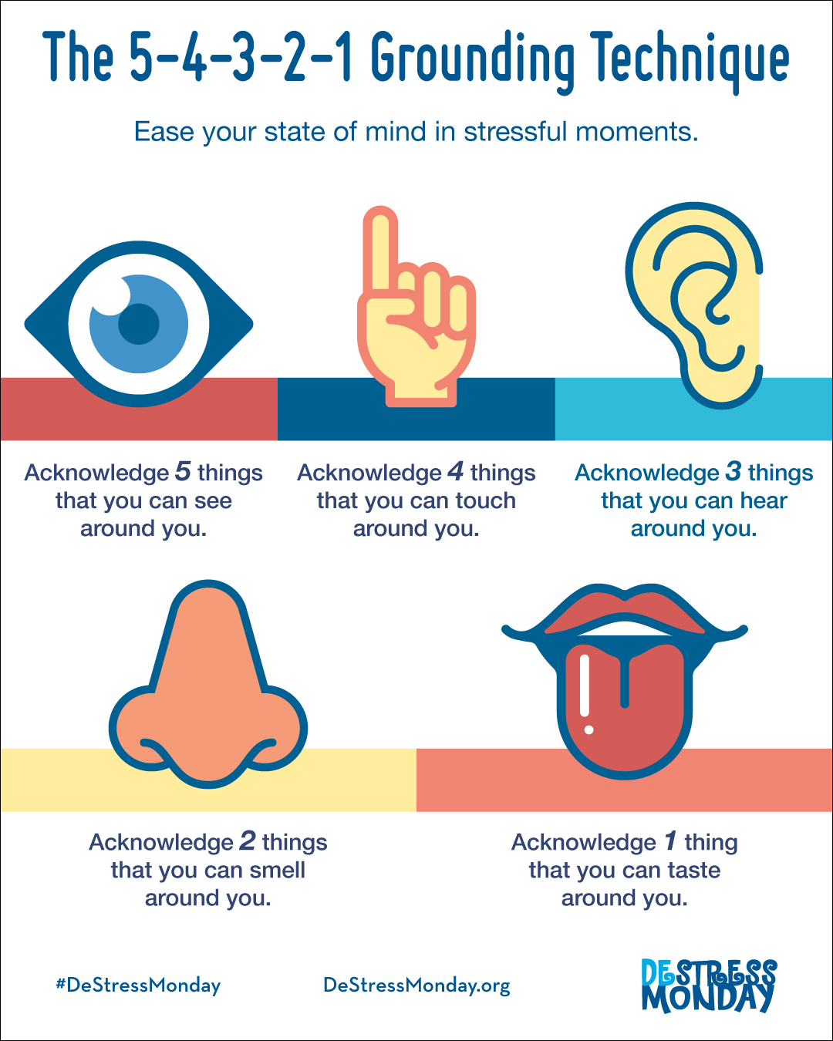


Slide 28
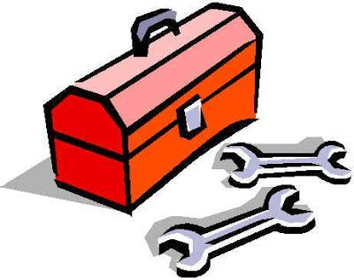
Self-Management Toolbox
Breathing exercises
How to apply energy conservation.
How to use different activities to help your breathing
Links local groups​
Use mindful breathing
Recognise the link between your emotions and thoughts
Notes:
By the end of the 8 week program we hope that you will have learnt new tools that you can use to manage your day-to-day symptoms.
This week we hop you will have or at the very least trial the following:
Breathing exercises to help correct any changes in your breathing pattern and to use during activity.
The knowledge of how to apply energy conservation to your day-to-day life to help your breathing.
How to use different activities to help your breathing and links to local groups.
How to use mindful breathing and understanding the link between emotion and thought. The importance of checking in.

Slide 29
Top Tips: Breathlessness
Stop and 'check in' on yourself (Breathing, body, mind and comfort)
Use your breathing exercises at rest (practise) and during activity.
Trial different forms of exercise to help your breathing.
Be aware of your thoughts and feelings while breathless monitor self-talk and use affirmations, relaxation apps/websites to calm yourself.
Create a plan to support you and your family/ friends for when you are breathless.

Slide 30
Thank you for listening

Slide 31
Resources
Physiotherapy for breathing pattern disorders resources for physiotherapists (physiotherapyforbpd.org.uk)
How to manage your energy levels - RCOT
Long Covid: symptoms, tests, treatment and support - BHF
Breath Cycle | Scottish Opera

