Slide 1
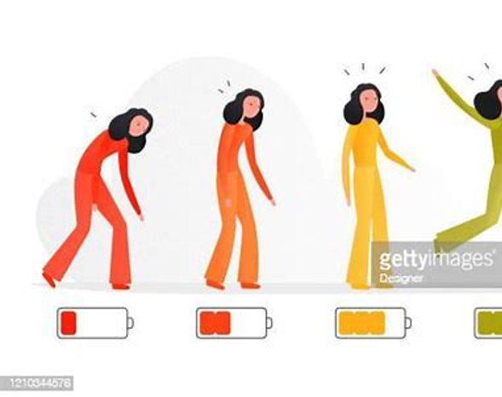
FATIGUE
Notes:
Hello and welcome to week 3 of our 8-week self-management Long Covid Course. Today’s session is on fatigue.
Fatigue remains the most reported symptom of Long Covid. The ONS (office of national statistics) reported that 71% of people with Long Covid report experiencing fatigue. It is for this reason that we have fatigue into 2 presentations.

Slide 2
"IT'S NICE TO BE NICE"
Notes:
Please remember our group rules, which are therefore to help improve your comfort and experience.
As always please be respectful to other, don’t interrupt (raise your hand or pop a question in the chat box) and try to keep yourself on mute if you are not talking.
Finanlly please remember tconfidentiality- what what is said in the group stays in the group.

Slide 3
SESSION AIMS
Define fatigue and examine some of the possible causes.
Discuss the symptoms and impact of fatigue.
Explore the importance of baseline assessment and use of fatigue diaries.
Introduce energy conservation strategies.

Slide 4
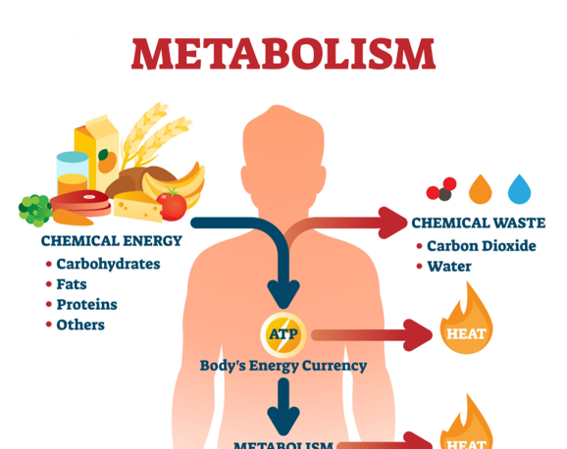
How does our body create energy to live?
Notes:
Energy is a critical requirement for the body that it doesn’t survive even a minute without it. Even during sleep, huge amounts of energy are consumed by the body. But unlike animals, the human body requires more energy as its needs and activities are more. Before we detail how energy is used in the human body, we thought we would touch upon how energy is produced in our bodies
ATP stands for adenosine triphosphate and is the term used to refer to a unit of energy. We need a continuous supply of this and it's also the unit of energy that aids metabolism that support and maintain life.
1. This energy is delivered to our body through the foods we eat and liquids we drink.
2. The stored chemical energy within food is broken down into smaller parts and our body absorbs them to use them as fuel.
We can think of this in same way that for a car to go it needs to have fuel put in it and our bodies work the same-if we do not have the fuel going in we cannot be active.

Slide 5
How our body uses PHYSICAL energy?
Muscle activation
Movement
Positioning
Walking, running, dancing
Notes:
When we consider fatigue we must consider energy and the types of energy we need to fulfill our lives.
Physical exertion
This is how most of the body’s energy is spent in living animals and humans beings.
This is done due to the intention to move, perform, or work.
The body energy is also consumed for muscle contractions and relaxation.
We see this during walking, running, lifting, jumping, talking, shouting, etc.
Further body language also consumes energy.
So you can notice that when you are hungry, your body language will be low and ineffective.

Slide 6
HOW OUR BODY USES SOCIAL ENERGY?
Spending time with others
Establishing and developing relationship.
Social cues and communication
Notes:
Social energy – the energy we use being in a group, socialising with others. Think about all the actions that occur to meet a friend for a coffee or even have them over to your house. We often try harder in a social environment to achieve the appearance of being “fine” but this actions uses vast amounts of energy which drains your system.
.

Slide 7
HOW OUR BODY USES COGNITIVE ENERGY?
Thinking energy
Planning
Learning
Problem solve
Focus
Notes:
Cognitive energy – is our thinking energy, allow us to focus, to remember, to problem solve

Slide 8
HOW OUR BODY USES EMOTIONAL ENERGY?
Feelings about and towards different aspects of our lives.
This Photo by Unknown author is licensed under CC BY-NC-ND.
Notes:
Emotional energy – how we feel with what is going on in our lives (feelings around our work, our relationships, feelings about our health & symptoms)
At any given time we may need energy for all of these types of activities. However when our energy store is depleted, fatigue occurs.
Feeling exhausted, You may think 'but I’ve done nothing today', when in fact you may have:….......
Got washed and dressed, made breakfast, climbed the stairs – examples of using Physical Energy
Arranged a personal appointment, prepared for and attended a works meeting, – examples of Cognitive Energy
Spoken with someone on MS teams, had a chat over coffee – use of Social Energy
Trying to put on a brave face but inside your angry, worried about the future – an example of Emotional Energy
So, how often do you use your energy stores without thinking about it? Do you stop and check-in with ourselves to see where those energy levels are truly sitting?
If you think about your mobile phone battery, and if we are honest, we can all admit to regularly running the battery low into the red. And annoyingly it seems to be when we really need to use it. If only we had given our phone a full charge at the earliest warning signs. Our internal body battery works in a similar way.
To manage your fatigue you need to stop, check in with yourself and be aware of those physical, cognitive, emotional and social energy requests that will be taken from your internal battery.

Slide 9
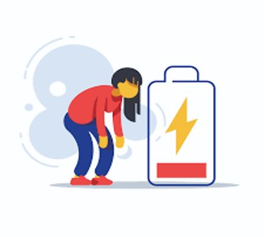
Fatigue
Extreme and persistent tiredness, weakness, or exhaustion of mental and/or physical origin that is not relieved by rest.
[Dittner, 2004]
Notes:
Before we look at a formal definition of fatigue we are interested to hear what fatigue feels like to you. In a second a word cloud will appear.
Using as many words as you want, please input what fatigue feels like to you?
2. Once everyone has answered a word cloud will appear describing how fatigue feels to everyone in this group.
There is no universal definition but here are 2 definitions that may resonate.
The above definition is from Dittner (2004) and another is by [Galland-Decker, 2019] -
“An unpleasant physical, cognitive and emotional symptom described as a tiredness not relieved by common strategies that restore energy. It varies in duration and intensity and reduces the ability to perform usual daily activities.”
Both accept fatigue is:
Unique to the individual
Mental, physical and cognitive
Not relieved by rest.

Slide 10
WHAT CAUSES LONG COVID FATIGUE?
Systemic Inflammation
Antibodies
Latent virus activation
Breathing patterns
Notes:
Looking at the research there are a number of possible theories why fatigue is such a significant symptom in the description of long covid, for example;
1.The effect of serious/ significant illness – it does take the body time to recover from ill health and muscle and tissue damage that might have happened
2.The ongoing inflammation process, this hasn’t settled down and still ongoing – When the body responds to viruses or infections it releases chemicals called cytokines, which promotes inflammation and this can cause many classic symptoms such as tiredness/ exhaustion, aches and pains, malaise.
Low antibodies-bodies inability to fight off any infection, lower levels of antibodies in those with more significant ongoing fatigue after a Covid Infection.
3.On theory that is being explored in research is damage to the mitochondria of the cell, which is the very battery/ energy source of the cell, thus causing fatigue
4. Latent virus activation-Covid 19 can trigger any underlying existing virus's within our system.
5. Breathing Pattern-if we have dysfunctional breathing pattern, not enabling our body to function at optimal level thus could be a contributing factor to fatigue.
●
There appears to be little correlation between the development of long covoid and the severity of the virus itself. For example someone can present with minimal to moderate symptoms during the acute covid phase but go on to develop long covid and conversely someone could have experienced severe covid symptoms requiring hospitalisation in ITU, HDU or ward but do not go onto develop long covid, that is ongoing symptoms post 12 weeks after the initial acute state of infection.

Slide 11
What is fatigue?
Notes:
This is a description of how it feels to person with fatigue in a long term condition
It is real and not some made up conditions
Its debilitating and persistent.
Affects all aspects of your life.
You can have ups and downs
Can you relate?

Slide 12
CONTRIBUTING FACTORS TO FATIGUE
Deconditioning
Pain
Breathlessness
Anxiety
Grief
Exertion
Hydration
Poor diet
Illness/infection
Notes:
As well as the physiological suggestions of causes of fatigue there are other contributing factors to fatigue and the potential exacerbation of it.
Deconditioning – refers to the changes in the body that occur during a period of time when you are not active. The changes happen in the heart, lungs and muscles. They make you feel tired and weak and decrease your ability to be active.
Breathlessness - we will look at breathlessness in more detail next week
Pain - If you have joint pain, you may use body positions that are less painful to your joints. However, these positions can put extra stress on your joints and muscles. This can lead to fatigue. Also the physical and emotional energy you use trying to deal with pain can also make you feel fatigued
Fatigue can also be caused/impacted by our emotional states:
Anxiety – can cause a hormonal rush that can leave you feeling drained and tired. It can lead to muscle tension because the fight or flight response triggers your body to be physically ready to respond at any moment.
Grief – grief is Loss of whatever type. Possible sense of loss of what you feel you may have lost due to long covid. Grief can trigger a strong stress response in your body.
How we live can also affect our fatigue:
Exertion: Our activity and energy use is often impacted by how we lived pre-covid. You may still be trying to maintain a level of activity that your body is currently unable to sustain. Or you may have a delayed reaction to exertion and experience post exertional malaise.
Hyrdration and diet can also impact our fatigue, we are going to explore this a little later.

Slide 13
Notes:
On the screen here we have shared what are found to be the 10 most commonly described symptoms of fatigue: Name them.....
Invite you to consider if these resonate with you or share either in chat box or if wish to speak any of symptoms you experience.......

Slide 14
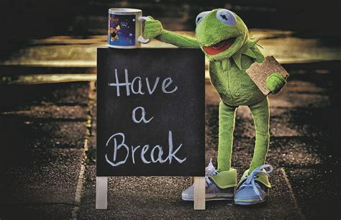
Let's stop here for 10 mins.
May be have a …
Drink of water
A snack
And try changing your position.
See you back soon!
Notes:
Time for a 10 minute break now.
In keeping with the theme of Fatigue, you may wish to grab a snack for energy and a glass of water to keep hydrated. And you may wish to change position or stretch to remove stress from body parts.

Slide 15
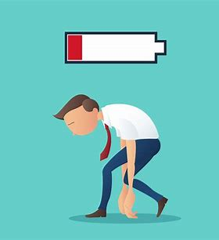
Recognition and Acceptance
Notes:
Research has suggested that acceptance does help with a persons experience and management of fatigue.

Slide 16
LONG COVID
Notes:
Those with an invisible illness or disability often face continual judgment from others.
Symptoms such as fatigue and brain fog can lead to feelings of anger, isolation, and helplessness.
Coping skills include:
1. lowering your expectations,
2. picking your battles
3. practicing self-compassion.
4. joy
The Challenges of Living with an Invisible Illness | Psychology Today

Slide 17
ACCEPTANCE
Refuse to buy into the judgments your mind makes about yourself (good judgments or bad ones.)
Instead, recognise your strengths and weaknesses.
Accept today and make plans for the person you want to be.
Notes:
ACT (Acceptance and commitment therapy)” is a type of mindful psychotherapy that helps you stay focused on the present moment and accept thoughts and feelings without judgment. It aims to help you move forward through difficult emotions so you can put your energy into healing instead of dwelling on the negative.” (ACT Therapy: What It Is and How It Can Benefit Your Mental Health (webmd.com)).
Acceptance and commitment therapy (ACT) teaches mindfulness skills to help individuals live and behave in ways consistent with personal values while developing psychological flexibility.
It teaches patients to change the way they relate to their negative thoughts and emotions so that these thoughts don't take over. Some of the techniques used include:
Sunset mind – when watching a sunset do you enjoy the moment, the beauty or are you critical and self-aware? For most, the moment is enjoyed for what it is. If we apply this to life-
Recognise and accept your thoughts and emotions,
Look at them but don’t analyse.
Celebrate the positives and move forward with that mindset.
Alternatively, there is the Hurricane technique- if you were in the middle of a hurricane would you be examining the hurricane or making a plan to get out? This technique encourages us to :
1. recognise/observe the issues.
2. Don't dwell
3. Be assertive- fight for change. Make a plan.

Slide 18
UNDERSTANDING YOUR FATIGUE

Slide 19
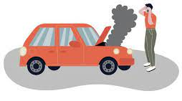
Step 2- Understanding your fatigue
To fix the problem, you must understand the issues.
It's important to recognise what, when, where and possibly who zaps your energy.
Notes:
Understanding the problem of fatigue is an important first step. It is much harder to manage/improve your fatigue if this step is skipped. Some of these questions you may know easily but others will take time and will need you to really explore.
_{Recognise the drains.}
_{What}
_{When}
_{Where}
_{Who}
_{...drains you?}

Slide 20
Benefits of Using A fatigue/ activity diary
Symptom tracking​
Triggers​
Identify priorities
Balance of rest and activity
Pattern recognition – routines and habits
Understand where you are now
Remember: Learn from today , trial tomorrow
Notes:
An activity diary can be used to look at different aspects of your fatigue. We would encourage that you start by completing an activity and symptom diary over 2 weeks. This allows you to identify:
If certain symptoms occur during or after certain tasks.
Possible triggers e.g. when you are busy does your symptoms increase.
Consider your prioriites.
Monitor your rest and activity- often this is out of balance.
Recognise the habits and routines that you have – are these working for you now ?
Gives you a good indication of how you are managing at present. Some people find this a difficult process butas already noted acceptance and understanding is the first stage of managing/improving your fatigue.

Slide 21
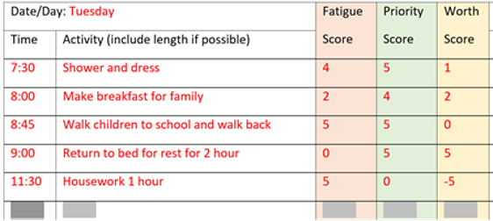
Step 2: Examining your fatigue - Activity Diary
Notes:
Pole: How many of you have used an activity/fatigue diary before?
Yes
No
Has anyone found this helpful?
Complete your diary for a minimum of 1 week but ideally 2. Your diary can be used to:
Check your routines
Clarify energy usage and related activities.
Consider your priorities
Compare your activity versus rest and relaxation
Look for links.
Ask yourself what can I change?

Slide 22
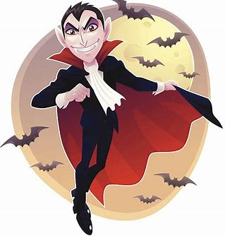
WHat/who/when are your ENERGY VAMPIRES?
Notes:
Consider what drains you, sometimes it can be helpful to apply a taffic light system. E.g.
Red- really draining tasks
Amber- tiring but achievable with adjustments
Green – low or energy boosting.

Slide 23
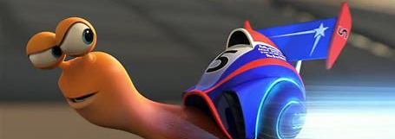
WHat/who/when are your Turbo jets (boosters)
Notes:
When we talk about fatigue we often concentrate on activity/ exertion but energy boosting is just as important in your recovery.

Slide 24
Understanding Your Routine
Routine gives our bodies a timetable to work to.
A routine will also promote comfort, give us access to support and a pattern of meals, activity and sleep
We often rely on well-established routines but check if these work for you now.
Notes:
Maintain a pattern of sleep, mealtimes and activity. A
Avoid doing too much on a good day which might exacerbate the fatigue and other symptoms.
Having a basic routine that has some flexibility can be helpful for when you are ready to start increasing activity. A regular routine can also help you sleep better.

Slide 25
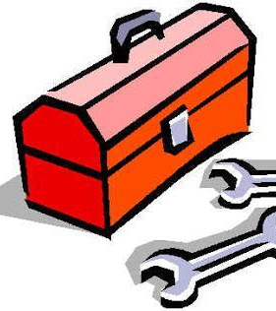
Wellbeing Toolbox

Slide 26
WHAT STRATEGIES DO YOU USE TO HELP MANAGE YOUR FATIGUE?

Slide 27
Understanding Your Energy Envelope
Our body uses our energy to:
Activities of Daily Living
Walking
Stress
Driving
Teams meetings
Work
Chat with a friend over coffee
Worry
£10
£8
£6
£5
£6
£3
£0
-£5
Notes:
If we all imagine that in the morning you are given £10 to spend throughout the day. There are diffierent ways to manage this money.
Spend the full £10 – What happens if there is a rainy day or special event?
2. Spend a little money and save - You create a cushion of money/energy but what do you cut out of your daily life to accommodate this?
3. Buy whatever you want and go into debt. If you are in debt today, tomorrow instead of £10 you may be starting your day with £5, suddenly you have the choice to cut 50% of your plans or over spend. This can create a cumulative effect where you are booming and busting.
4. Do nothing and save all the money. We know that withdrawing and doing nothing, although sometimes needed is not good for our health or wellbeing.
Ask yourself, how do your spend your energy envelope.

Slide 28
DIET
Try to eat your 5 a day.
Eat little and often
Try higher carbohydrate
Try to batch cook
Remove caffeine (gradual)
Notes:
Base your meals on potatoes, bread, rice, pasta or other starchy carbohydrates, as they are a good source of energy. Aim to choose ‘lower GI’ carbohydrates that release energy more slowly
Milk, cheese and yoghurt are a source of protein and some vitamins. They’re also an important source of calcium, which helps keep bones healthy. If choosing dairy alternatives, ensure you select versions that are fortified with calcium
Aim for at least five portions of a variety of fruit and vegetables each day for vitamins, minerals and fibre
Choose unsaturated oils and spreads in small amounts
Your Gp may want to check vitamins such as B12 deficiency and folate as these can cause fatigue.
You may find it helpful to plan your meals in advance, and to batch-cook and freeze meals in individual portions for days when you are lower in energy.
There is a lot of conflicting information about ME/CFS and diet online. There is no scientific evidence
Myalgic Encephalomyelitis (or Encephalopathy) / Chronic Fatigue Syndrome (ME/CFS) | British Dietetic Association (BDA)

Slide 29
Staying Hydrated
Notes:
atigue is one of the first signs of dehydration
Water is essential for carrying nutrients to your body's cells and taking away waste product
Roughly 50% to 60% of your body weight is water, - going to the toilet, breathing and sweat.
When you are low on fluids, your body may feel tired and weaker than usual.
Ensuring you drink regular throughout the day will help replenish you.
6-8 glassess of water are enouraged per day.
Caffeine occurs naturally in coffee, tea, cocoa, and chocolate and is also added to some popular beverages.
For some people, a cup of coffee or a can of cola is all it takes to get a little energy boost but should be done in moderation
Drink plenty of fluids – water, milk and sugar-free drinks all count.
Fruit juice and smoothies also count, but limit these to 150ml per day.
Some people find they are more sensitive to caffeine, so you may find it helpful to reduce tea and coffee, or switch to decaffeinated.
If caffeine affects your sleep, avoid caffeinated drinks in the late afternoon and evening
Myalgic Encephalomyelitis (or Encephalopathy) / Chronic Fatigue Syndrome (ME/CFS) | British Dietetic Association (BDA)

Slide 30
SLEEP (RECOVERY)
Sleep is an essential activity and is needed to support motor and cognitive function.
Sleeping supports recovery and allows your body to rest.
Sleeping for long spells can result in poor sleep at night, thus causing further fatigue.
Multiple naps are not recommended .
Notes:
"That allows your body to restore itself. You're working your muscles when you're awake. When you rest, it allows them to heal. When you get a cold, at night it allows your immune system to fight off those bad germs.
but a short nap (no longer than 60 mins) can be useful, not too late in the afternoon, is helpful.
Physical Rest
Muscles need to rest.
Helps the body to grow - the body works to rebuild itself for the next day.
Mental Rest
Sorting out things that have happened in the day and storing them in our memory.

Slide 31
Idea: Re-frame the idea
of exercise, consider all
activity as exercise.
Promotes sleep
Reduces Stress
Maintains Conditioning
Boosts mood (happy hormones)
Promotes Strength and Movement
Reduces Stiffness.
BENEFITS OF EXERCISE
Notes:
" physical activity that you do to make your body strong & healthy" (Cambridge Dictionary)
Exercise is different to physical activity. Exercise is planned, structured, repetitive and intentional movement intended to improve or maintain physical fitness. Physical activity is any bodily movement produced by muscles that results in energy expenditure. Physical fitness is a set of attributes that are either health- or skill-related. Exercise and physical activity are often recommended as public health and rehabilitation interventions to prevent, manage or improve diseases, health related challenges, disability, quality of life and well-being.
Exercise — Long COVID Physio
Gentle stretching
Going for a short walk
Suzy Bolt Yoga
https://youtu.be/6MQO8YGC6PM
Mindful walk

Slide 32
Rest and Relaxation
Rest allows your body and mind to calm.
This can be achieved by:
Listening to music
Journalling
Being in nature
Meditation (CALM app)
Formal Relaxation
Notes:
As noted rest is important and we would encourage you to consider how you rest. Is watching Tv restful, or are you concentrating and thinking throughout? Consider what allows you to relax.
Are your someone who can switch off while listening to music?
Do you find writing calming and a helpful way to off load?
Is being in nature or sitting out in the garden your calming time?
Alongside these there are formal methods of relaxation or meditations that you can try. There are lots available, we have added links at the end of this session. Please remember relaxations are a bit like pick in mix sweets, you have to find the one for you. Don’t give up if the first one doesn’t work, think about what you liked and/or disliked and try something different the next time. Every change is an opportunity to learn.

Slide 33
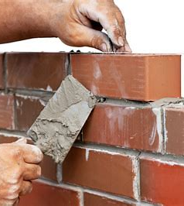
Making Changes
Change Only One Thing at a Time
Identify Why You Want to Change
Understand How the Behavior Serves You
Sit with the discomfort
Take Baby Steps
Set no time limits but do review.
Notes:
Change Only One Thing at a Time
Identify Why You Want to Change
Understand How the Behavior Serves You
Sit with the discomfort
Take Baby Steps
Set no time limits but do review.
6 Steps for Personal Change | Psychology Today

Slide 34
SELF-MANAGEMENT TOOLBOX
Improved understanding of Fatigue.
Improved awareness of energy.
Acceptance exercises that promote realistic thinking
and encourage self-management skills.
Awareness of the benefits of an activity diary and how
to complete.
Skills to make small changes applying energy conservation strategies.

Slide 35
KEY POINTS
We have 4 main energy types:
physical, emotional, social and cognitive.
Fatigue is individual to you.
Fatigue is a complex symptom that can vary hour by hour or day by day.
The first step to managing your fatigue is to accept where you are starting.

Slide 37
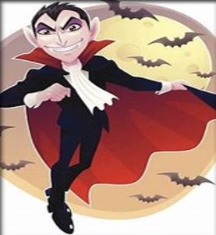
Thank you!
Any Questions?

Slide 38
SUPPORT
Tiredness and fatigue - NHS (www.nhs.uk)
How to manage your energy levels – RCOT
How I Manage My Many Energy Envelopes | ME/CFS & Fibromyalgia Self-Help (cfsselfhelp.org)
Exercise — Long COVID Physio
6 Steps for Personal Change | Psychology Today
The Challenges of Living with an Invisible Illness | Psychology Today
How I Manage My Many Energy Envelopes | ME/CFS & Fibromyalgia Self-Help (cfsselfhelp.org)
Long Covid recovery: tips for fatigue and breathlessness - BHF

Slide 39
SUPPORT
How I Manage My Many Energy Envelopes | ME/CFS & Fibromyalgia Self-Help (cfsselfhelp.org)
Exercise — Long COVID Physio
6 Steps for Personal Change | Psychology Today
The Challenges of Living with an Invisible Illness | Psychology Today
How I Manage My Many Energy Envelopes | ME/CFS & Fibromyalgia Self-Help (cfsselfhelp.org)
Myalgic Encephalomyelitis (or Encephalopathy) / Chronic Fatigue Syndrome (ME/CFS) | British Dietetic Association (BDA)
The Free Mindfulness Project

Slide 40
SUPPORT - Apps
Insight Timer - #1 Free Meditation App for Sleep, Relax & More
BellyBio: Interactive breathing (by Relaxline)
Get some headspace (free 10 day trial)
ActiveME – activity diary
Relax and sleep by Glenn Harrold
Calm - The #1 App for Meditation and Sleep
Visible - Activity tracking for Long Covid and ME/CFS (makevisible.com)

