Slide 1

NHSGGC Long Covid Group Programme
Session 1 - Introduction
Long COVID - NHSGGC
Notes:
Slide 1
Welcome to the NHS GGC Long COVID Self-management group - an 8 week group where you will gather information on Long COVID and various strategies to support you in managing your condition. You will have the opportunity to discuss your journey with each other and support each other as you complete this course. My name is ….. We have 5 Occupational Therapists, 2 Physiotherapists, HCSW and Admin support. We do not have any doctors within this team, as this is a self management service aimed to provide you with the tools and strategies needed to self manage your condition.
Today’s session is an introductory session. Aimed at settling you into the group and the tech we’ll be using over the next 8 weeks. Hopefully you will leave today's session with some new knowledge about your condition, you will learn, techniques and strategies and be given support to start implementing small changes that will make a difference to your Long COVID journey. The focus of all the techniques and strategies is to give you the tools to self manage your condition by managing your symptoms in the best way possible.
Let's get started:

Slide 2
Part 2​
Goals - small changes​
Supported Self-Management​
Self-Compassion Mindset​
Creating Conditions for Change​
5 top tips​
Mindfulness Practice​
Questions and Feedback​
​
Part 1
Housekeeping
Aims of the session
What is Long Covid
Breakout room for 20 min
10-minute Break
Notes:
Part 1 of today includes the more practical aspects of the session how to use MS teams, the aims we hope to achieve today, as well as some facts and figures related to Long covid, what it is, how common it is, and what the main symptoms of long Covid are. This will then be followed by a breakout room for 15 min providing you the opportunity to share your Long Covid Journey. We will then take a short break and after the break ……. will present part 2
Part 2 includes discussion around Goals, self management, self compassion and how to implement change. With 5 top tips, A mindfulness practice and an opportunity for questions and feedback.

Slide 3

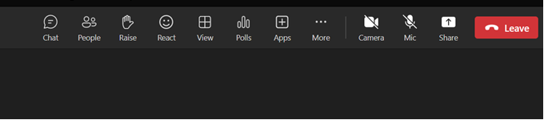
Notes:
To assist in the smooth running of the course, a few pointers about Microsoft Teams The picture above is of what you will see if you join on a laptop or PC. (If you are joining on a mobile device then you press the 3 dots button and you will have similar options). Starting on the left of the top bar, you will see:
The chat function, please use this to write any comments you may want to make during the discussions. A member of the team will keep an eye out and answer any questions as we go along
You will be able to raise your hand if you would like to speak, although there will be an opportunity at the end to ask any questions.
Next you will see the reaction button – you can press this for giving a thumbs up etc.
Further along on the top bar, you will find the camera and the microphone, please keep yourself on mute at all times, to prevent any noisy distractions from having an impact on the group. if you would like to have your camera on please do, but if you would prefer to keep the camera off, please feel free to do that as well.
Everyone in the group is visible to everyone else in the group – attendees and the Long COVID team.
certain devices like phones or tablets may have some limitations, but you will able to access the slides on the website
We will be making use of breakout rooms which provides an opportunity for further discussion This is randomised, and should be different each time. You will automatically move to the room and you will be moved automatically back at the end of the session, which can be unceremonious at times, a warning will appear when you have 10 seconds left of your group.
If for any reason you are kicked out of the meeting, please re-join the session by clicking the original link in the email you received regarding the group. It will be the same link each week.
At the end of the session, the members of the Long COVID Team will leave the session, but the room will remain open if anyone would like to stay on and chat to the other people in the group living with Long COVID.
Previous groups have started a WhatsApp group which helps with peer support ( no one from the long covid Service will be involved). If anyone would like to be involved in this, you can stay on and discuss this amongst yourselves at the end of the session. Alternatively if anyone in the group would like to manage the WhatsApp group and are willing to share your number in the chat, that will allow everyone to exchange numbers and form a WhatsApp group. Chest Heart and Stroke Scotland is able to put you in contact with other Long Covid Patients if you would like more opportunities for peer support, and you can self refer to their service via their website.

Slide 4
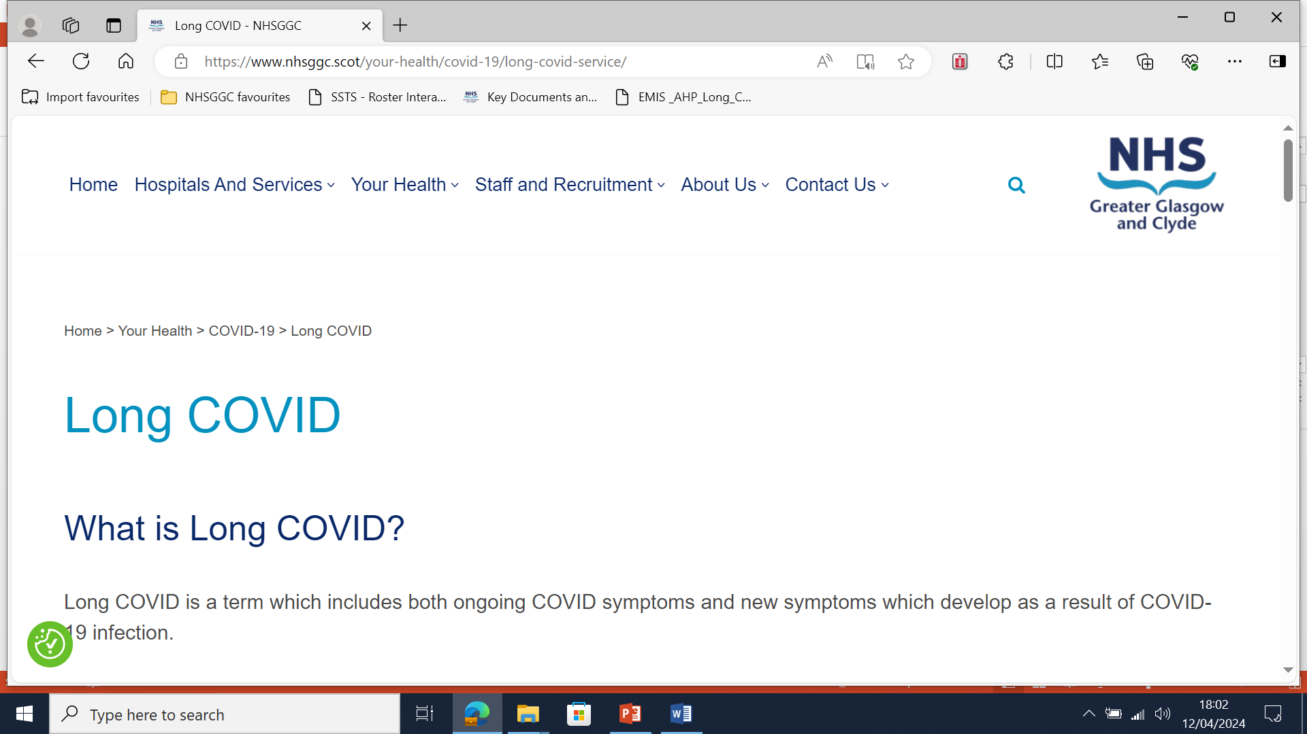
NHS GGC LONG COVID WEBSITE
Notes:
THE NHS GGC long covid Service has a website, which has many resources for many of the symptoms of Long Covid, if you are looking for resources before that session is offered in the group programme, please make use of the website or the long covid Workbook that you will have received in the post.
I will quickly share my screen and give a quick demonstration of the website for those of you who have not yet had the opportunity to access the team website.
To find the website you can type NHS GGC Long covid service into the search bar, otherwise there is a QR code on the introductory letter you will have received from the service.

Slide 5
Be respectful to others
Remember that what is said in the group stays in the group( confidentiality)
Do respectfully listen, allowing one person to speak at a time. Raise you hand if you wish to talk/ have a question
Ensure : Ensure you are muted to allow everyone to hear the presentation without interruption from background noise
Notes:
The rules of participation:
Please be respectful to others
Remember that what is said in the group should stay in the group
Do Respectfully listen, allowing one person to speak at a time and raise your hand if you have a question, or make use of the chat function
Please remain on mute during the presentation, to prevent the session being impacted by any background noise.

Slide 6

Outline
8 Week Programme
Week 1 – Introduction
Week 2 –Dysautonomia, Activity and Pain
Week 3 - Fatigue Part 1
Week 4 – The Breath
Week 5 – Brain Fog
Week 6 – Fatigue and Sleep – Part 2
Week 7 – Wellbeing
Week 8 – Planning for the Future
This Photo by Unknown author is licensed under CC BY-SA.
Notes:
On the right hand side of the slide is the plan for the next 8 weeks, highlighting the theme of each week, where each week, the focus will be on providing you with some theoretically knowledge of the topic as well as techniques and strategies to assist you in self managing your symptoms in the best way possible.
Each of the weeks covers the various symptoms associated with Long Covid. Each of you will have completed a C19 YRS questionnaire which highlights 18 symptoms of Long Covid, Each week a symptom, or a group of symptoms will be discussed and tools and tips will be provided to assist you in dealing with your symptoms. By the end of the 8 week course, you will have various tools in your toolkit that can be used to assist you to manage your condition going forward. For example week 3 Fatigue will address the aspects associated with the most common symptom of Long Covid . The aim of that session and all other sessions, will be providing some theory, but ultimately giving you the needed coping strategies to assist with managing your Fatigue.

Slide 7
Aim of Today's Session
Information on Long COVID, Supported Self-Management Strategies
Use of interactive technology – comments, polls, word cloud and break out rooms
Breakout rooms to give opportunity to discuss and share information in smaller groups and to get to know each other
Mindfulness and/or Relaxation incorporated into each session to invigorate, accelerate your learning and encourage new/useful skill which also has potential to accelerate your healing.
Room is left open at the end to talk (without the Long COVID Team)
Notes:
The aim of today's session is to provide you with Information on Long Covid, and supported self management. to familiarise yourself with the technology, use a break out room, with a Mindfulness activity incorporated at the end. The room will be left open at the end for you to stay and talk amongst each other, without a member of the Long Covid team present.
We are not expecting people to be completely recovered at the end of 8 weeks. Nor should you have that expectation of yourself. Instead we encourage you to look for small changes We are hoping there will be light bulb moments for everyone. A chance to take on new information at the right time and the right pace for each of you so that you can begin to think about doing something different in terms of managing your symptoms. We are here to offer knowledge, skills and advice to help you to reduce your daily symptom burden through effective self- management strategies and techniques.
Pick one tip and strategy, and make small changes regarding that one symptom, over weeks as this symptom starts to improve, a second tip and strategy can be chosen and again small changes over that time will lead to improvement.
Remember that this group is a mix of different stages of the Long Covid Journey, different ages and people who have mixed understanding of Long Covid. Some have done more personal research on Long COVID than others. The sessions will be presented to accommodate all of this. For this reason some people might be overwhelmed with new information and others may feel that they know a lot of what is being said. For those of you who are further into your Long covid Journey, your experiences and what has worked for you will be invaluable to those who are new to the Long Covid Journey, if you feel comfortable to share these experiences please do.

Slide 8
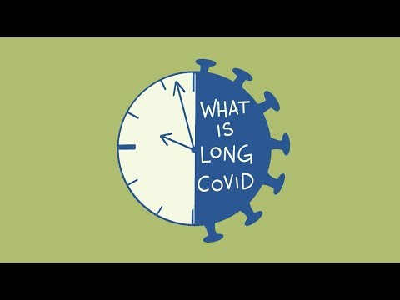
What is Long COVID?
(Video -What is Long COVID — Long COVID Physio
Notes:
What do we know about Long COVID – this next video gives a description of what Long COVID is and the common symptoms associated with it
.

Slide 9
How many people are affected?
1.9 million people living in private households in the UK 2.9 % of the population are experiencing Long Covid Symptoms
The most common symptoms are Fatigue (60%), Brain Fog (38%) Muscle Aches (42%) and Breathlessness ( 48%)
Office for National Statistics (ONS), released 30 March 2023, ONS website, statistical bulletin, Prevalence of ongoing symptoms following coronavirus (COVID-19) infection in the UK: 30 March 2023
Notes:
we do know more about Long COVID than we did 2-3 years ago but we still have so much to learn. Plenty of research has been compiled for the symptoms but there is still lots of research to be done.
There are 1.9 Million people living with Long Covid in private households in the Uk, which is 2.9 % of the population, and 1.5 million of the Long Covid Population report that long covid is adversely affecting their day to day activities.
There are many symptoms of Long Covid, but fatigue continues to be the most common symptom with 60% of people with Long Covid reporting it. This is followed by difficulties concentrating, or brain fog as it is commonly known,. complain of muscle aches and complaints of shortness of breath.

Slide 10
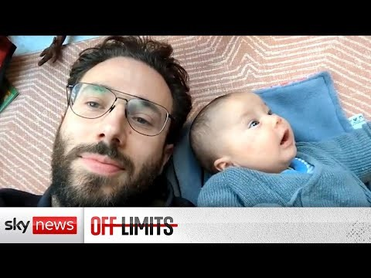
The Long Covid Journey
Notes:
The video clip that I am going to play is only a short section of a 15 minute story by sky news, which follows the story of Rowland from the early days of his Long covid Journey to the more recent days of his journey. if you would like to watch the full video, it can be found on youtube by searching Long covid sky news
The video we have just heard explains a few of the Long Covid patient journeys that have occurred. Each Journey is different, each journey may invoke different emotions. Some emotions may include frustration, fear and grief. Others may have some anger and resentment about the situation they have been left in. All of these emotions have a place, it is completely understandable that these emotions might be present.
The anger may be directed at the handling of the pandemic by the government, or directed at managers from work or GPs / health services / there may be anger directed at us for being unable to give you the answers which we are unable to give.
It is completely understandable why these emotions may be present. You have a right to feel this way.
However, these emotions and anger (in particular) can become all encompassing. It can eat away at the very little energy you have. The future sessions will described prioritizing your energy – think of your anger as being something which uses up the energy you could spend doing something which gives you joy. Would you prioritize it?
Someone might have said something which has been insensitive or unhelpful – quite often this comes from a lack of understanding of the condition "you look well", "my cousin had Long COVID but she went back to work after a few weeks", or the one I hear all the time "do you think it is real?". Or the manager who was initially sympathetic but as the weeks and months have passed just keeps asking "when are you coming back?". Signposting these people to CHSS or our webpage may help with some education. Nobody will fully understand it unless they have lived it. We are hoping that this group will introduce you to people who have lived it, who will understand what you have been through, and hopefully provide you with advice, experience and support that will be beneficial to you as you move forward.
We are now going to split into break out rooms and provide the opportunity for you to get to know the other people who all share a long Covid journey with you. Take the opportunity to exchange some stories about your own journeys with Long Covid. The breakout room will be for 15 minutes, providing each of you with 3 minutes to share something about your journey. There will be a member of the team in the breakout room, but this is an opportunity for you to talk to each other, to share stories, to exchange tips and hopefully to provide each other with support from people who have had similar experiences.
.

Slide 11
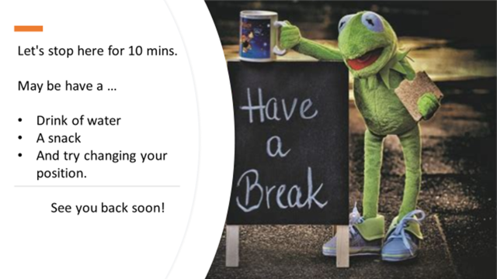
Notes:
I hope that you have all gained something from the break out rooms, we will now break for 10 minutes, please take the time to change position, move a little and get something to drink.
please do not leave the meeting, just mute and turn off camera – relax / have a drink we will return after 10 mins.
The time is now …...

Slide 12
“Begin with the end in mind.”
~ Stephen Covey
WHAT IS IT YOU WOULD LIKE TO HAVE HAPPEN AS A RESULT OF ATTENDING THIS GROUP?
Think about small changes
Notes:
I hope you found the break s beneficial and managed a drink and change of position during the break. In the second half of the session we are going to look in a bit closer detail about what the service can offer to support and enable you to tailor your own ways of managing your Long Covid and its impact upon you.
So 'Begin with the end in mind'
Consider this statement in the context of your own goals for attending this course…but try to break it down and think of perhaps some of the small changes that lead to bigger changes …..the type of small changes that have the potential to change vicious cycles into virtuous cycles…
At the end of the 8 weeks, what do you want to have achieved? in a moment a word cloud, will pop up on your screen, if you feel comfortable to share your goal, please type it, into the word cloud- if you are unable to use the word cloud, you could write it into the chat.
Once you have typed your goal, hit submit and then there should be a link appear in the chat box, if you click on this you will be able to see the formation of a word cloud with the thoughts and goals that have been kindly shared by the group today.
Word cloud poll: Begin with the end in Mind.
Brief noting of themes that are appearing/acknowledging what people are sharing.
.
As an example of a goal, Cooking/preparing a meal is something that most if not all of us can relate too. For some the goal might be to make a really simple meal and for others it may be thinking about preparing a full birthday dinner, but the achievement of the end goal is about the realisation of many small, little steps required to reaching the end goal.
It is about thinking where you are on this journey and personalising the steps for your own goals.
If we take cooking a meal as an example, it is about Planning the meal, purchasing the ingredients required, preparing the meal, cooking the meal, serving the meal, washing the dishes. There are so many aspects to the overall goal of preparing a meal. What I am hoping to convey here is that it is important to take each step/stage in turn and individually and gradually add/fit the pieces of the jigsaw together to meet the end goal.

Slide 13
Supported
Self-Management
What does this mean?
Aim to empower people to take control.
Set of approaches to help manage your own health.
Physical Health, Mental Health or Both
Notes:
So how do we get achieve the "end in mind scenario", unfortunately (at present) there is no one single fix or medication for Long Covid, and of all evidence collated to now, the most effective way found to assist people in managing their condition is a Supported self management Approach and this is what we aim to offer as a service.
What does Supported Self Management mean?- It is empowering people living with Long term conditions, such as Long Covid to take control of their management.
A set of approaches are used, which will help you to manage your own health -think of creating your own individual toolkit to best meet your needs and personal circumstances. It focuses upon what matters to you and also recognising that you are the experts of your life and that the goal setting is guided by the knowledge, strengths and confidence that you all have as individuals.
Thinking about what to include in your toolkit to assist with managing any unexpected bumps in the road/challenges that occur as you work towards your goals and then also the maintenance of the goals achieved.
These could be approaches to address your physical health, mental health or both-which we find commonly links in, if we are able to improve an aspect of health it often has a positive impact upon the other, e.g improve our physical health beneficial to mental health.
The importance of peer support is part of this, it is found that having peer support enables people living with similar long-term conditions or health experiences to better understand the condition and also assist with self management of it, that is why group sessions within already established Long Covid Services have found having a group programme as one of the approaches worked well, due to the peer support amongst members of the group.

Slide 14

Notes:
Everyone is on their own individual Long Covid journey but it is important to establish your baseline from the start to help you get the most out of your interventions and to teach you how to implement the strategies and tools learned in the future. Your baseline is where you are just now in terms of your symptoms and how these impact on your activities of daily living. This can be in terms of your personal life, your studies or work to name a few.
By using an activity diary can really help identify patterns of behaviour and is a visual tool which demonstrates where you currently are and highlights patterns which can be impacting on your symptoms without you even realising. We go more into detail about fatigue on this course but its helpful to get a head start in completing these for a week, preferably two weeks where you record your days and discuss these with your key worker to help guide meaningful work. They can be downloaded on the NHS long covid website. Under fatigue diary. I would encourage you to complete these as it is a powerful tool to help manage your symptoms. It can help you create a balance of rest and activity which in turn will hopefully give you a sense of control. There will be more detailed explanation on this in the fatigue session
I am an occupational therapist, on the Royal College of OTs there are some useful tips on energy conservation and the use of fatigue diaries which I would encourage you to view when you feel you have the time and energy to do so as these may be beneficial to you in your journey.

Slide 15
Quick wins
Hydration pacing avoid caffeine insight timers mindfulness relaxation
Breath work
Notes:
Quick wins: Where to start some quick wins for week 1
There are things which you can implement starting even today. These are;
Hydration
Pacing
Avoid Caffeine
Using insight timers/ mindfulness / relaxation – a lot of evidence to show that mindfulness will help with resting and prepares your body for healing and change work
Belly breathing / breath work – improves focus, concentration, mood, memory
There will be more detail about all of this in the weeks to come, but if you are wanting to start with something these are useful habits.
Again, I would encourage you to look at the NHS Long Covid website each week as there are a lot of useful information on Sleep, fatigue, mental health resources and links on our website which will be discussed later on in the course but it can be useful to read over at this stage incase you wish you discuss these with your key worker sooner as everyone has different needs.

Slide 16

Progress journey
Notes:
As part of healing, it is important to remain hopeful and positive. Try to keep in mind that recovery is not linear, there may be bumps in the road and the journey is not an A – to – B straight line and acknowledging that is ok. This course can help you identify where small changes are needed, provides you with a toolkit of tools to better respond to symptoms. By putting into place the strategies and tools you will learn along the way will hopefully make the recovery time from fatigue crashes or symptoms burden less and less the more you put into practice what you will learn from our service.

Slide 17

What is Solution-Focused Practice?
Solution-focused brief therapy is a short-term therapy which focuses on setting goals and working out how to achieve them. It’s about the future rather than the past and promotes positive change by encouraging you to focus on what you can do, rather than what you can’t.
Focusing on what is Working vs Not Working
Notes:
Self supported management is focused upon helping people to find solutions, make plans and help you to breakdown your health and care goals into manageable steps. We focus upon YOUR goals not what us as health professionals believe what your goals should be.
So what is SF Practice and the SF mindset?
'Solution-focused brief therapy is a short-term therapy which focuses on setting goals and working out how to achieve them. It’s about the future rather than the past and promotes positive change by encouraging you to focus on what you can do, rather than what you can’t.
Focusing on what is Working vs Not Working'
The emphasis here is on encouraging a solution focused mindset. It's very much an attitude that can be useful to you.
It’s a helpful mindset to apply when undertaking any kind of change work as the focus is on what is working vs not working .
Looking at ways to self manage look at the solutions focused.
It’s a useful mind-set to adopt and one that when used, can conserve precious energy, and we know from the first half of the presentation, fatigue is a significant factor within Long Covid.
It is important to reflect upon and review regularly the steps towards the goals and consider is this working for me and if it is not, what (if anything) can I do to change it and find an alternative solution.

Slide 18
Small changes lead to big changes
Small changes
Turn vicious cycles
Into virtuous cycles
Notes:
We hope over the 8 weeks that you Identify and experience small changes which in turn create big changes over time. a key take-away message from today
Small changes can turn vicious cycles into virtuous cycles
Now that we have considered a self supported management and solution focused/goal setting approach, we have one final poll that we would like to ask you to participate in today.
In a moment a poll should appear on your screen and I would like to ask to you rate yourself on the question of where are you on the confidence scale in identifying something that you could change as part of your journey of supported self management of your condition, with 1 being not very confident at all and 10 being very confident.
How confident on a scale 1-10
When you think about confidence, just remember the steps that you have already made to get here today and the knowledge and support that will be available to them in the next 8 weeks.
We will review this at the end of week 8

Slide 19
Mindset of Self-Compassion
‘When you're trying to motivate yourself, appreciate the fact that you're even thinking about making a change. And as you move forward, allow yourself to be good enough‘
Alice Domar
Notes:
Thank you for sharing your thoughts around confidence and small changes, And we know that by adding in a mindset of self compassion we go even further in optimising our chances of success even further.
Because we know our internal dialogue isn’t always supportive of the changes we might wish to make
. Learning to be kind to yourself can really can make a difference.
notice your self talk in the coming days and weeks
And know by doing this, we are much more likely to notice the small changes, and when you do notice these changes give yourself the credit for implementing them.
Empowering you to be in control of your life and not feel like your Long Covid is ruling/in control, as you are all so much more than a health condition.

Slide 20
Realisation that big goals need to be broken down into smaller steps.
Adopting a Solution-Focused Attitude
Look for small changes = Hidden successes
Lots of small changes = Bigger steps forward
Mindset of Self Compassion
Mindful Daily Practices
Creating the Conditions for Change
Notes:
To create the best conditions for change within self management, it's useful to ..
•Consider and realise the big goals we have need to be broken down into smaller steps to enable us to increase chances of achieving them
•Adopt a Solution-Focused Attitude
•Look for small changes = Hidden successes
•Lots of small changes = Bigger steps forward
•Mindset of Self Compassion-be kind to yourself, think about the way you speak to yourself, would you speak to friend/family in that way.
•And if you can throw in some Mindful Daily Practices you will be on your way to living well with your symptoms and progressing your recovery. We will be utilising/sharing a variety of different mindful type practices throughout the course and hopefully you will find one or more that you can connect with and add into your toolkit

Slide 21
'In ancient times having power meant having access to data. Today having power means knowing what to ignore'
Yuval Noah Harari, Homo
Top 5 Tips
Sleep
Be kind to yourself
Notice the little changes
Be aware of the different types of exertion.
Avoid burn out with research
Notes:
As we are nearing the end of our first session, we wanted to share with you some of the feedback that has been compiled from the Long Covid Journey of others.
Top 5 Tips
1.Good quality sleep is important (night time sleep especially) - covered later in the course program
2. Don’t be too hard on yourself – try one strategy at a time and focus on the overall improvements rather than any small set backs – (remember the SF attitude and mindset of self compassion)
3. They all talked about noticing the Small changes that can lead to big changes –
4. Be aware of different types of exertion - Fatigue can be brought about by exertion – physical, emotional or mental. Think about all the little things you are doing in your day, not just the physical when you complete your activity diaries – the mind body connection is real.
5. Don’t fall into the trap of burn out with personal research on Long COVID. It will waste valuable energy. Set aside time if you want to but the internet is a huge place sending you down rabbit holes. Not how you would want to prioritise your energy. Most people reflect that they regretted doing this and that this energy would be better invested in their healing, however again this is individual choice and everyone is at a different stage in their journeys', but an important point to consider and think about how to best manage/approach it if you do wish to do further research.

Slide 22
Mindfulness Activity
2 Minute Reset | Julia Albertson, Insight Timer
Notes:
I would like to invite you to participate in a short mindfulness activity, , we are going to spend the next 2 minutes on this practice, please only do what feels right for you today, please feel free to turn your camera off if you would prefer. During the activity a mention is made of stretching your arms, only do this if it feels right for you.

Slide 23
Any Questions ?
Notes:
We would like to thank you for attending the session today and invite you to ask any questions/comments that you may have, either by popping them in the chat or raising your hand function........
We will also leave the meeting room open to enable anyone who wishes to stay on and chat with each other, the Long Covid Team will leave, to allow you space together without us around.
We are going to share a link in the chat box, if we could ask you to kindly consider completing this feedback on today's sessions, it is just a couple of questions and it would be greatly appreciated by us, allow us to review and develop the course and make any changes necessary.
Thank you all again and we look forward to seeing you all here next week, the topic being discussed is Post COVID Dysautonomia.
if you would like to be part of a peer support WhatsApp group. Or if you would be happy to arrange the WhatsApp group, stay on and discuss with other members of the group once the Long Covid Service leaves.

