Slide 1
Cross Sector
Practice Placement Briefing
Placement Area: Acute Wards & NHS Specialties
Academic Year 25/26

Slide 2
Placement Details
The academic year runs from September – August each year.
For this academic year 25-26 students will be on placement during the following dates:
Acute Wards
Monday 5th January – Sunday 25th January 2026
Monday 13th April – Sunday 19th April 202 (excl. maternity)*
Monday 10th August – Sunday 30th August 2026
How long: 1 week (36 hours)
NHS Specialties
Monday 18th May – Sunday 28th June 2026
How long: 2 weeks (36 hours per week)
*Only for any students who still have outstanding placement required to graduate
Acute wards - Students will attend one placement in each setting during years 2 & 3
NHS Specialties – Students will attend two 2-week placements in year 2

Slide 3
Learning Outcomes – A&E
Patient Assessment and Triage – Demonstrate the ability to perform systematic patient assessments, recognize clinical priorities, and contribute to the triage process in a fast-paced emergency setting
Clinical Decision-Making – Develop critical thinking and shared decision-making skills by observing and assisting in the diagnosis and management of a variety of acute medical and traumatic conditions
Interprofessional Collaboration – Work effectively within a multidisciplinary team, communicating appropriately with doctors, nurses, and other healthcare professionals to ensure comprehensive patient care
Procedural Skills and Interventions – Where possible, gain hands-on experience in performing key clinical procedures, such as cannulation, airway management, and basic life support, under supervision
Conduct and Communication – Demonstrate professional behaviour, ethical practice, and effective communication to deliver patient-centred care while maintaining patient autonomy, dignity and quality of life
Notes:
Paramedics attend patients with a wide variety of needs and have an important role in hospital admission avoidance through avenues including treating and discharging patients at home or referral to alternative treatment pathways. The profession in Scotland is also moving towards alignment with the rest of the UK in developing a greater presence in settings outside of prehospital emergency care including primary care, in-hospital, and community care environments as well as education, governance and public health. This video created by NHS GGC gives some more information and insight into cross sector placements: https://youtu.be/D3Lm7etIux8?si=SA4umeBOh9dAB9Lh
With the drive towards a connected whole system approach to improving care for all, we want to prepare our students for their responsibilities through engaging with diverse learning experiences in practice settings. By placing year 2 and 3 paramedic undergraduate students into a variety of care environments we can achieve a number of pertinent learning outcomes associated with early development of the holistic healthcare practitioner, such as:
Enhance understanding of patient assessment, treatment and management in in-hospital emergency care settings
Exposure to a variety of patient groups and clinical presentations
Recognise the role of the healthcare professional in maintaining patient autonomy, dignity and quality of life
Explore adaptations to communication and care provision to aid delivery of person-centred care to patients with a variety of needs
Opportunity to develop knowledge and understanding of NHS services and the complexity of patient journeys
Identify the need for, and reflect on, interprofessional collaboration and multidisciplinary team working to enable quality person-centred care
Explore and analyse wider health and social care provision challenges

Slide 4
Learning Outcomes – Paediatrics
Paediatric Assessment and Triage – Demonstrate the ability to assess paediatric patients using age-appropriate tools such as the Paediatric Assessment Triangle and recognise signs of serious illness or deterioration.
Recognition and Management of Paediatric Emergencies – Identify and assist in the management of common paediatric emergencies, including respiratory distress, seizures, sepsis, and trauma, applying appropriate interventions.
Paediatric Medication Administration and Dosage Calculations – Develop an understanding of weight-based drug calculations and learn about safe administration of medications commonly used in paediatric care.
Effective Communication with Children and Families – Adapt communication skills to engage effectively with children of different ages and developmental stages, while also providing reassurance and clear explanations to parents or caregivers.
Interprofessional Collaboration in Paediatric Care – Observe and participate in the teamwork between paediatricians, nurses, and other healthcare professionals to understand the paramedic’s role in hospital-based and pre-hospital paediatric care.
Notes:
Paramedics attend patients with a wide variety of needs and have an important role in hospital admission avoidance through avenues including treating and discharging patients at home or referral to alternative treatment pathways. The profession in Scotland is also moving towards alignment with the rest of the UK in developing a greater presence in settings outside of prehospital emergency care including primary care, in-hospital, and community care environments as well as education, governance and public health. This video created by NHS GGC gives some more information and insight into cross sector placements: https://youtu.be/D3Lm7etIux8?si=SA4umeBOh9dAB9Lh
With the drive towards a connected whole system approach to improving care for all, we want to prepare our students for their responsibilities through engaging with diverse learning experiences in practice settings. By placing year 2 and 3 paramedic undergraduate students into a variety of care environments we can achieve a number of pertinent learning outcomes associated with early development of the holistic healthcare practitioner, such as:
Enhance understanding of patient assessment, treatment and management in in-hospital emergency care settings
Exposure to a variety of patient groups and clinical presentations
Recognise the role of the healthcare professional in maintaining patient autonomy, dignity and quality of life
Explore adaptations to communication and care provision to aid delivery of person-centred care to patients with a variety of needs
Opportunity to develop knowledge and understanding of NHS services and the complexity of patient journeys
Identify the need for, and reflect on, interprofessional collaboration and multidisciplinary team working to enable quality person-centred care
Explore and analyse wider health and social care provision challenges

Slide 5
Learning Outcomes – Maternity
Understanding Normal Pregnancy and Birth – Consolidate knowledge of the physiological changes in pregnancy, the stages of labour, and the key principles of normal vaginal delivery
Recognition and Management of Obstetric Emergencies – Identify and respond appropriately to obstetric emergencies such as postpartum haemorrhage, eclampsia, shoulder dystocia, and umbilical cord prolapse
Neonatal Resuscitation – Develop competency in assessing and initiating resuscitation for a newborn, including airway management, effective ventilation, and chest compressions if required
Communication and Teamwork in Maternity Care – Develop effective communication with pregnant individuals, their families, and the multidisciplinary maternity team to ensure safe and compassionate care
Postpartum Care and Maternal Wellbeing – Recognise the importance of pre- and postpartum assessments, including monitoring maternal vital signs, identifying complications, and providing emotional support to new mothers
Notes:
Paramedics attend patients with a wide variety of needs and have an important role in hospital admission avoidance through avenues including treating and discharging patients at home or referral to alternative treatment pathways. The profession in Scotland is also moving towards alignment with the rest of the UK in developing a greater presence in settings outside of prehospital emergency care including primary care, in-hospital, and community care environments as well as education, governance and public health. This video created by NHS GGC gives some more information and insight into cross sector placements: https://youtu.be/D3Lm7etIux8?si=SA4umeBOh9dAB9Lh
With the drive towards a connected whole system approach to improving care for all, we want to prepare our students for their responsibilities through engaging with diverse learning experiences in practice settings. By placing year 2 and 3 paramedic undergraduate students into a variety of care environments we can achieve a number of pertinent learning outcomes associated with early development of the holistic healthcare practitioner, such as:
Enhance understanding of patient assessment, treatment and management in in-hospital emergency care settings
Exposure to a variety of patient groups and clinical presentations
Recognise the role of the healthcare professional in maintaining patient autonomy, dignity and quality of life
Explore adaptations to communication and care provision to aid delivery of person-centred care to patients with a variety of needs
Opportunity to develop knowledge and understanding of NHS services and the complexity of patient journeys
Identify the need for, and reflect on, interprofessional collaboration and multidisciplinary team working to enable quality person-centred care
Explore and analyse wider health and social care provision challenges

Slide 6
Learning Outcomes – NHS Specialties
Exposure to Diverse Patient Groups & Settings - Gain experience with a range of clinical presentations across primary, secondary, tertiary, and community care.
Develop Clinical & Assessment Skills - Enhance understanding of patient assessment, treatment, and management within different healthcare environments.
Understand NHS Services & Patient Journeys - Build knowledge of healthcare pathways, service complexity, and the multidisciplinary approach to care.
Strengthen Communication & Interpersonal Skills - Apply and adapt communication strategies to engage effectively with patients, families, carers, and healthcare teams.
Recognise the Importance of Person-Centred & Collaborative Care - Reflect on interprofessional teamwork, ethical considerations, and strategies to uphold patient autonomy, dignity, and quality of life.
Notes:
Paramedics attend patients with a wide variety of needs and have an important role in hospital admission avoidance through avenues including treating and discharging patients at home or referral to alternative treatment pathways. The profession in Scotland is also moving towards alignment with the rest of the UK in developing a greater presence in settings outside of prehospital emergency care including primary care, in-hospital, and community care environments as well as education, governance and public health. This video created by NHS GGC gives some more information and insight into cross sector placements: https://youtu.be/D3Lm7etIux8?si=SA4umeBOh9dAB9Lh
With the drive towards a connected whole system approach to improving care for all, we want to prepare our students for their responsibilities through engaging with diverse learning experiences in practice settings. By placing year 2 and 3 paramedic undergraduate students into a variety of care environments we can achieve a number of pertinent learning outcomes associated with early development of the holistic healthcare practitioner, such as:
Enhance understanding of patient assessment, treatment and management in in-hospital emergency care settings
Exposure to a variety of patient groups and clinical presentations
Recognise the role of the healthcare professional in maintaining patient autonomy, dignity and quality of life
Explore adaptations to communication and care provision to aid delivery of person-centred care to patients with a variety of needs
Opportunity to develop knowledge and understanding of NHS services and the complexity of patient journeys
Identify the need for, and reflect on, interprofessional collaboration and multidisciplinary team working to enable quality person-centred care
Explore and analyse wider health and social care provision challenges

Slide 7
What can students do?
Resident case studies
Observe and assist a variety of staff involved in patient care (with both patient and clinician consent)
Follow medication rounds and specific care elements e.g. triage, assessments, medication prescription and administration
Observe and discuss shared decision making in developing patient care plans
Spend time with the senior team to enable understanding of the day to day running of the department
More area-specific information and ideas are on the Acute Wards Guidance documents on GCU Learn & in the allocation emails
We are often asked what students can do in the acute ward placement environments.
Here are some suggestions of how they can be engaged and active learners to achieve the learning outcomes:

Slide 8
What is expected of placement providers?
We ask that there is a nominated practice educator (PE) or mentor within the placement area who would meet students on the start of the first day for orientation.
They would ideally also be responsible for identifying and directing students to learning opportunities throughout the placement block.
Students are reminded that placement settings can be busy due to the current climate in healthcare across the UK. They are encouraged to offer to help and get involved where they can!
Students are able to explain the role and scope of a modern paramedic if needed. Some healthcare professionals (understandably!) aren’t sure what the modern paramedic does as the role has evolved so quickly
Staff are encouraged to sign placement assessment documentation (PAD) to confirm student attendance, verify learner contracts written by students, and provide feedback if they wish!
Notes:
We ask that there is a nominated practice educator (PE) or mentor within the placement area who would meet them at the start of the first day for attendance keeping and orientation. They would ideally also be responsible for identifying and directing students to learning opportunities (such as those suggested above) throughout the placement block.

Slide 9
What is expected of students?
All students should adhere to the GCU Code of Student Conduct and HCPC Standards of Conduct, Performance and Ethics (2024)
Be polite, professional and engaged. Be on time for shifts, and communicate EARLY if there are any issues
Follow uniform guidelines
  Clean uniform and boots
  Appropriate PPE
Be pro-active, get involved and ask for feedback
Know their scope of practice and actively try to gain experience
Have fun!

Slide 10
Before placements, students should…
Placement guidance: Read through the placement guidance resources and know what’s expected of them
PAD: Prepare the relevant placement documents (paper or electronic)
Print guidance: Print the A&E/Paediatric/Maternity Placement Guidance documents and take these to placement. These are useful to check for ideas on things to do!
Get in touch: Email their named placement contact for introductions and to confirm shifts
Under 18s: If students are under 18 while on placement, they are not allowed to do more than 8 hours per day and not between 10pm – 6am.

Slide 11
Welfare and Support

Slide 12
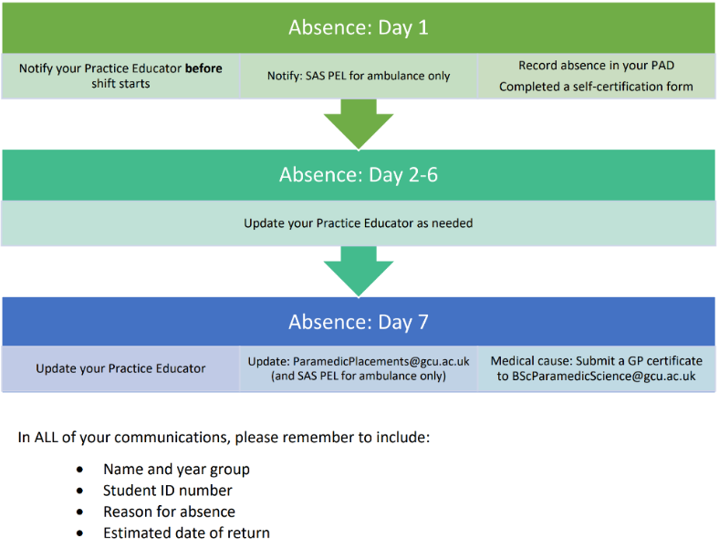
Absence Reporting
Students should follow the process shown.
If a student hasn’t notified you of an absence, please contact paramedicplacements@gcu.ac.uk and a member of the academic team will follow up.

Slide 13
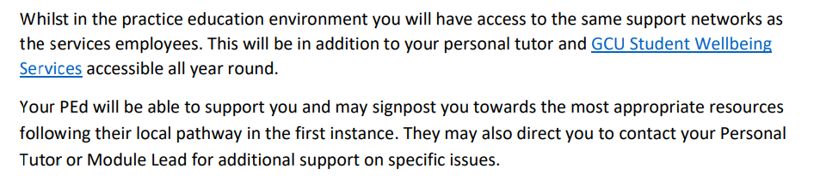
Welfare
Students are given the following advice per the Practice Based Learning Agreements in place between NHS GGC and GCU:
Please contact paramedicplacements@gcu.ac.uk if you are unsure.

Slide 14
Emergency Situations
If students have attended a traumatic event or something occurs whilst they are on shift that has impacted their ability to continue the shift/placement, AS SOON AS POSSIBLE students should:
Monday – Friday 8am – 4pm
  Contact paramedicplacements@gcu.ac.uk who will ensure they receive welfare support
  Nights and Weekends
  Students should be supported by their PEd and senior operational staff
  Immediately inform GCU PELs at paramedicplacements@gcu.ac.uk and they will follow up as soon as they are available

Slide 15
Placement Assessment

Slide 16
Placement Assessment
Students should complete and submit the following forms from their PAD:
Essential (ideally signed by PEd/mentor but not a requirement)
1 | Practice Setting Orientation
2 | Record of Attendance
3 | Learner Contract
Optional (should the PEd/mentor opt to provide additional feedback)
5 | Final Report
8 | Non-Technical Skills Assessment
11 | Signature Verification
All forms should be completed as soon as possible DURING placement – NOT left until after!

Slide 17
Essential Documents
All relevant documentation should be completed independently by the student. While it is not necessary for PEd/mentors to review/verify these, but comments and feedback are welcomed and encouraged where possible.

Slide 18
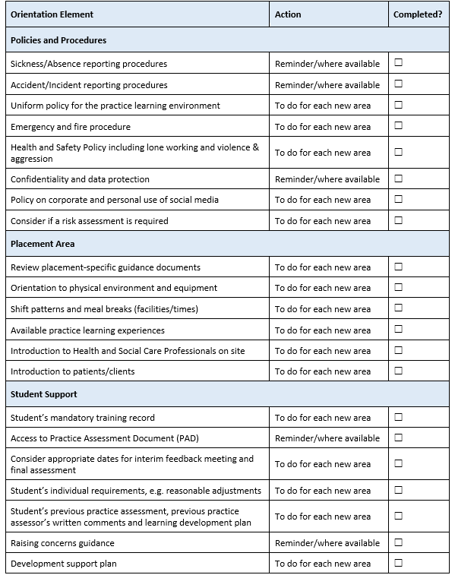
1. Practice Setting Orientation
Who Completes: The Student​
PEd Verification Needed?: No
​
Learners may need to ask specifically about some of these to ensure they are fully informed of procedures at the placement site.​
The key here is that students know the health and safe aspects of the site they are entering AND they have a plan with your Practice Educator about when specific records will be completed. ​

Slide 19
2. Record of Attendance
Who Completes: The Student​
PEd Verification Needed?: YES
​MUST be completed and submitted for each practice-based learning experience​
Students should record the number of weeks attended, and their cumulative hours for attendance monitoring/reporting purposes only​
Where there has been an absence, students MUST record this including the reason for the absence, the names of those this was communicated to, when this was reported and date of return (if applicable)​
This form MUST be verified by a relevant person on the placement to confirm it is a true record of attendance​

Slide 20
3. Learner Contract
MUST be completed at the beginning of every placement block
Initial sections are completed by the student
Completion of latter sections can be in collaboration with a practice educator or supervisor in the placement environment (NOT afterwards)
There are additional boxes (not shown in this picture) to allow for additional comments and verification of agreement.
The additional section also encourages the student to undertake a mini reflection on their experience
This does not require a signature from the cross-sector PEd

Slide 21
Optional Documents
PEds/mentors have the option of reviewing and signing these documents should they wish to provide additional feedback, but this is entirely optional. This has been added in response to requests from previous years’ PEds/mentors.

Slide 22
8. Non-Technical Skills Assessment
Can either be completed collaboratively between the PEd and the student, or the student can complete as a self-assessment. In either instance this must be signed and verified by the PEd.
The form also has an area for additional comments. This is particularly important to complete where students are assessed as 1 and 2 on any metric.
The marking criteria/scaling has been changed and simplified from the previous rubric to enable a fair and consistent approach to grading.
Scoring:
1 = Extremely poor for stage of learning
2 = Poor for stage of learning
3 = As expected for stage of learning
4 = Good for stage of learning
5 = Exceptional for stage of learning
Scoring of this should be considered against the stage of learning they are currently at, not to the level of a qualified and practicing paramedic

Slide 23
5. Final Report
This should be completed towards the end of the placement block. Initial sections are completed by the student
Latter sections should be completed by student and Practice Educator together
The final part requires the Practice Educator to verify whether the learning outcomes for the placement block have been achieved or not achieved.
These align to the assessment of safe practice and where the student is performing in relation to expected learning outcomes
Please ensure you include positive feedback, any areas for improvement, and future recommendations for progression
See next slide for guidance on achieved/not achieved grading

Slide 24
Achieved or
Not Achieved
5. Final Report:
These should all be considered within the context of the expectation for the placement and the learning outcomes
Any students with a ‘not achieved’ grading should have a robust final report which clearly identifies which learning outcome(s) have not been met and why

Slide 25
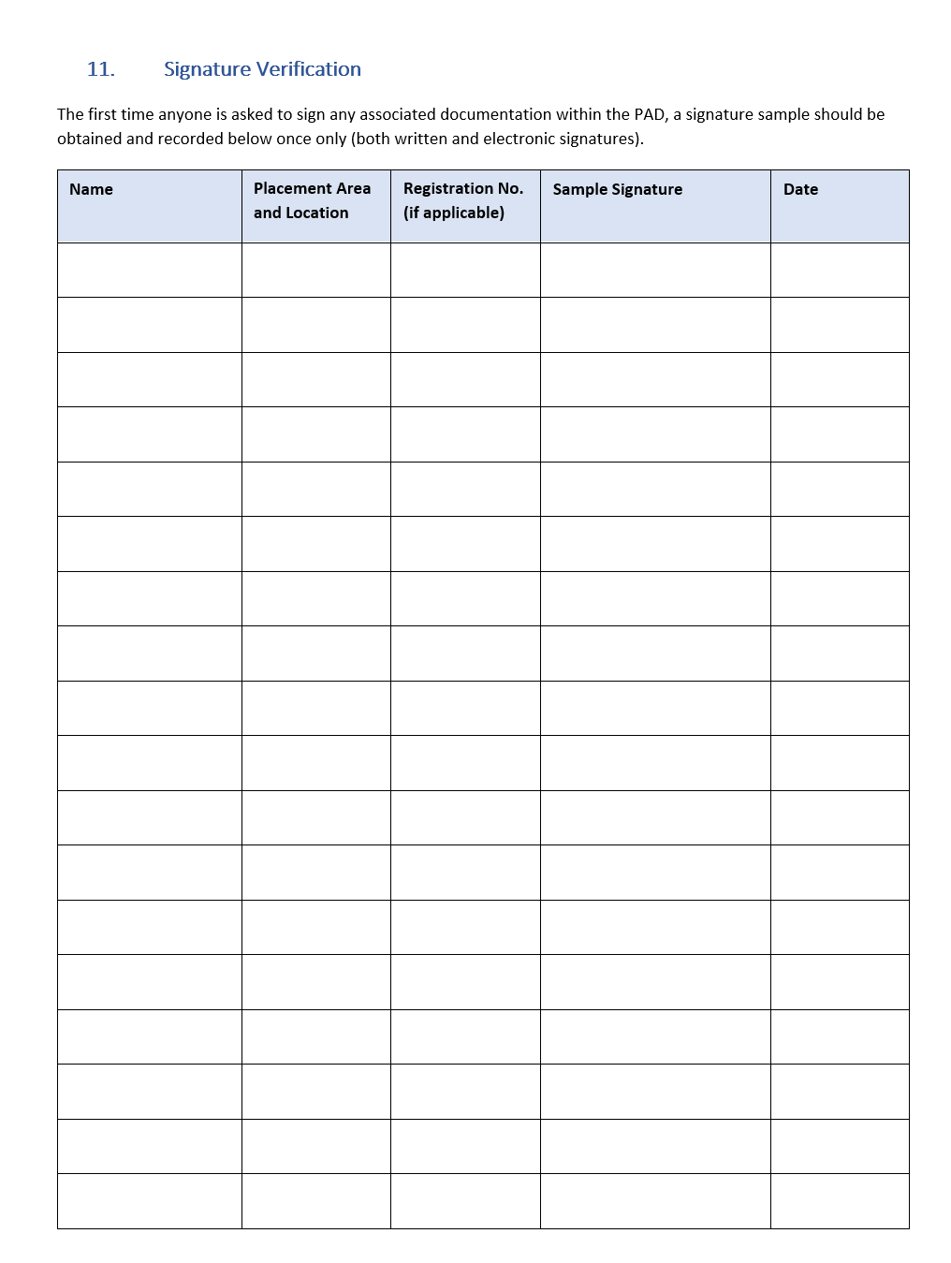
11. Signature Verification
The first time anyone is asked to sign any documentation in the PAD, a signature sample should be obtained and recorded one this document (once only).
This applies to both written and electronic signatures.

Slide 26
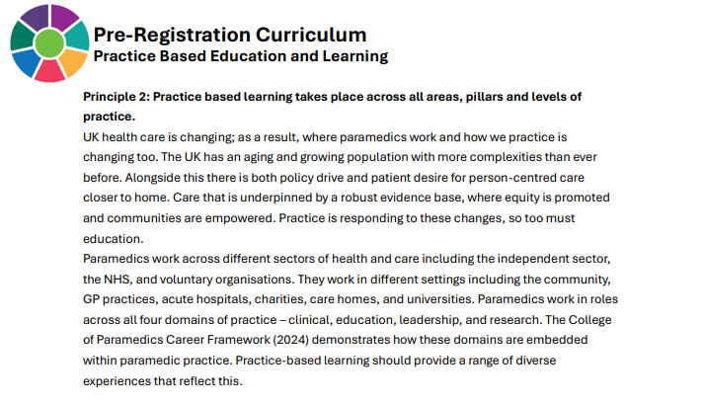
So, how is this marked?
This is not a graded placement, so students will not receive a mark.
However, it is essential for students to complete this placement to complete the programme and achieve the BSc award.
Click here for more information on the CoP Curriculum 6th Edition

Slide 27
Scope of Practice
With the consent of both the patient and clinician, students are permitted to practice clinical skills within their scope of practice under supervision of a suitably qualified NMC/GMC/HCPC registrant.

Slide 28
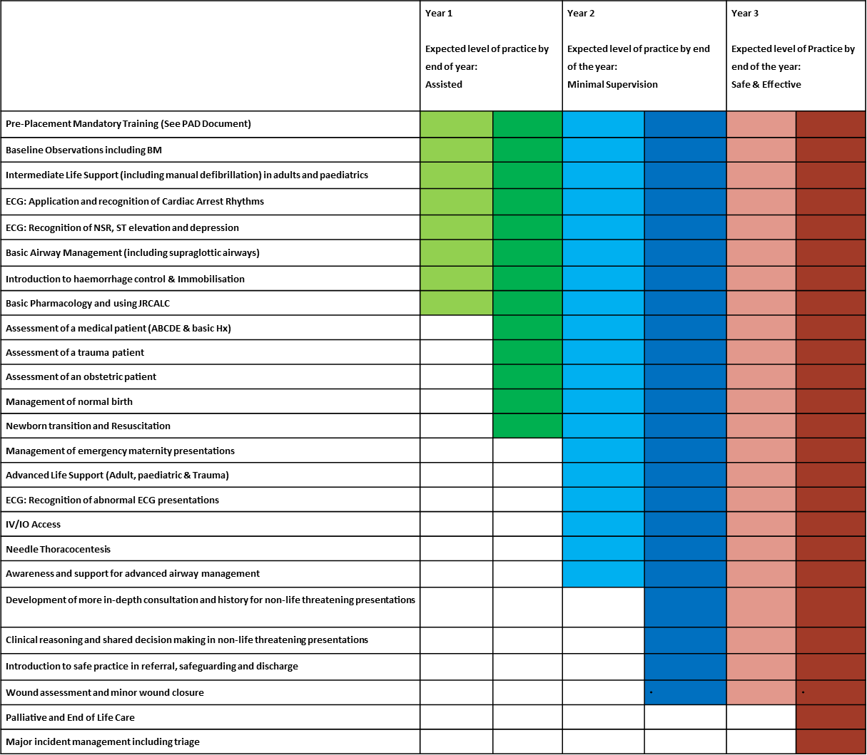
Scope of Practice:
Technical Skills
Students have undertaken learning and skills development in the following areas and should be encouraged to develop confidence in their application.
Please note that some learning may not yet have been covered where placement is timed before module teaching, for example Year 2 Tri B and Year 3 Tri A. This is due to placement capacity restrictions which we hope to address.

Slide 29
Airway Skills
Under the supervision of their practice education mentor, and if appropriate to the situation, students can practice the following airway skills:
Inspection
Using laryngoscopy if required
Clear Obstructions Suction and magills forceps
Positioning: Head tilt/chin lift, jaw thrust, ramping
Insert an appropriate adjunct: OPA/NPA
Prepare and insert an SGA:
iGel
Assist with endotracheal intubation
ASSIST ONLY: Not to be undertaken as primary clinician
Assist with needle cric
ASSIST ONLY: Not to be undertaken as primary clinician
In line with the agreement between all HEIs agreement, students will not be attending placements in theatres for the purposes of attaining a specific number of ETI procedures. Any placements in these areas will focus on a range of learning outcomes across airway, ventilation and patient management in intensive care settings.
The advanced skills of ETI and needle cric. are practised as primary clinician in simulation only. Can observe and assist with these skills in practice placement but not be independently performed

Slide 30
Resuscitation
Adult BLS
Paediatric BLS
Newborn Life Support
Traumatic Cardiac Arrest
Students have undertaken learning and skills development in the following areas and should be encouraged to develop confidence in their application
Students cannot deliver cardiac arrest drugs, but should be encouraged to develop knowledge of the regime and management of pharmacology during a resuscitation

Slide 31
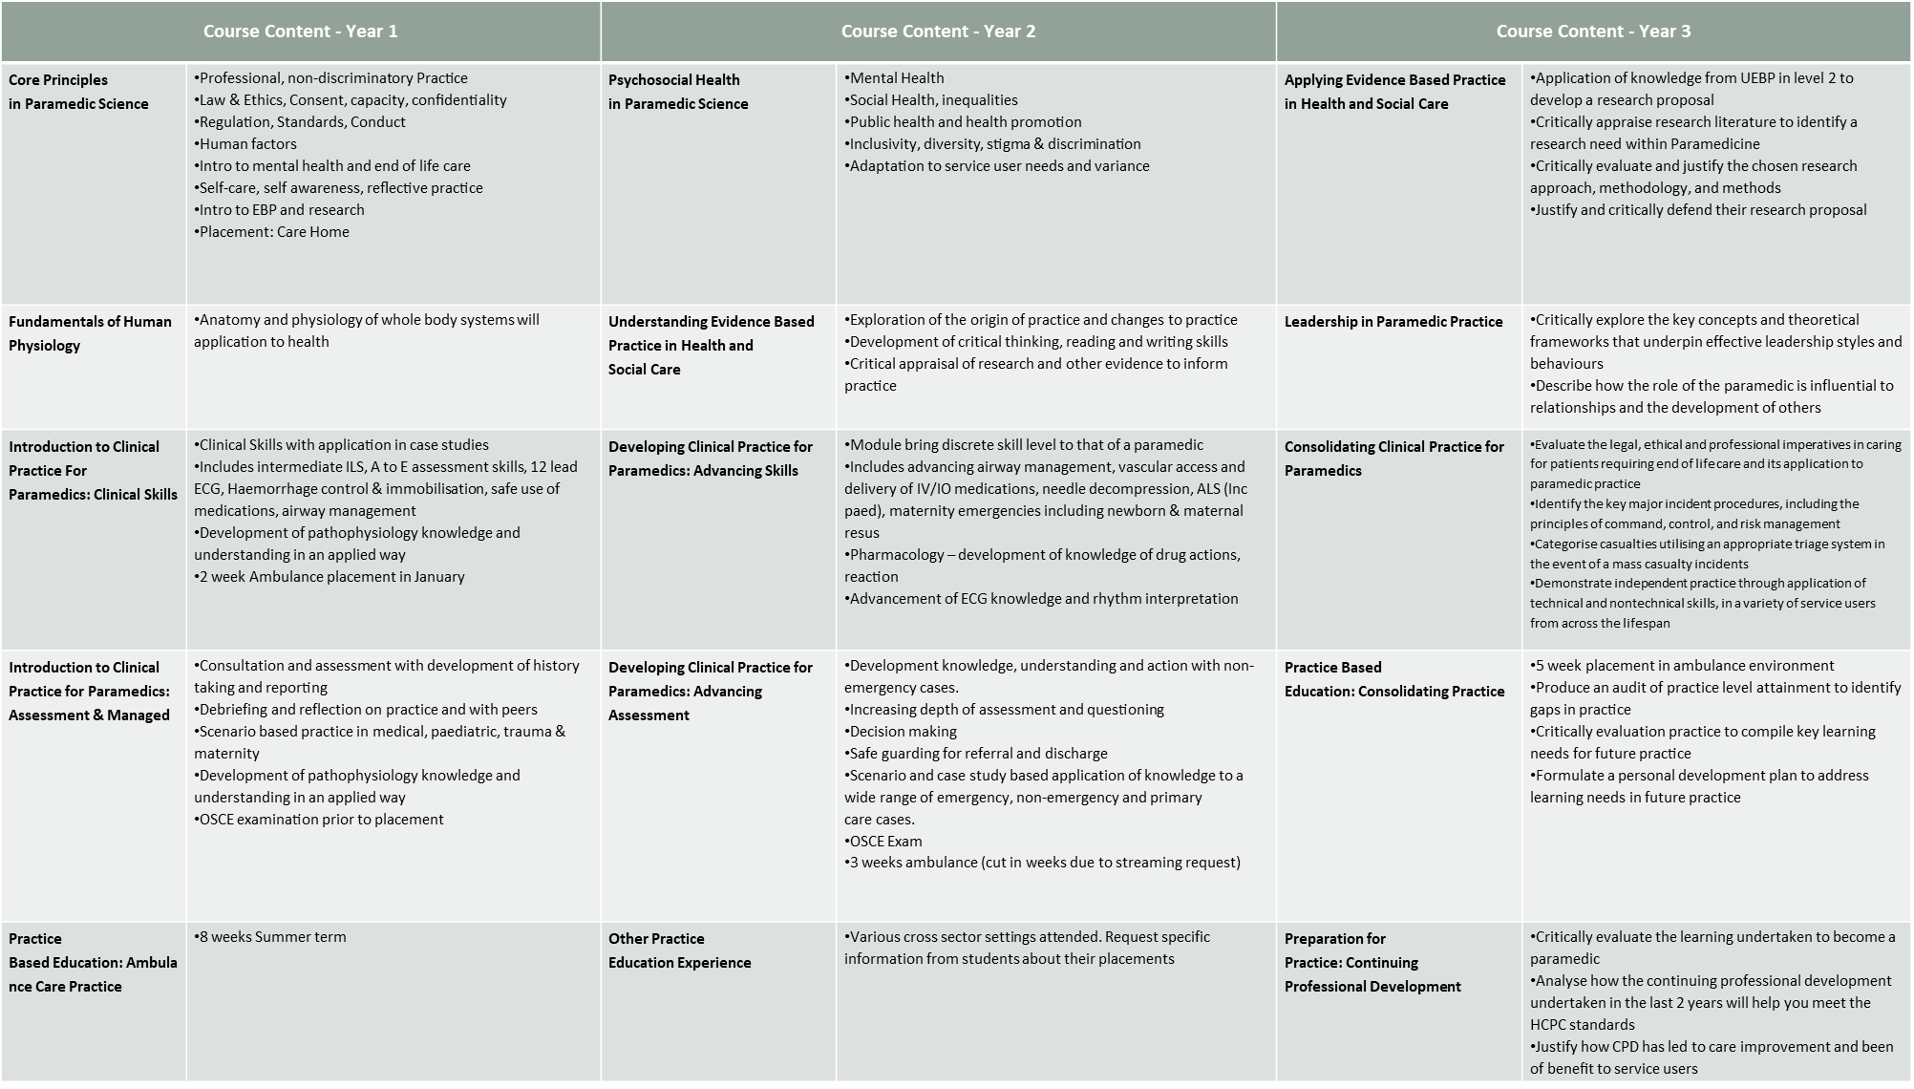

Slide 32
Any Questions?
If you have any questions, please feel free to e-mail paramedicplacements@gcu.ac.uk

