Slide 1
Leading a Diverse Workforce,
Delivering a Better Workplace
#ggcequality24

Slide 2
Learning Event Programme
8.30am | Registration, Networking and Coffee
9.00am | Welcome and Introduction
9.05am | Opening: Our commitment to Workforce Equality, Diversity and Inclusion | Dr Lesley Thomson KC, Board Chair
9.15am | Our Workforce Equality Plan: What are we doing to improve the experience of all staff | Anne MacPherson, Director of Human Resources and Organisational Development
9.30am | Key Note Speaker: Differences Not Disorders: Embracing Neurodiversity | Katie Forbes, Founder of Autistic Flair
10.10am | Comfort / Refreshment Break
10.40am and 11.30am | Break-out Sessions Reasonable Adjustments Women’s Health and Menopause Inclusive Recruitment Supporting Transitioning Staff Supporting International Staff Sexual Harassment: Cut It Out Staff Wellbeing for Diverse Teams | Helen Downie, Occupational Health Louise Carroll, Equality & Human Rights & June Ramsay, RNC Dr Mathew Pay and Heather Silvester, Recruitment Scott Johnson, Police Scotland May Parsons, Regional Director for Filipino Nurses Association UK Brian Keogh and Audrey Slater, L&E/ HR Becky Choat, SWAN Scotland
12.15pm | Panel Session: Best Practice in Workforce Equality, Diversity and Inclusion | Anne MacPherson, Katie Forbes and May Parsons
1.00pm | Close: Reflections on the Day | Jane Grant, Chief Executive
1.15pm | Lunch, Networking and Visiting our Stalls
WIFI Password: nhspatient
Twitter/X : #ggcequality24
Notes:
Liam’s background slide.

Slide 3
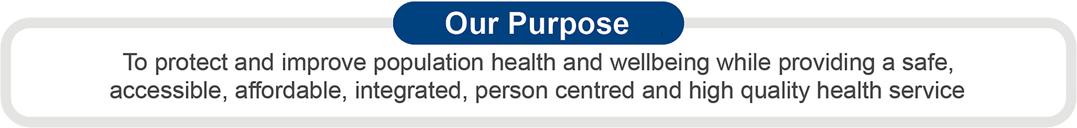
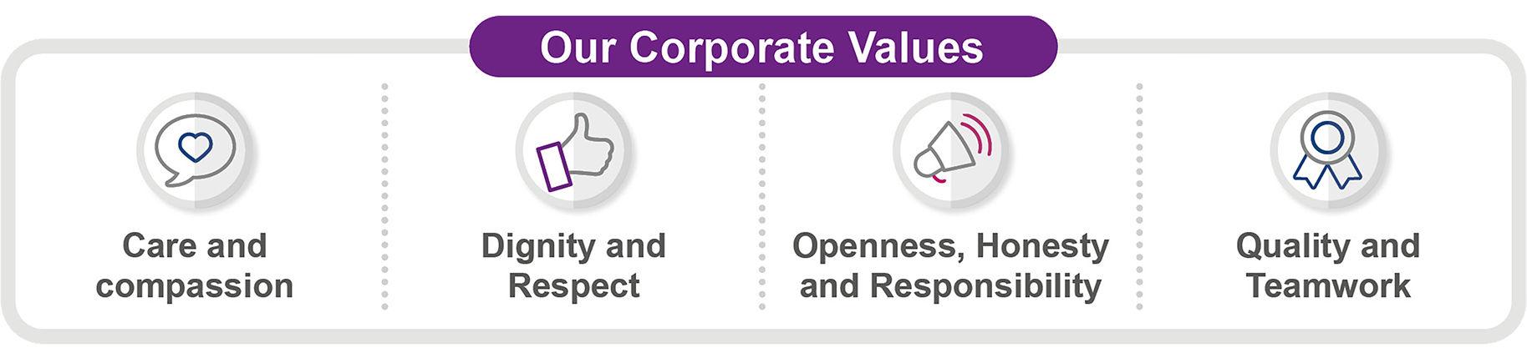
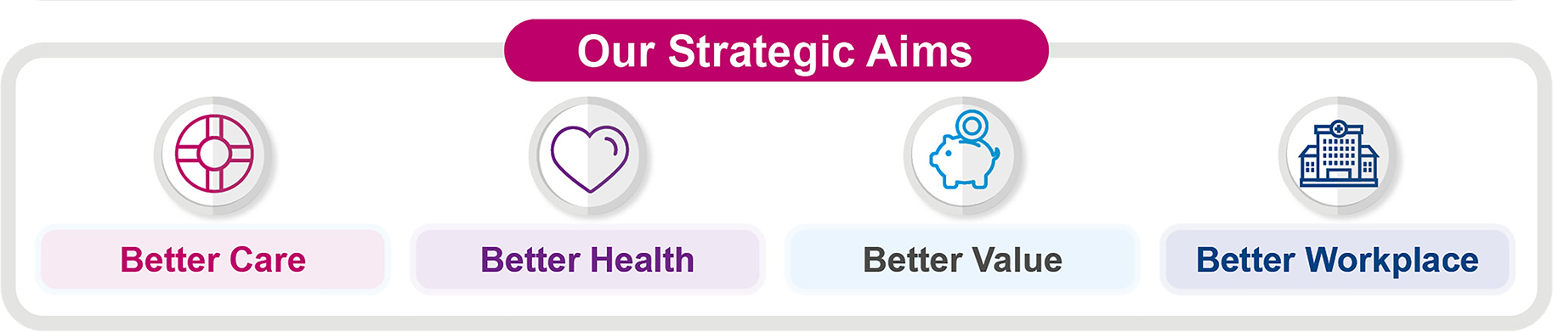



Notes:
Background slide for Lesley Thomson

Slide 4
Leading a Diverse Workforce,
Delivering a Better Workplace
Anne MacPherson, Director of Human Resources & Organisational Development
#ggcequality24

Slide 5

Our Diverse Workforce
NHSGGC has 41,000 employees of which:
5% are under 24 and 3% are over 65.
In 2023, we received over 250,000 applications for jobs from over 60 different countries
8% of our workforce have identified as BME, compared to 6.3% in 2023 and 13% of the population across our communities
Only 1% of our workforce record on eESS that they have a disability. iMatter information is 8%.
3% of our workforce have advised us they are LGBTQ+ iMatter information is 5%
79% are Female and 21% Male
Notes:
*Figures as of 1st January 2024

Slide 6

Why Workforce Equality, Diversity and Inclusion makes us a better organisation
Stronger Patient Care: Reflecting the communities we serve enables us to better understand our patient and service user needs and deliver culturally competent care.
Improved Innovation: Diverse perspectives spark creativity and lead to better solutions for healthcare challenges.
Employee Engagement: A culture of inclusion fosters a sense of belonging and can motivate staff, leading to higher engagement and productivity.
Legal and Ethical Obligation: NHSGGC is committed to upholding equality legislation and creating a fair workplace for all.
Investing in workforce equality, diversity and inclusion is not just the right thing to do, it's essential for delivering excellent patient care and achieving our goals.

Slide 7
Ensuring our Practice is Informed by the Lived Experience of our Staff
NHSGGC Board
Three staff led groups, championing and advocating on behalf of staff with protected characteristics. Other staff groups include Neuro-divergent, Carers and Supporting our Armed Forces(reservists and veterans)
Over 500 staff, sharing their lived experiences, enabling us to improve our guidance and support.
Board level, non-Executive champions aligned with each group and strong commitment through our Board
Workforce Equality Group, chaired by the Director of Human Resources & Organisational Development, with partnership representatives and the chairs of the staff led groups.
Staff Governance Committee
Corporate Management Team
Area Partnership Forum
Workforce Equality Group
BME Network
Staff Disability Forum
LGBTQ+ Staff Forum
Neuro-Diversity Sub-Group

Slide 8
Workforce Equality Plan –
Strategic Aims
1
Our staff are treated fairly and consistently, with dignity and respect, in an environment where diversity is valued.
2
Our data collection is legally compliant and is used to improve equality and diversity of our workforce.
Promote and advocate our equality commitments to the attraction, development, retention and career advancement opportunities of all employees within our diverse workforce
3
4
We have taken all the actions in our control to reduce equal pay gaps by sex, disability and ethnicity.
5
Staff from equality groups are fully engaged in contributing to the Workforce Equality Group.

Slide 9

Building the Trust and Confidence of Our Staff that we are Listening
Organisations where staff find it easy and feel safe to Speak Up have a better motivated and engaged workforce, retain staff for longer and deliver better outcomes for their customers through continuous learning & innovation.
Our Speak Up programme empowers staff through creating platforms for staff to voice concerns
We ensure a range of support is in place from Whistleblowing to Peer Support, to meet different needs.
Psychologically safe environments are key to ensuring safety and quality
Staff with disabilities, BME staff or other protected characteristics can often feel more vulnerable when raising issues or stepping forward with suggestions.
Current programmes to underpin speaking up for specific groups are underway Sexual Harassment: Cut It Out and Anti-racism.
A key role for all leaders is to promote Speak Up across all teams and ensure staff feel supported to raise issues.

Slide 10
Sexual Harassment: Cut It Out
Empowering our staff. Empowering staff to work in a safe space, free from intimidation.
Protecting our patients. Staff who feel valued and respected are more likely to deliver exceptional care to our patients.
Embedding our values. "Cut It Out" ensures a workplace where everyone feels respected, regardless of their background or identity.
"Cut It Out" is not just a program; it's a statement. It's a statement that says sexual harassment has no place at NHSGGC. It's a statement that says we value our staff and are committed to creating a positive and productive work environment for all”
- Una Graham & Hazel Miller, co-chairs of the NHSGGC Medical Wellbeing Group

Slide 11
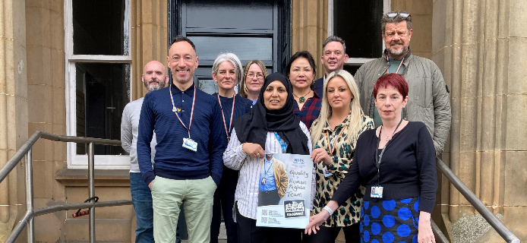
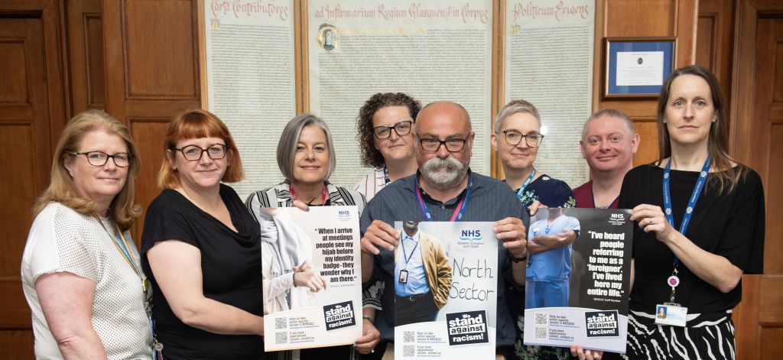
NHSGGC: An Anti-Racism Organisation
Front line assessment tool to recognise racism and discrimination and support teams to develop the means to eliminate it.
NHSGGC’s ‘We Stand Against Racism’ campaign which is visible in patient facing areas
Maternity services challenging racism and creating equitable health outcomes for BME women.
Equality e-learning module informing anti-discriminatory practice and improve patient experience sits above 90% of total workforce completion.
NHSGGC’s ‘Equality Law – A Manager’s Guide to Getting it Right in NHSGGC’ sets compliant patient care by each protected characteristic.
An annual and visible celebration of Black History Month and South Asian Heritage Month, co-created and delivered in partnership with our BME Network.
A dedicated leadership programme for BME staff, to facilitate the promotion of more BME staff into senior positions.
From 2024, specific anti-racism objectives incorporated into all Executive And Senior Managers Objectives

Slide 12
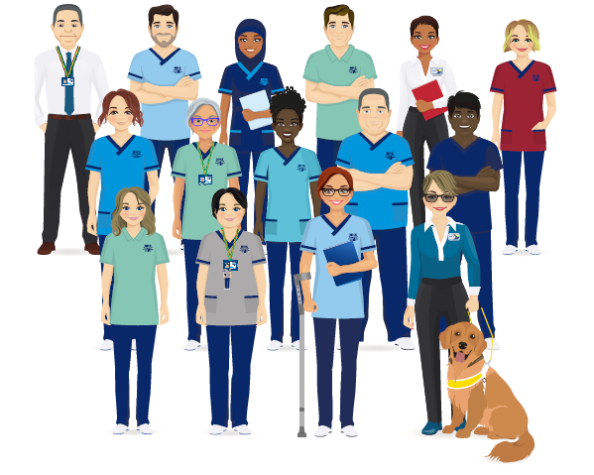
Ensuring all Staff are Treated Fairly and Consistently
Reasonable Adjustments: New guidance implemented, with clearer advice for managers and an updated Workplace Adjustment Passport to support conversations
Training for all managers: Tutor led training piloted in the spring with great feedback. Developing programme for full roll out later this year.
Improving Accessibility: Through our Clear to All Policy, within our systems and via our new Staffnet Intranet
Carer Positive: Established level achieved for the organisation, with a new online community for staff who are carers
Armed Forces: NHSGGC recognised as a Gold Employer of staff who are part of the armed forces family (Veterans, Reservists, family members)

Slide 13





Attract, Develop and Retain Staff Across our Diverse Workforce
BME Leadership programme – 60 participants now completed
A consistent approach to Succession Planning at all levels of the organisation
EDI content integrated into all leadership programmes such as Medical Managers or our Induction Pathway for New Managers
New Recruitment Policy, with training required and rolling out for all recruitment panels
Continuous improvement in the % of protected equalities data we hold – but still lots to do. Please encourage your staff to keep their eESS up-to-date.

Slide 14
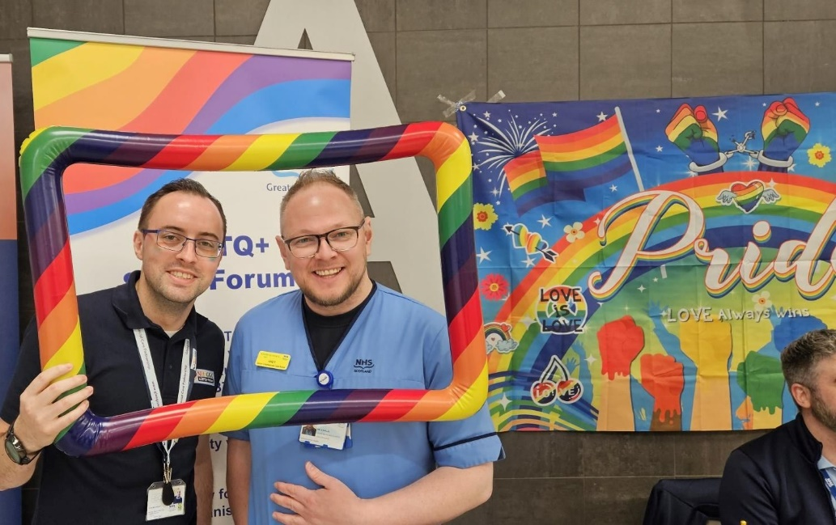
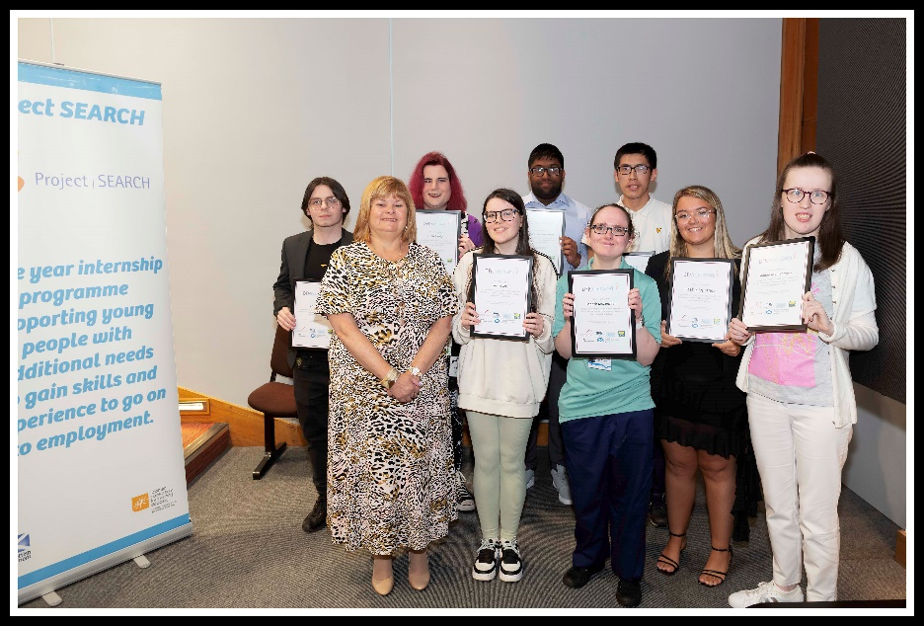
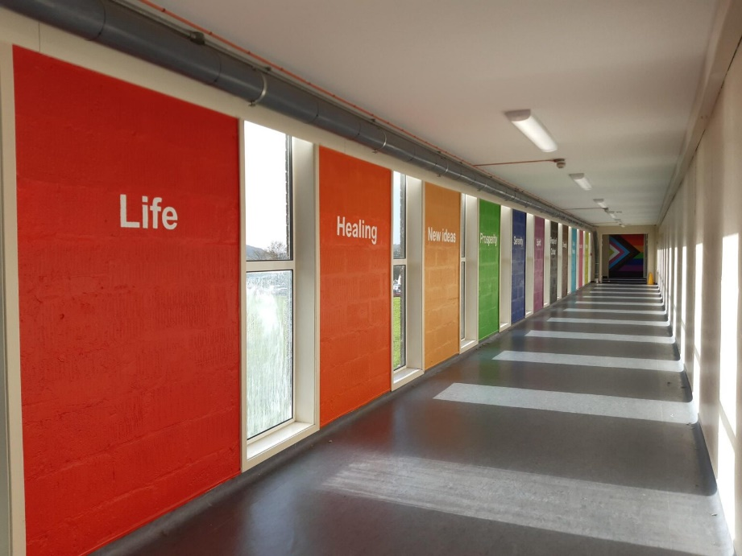
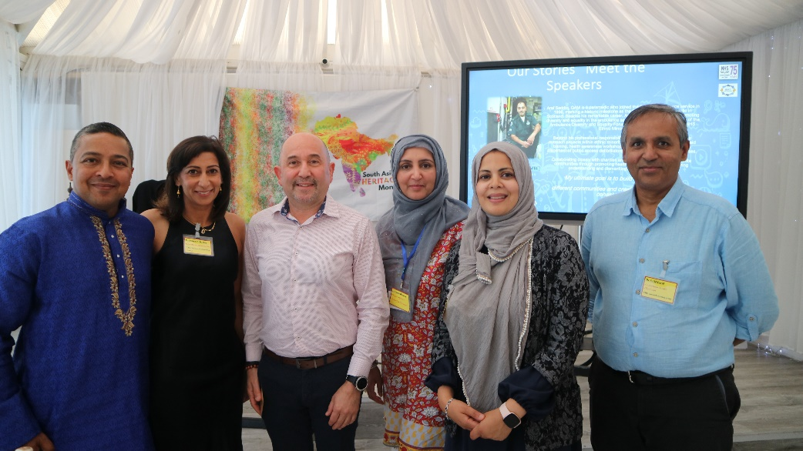
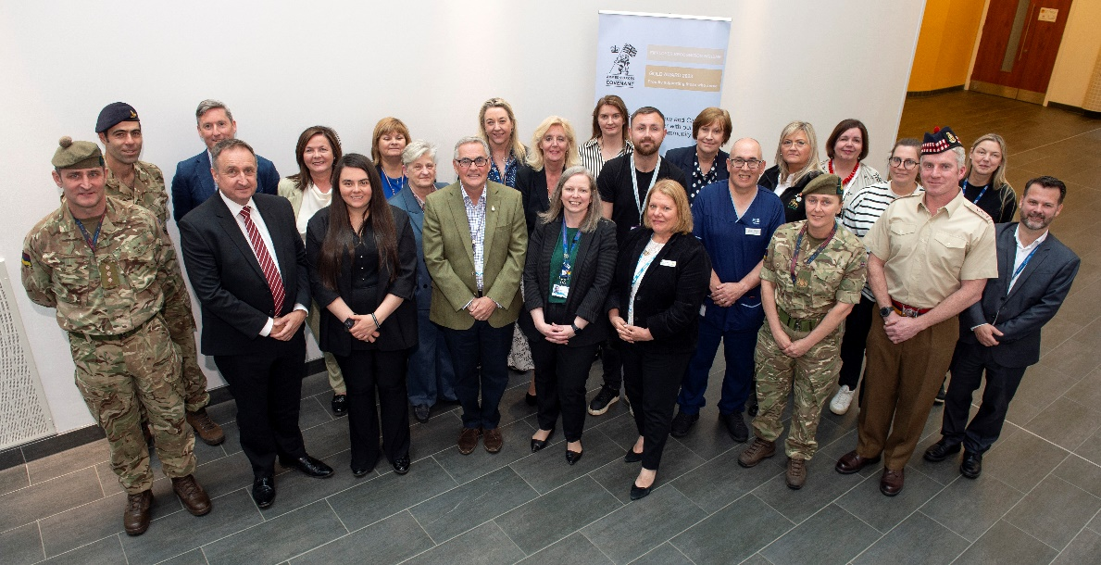
Promoting an Inclusive WorkPlace
Notes:
Pride 2024
Project Search 2024 Graduates
Art works celebrating inclusivity at the IRH and QEUH.
South Asian Heritage Month
Armed forces event celebrating our reservists.

Slide 15




Benchmarking with National
Best Practice – Our Achievements

Slide 16
Our Ask Today
Consider how you put the voice of staff at the heart of what we are doing, respecting and understanding their different needs
Consider what you can do in your teams and departments to embed an inclusive, people centred approach
Reflect on what you hear and be our equality advocates
Tweet / X using the hashtag #ggcequality24 to show your support for today
Enjoy our Learning Event.

