Slide 1
New Student Induction-GGC line managers
The Open University
Margaret Crowley, Staff Tutor, NHSGGC
School of Health, Wellbeing and Social Care
October 2023

Slide 2
Outline of session
Introductions
Presentation
Questions and Discussions

Slide 3
Welcome
to the
Future Nurse Curriculum
The Open University has offered pre-registration nursing programmes since 2002
NMC approved programme Future Nurse, Standards of proficiency for registered nurses
Offers all 4 fields of practice
Programme delivered in partnership with a wide range of health and social care partners​
Commissioned and funded by Scottish Government
Backfill monies​
…
Notes:
This is the start of your journey toward professional registration with the Nursing and Midwifery Council. ​
The programme offers adult, mental health, children & young people and learning disability pathways. ​
In May 2018, the Nursing and Midwifery Council (NMC) published, Future Nurse, Standards of proficiency for registered nurses: ​
The programme has been designed to apply across all four fields of nursing practice (adult, children & young people, learning disabilities, mental health) and across all care settings.​
Registered nurses must be able to meet person-centred, holistic care needs of all individuals across the lifespan including mental, physical, cognitive or behavioural health challenges. ​
You will have opportunities to learn in placement experiences and gain insight in these beyond your own field of practice. ​
​

Slide 4
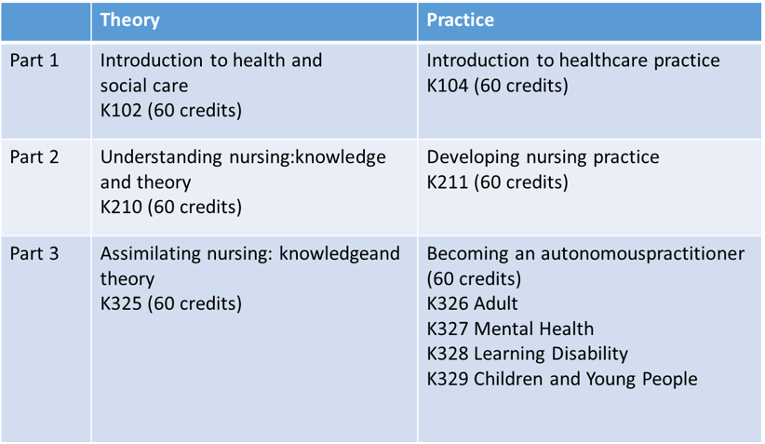
Programme Structure

Slide 5
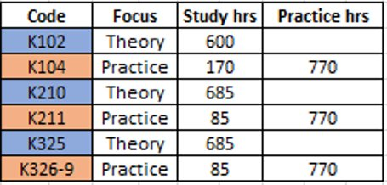
4 year plan

Slide 6
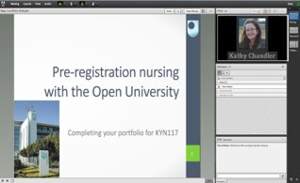
Adobe Connect
Your tutorials will take place in our online rooms, using software called “Adobe Connect”. ​
Links to joining the tutorials will be on the tutorials page for your module.​
Notes:
You can think of these as virtual meeting rooms, where you can talk (by voice or text) to other students and tutors, and see material shared by the tutor, have a go at online polls, contribute your thoughts and ideas in discussions and sometimes work in small groups with other students. ​
​

Slide 7
Student support – Help centre
Notes:
When students access the Help Centre tab from StudentHome, as well as finding a ‘Search the Help Centre’ box top right, there is also this set of links to different Help topics.

Slide 8
Students with credit migration or transfer |  | Stage 1 – K104 commences March 2024
 |  | Stage 2 – K210 commences Feb 2024
 |  | Resources provided to prepare for study
Notes:
For those who are not starting on K102. Credit transfer (RPL) = successful study at another institution that can be used towards OU study. Credit migration = previous achievement of K101/102 etc.

Slide 9
Introducing Health and Social Care: K102
About the module:
60 credit module​
OU level 1​
8 month duration​
Four nations approach​
Online throughout​
Strong focus on theory​
Open Studio (real time discussions)​
Online discussions​
Extension and review activities​
Nursing and social work activities​
Notes:
Open Studio – real time discussions

Slide 10
Module structure
Block 1
Informal and formal care
Block 2
Sociology of health and social care
Block 3
Human development across the life course
Block 5
Vulnerability and risk
Block 6
Digital technologies and innovation
Block 4
Context and structure of health and social care

Slide 11
Introduction to Healthcare Practice: K104
About the module:
60 credit module
Practice-based module
16 learning guides alongside work-based practice
Student Practice Assessment Document (PAD)
Introduction to Principles of Enquiry Based Learning (EBL)
​

Slide 12
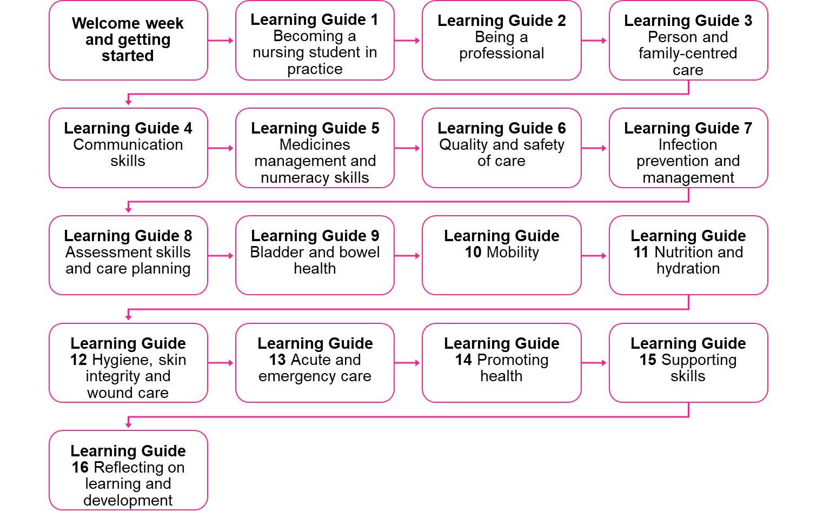
Module structure

Slide 13
Preparing for academic study
Get familiar with ‘Study skills’
Time management
Reading skills
Making notes
Writing skills
Functions in Word
Naming and saving files​

Slide 14
Student responsibilities
Professionalism
Tutors work part-time
Your learning, shared responsibility
Student Charter
Communication is key!

Slide 15
Employer / line manager responsibilities
Effectively utilise SG funding to facilitate student learning:
Supporting study time
Facilitate student placements and attendance at tutorials / EBL sessions throughout the programme
Supporting PAI (Practice Assessment Interview)
Name badges and uniforms
Liaise with the board employer link as required

Slide 16
Completing assessments
eTMA system (electronic Tutor Marked Assessment)
Check the cut-off dates
Plan ahead
Follow all the guidance
Consider the marking criteria
Submit the correct file
No extensions for iCMAs (interactive Computer Marked Assessments) or EMAs (End of Module Assessments)
Seek support from your module tutor
Notes:
Students can submit a dummy TMA by following guidance reached from the link on their module website labelled ‘online TMA/EMA service’. This checks they are using the system correctly, the tutor collects the dummy TMA and returns it to the student - student can also test the ‘Collect’ element of the system.
Students must check their study calendars and Assessment resources, both give dates for submitting TMAs or interactive computer marked assignments.
This enables them to plan ahead to allow sufficient time to complete required learning before tackling assignments. It also enables flexibility so that where a student is going to be e.g. on annual leave at the time of handing in an assignment they can complete and submit in advance.
Most TMAs have detailed guidance and it is essential students read all the guidance and don’t just attempt to respond to the assignment question, using their own interpretation of what is required.
Students are encouraged to look at the marking criteria grid, which will help them determine for themselves the level of pass they are likely to achieve.
There is good evidence that students do submit the wrong files to the TMA system. This usually arises from poor file labelling.
There are no extensions for EMAs. If a student has concerns about completing their EMA they should contact their Staff Tutor to discuss the best way forward.
If students need additional support and advice at any time about assignments they should contact their module tutor. Emphasise that it is not the role of their mentor or their practice tutor to advise them about their assignments.

Slide 17
Support available
Further support
Practice Tutor / Academic Assessor
Library
IT Helpdesk
Student Home
Student Support Team
Module Teams
Employer Link
Academic / Module Tutor
Practice Assessor
Staff Tutor / Local Nursing Lead
Student
Practice Supervisor
Student Support Teams
Peer to peer support
Community of learning
OU Staff
NHS Staff
Learners
Notes:
Highlight PT role in placements – this is an OU staff member.
PT will contact the student, arrange an introductory meeting and meet once per placement. PAI in 2nd placement in each stage.

Slide 18
Learning in practice
2300 hours of practice must be achieved across the programme
770 hours to complete in each stage
Practice learning experiences are carefully planned to enable you to meet NMC competencies

Slide 19
Learning in practice
Placements occur within a “window” of time (dates)
OU works with employer links and other university placement teams to organise placements
3 PLEs in each level (Placement Learning Experience)
770 hours split into 3 PLEs:
2 complimentary
1 in base area
Example if full time:
PLE1: 250 hours = 7 weeks
PLE2: 250 hrs = 7 weeks
PLE3: 270 hrs = 7 weeks
Include breaks in clinical hours
Notes:
Highlight that the number of hours they work as a HCA will have been agreed with them by their employer. This varies among all nursing students because of their own circumstances and the requirements of their employer.
In order to stay on track it is important that the required number of practice hours for a practice period is completed within that period. However, in exceptional circumstances there will be some flexibility. Changes to arrangements must be discussed with their Practice Tutor and may be referred on to the ST.
Students must complete nursing practice hours across all days of the week and must also work some weekends. They should aim to complete one Saturday or Sunday per practice learning period.
If students have allocated theory days, they must make effective use of this time. It is not acceptable to have an allocated theory day and then work a bank shift for another part of their organisation or elsewhere. This is fraudulent and the student could find himself or herself being disciplined by their employer, with a potential to lose their HCA job and therefore their ability to continue with their nursing studies. Some students complete their theory hours entirely in their own time, so again need to be organised with the way in which they use this time.
Annual leave is always negotiated with their line manager. Annual leave on the study calendar is indicative only and does not have to be taken during the weeks indicated. Annual leave is also indicated on the practice learning pathways. Students should aim to negotiate weeks of leave within practice learning periods as indicated in the pathways in order to stay on track with completing their leave.

Slide 20
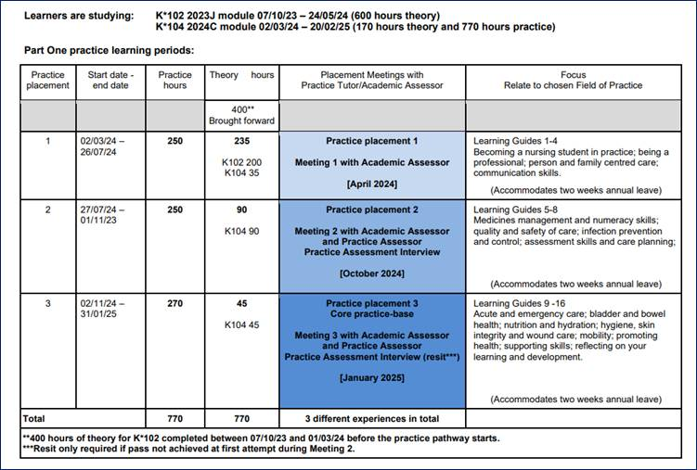
Practice placement windows: Stage 1

Slide 21
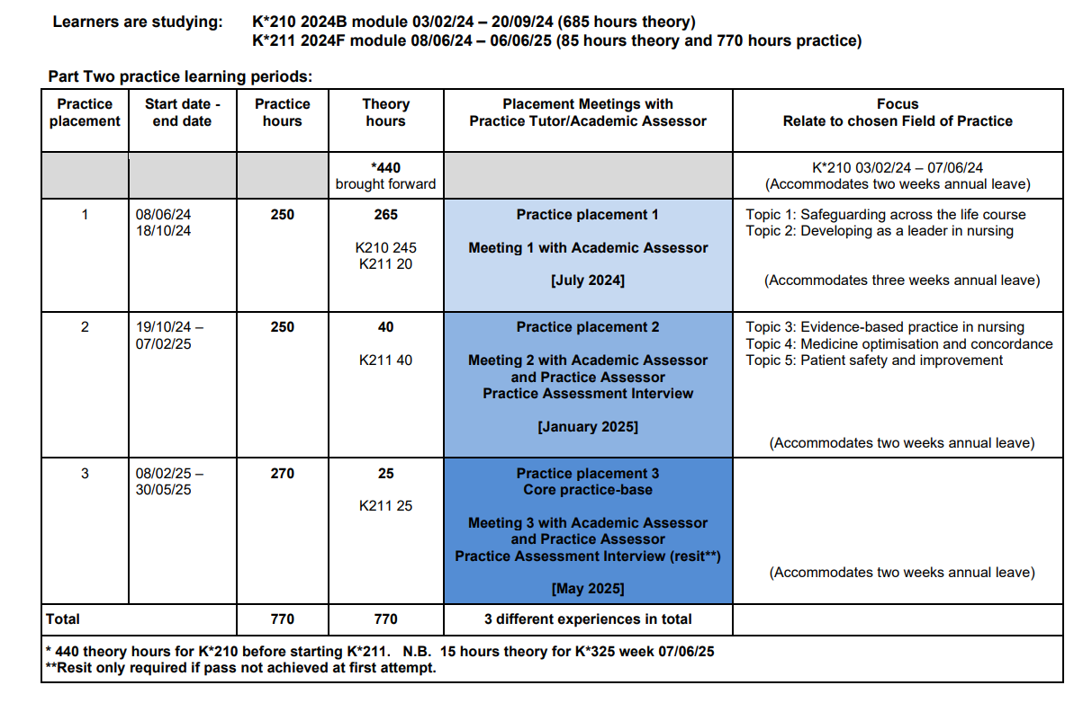
Practice placement windows: Stage 2
This is relevant for anyone who has completed either:
K102 & K104 (standalone)
T01 Certificate in Higher Education Healthcare Practice
Credit transfer awarded for K102 and K104 from another organisation
Enrol in October, K210 commences in February

Slide 22
Supernumerary status
While on practice learning experiences (PLEs):
you are not rostered as part of the workforce team
you will be closely supervised by practice supervisors
you have a legal right to practise as a nursing student
Notes:
Being supernumerary enables students to capitalise on learning opportunities as and when they arise.
As HCAs they often have to escort patients to other services for investigations or interventions. However, having safely delivered patients they then have to return to their team or ward.
As a nursing student, this is an opportunity to find out more about the investigation, watch what happens, ask for explanations about results etc. Or see the interventions delivered by other healthcare practitioners. This helps them to gain a holistic understanding of the patient’s condition and needs.

Slide 23
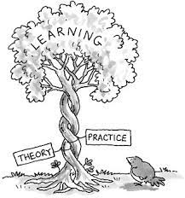
Learning in practice
Work your contracted HCSW hours whilst on placement as a student nurse unless agreed by Staff Tutor/employer link (minimum 26hrs / wk)
Complete your practice hours as allocated on QMPLE
Work the normal working pattern of your placement (night shift, weekends)
Awareness of unsocial hours payments
Complete theory in any allocated study hours and in your own time
Study leave is negotiated with your line manager -
Plan your annual leave with your line manager - Annual leave cannot be taken when on placement.
Notes:
Highlight that the number of hours they work as a HCA will have been agreed with them by their employer. This varies among all nursing students because of their own circumstances and the requirements of their employer.
In order to stay on track it is important that the required number of practice hours for a practice period is completed within that period. However, in exceptional circumstances there will be some flexibility. Changes to arrangements must be discussed with their Practice Tutor and may be referred on to the ST.
Students must complete nursing practice hours across all days of the week and must also work some weekends. They should aim to complete one Saturday or Sunday per practice learning period.
If students have allocated theory days, they must make effective use of this time. It is not acceptable to have an allocated theory day and then work a bank shift for another part of their organisation or elsewhere. This is fraudulent and the student could find himself or herself being disciplined by their employer, with a potential to lose their HCA job and therefore their ability to continue with their nursing studies. Some students complete their theory hours entirely in their own time, so again need to be organised with the way in which they use this time.
Annual leave is always negotiated with their line manager. Annual leave on the study calendar is indicative only and does not have to be taken during the weeks indicated. Annual leave is also indicated on the practice learning pathways. Students should aim to negotiate weeks of leave within practice learning periods as indicated in the pathways in order to stay on track with completing their leave.

Slide 24
Preparation for placements
Ensure Mandatory training is up to date prior to placement.
Discuss any issues with Staff Tutor
Familiarise yourself with local policy and procedures, including Covid-19
Inform Staff Tutor of any reasonable adjustments for practice
Mandatory Training
Policies and Procedures
Reasonable adjustments

Slide 25
Scottish Practice Assessment Document (PAD)
Scotland wide assessment document used by student nurses at all universities in Scotland
Hard copy sent to your home address
Evidence and record achievement of proficiencies and nursing skills
Record practice-based assessments

Slide 26
Key messages
Keep in regular contact with your Module tutor and PT/AA
Your PT will contact you for an introductory session and meet you in each placement
Use the Student BSc (Hons) Nursing Handbook as a resource: it contains important guidance
Access and use your OU email address (needed for QMPLE and Turas)
Make use of help available via student home page
Ask for help if struggling – we are here to support you
Achieve success in your studies by careful planning

