Slide 1
One Good Adult
Who might yours be?
Notes:
Introduction (5 mins)
COVID-19 has touched everyone and for some the affects have been overwhelming and many are struggling with their mental health. It is important that we take care of our mental health just like we do our physical health. Having a one good adult or adults can help us through difficult and challenging times. This activity session will look at what a one good adult is, what qualities should a one good adult have and get you to think about who yours might be.

Slide 2
One Good Adult
https://youtu.be/nuEHXTQNE-k

Slide 3
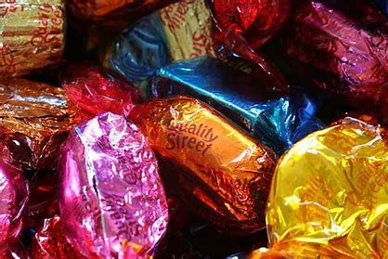
What are the qualities of a one good adult?
Good listener
Non-judgemental
Compassionate
Kind
Open minded
Believes in the young person
Warm……..

Slide 4
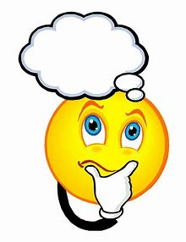
Who is your one good adult(s)?

