Slide 1




Create and Prosper Financial Services Ltd.
SPPA/NHS Pension Information Session
Create and Prosper Financial Services Ltd is authorised and regulated by the Financial Conduct Authority. FCA Number 520631

Slide 2
Our brief
To deliver information relating to pension tax charges and REC
Fairly wide scope……….
If you need specific Financial Advice speak to a Financial Adviser
Create and Prosper Financial Services Ltd is authorised and regulated by the Financial Conduct Authority. FCA Number 520631

Slide 3
Framework
SPPA/NHS Pension Schemes - How They Work/Overview
The Annual Allowance and Tapered Annual Allowance
The Lifetime Allowance
Tax Charges
How Scheme Pays works
Protections
Create and Prosper Financial Services Ltd is authorised and regulated by the Financial Conduct Authority. FCA Number 520631

Slide 4
Background to The Session
NHS employees hit with large/unexpected tax bills
Information overload/rumours
Many are unaware of where or who to turn to
Your employer is not allowed to provide Financial Advice
Rules are from HMRC not SPPA
Create and Prosper Financial Services Ltd is authorised and regulated by the Financial Conduct Authority. FCA Number 520631

Slide 5
Some Sources of Information
SPPA – pensions.gov.scot/nhs
Mypension – mypension.sppa.gov.uk
BMA – bma.org.uk
HMRC – gov.uk
Pensionwise – pensionwise.gov.uk
Word of mouth/rumours/forums/blogs/internet
Applying general information to your personal situation
Some of the media
Create and Prosper Financial Services Ltd is authorised and regulated by the Financial Conduct Authority. FCA Number 520631

Slide 6
The SPPA Pension – Different Schemes
1995 scheme – If joined before 1/4/08
1/80th of final pensionable pay and 3/80ths tax free lump sum
2008 scheme – 1/60th with no automatic lump sum
2015 scheme – CARE 1/54th with no automatic lump sum. Accrual of CPI plus 1.5% per year
Create and Prosper Financial Services Ltd is authorised and regulated by the Financial Conduct Authority. FCA Number 520631

Slide 7
The SPPA Pension – Contribution Rates
Employer contribution 20.9% of pensionable earnings
Employee contribution rates -
Tier | Column 1 Pensionable earnings band | Column 2 Contribution percentage rate
1 | Up to £21,614 | 5.2%
2 | £21,615 to £25,981 | 5.8%
3 | £25,982 to £32,914 | 7.3%
4 | £32,915 to £66,017 | 9.5%
5 | £66,018 to 92,423 | 12.7%
6 | £92,424 to 123,147 | 13.7%
7 | £123,148 and above | 14.7%
Create and Prosper Financial Services Ltd is authorised and regulated by the Financial Conduct Authority. FCA Number 520631

Slide 8
The SPPA Pension – Where Are We Now
Concerns about tax charges
Lack of control for scheme members
Why should I work? Reducing hours?
Opting out?
Temporary Fix – from 1st October 2022 until 31st March 2023 (REC)
Any longer term changes require the consent of HM Treasury
Create and Prosper Financial Services Ltd is authorised and regulated by the Financial Conduct Authority. FCA Number 520631

Slide 9
The Annual Allowance
£40,000 for 2022/23 tax year but can taper down to £4,000 depending on income
For Defined Benefit pension schemes (e.g. SPPA/NHS) – this applies to the increase in value of someone’s pension benefits using “deemed growth rate”
For Defined Contribution pension schemes (e.g. AVC/Personal Pension) – contribution level
The Annual Allowance includes the total of all individual contributions, employer contributions plus any third party contributions into someone’s pension
When the Annual Allowance is exceeded during a single year, a tax charge is applied on excess
Create and Prosper Financial Services Ltd is authorised and regulated by the Financial Conduct Authority. FCA Number 520631

Slide 10
The Annual Allowance
Just to make things more complicated, an individual’s annual allowance isn’t always £40,000
The level depends on whether an individual has accessed their pension benefits flexibly (in which case their allowance is reduced to £4,000) – Money Purchase Annual Allowance applies
Someone’s adjusted income is over £240,000 and their threshold income is over £200,000
the Tapered Annual Allowance then applies
By earning over £240,000, your individual annual allowance will reduce by £1 for every £2 of adjusted income over £240,000 (down to an absolute minimum AA of £4,000)
Create and Prosper Financial Services Ltd is authorised and regulated by the Financial Conduct Authority. FCA Number 520631

Slide 11
The Tapered Annual Allowance
Threshold Income of £200,000
Includes -
Total income, including salary sacrifice pension arrangements
Deducts
Any individual pension contributions made during the tax year
Certain taxable reliefs – i.e. charitable donations made
Create and Prosper Financial Services Ltd is authorised and regulated by the Financial Conduct Authority. FCA Number 520631

Slide 12
The Tapered Annual Allowance
Adjusted Income of £240,000
Includes -
Taxable Income (see Threshold Income)
Any employer contributions made to a pension (including salary sacrifice)
Any built up Final Salary benefits, excluding the cost of individual contributions
Deducts
Certain charitable donations i.e. gift aid
Create and Prosper Financial Services Ltd is authorised and regulated by the Financial Conduct Authority. FCA Number 520631

Slide 13
The Tapered Annual Allowance
If Threshold Income is not breached (£200,000)
Tapering does not apply, even is Adjusted Income is over £240,000. However if in excess of £40,000 Annual Allowance limit you may still receive a tax bill
If you exceed Adjusted Income
If over Annual Allowance – no tax relief on contributions over that limit and you will be faced with an annual allowance charge.
Annual Allowance charge added to your taxable income for the tax year in question when determining your tax liability.
If Annual Allowance charge is over £2,000, you can ask your pension scheme to pay the charge from your benefits. This means your pension scheme benefits would be reduced.
You may be able to carry forward any unused annual allowances from the previous three tax years, to reduce or eliminate annual allowance charge completely.
Create and Prosper Financial Services Ltd is authorised and regulated by the Financial Conduct Authority. FCA Number 520631

Slide 14
The Annual Allowance – Example 1
Worker aged 55 (DOB 01/12/1964) , started in NHS 30 years ago (01/12/1989), inflation is assumed to be 2%, salary at start of period was £80,000 and £81,000 at the end of the period.
Beginning of period – 29 years service, therefore 29/80 x £80,000 = £29,000
Uprate for inflation (x1.02) = £29,580
Lump Sum 3 x £29,580 = £88,740
At end of period -30 years service, therefore 30/80 x £81,000 = £30,375
Lump sum 3 x £30,375 = £91,125
Create and Prosper Financial Services Ltd is authorised and regulated by the Financial Conduct Authority. FCA Number 520631

Slide 15
The Annual Allowance – Example 1
Income £30,375 - £29,580 = £795 x 16 = £12,720
Lump Sum £91,125 - £88,740 = £2,385
Total Increases £12,720 + £2,385 = £15,105
Therefore as under £40,000 no Annual Allowance Tax Charge
Create and Prosper Financial Services Ltd is authorised and regulated by the Financial Conduct Authority. FCA Number 520631

Slide 16
The Annual Allowance – Example 2
Worker aged 45 (DOB 01/12/1974) , started in NHS 20 years ago (01/12/1999), inflation is assumed to be 2%, salary at start of period was £85,000 and £90,000 at the end of the period. In 1995 and 2015 Schemes.
Beginning of period -
1995 section 16 years service, therefore 16/80th x £85,000 = £17,000. Uprate for inflation (x1.02) = £17,340. Lump sum 3 x £17,340 = £52,020
2015 section – active revaluation (15/16) 1/54 x £85,000 x 1.035 (CPI + 1.5% 15/16) x 1.035 (16/17) x 1.035 (17/18) x 1.035 18/19 = £1,806
All sections with active revaluation = £1,806 + £1,745 + £1,686 + £1,629 = £6,866 x 1.02 = £7,003
Create and Prosper Financial Services Ltd is authorised and regulated by the Financial Conduct Authority. FCA Number 520631

Slide 17
The Annual Allowance – Example 2
At end of period -
1995 section 16 years service, therefore 16/80th x £90,000 = £21,375. Lump sum 3 x £21,375 = £64,125
2015 section – previous pension with increases for revaluation £6,866 x 1.035 = £7,106
New accrual for this year 1/54 x £90,000 x 1.035 = £1,725
Total 2015 section pension after uprating = £8,831
Create and Prosper Financial Services Ltd is authorised and regulated by the Financial Conduct Authority. FCA Number 520631

Slide 18
The Annual Allowance – Example 2
Increase in pension at start and end of period -
Income ((£21,375 + £8,831) – (£17,040 + £7,003)) = £6,163 x 16 = £98,608
Lump sum £64,125 - £52,020 = £12,105
Total increase £98,608 + £12,105 = £110,713
Annual allowance breached by £70,713
If no carry forward then there is a tax charge on £70,713
Added to income and taxed at 41% and 46%
Create and Prosper Financial Services Ltd is authorised and regulated by the Financial Conduct Authority. FCA Number 520631

Slide 19
Annual Allowance – Income Tax Rates
Taxed at marginal rate – sits on top of other income
The Income Tax Personal Allowance is £12,570
Scottish income tax rates 2022/23 | Scottish income tax bands 2022/23
Scottish starter rate - 19% | £12,571 - £14,732
Scottish basic rate - 20% | £14,733 - £25,688
Scottish intermediate rate - 21% | £25,689 - £43,662
Scottish higher rate - 41% | £43,663 - £150,000
Scottish top rate - 46% | £150,001 and above
Beware – For earnings over £100,000 - Personal Allowance is reduce by £1 for every £2 over
Create and Prosper Financial Services Ltd is authorised and regulated by the Financial Conduct Authority. FCA Number 520631

Slide 20
Annual Allowance - Carry Forward
Carry Forward
If you exceed the £40,000 Annual Allowance limit in one of the NHS schemes – Pension Saving Statement issued by 6th October in following tax year.
It will show your ‘pension input amounts’ for the current year tax and three previous years. You can also request an Annual Allowance statement at any time.
If you do have to pay an Annual Allowance tax charge, you’ll have options to either deal directly with HMRC or to use the Scheme Pays option which will mean that SPPA manages the process on your behalf.
Carrying forward unused allowance
If you have unused Annual Allowance from the previous three years, you can carry this forward to offset any charge.
Create and Prosper Financial Services Ltd is authorised and regulated by the Financial Conduct Authority. FCA Number 520631

Slide 21
Annual Allowance - Scheme Pays
If the value of the benefits across all your pensions arrangements increase by more than £40,000 in a year, you’ll be subject to an Annual Allowance tax charge.
This is paid directly through HMRC’s self-assessment arrangement or you can choose to have it paid on your behalf through a ‘Scheme Pays’ election.
Effectively, this means the pension scheme pays the charge on your behalf and reduces your future pension entitlement.
A loan increased by CPI
This is deducted from your final pension before any assessment against the Lifetime Allowance
Not applied if death in service occurs
Create and Prosper Financial Services Ltd is authorised and regulated by the Financial Conduct Authority. FCA Number 520631

Slide 22
Annual Allowance - Scheme Pays
Worker aged 45 with £10,000 Annual Allowance tax bill
Normal Pension Age 67 (in 2015 CARE scheme)
Assumed CPI 2%
Scottish 2015 Scheme – Scheme Pays factor at age 45 = 10.34
Notional reduction to pension £10,000/10.34 = £967.12
Compound CPI over 22 years = 154.59%
Gross reduction = £967.12 x 154.59% = £1,495.07
Reduced if retiring early by early retirement factor
Debt wiped with death in service
Deducted before Lifetime Allowance is calculated
Create and Prosper Financial Services Ltd is authorised and regulated by the Financial Conduct Authority. FCA Number 520631

Slide 23
Annual Allowance - Scheme Pays
Gross reduction = £967.12 x 154.59% = £1,495.07
Real value of the £10,000 Annual Allowance tax bill after 22 years is £15,521
Remember that in order to have an Annual Allowance tax bill there has to be a pension input amount increase
Create and Prosper Financial Services Ltd is authorised and regulated by the Financial Conduct Authority. FCA Number 520631

Slide 24
Lifetime Allowance
Value of pension benefits at the point of “crystallisation” (receiving pension) or age 75 if later
Brought in 2006/7 at £1,500,000 was previously as high as £1,800,000
Currently £1,055,000, increases each year in line with CPI
Maximum Tax Free Cash (TFC) is 25% of Lifetime Allowance (LTA)
Maximising TFC reduces benefits tested against LTA (12/1 factor)
Can allocate some of SPPA pension to named dependent if over LTA
Divorce/Pension Sharing Order counts as a debit against LTA
Annual Allowance – Scheme Pays reduces LTA
Create and Prosper Financial Services Ltd is authorised and regulated by the Financial Conduct Authority. FCA Number 520631

Slide 25
Lifetime Allowance
Calculation for Defined Benefit Schemes – Annual pension x 20 plus lump sum
If the value of all of your pension benefits, across all schemes, exceeds the lifetime allowance, any excess attracts a tax charge of 25% if it is withdrawn as an income or 55% if it is withdrawn as a cash lump sum.
You only face a tax charge if the value of your benefits exceeds the lifetime allowance when you access your pension in what is known as a Benefit Crystallisation Event (BCE)
Calculation for Defined Contribution Schemes – Value of the benefits at the point of “crystallisation”
Create and Prosper Financial Services Ltd is authorised and regulated by the Financial Conduct Authority. FCA Number 520631

Slide 26
Lifetime Allowance – Example
Annual Pension £60,000
Lump Sum £180,000
Capital Value £1,380,000 (£60,000 x 20) + £180,000
Excess Over LTA = £1,380,000 - £1,055,000 = £335,000
Tax charge payable £335,000 x 25% = £83,750
Reduction to pension £83,750/20 (actuarial factor) = £4,187
Reduced Pension Payable = £55,812
Create and Prosper Financial Services Ltd is authorised and regulated by the Financial Conduct Authority. FCA Number 520631

Slide 27
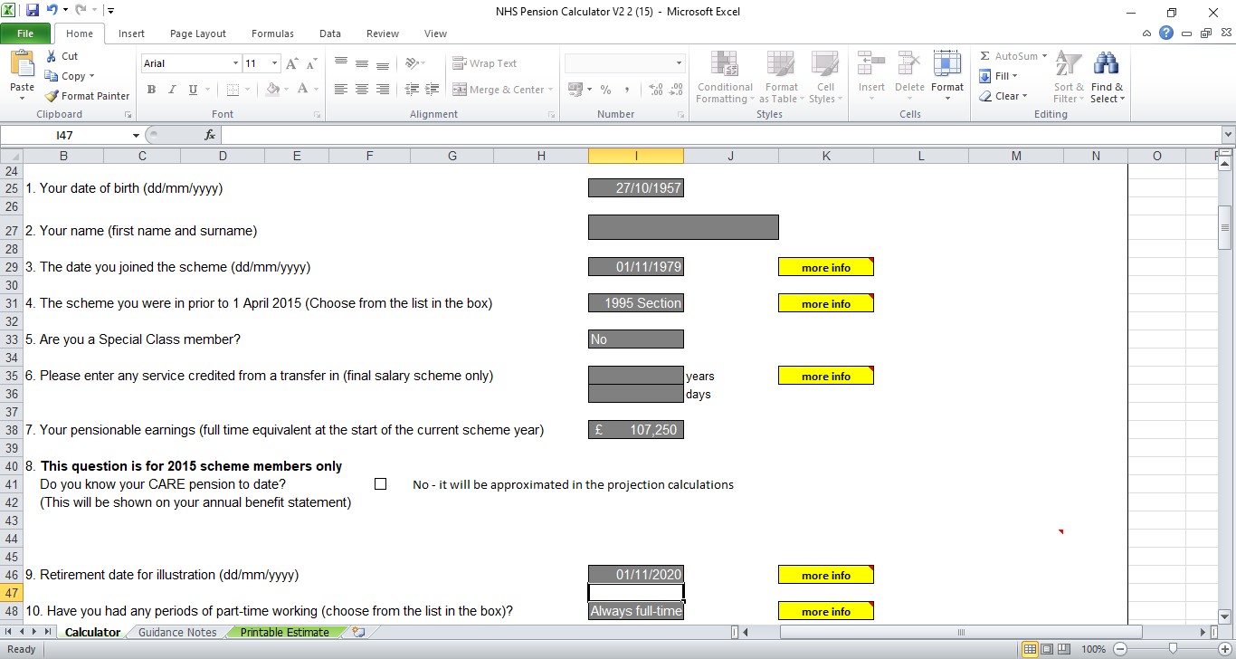

Slide 28
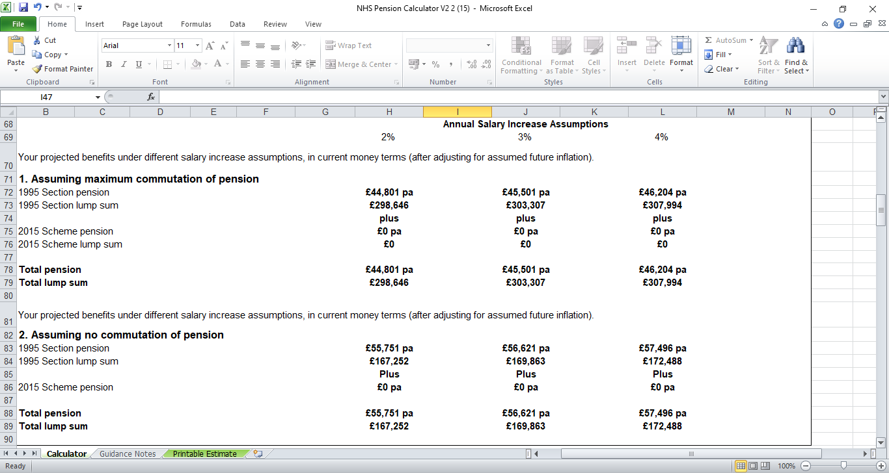

Slide 29
Lifetime Allowance
LTA reduced by £87,606 as a result of reducing pension and maximising TFC
Maximum TFC
Maximum Pension
£44,801 x 20 = £896,020
Tax Free Cash = £298,646
TOTAL £1,194,666
£55,751 x 20 = £1,115,020
Tax Free Cash = £167,252
TOTAL £1,282,272
Create and Prosper Financial Services Ltd is authorised and regulated by the Financial Conduct Authority. FCA Number 520631

Slide 30
Lifetime Allowance – Protections
There have been various forms of protection against a reducing LTA over the years. Currently we have-
Fixed Protection 2016 sets someone’s lifetime allowance at £1.25 million with very limited opportunity to accrue further pension benefits.
Individual Protection 2016 allowed people who had already accumulated more than £1 million at 5 April 2016 to continue pension saving with a maximum lifetime allowance of £1.25 million.
There is no application deadline for Fixed Protection 2016 or Individual Protection 2016. However, individuals will need to apply online for protection before they take their benefits as they will need the HMRC reference number if they want to rely on the protection
Create and Prosper Financial Services Ltd is authorised and regulated by the Financial Conduct Authority. FCA Number 520631

Slide 31

Opting Out
“Before leaving the NHS pension scheme you should carefully consider all your options, comparing any costs and the value of the many benefits provided by the scheme. It’s also worth taking independent financial advice.”
Don’t let the tax tail wag the dog
Create and Prosper Financial Services Ltd is authorised and regulated by the Financial Conduct Authority. FCA Number 520631

Slide 32
Opting Out
Our general view is that for most people the SPPA/NHS Pension Scheme represents excellent value and you should not leave it
If you leave you’ll lose –
A pension payable for life upon retirement for the period opted out
The option to take part of your pension as a tax-free lump sum when you retire
A generous pension contribution from your employer (20.9%)
The compounding affect of pension contributions
Tax relief on any contributions you pay into the scheme
Valuable benefits for your dependants if you die
The option to nominate individuals, to receive a lump sum payable in the event of your death
The option to apply for ill-health retirement if you’re unable to work due to ill-health
You can rejoin at any time but if over 5 years you will be opted back in to CARE – 2015 Scheme
Create and Prosper Financial Services Ltd is authorised and regulated by the Financial Conduct Authority. FCA Number 520631

Slide 33
REC Scheme
REC = Recycling of Employer Contributions
Employer cannot provide advice – Independent Financial Advice required
For staff who may be impacted by AA tax charge
Will need to opt out of scheme, if in more than 1 scheme more than one application
Those who qualify may still have an AA tax charge
Available from 1/10/22
Applications to be received no later than 28/2/23
The rate of recycle is 12.4%
Will cease on 31/03/23
Create and Prosper Financial Services Ltd is authorised and regulated by the Financial Conduct Authority. FCA Number 520631

Slide 34
Timeline - Dates
6th April – start of tax year
To 28th February– can join REC scheme
31st July - Annual Allowance Scheme pays – must tell pension scheme by 31st July following year to which AA charge relates
5th October – register for self assessment
6th October - Pension Scheme Input Statements issued following year of contributions
31st October – Paper tax returns due
31st January – Online tax returns due and pay tax for previous tax year
Create and Prosper Financial Services Ltd is authorised and regulated by the Financial Conduct Authority. FCA Number 520631

Slide 35
Summary – The Primary Issues
Lifetime Allowance Tax Charge
Annual Allowance Tax Charge
Tapered Personal Allowance
Tapered Annual Allowance
Create and Prosper Financial Services Ltd is authorised and regulated by the Financial Conduct Authority. FCA Number 520631

Slide 36
Options
Pay the Tax Charge
Opt Out of Scheme/REC
Use Carry Forward
Use Scheme Pays
Create and Prosper Financial Services Ltd is authorised and regulated by the Financial Conduct Authority. FCA Number 520631

Slide 37
Help Is At Hand – Weighing Up Cost v Benefit
Information is available but is very generic and can sometimes be confusing
If you are looking for advice relating to your individual circumstances you should approach an Independent Financial Adviser
However –
Make sure they are qualified to deliver advice in this area – Advisers who have authorisation to advise on all Pension Transfers will have a greater knowledge of pension schemes
Make sure the adviser has an understanding of the nuances of the SPPA pension schemes
Are they independent – Ask the question!
Check their experience and qualifications, a Chartered adviser will not necessarily cost more
Make sure you agree a cost/fee basis up front
Create and Prosper Financial Services Ltd is authorised and regulated by the Financial Conduct Authority. FCA Number 520631

Slide 38
Legal Information
References in this presentation to legislation and tax are based upon Create and Prosper’s understanding of UK law and HM Revenue & Customs practice in the UK as at the date of presentation.
Tax and legislation are likely to change.
The value of tax reliefs depend on individual circumstances.
No guarantees are given regarding the effectiveness of any arrangements entered into on the basis of these comments.
These examples provide a suggested approach only - other approaches may be equally suitable. Every customer’s circumstances will be different and require individual advice.
Create and Prosper Financial Services Ltd is authorised and regulated by the Financial Conduct Authority. FCA Number 520631

Slide 39

Q&A

