Slide 1
Moving & Handling Quick Guide March 2020
Important notes:
This presentation is intended to provide a pictorial guide to some common activities relating to assisting people to move. It should be interpreted as principles to be applied as each individual will have different needs.
Prior to all M&H activities, the persons needs should be identified, how you are about to help them explained and their consent obtained.
If you are having any difficulties, discuss this with your colleagues, prior to helping the person.

Slide 2
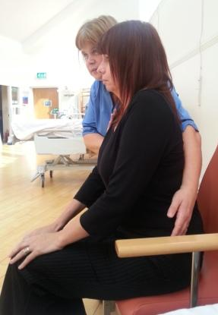
Assisting with a Standing Transfer

Slide 3
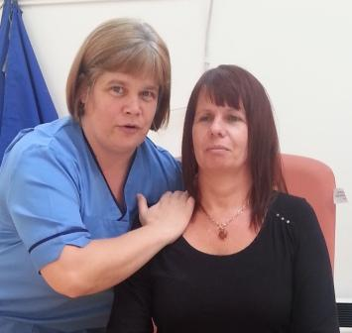
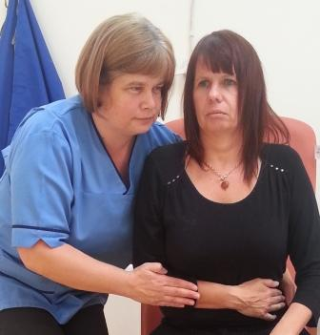
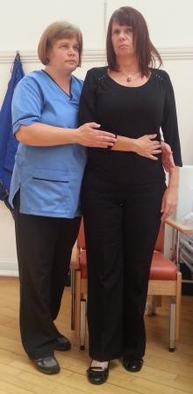
Assisting with a Standing Transfer

Slide 4
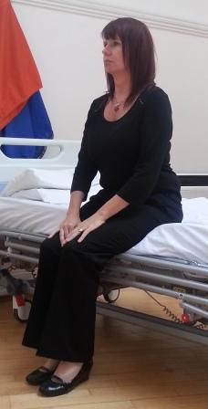
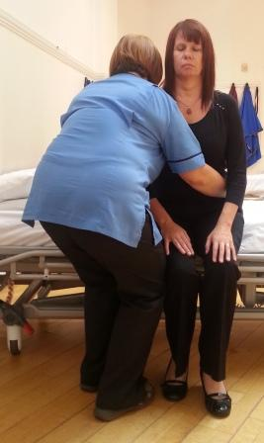
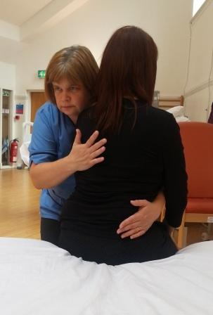
Assisting someone to stand up from a bed / plinth

Slide 5
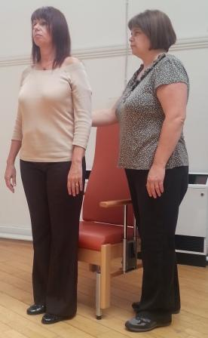
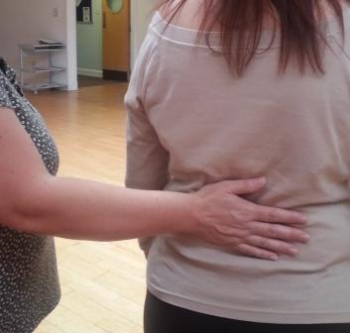
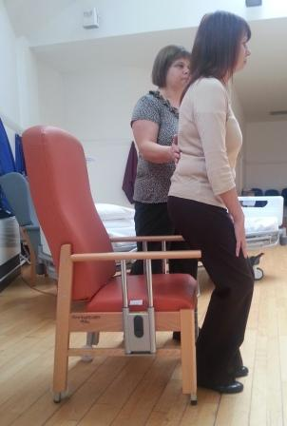
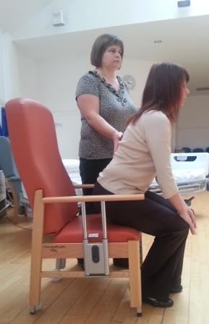
Sitting down with minimal assistance

Slide 6
Sitting/standing with assistance of two

Slide 7
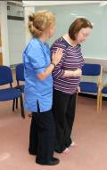
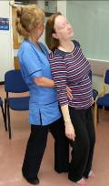
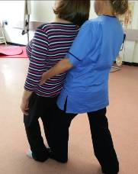
Assisting the falling person

Slide 8
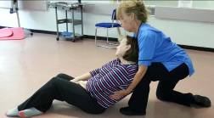
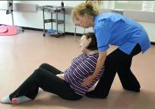
Assisting the falling person (cont/d)

Slide 9
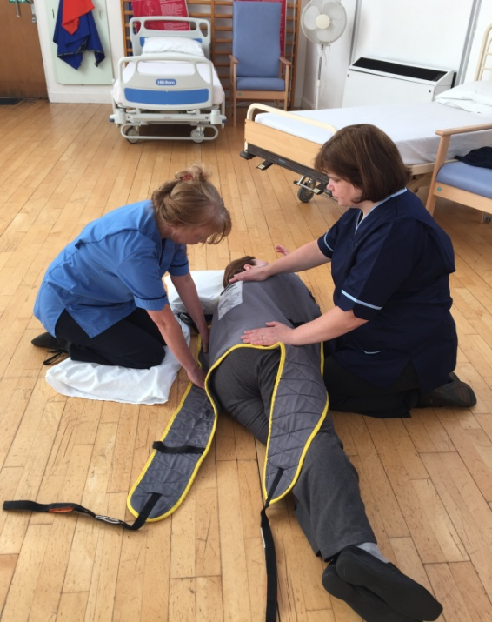
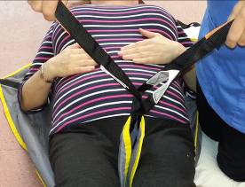
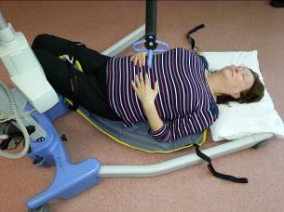
Recovering a person from the floor with a hoist (minimum of two staff required)

Slide 10
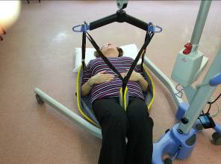
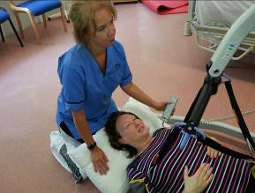
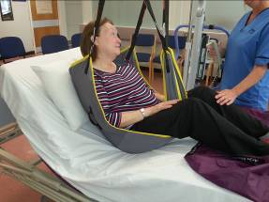
Recovering a person from the floor with a hoist (minimum of two staff required) (cont/d)

Slide 11
Turning & rolling

Slide 12
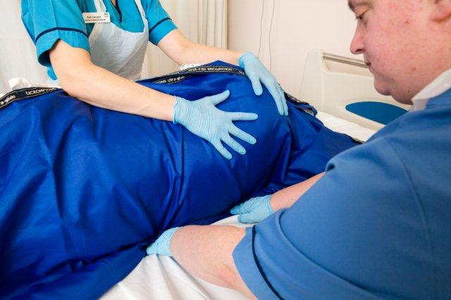
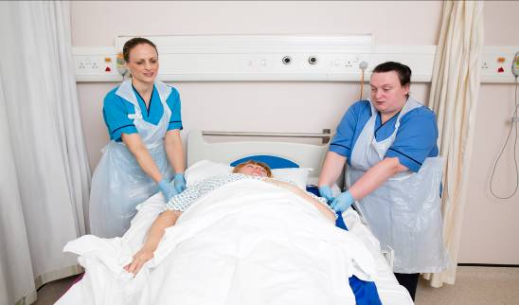
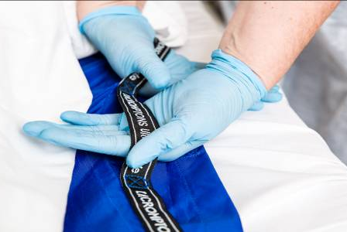
Repositioning patients using sliding sheets

Slide 13
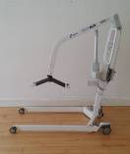
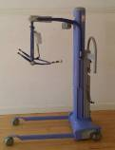
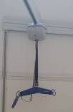
Passive sling lift hoists (mobile & overhead)

Slide 14
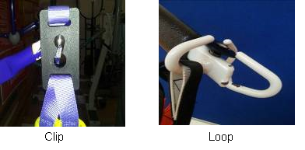
Passive hoist sling attachment points can be either ‘clip’ or ‘loop’. Clip slings cannot be used on a loop attachment spreader bar and vice versa.

Slide 15
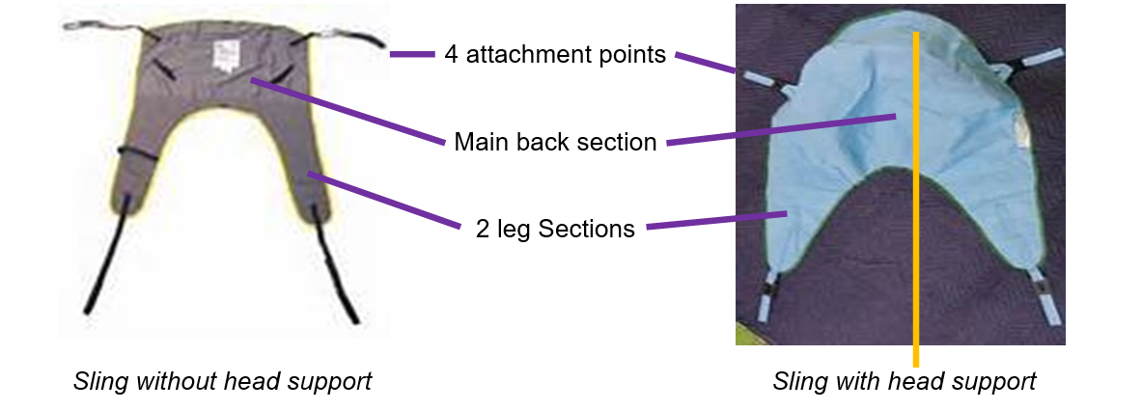
General Purpose Sling Styles

Slide 16
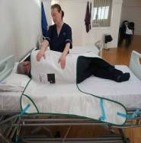
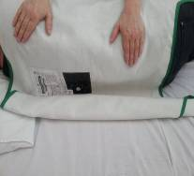
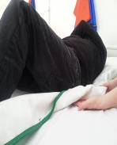
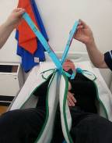
Fitting a sling to a person lying in bed

Slide 17
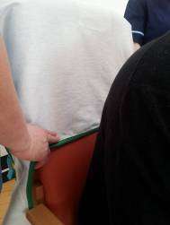
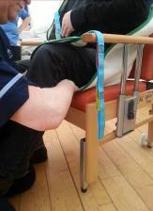
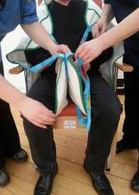
Fitting a sling to a person sitting in a chair

Slide 18
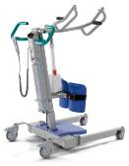
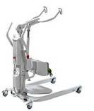
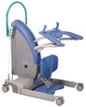
Active hoists for people able to weight bear / and follow instruction

Slide 19
Active hoist attachment points

Slide 20
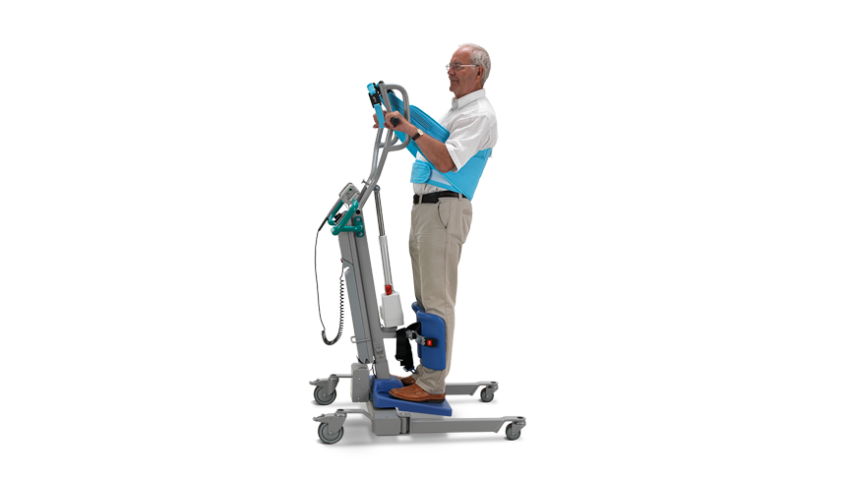
Active / stand aid hoist sling

Slide 21
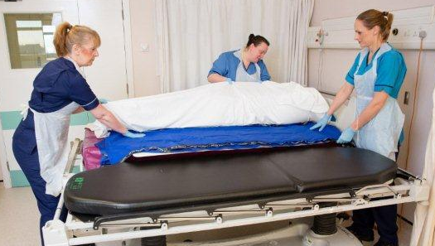
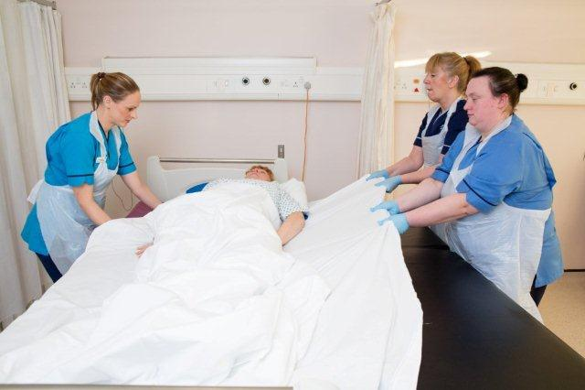
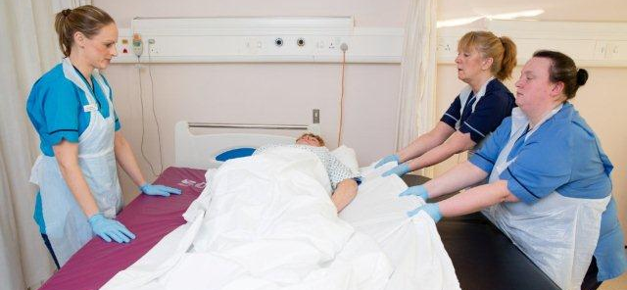
Lateral Transfer using rigid board & sliding sheets

Slide 22
For further information see our HRConnect web page
Moving and Handling - NHSGGC

