Slide 1
Delivering high quality person-centred health and care
An introduction for Health Care Support Workers

Slide 2
What is person-centred care?
The term 'person-centred care' is used to describe many different principles and activities. When care is person-centred, what it looks like will depend on the needs, circumstances and preferences of the person receiving care. What is important to one person in their health care may not be as important to another. It may also change over time, as the person’s needs change.
In health care, no matter who you are or what your role is, the people who use our services should be central to everything that we do.
Take a few minutes to play the video on the next page

Slide 3

What is person-centred care?

Slide 4
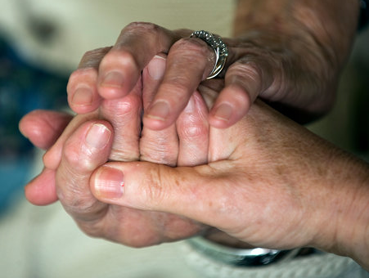
‘Must Do With Me’ principles
To give the right care for the right patient at the right time, there are five principles that should ensure that all our interactions with patients and their family are characterised by listening, dignity, compassion and respect.
Person-centred care is promoted by these five key ‘Must Do With Me’ principles which you’ll see on the next page.

Slide 5
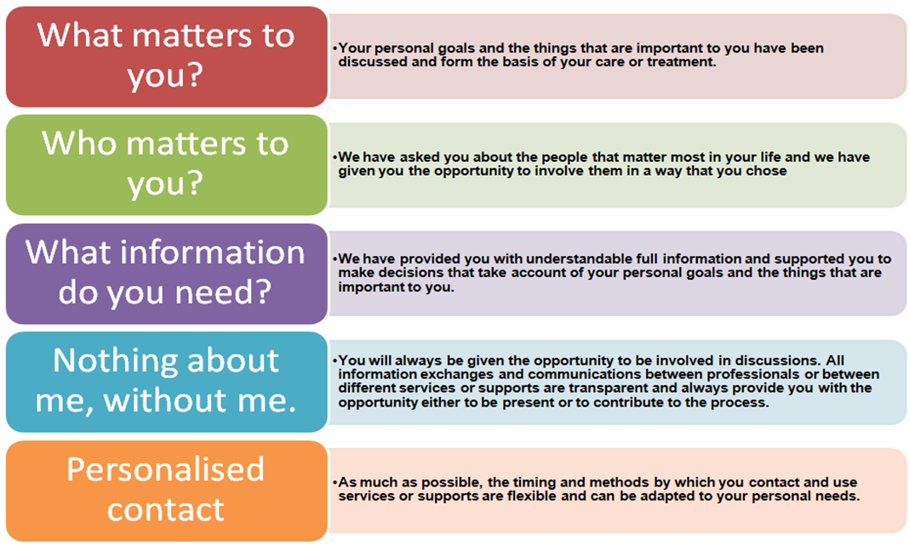
‘Must Do With Me’ principles?

Slide 6
Conversations
Asking people ‘what matters to them today’ can support more meaningful conversations between patients, families and the people providing care.
This person-centred approach can help:
establish more effective relationships
build trust
understand more about the person and what's most important to them
you work better with the person and support the things they value in their care
Please play the video above to hear a little more about the value and importance of asking
“What matters to you?”

Slide 7
How do we ask people of about ‘what matters?’
When chatting to the person you are looking after, try asking “What matters to you?” or use one of these phrases:
What is important to you at the moment?
What can I do to help support you in your care today?
What would you like to achieve today?
Is there anything else you want to tell me that we haven’t covered?
Is there anything you need information about today?
What do you find works for you when this happens?

Slide 8
Ask, Listen and Do ‘What Matters’
Asking, listening and doing what matters to people helps to individualise their care.
When we work together with people in partnership we are more likely to achieve common goals and have a shared understanding of expectations. This can improve:
  patient and staff satisfaction
  quality of care
  experience of care

Slide 9
What matters to you? conversations
Please play this video which was created by one of our ward teams. They tell their story about how they ask, listen and do what matters for their patients.
Further information about how to put the WMTY approach to 'ask, listen and do what matters' for patients into practice can be found at NHSGGC : WMTY Information for staff

Slide 10
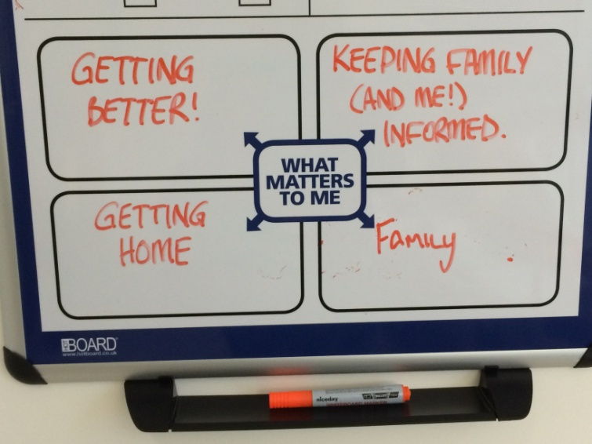
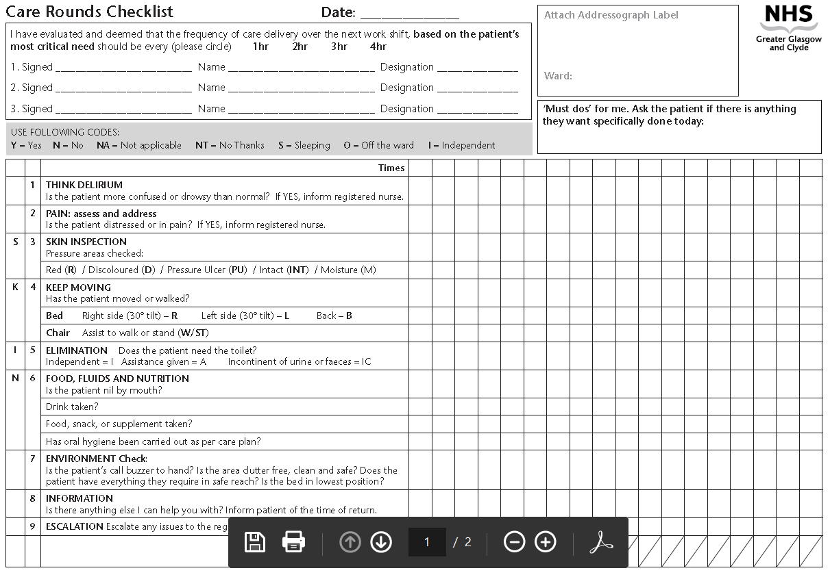
Writing ‘What Matters to patients’
On a day to day basis we record what matters to the patient on the ‘What matters to me’ board and in the red circle (shown above) on the Care Rounds Checklist

Slide 11


Getting to know who matters to patients is important too…
Welcoming people as they arrive in the ward helps people to feel welcome and to be acknowledged – using the #hellomynameis principle is a useful introduction (click on the link to find out more).
Working in partnership with the people who matter to patients can help to build respect and trust
You should always be polite and courteous when talking to people
Offering to share information about the ward and what happens each day can be useful too.

Slide 12

Person Centred Care Planning
The purpose of a person-centred care plan is to:
Describe the care, treatment and interventions that a person should receive, to ensure that they get the right care at the right time.
Provide a record of care and personal needs, actions and responsibilities.
Ensure care planned is based on best practice and best evidence to ensure quality care.
Identify patient and family involvement in care
Provide a structured multi-professional approach to the plan of care.
Provide quantitative and qualitative information that can be monitored and measured to assess and evidence quality of care
Provide factual information that can be used in defence of a complaint in a legal context.

Slide 13






Core principles of Person Centred Care Planning
WHAT MATTERS
  Listen to understand what matters to the individual in the context of their illness or treatment and include their individual preferences and choices
WHO MATTERS
  Ask who matters and how they wish them to be involved in decision making about their plan of care and provision of care
COMMUNICATION AND SUPPORT NEEDS
  Include the preferred approach, tools and resources to support communication and support needs
REALISTIC AIMS AND GOALS
  Set realistic aims and goals which are achievable across the whole episode of care
MULTI-PROFESSIONAL APPROACH
  Reflective of a structured multi-professional approach to plan of care

Slide 14

Person Centred Visiting
It is important for patients to be able to have support from the people who matter most to them while in hospital
Family play a vital role is supporting patient recovery and wellbeing
The core principles of Person Centred Visiting (next slide) should be applied in every inpatient ward
Information about current visiting arrangements is available on NHSGGC’s website here

Slide 15
Core principles of Person Centred Visiting
WELCOMING
  Welcome and encourage the involvement of the people who matter to patients.
PATIENT LED
  We are guided by patients: when the people who matter will visit, how they would like them involved in their care, and when they want to rest.
PARTNERSHIP
  We work in partnership with the people who matter to patients.
FLEXIBILITY
  We have no set visiting times.
RESPECT
  We respect peoples’ individual needs and act on an individual basis to ensure the safety, privacy and dignity of all patients. This means there may be times when we need to ask people to
  leave a clinical area temporarily.

Slide 16
Applying the PCV core principles
The application of the core principles of Person Centred Visiting in practice may look very different, depending on the patients you are helping and the ward you work in (for example, visiting in single room wards may look different to shared bays)
Avoid ‘one size fits all’ approaches where possible – for example, it may be helpful for some family members to be present during mealtimes, or ward rounds
Please speak to staff in your area to understand current arrangements.

Slide 17


The difference this makes
Being in hospital is a stressful time and welcome family and friends being able to visit when they want.
Change to visiting long overdue. Living in modern time and need to move forward.
I would like my partner to be there to help with personal care
Patients in Critical Care, QEUH

Slide 18
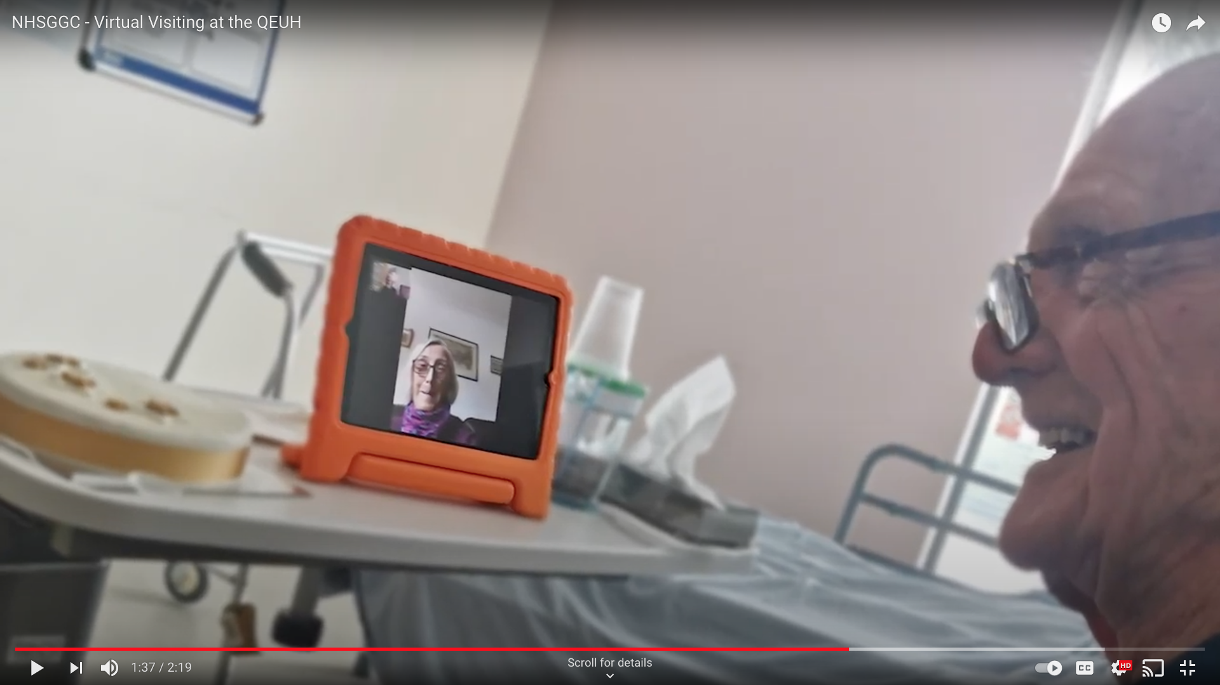
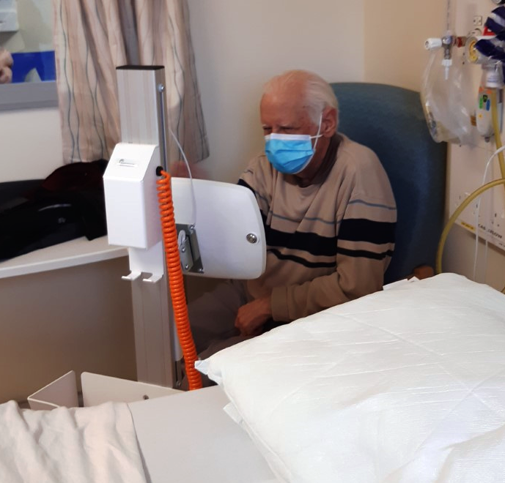
Virtual visiting
Virtual visiting can help patients to see those who matter to them when they are not able to visit in person. Patients can keep in touch with their relatives and friends by using technology on their mobile device, laptops or computers.
All wards have iPads set up to enable 'virtual visits‘
(video call) using FaceTime, Skype or Zoom.
Further information can be found here.

Slide 19


Asking patients about their experience of care
Gathering feedback helps us to learn what is important to patients and their families, so we can learn what we do well and where we can improve.
For example, Care Opinion is an online platform where patients, families and carers can share their experience of health or care services to help make care better for everyone.

Slide 20
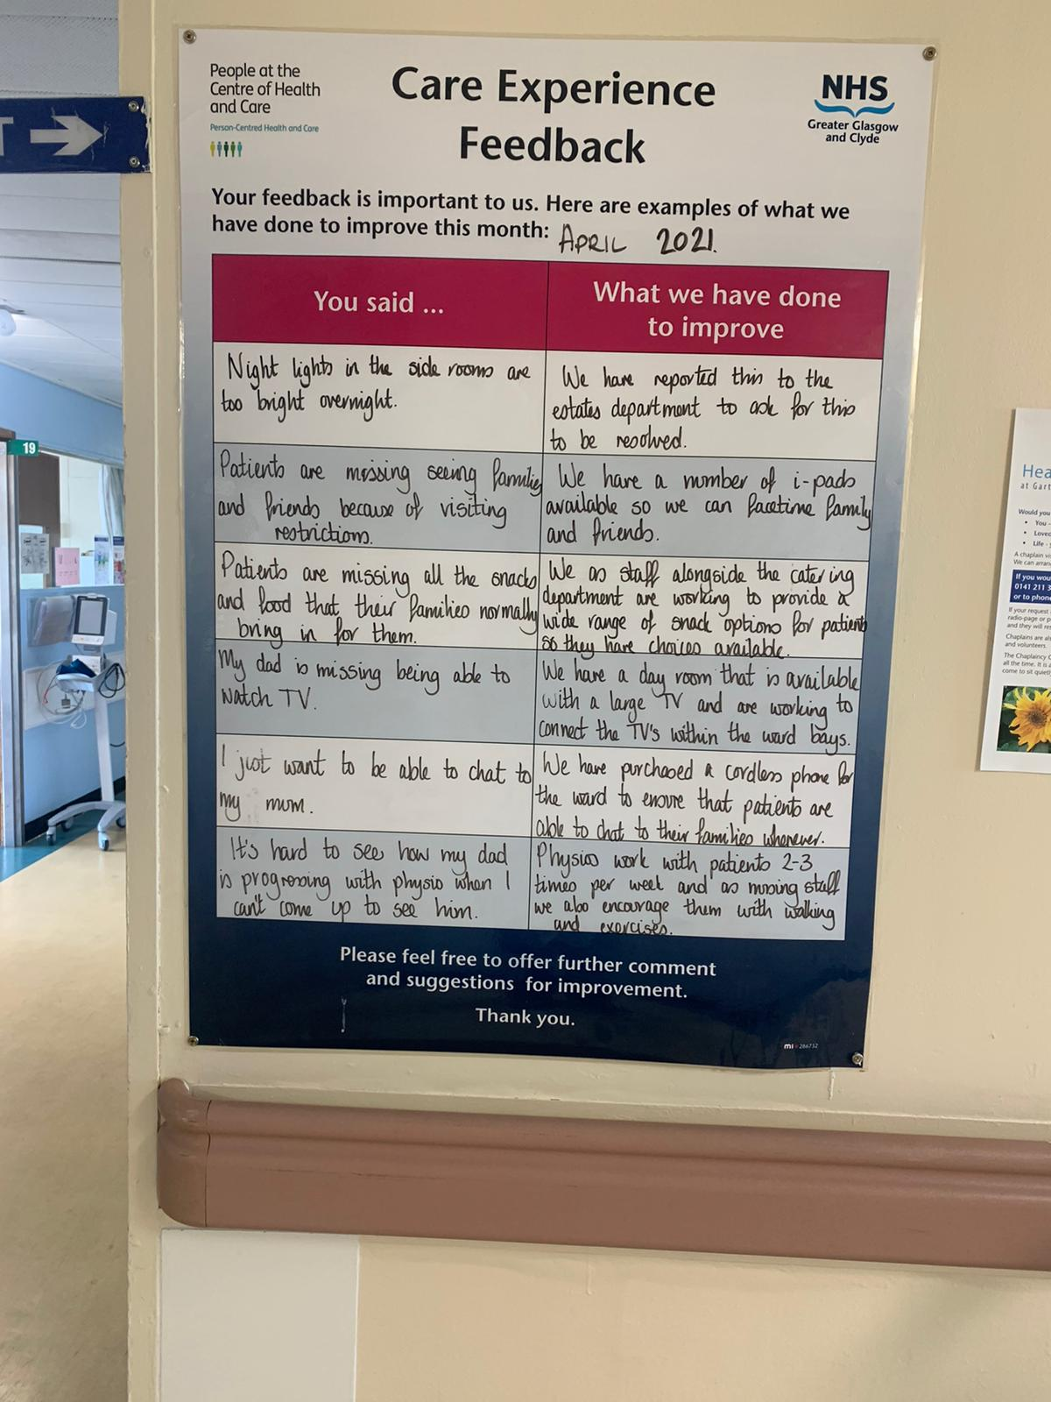

Care Experience Feedback
In your ward or department there may be other ways to gather care experience or feedback. Find out by asking your colleagues.
Many wards display their Care Experience feedback on the ‘You said, we did’ board.

Slide 21
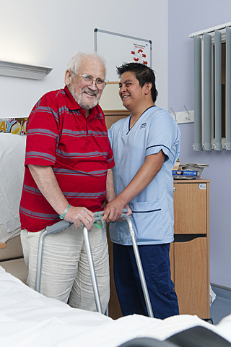
Make person centred care part of your everyday approach…
“people will forget what you
said, people will forget what
you did, but people will never forget how you made them feel”
(Maya Anjelou)

