Slide 1
HCSW Induction Fundamental
Essential Learning

Slide 2
Record Keeping
The HCSW Code of Conduct states that up to date and accurate record keeping is an essential part of your role.
Patient records provide evidence of care provided. What you record as a HCSW can be used for a wide range of purposes. These include patient safety and care, care assurance, response to complaints, police investigation and enquiries.

Slide 3
Principles of good record keeping
NHSGGC Professional Standards for Record Keeping Policy
Entries must be:
Dated and timed as soon as possible after care provided, for example, Care Rounding
Signed and printed with name and designation
Clear and concise
Person centred, for example, preferred name, what matters and who matters
Legible and factual
Write in black ink
Records should never be falsified or tampered with
Errors should be scored through with a single line, signed and dated.
Avoid:
Jargon
Speculation
Your own opinion
Offensive remarks
Abbreviations

Slide 4
Accountability and Delegation
Accountability
Make sure you can always ‘answer’ for your actions or omissions
Code of Conduct for Health Care Support Workers
Delegation
Delegation is the allocation of clinical or non-clinical duties to a competent person
Making Delegation Safe and Effective

Slide 5
Delegation Considerations
Have you confirmed the instruction has been completed?
Are instructions clear?
Do you have the skills, knowledge and are you confident?
Has the person delegating the duty given clear instructions?
Do you understand what is being asked of you?
Have you had the appropriate training?
Are you competent to carry the duty out safely?
Are you confident in your abilities? have you “closed the loop”? Have you provided feedback and completed documentation?
Have you escalated any concerns/findings?

Slide 6
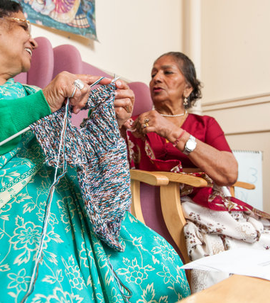
Enhanced Observations
Some patients may require enhanced observations due to an identified risk, for example, falls, absconding, stress and distress
The nurse in charge will inform you of your role and responsibilities for specific patients
You may be asked to complete a patient monitoring chart
Please use the What Matters to Me board and Getting to know Me form to provide person centred care interventions
During handover report how the patient has been
Escalate concerns to the nurse in charge

