Slide 1


Health and Care (Staffing) (Scotland) Act 2019 - HCSSA
What does it mean for wellbeing?
Steven Young, Consultant Anaesthetist
Professional Lead NHSGGC HCSSA Programme

Slide 2

2019 Legislation
Covid pause
2024 Enactment & Implementation
2025 “Compliance Monitoring"
The Acts Timeline

Slide 3

HCSSA
Puts a legislative framework in place to support staffing
Puts staffing at the centre of organisational decision making
Health Boards must provide assurance that their processes are aligned with the Act
"Enforced" by HIS from April 2025
Complex, linked series of guiding principles and duties
"Right people with the right skills in the right numbers in the right place at the right time to provide safe and high -quality care"

Slide 4

What is NOT in the ACT
Any minimum staffing levels
Any minimum time allowance for leadership, training etc
Long-term funding

Slide 5

Don’t Switch off!
This applies to you, and all other regulated health professionals

Slide 6

What is Realtime Staffing supposed to look like in practice?

Slide 7

Hypothetical Example
The morning staffing huddle has identified that 3 resident doctors that have phoned in sick, and the unit is busy with patient demand, the duty ST4 has reported this (using an electronic system) and wants to know what to do next.

Slide 8

Clinical Leader
Clinical Leader has a RealTime view of staffing requirements
Has appropriate time in their job plan for staffing duties and for training of staff as applicable
Considers patient and staff wellbeing in their decision making

Slide 9
Assessment
Clinical Leader assesses the staffing implications (skill mix and patient acuity as well as numbers)
Decisions have to be made after seeking appropriate clinical advice- ie cannot be made by a non-clinical manager or admin without the input of one or more clinicians

Slide 10
Assessment
The Clinical Leader has "time to lead" in their job plan. They have the appropriate time, knowledge and authority to make staffing assessments and formulate appropriate plans

Slide 11
Mitigation
Refering to the Team’s documented staffing policy, The Clinical Leader decides to get the ST4 to cover an extra ward and move a trainee doctor from a clinic to provide extra ward cover (mitigation)
Ideally this action is logged against the incident using an electronic system.
The system ideally will automatically inform the original reporter and potentially more senior staff (CD).
This might be enough to close off the episode without the need for any further action

Slide 12
Further mitigation / escalation
In this scenario, the ST4 does not agree with the mitigation plan because the unit is too busy for her to cover 2 wards at the same time, and the doctor displaced from the clinic does not have the appropriate experience.
This disagreement is registered by the electronic system and returned to the clinical leader

Slide 13
Further Mitigation / escalation / accepting risk
The clinical leader might stick with the original plan and record the disagreement.
In this case she tries to organise extra cover using staff bank
The Act states that "agency" staff should be paid no more than 150% of an equivalent employee rate. If the agency worker provided is equal or above 150% this is recorded and reported to the Board and Scottish Government in the Boards quarterly High-Cost Agency report.
In this scenario the unit is unable to find cover
The clinical leader escalates to the Chief of Medicine (as per the unit staffing policy)

Slide 14

Escalation
Escalation of an unmitigated risk should be via an electronic system, or manually within an appropriate separate recording system. The former would allow the CoM to have earlier oversight of issues.
They have the option of accepting the risk, escalating to a more senior decision maker, or authorising other mitigation measures, eg close the unit to new admissions and divert to another unit

Slide 15

Staffing escalations can go all the way up the management tree.
Decisions and disagreements are recorded and reportable.

Slide 16
Decisions are shared with the staff involved who have the option to register if they disagree with the plan. This has to be recorded.
Someone in the unit / team is assigned to complete a DATIX or equivalent if the scenario has resulted in or could have resulted in patient harm. Datix can also be used for disagreement reporting

Slide 17
Severe and Recurrent Risk
Senior decision makers will regularly review the information from DATIX and any other electronic system in use to identify severe and recuring risks
The assessment of severity or frequency of staffing related incidents is recorded
These should be reviewed to make an outline case for service redesign to reduce these risks. This should be included in Workforce plans
Staff must be consulted on staffing decisions
Annual Reports are sent to SG detailing Act assurance levels and assessment of compliance.
HIS have an oversight role to monitor and ensure levels of compliance. They also can report to SG on findings. They can request information and evidence at any time (not restricted to inspections). They require to be issued with the Boards Qtr Assessment Reports

Slide 18


Staffing decisions need to be open and transparent take account of the views of staff and service users, and take account of service users' needs whilst respecting their dignity and rights.

Slide 19
Key concepts of Real Time Staffing
Daily staffing review
Mitigation
Escalation
Disagreement log
Risk reporting (Datix)
Severe and recurrent risk review (Datix)
Appropriate clinical advice
Communication
Take account of wellbeing

Slide 20

Implications
For doctors

Slide 21

What does the Health and Care Staffing (Scotland)Act (HCSSA) mean for Resident Doctors?
You need to have a basic understanding of the requirements of the HCSSA*
You are part of a team with a shared responsibility to ensure staffing is appropriate to provide safe and high-quality care for your patients.
You should be aware of your unit's staffing escalation policy (to the "Clinical Leader" in the first instance).
You should know who the "Clinical Leaders" are in your team: this would normally be the Clinical Director, who may delegate to others eg Lead Clinician, Duty Consultant etc.
You should engage with staffing discussions and decisions as they arise.
*Health & Care (Staffing) (Scotland) Act 2019 - NHSGGC
Health and Care Staffing in Scotland | Turas | Learn (nhs.scot)

Slide 22
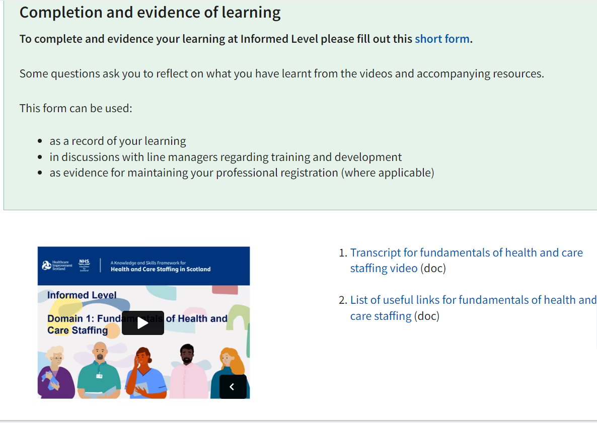
Turas
Learning resources : Informed level | Turas | Learn

Slide 23

What does the Act say about wellbeing?

Slide 24

Wellbeing
“Any person who provides a care service must ensure that at all times suitably qualified and competent individuals are working in the care service in such numbers as are appropriate for-​
(a) the health, wellbeing and safety of service users,​
(b) the provision of safe and high-quality care, and​
(c) in so far as it affects either of those matters, the wellbeing of staff.”

Slide 25
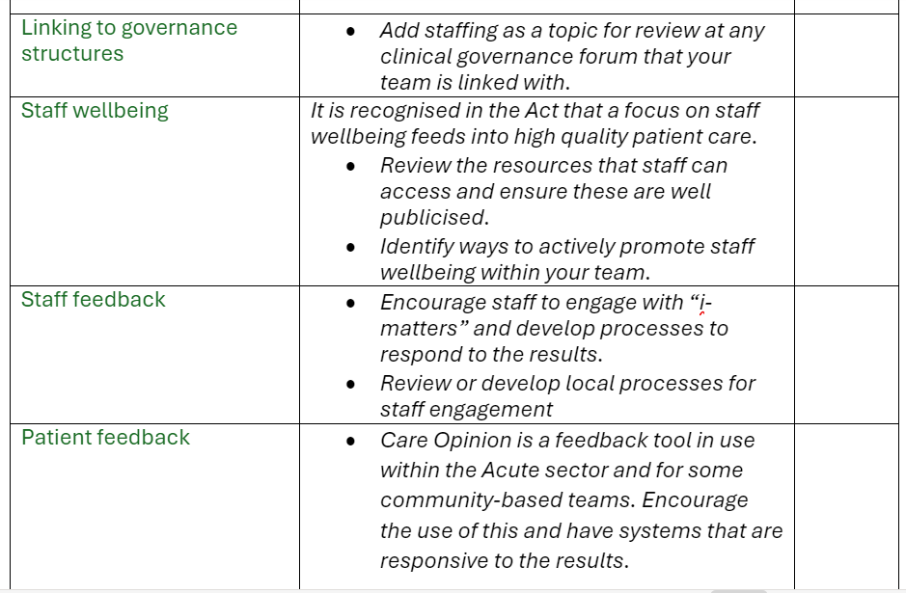








Slide 26
Guiding Principles
• Increased staff wellbeing is linked to better outcomes for service users.
• Staff should be informed, supported and engaged at work.
• Organisations should be able to demonstrate:
Appropriate measures, checks and support should be in place to support staff wellbeing.
A culture of open communication and psychological safety

Slide 27

Training in the Act
Competency in role
Involved in staffing decisions
Wellbeing is protected
Escalate and disagree with staffing decisions
RESULTS IN:
Responsibility for staffing risk moving from "floor to board"
Services with severe and recurring risks are highlighted

Slide 28

Personal Opinion
Complicated and ambitious legislation
Pushes responsibility for staffing up to board level (potentially)
Incentivises service redesign
Empowers staff to escalate issues
Recognises importance of staff well -being on patient care
Recognises and protects clinical leadership
No money for extra staff (and maybe no extra staff to employ anyway)
Big question marks about how rigorously this will be enforced

Slide 29


Useful resources, and signposting available
Health & Care (Staffing) (Scotland) Act 2019 - NHSGGC

