Slide 1
Get Ready For – Occupational Therapy

Slide 2
What Is Occupational Therapy?
Occupational therapy helps people take part in everyday activities that matter to them. It supports people of all ages who face challenges due to physical and/or mental health illness, injury, disability, or ageing.
The Goal:
To help people live independently, safely, and meaningfully — doing the things that give life purpose.

Slide 3
What attributes make a good OT?
Interpersonal skills
Observation skills
Problem solving skills
Highly organised/detail focused
Adaptable
Good verbal/written communication skills
Curious learner
Team player
Compassionate
Creative thinker
Professionalism

Slide 4
What OT's help with
· Self-care (dressing, washing, eating)
· Work or school tasks
· Home activities (cooking, cleaning, childcare)
· Leisure and social participation
· Independence at home or in the community

Slide 5
How OTs Support People
Practising real-life tasks to build skills
Recommending adaptive equipment
Adjusting environments to make activities easier
Teaching strategies for energy, organisation, or sensory needs
Cognitive assessment, rehabilitation and coping strategies
Rehabilitation after illness or injury

Slide 6
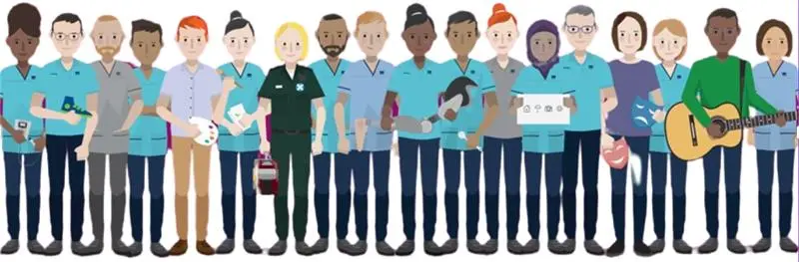
Art Therapy
Dietitian
Occupational Therapy
Orthoptics
Orthotics
Paramedics
Physiotherapy
Podiatry
Prosthetics
Radiography (Diagnostic)
Radiography (Therapeutic)
Speech & Language Therapy

Slide 7
Working in a Multidisciplinary Team
Occupational Therapists within NHSGG&C work as part of multidisciplinary team’s (MDT)
One of 12 AHP job families in NHSGG&C
Role within the MDT is to communicate the progression and outcomes of assessment, rehabilitation, discharge planning, including the identification of ongoing risks and how these have been minimised.
Advocating for patients to ensure their wishes/goals are at the centre of all care planning.
Attend MDT’s, case conferences/reviews.
Promote the role of Occupational Therapy.
Generally, in an inpatient setting work most closely with Physiotherapists, Speech and language therapists and Dieticians.
In community settings work most closely with social work, Physiotherapists.

Slide 8
Where do we work?
Some examples...
Acute (hospitals) eg adults, paediatrics, mental health
Peoples homes eg home based rehab, social work (adaptations), community mental health teams
Primary care (GP surgeries)
Other public sector eg schools, prisons
Specialist clinics/services condition specific eg brain injury, rheumatology

Slide 9
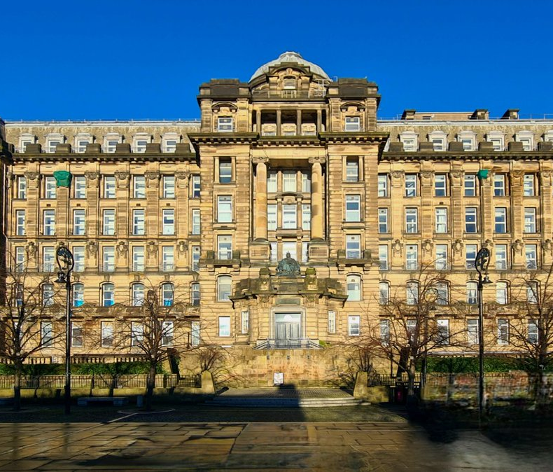
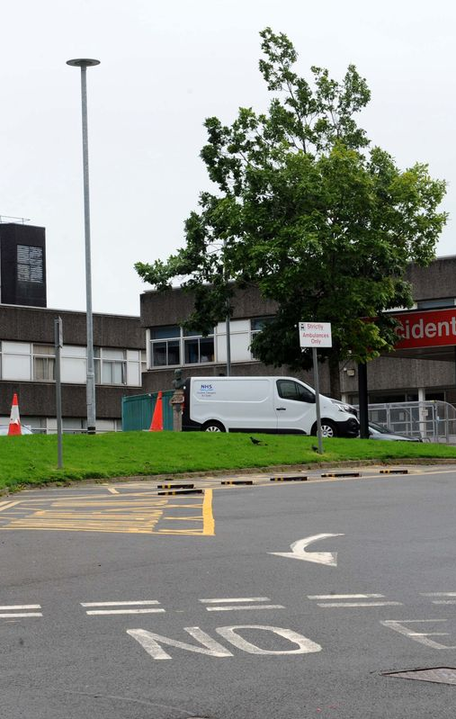
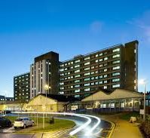
Working in Acute NHSGG&C
Glasgow sites
Queen Elizabeth University
Gartnavel General
Glasgow Royal Infirmary
Lightburn
Stobhill
Clyde sites
Royal Alexandra
Vale of Leven
Inverclyde Royal

Slide 10
Specialty Areas On GGC Acute Rotation
Rotational posts allow opportunity to work in a broad range of clinical areas as a new graduate making it an ideal 1st post!
Older Peoples Services
Medical
Neurology
Orthopaedics
Spinal Injuries
Major Trauma
Stroke
Neuro Rehab
Surgical
Oncology

Slide 11
Community Based Case Examples
Occupational Therapists work in the community in a variety of rehabilitation roles, helping people who have experienced illnesses or injuries that have affected their emotional functioning and cognitive (thinking) skills. These are often known as ‘hidden disabilities’. We visit people at home, in community settings, and in their workplaces.
Here’s an example which shows what we do –
Imagine you are involved in an accident when cycling. You experience a traumatic brain injury, which is successfully treated in hospital and you are soon well enough to go home.
Over the next few days and weeks, you notice that some things have not returned to normal. You are not as good at remembering things you need to do or what people tell you. You have had accidents at home, forgetting to turn off the cooker. You think you are maybe a bit less patient with people, but your family says you get quite angry. You get extremely tired even when you are not that active.
You get frustrated because of these things, which are affecting your home life and your relationships with friends, and you are also making mistakes at work. Because of your injury, you are not allowed to drive at the moment. This means you need to take a bus to work, but this makes your day longer and you feel exhausted. You make more mistakes.
Your frustration turns into low mood and then you start feeling depressed. Problems start piling up and you need time off work. You start worrying more about things such as money, and you lose a lot of confidence.

Slide 12
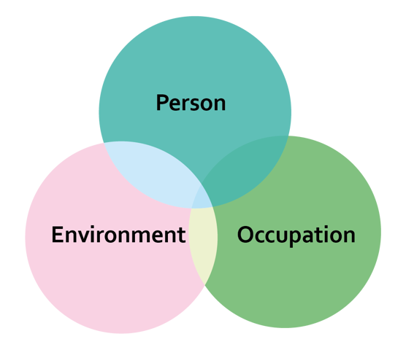
Community Based Case Examples
Before you were discharged from hospital, you were referred for follow-up review of your brain injury. You now start to see an Occupational Therapist, who explains more about your injury.
They carry out a cooking assessment, to see how you are managing. They suggest strategies to help with memory, attention and organising yourself, as well as problem-solving tips. These can be basic methods such as calendars and notes, or phone Apps and assistive software. The OT provides fatigue management advice such as planning, pacing and prioritising. They help you plan a graded return to work, using activity analysis of your job tasks and recommending some adjustments to your role.

Slide 13

Community Based Case Examples
Because of the changes in your mental health, you start to see an Occupational Therapist from the mental health team. They tell you about the link between how we occupy ourselves and how we feel.
You learn about strategies such as anxiety management, how to deal with worries and intrusive thoughts, and mindfulness techniques. The OT uses motivational interviewing to help you prioritise what is important, identify your strengths, and set achievable goals. They give you time to talk about difficult issues. This helps you to feel more able to meet up with friends again, and think about the future, even though your mood still isn’t great. They also explore what is meaningful to you, so you can return to activities that give you pleasure and satisfaction.
OTs working in these types of settings usually see people over an extended period of time. This means we get to know you well, can help practise new ways of doing things, and can give you feedback on your progress.

Slide 14
Acute Case Study
Helen is an 80-year-old woman who fell in the bath while having a shower and sustained a left proximal humeral fracture. She lay for 10 hours until her daughter came over to visit her.
The injury is for non-surgical management to be immobilised in a poly sling for 6 weeks
OT initial subjective assessment: she lives alone and was previously independent with all activities of daily living but found herself ‘slowing down recently’. This is the 3rd fall she has had in the last year and the second in her shower.
Transfer assessment: managing on/off the armchair and toilet independently, however, is struggling to get in/out of the bed due to restricted use of her left arm. She could previously do this with no difficulty and has no equipment at home. Following 2 practice sessions with the OT using compensatory techniques she was able to complete this again independently.
Wash/dressing assessment: nursing staff have been helping Helen to get washed and dressed since her injury due to her reduced confidence and uncertainty of her upper limb restrictions and the sling she is wearing.

Slide 15
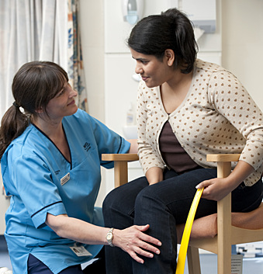
Acute case study continued
The OT completed a washing and dressing assessment with Helen teaching her the correct way to doff and don her sling and the technique to dress her top and lower half whilst keeping her shoulder immobilised. Also recommending Helen wears clothes that are easier to dress with one hand such as baggy t shirts and skirts that don’t have buttons or zips and slip on shoes.
Due to having multiple falls in the shower Helen and the OT agreed to reduce risk whilst her shoulder is immobilised, she should have a strip wash at the sink and the OT provided her with a perching stool to complete this task seated.
As well as this the OT arranged a pendant alarm for Helen so if she was to fall again, she could get emergency support from the falls team. The OT also helped arrange a key safe to be fit at Helen’s door so emergency responders could gain access.

Slide 16
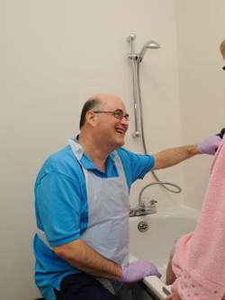
Acute case study continued
Food preparation and feeding: on the ward Helen was having some difficulty adapting to eating and drinking with one arm, the OT provided a plate guard to stop Helen’s food coming off the plate when she was scooping it and dycem to put under her plate to steady it which helped maintain Helen’s independence.
Helen was nervous about how she would prepare her meals at home, Helen and the OT attended the therapy kitchen where she attempted to make a hot drink and a ready-made soup. With encouragement from the OT and modified techniques suited to Helen, she did manage this but felt very exhausted from this task. Helen wished to maintain her independence but was concerned how she would be able to complete this 3 times a day after experiencing this fatigue. The OT recommended she receive a hot meal service at lunch time to conserve her energy for morning and evening meals.
Helen was discharged home and the OT sent a referral for community occupational therapy follow-up to review her ability getting in/out of her bath and safety showering, they provided her with a bath board for ease of getting in and to sit on if she was feeling fatigued while showering. Once her sling was removed and able to mobilise full range in her arm again Helen gained her confidence back and eventually cancelled her hot meals service.

Slide 17
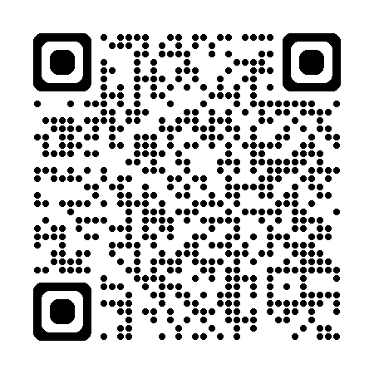
Routes in to OT
Preferred subjects include human biology, psychology, english and maths.
University
Masters
Glasgow Caledonian University
minimum highers BCCC
Queen Margaret University
minimum requirements BBCC
Robert Gordon University
minimum requirements BCCC
Glasgow Clyde
two highers (ideally one english, one in science)
Glasgow Caledonian University
2:2 honours degree
Queen Margaret University
2:1 honours in relevant subject
Edinburgh Napier University
2:1 honours relevant subject
College

Slide 18
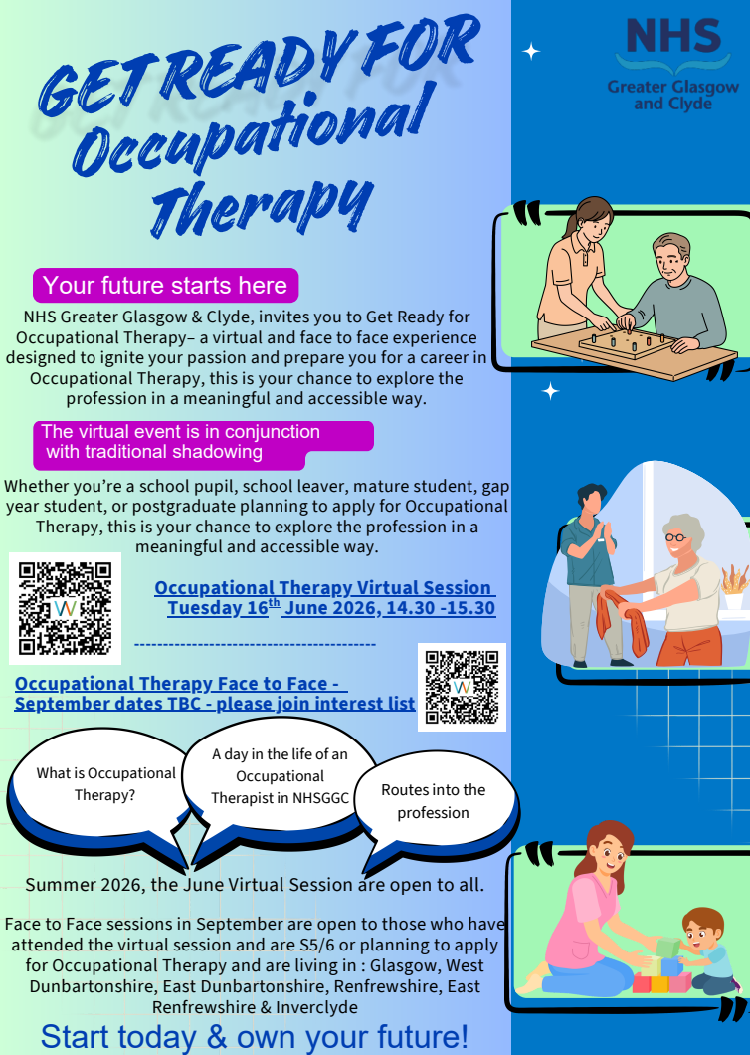
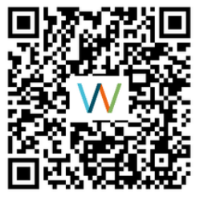
Next steps?
Use QR code to join the interest list for face to face shadowing opportunities in September – dates tbc

Slide 19
Questions???

