Slide 1
Food, Fluid and Nutrition
NHSGGC Paediatric Nurse Induction

Slide 2
Contents
Overview of Nutrition
Weighing and Measuring / Height and Weight
Identification of Malnutrition
Food provision for children in the RHC
Texture Modified Food and Fluid
The Mealtime Bundle

Slide 3
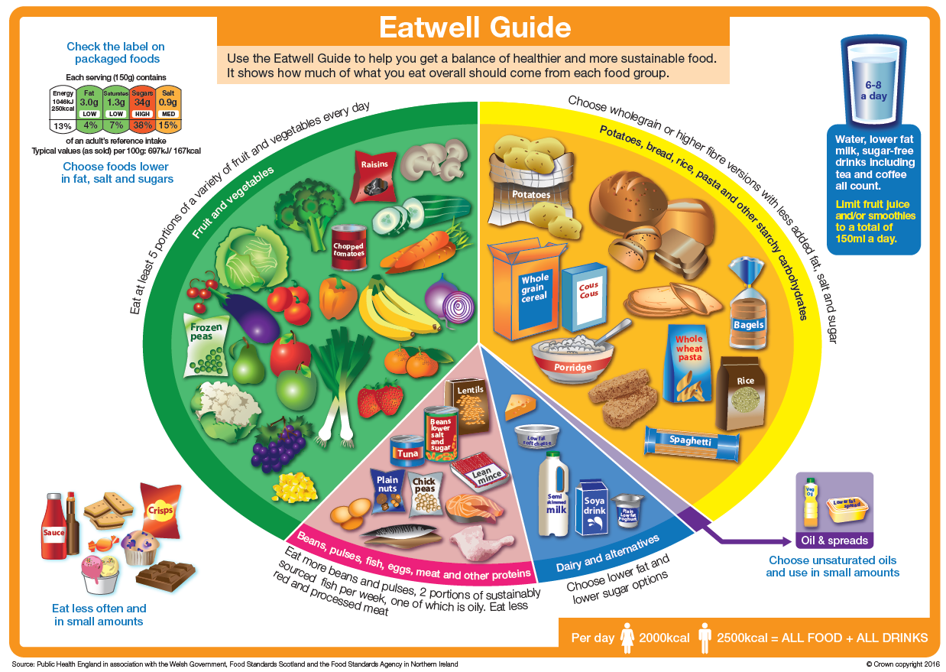
Nutrition – what’s the fuss?
Provides body with energy
Health and wellbeing
Everyone’s nutritional needs are different
Balanced diet is best
Imbalance in diet can result in malnutrition

Slide 4
What is malnutrition?
Malnutrition essentially means ‘bad nutrition’ i.e. deficiency, excess or imbalance of energy and protein relative to demands.
The term malnutrition does include obesity, however the focus is on “undernutrition”.
It can have short term or long term detrimental effects on the function of the body

Slide 5
Symptoms of Malnutrition
Loss of appetite
Weight loss
Loose clothing
Tiredness
Poor concentration/ altered mood
Reduced physical performance

Slide 6
Consequences of malnutrition
Delayed Growth
Impaired brain development
Life long health implications (e.g. bone health)
Impaired wound healing
Impaired temperature control
Reduced respiratory muscle function
Increased susceptibility to infections

Slide 7

Healthcare Improvement Scotland
Food, Fluid and Nutritional Care Standards (2014)
Standard 2
When a person is admitted to hospital, or to a community caseload, a nutritional care assessment is carried out. Screening for the risk of malnutrition is also carried out, both initially and on an ongoing basis. A person centred care plan is developed, implemented and evaluated

Slide 8
What is a nutritional care assessment?
An initial nutritional care assessment is an overall look at an individuals nutrition through a series of questions which can identify factors that may prevent the individual from eating and drinking enough to meet their nutritional requirements.
This assessment should be undertaken within 24 hours of admission to hospital or on first visit after being assigned onto a community nursing caseload.

Slide 9
Nutritional Care Assessment must include:-
  food allergies or intolerances
  eating and drinking likes and dislikes
  Therapeutic or texture-modified diets requirements
  cultural, ethnic or religious dietary requirements
  social and environmental mealtime requirements
  physical difficulties with eating and drinking, including swallowing difficulties
  the need for help and support with eating and drinking, for example prompting and encouragement, equipment or community meals,
  oral health status.

Slide 10
Weighing and Measuring
Height and Weight

Slide 11
Why do we need a height and weight?
Needed for accurate assessment of nutritional status and nutritional interventions
Important for medication doses
Must be recorded as part of PYMS on admission (within 24 hours of admission)
Height and weight should be plotted in age/ condition growth specific charts

Slide 12
Baby 0-2years
Good practice for 2 staff members to be present
Weigh baby (naked)
Electronic baby scales (ideally lying down, if child too big sit them in centre of scales)
Record to 3 decimal points e.g. 3.465kg

Slide 13
Length (supine)- essential for calculating surface area and monitoring growth.
Do on admission and every month
Lying down, naked and with no footwear
Length should be taken with flat feet rather than tip toes against measuring gauge
It is good practice to take 3 measurements and use the average

Slide 14
Child >2yrs
Weigh in light clothing (no shoes, <5yrs no socks)
Electronic sitting scales - ensure child is sitting in chair with bottom as far back on the seat as possible
Record to 2 decimal places e.g. 10.25kg

Slide 15
Measure height using a Stadiometer or rigid
upright measure with a T piece- No shoes
Heels, bottom, back and head must be touching the apparatus
Eye and ears at 90º
Make sure the child isn’t trying to stretch up
Measure on expiration

Slide 16
Recording of Measurements
Record weight every 7 days
Except:
  Patient on IV Fluids (weight daily)
  Nutritional screening tool indicates a weight in less than 7 days
  Dr/ Dietitian requests a weight in less than 7 days
Where to document?
  Cumulative Fluid Balance and Weight Chart
  Daily Fluid Balance Chart
  PYMS Chart

Slide 17
Videos
Please watch the following short videos to familiarise yourself with:
How to measure height
How to measure length
How to weigh
How to weigh children who don’t want to be weighed
https://www.rcpch.ac.uk/resources/uk-who-growth-charts-guidance-health-professionals

Slide 18
Identification of Malnutrition

Slide 19
iGrow
Includes plotting and monitoring height, weight, head circumference and BMI
Used to identify potential malnutrition in children <1yr
Weight faltering defines a weight gain pattern rather than a diagnosis
A child is classed as weight faltering if dropped > 2 centiles or more
Assessment required if a child remains below 0.4th centile

Slide 20
About PYMS
Developed in the Royal Hospital for Sick Children at Yorkhill in 2008
Designed to assist health professionals identify children at risk of malnutrition
Used for ages 1-16 years
Simple 4 step process, consisting of questions which are strong predictors of malnutrition
Step 5 is calculating the overall nutritional risk score
Action plan follows according to the overall nutrition score

Slide 21
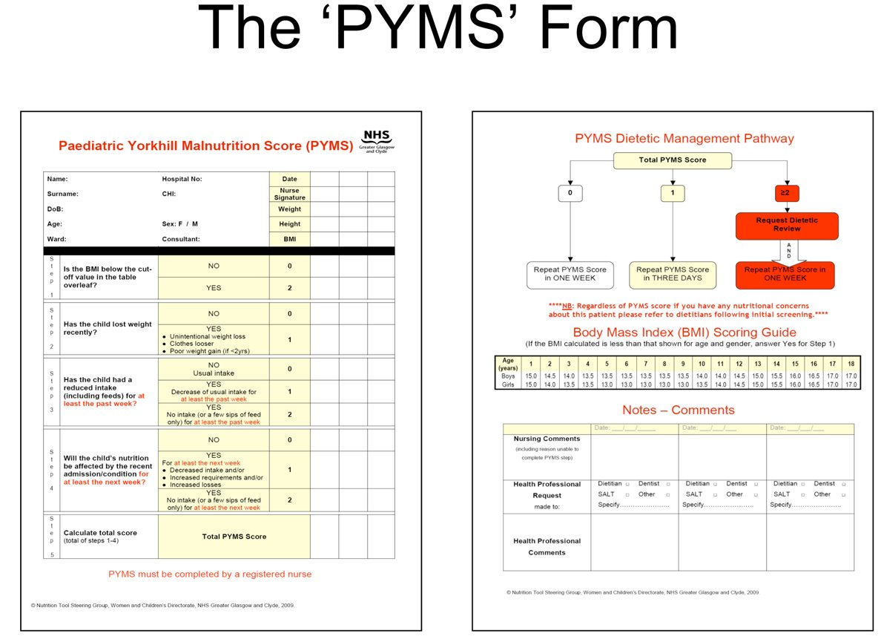

Slide 22
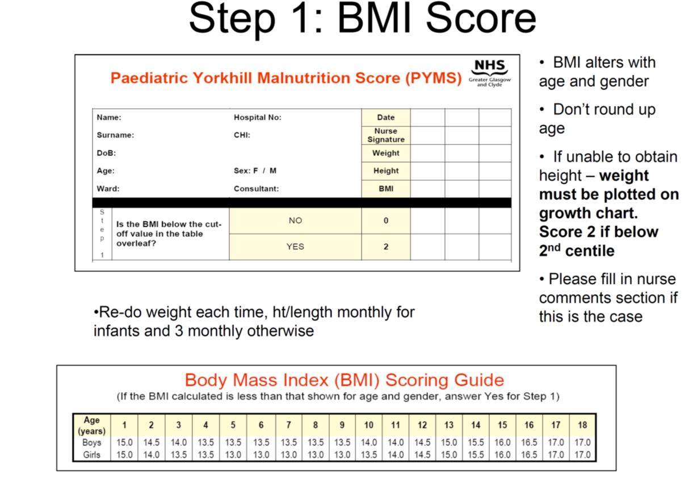
(BMI scoring guide overleaf)

Slide 23
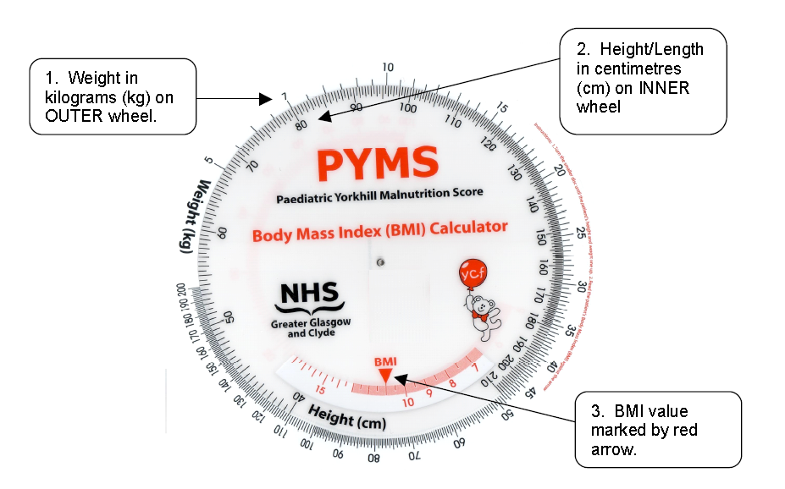
Calculating BMI using PYMS wheel

Slide 24
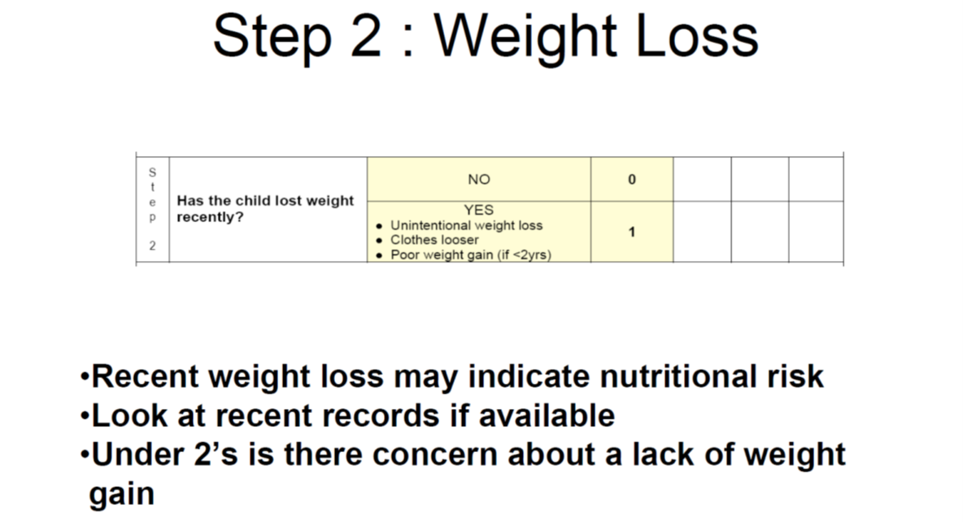

Slide 25
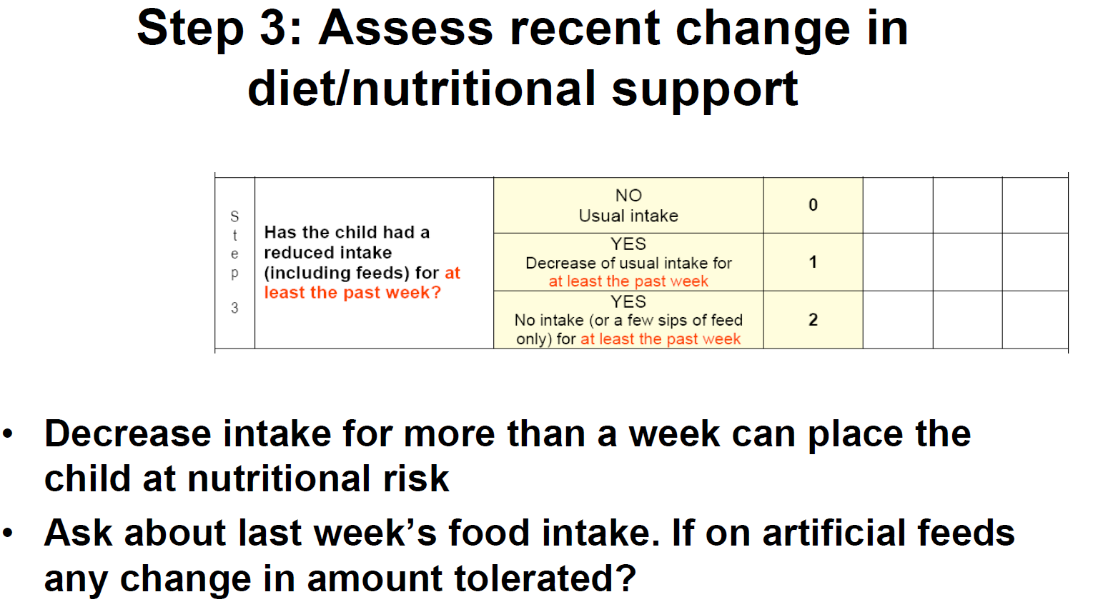
Unless a health professional has instructed reduction in calorie intake.

Slide 26
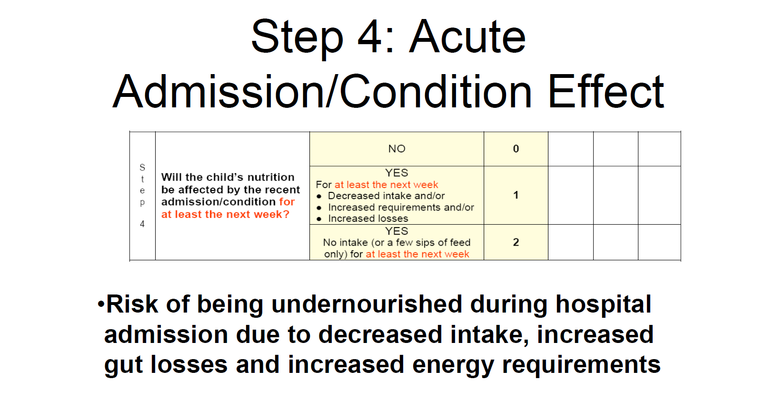
e.g;
• Persistent diarrhoea
• Persistent vomiting
e.g;
• Major
trauma
• Major burns
• Sepsis
• Pyrexia

Slide 27
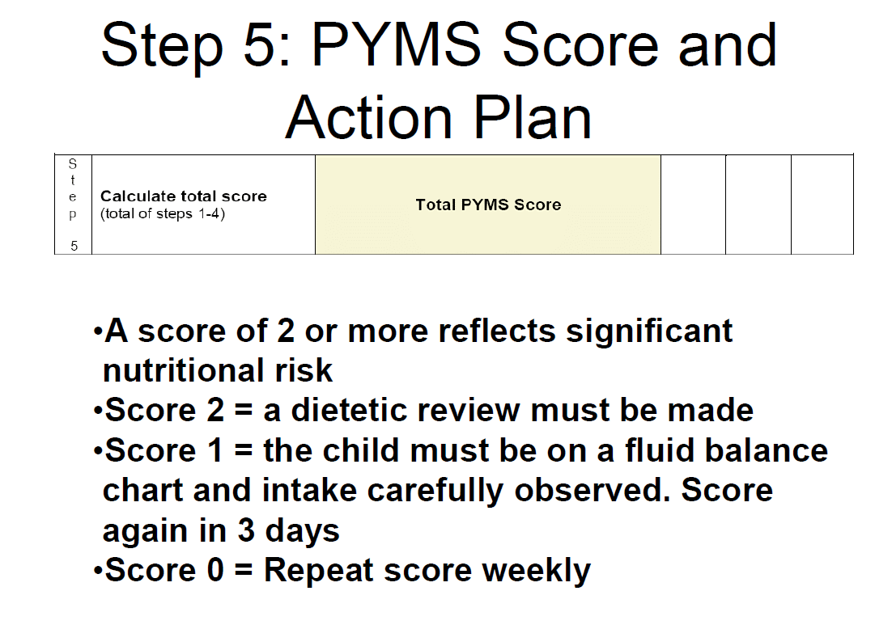

Slide 28
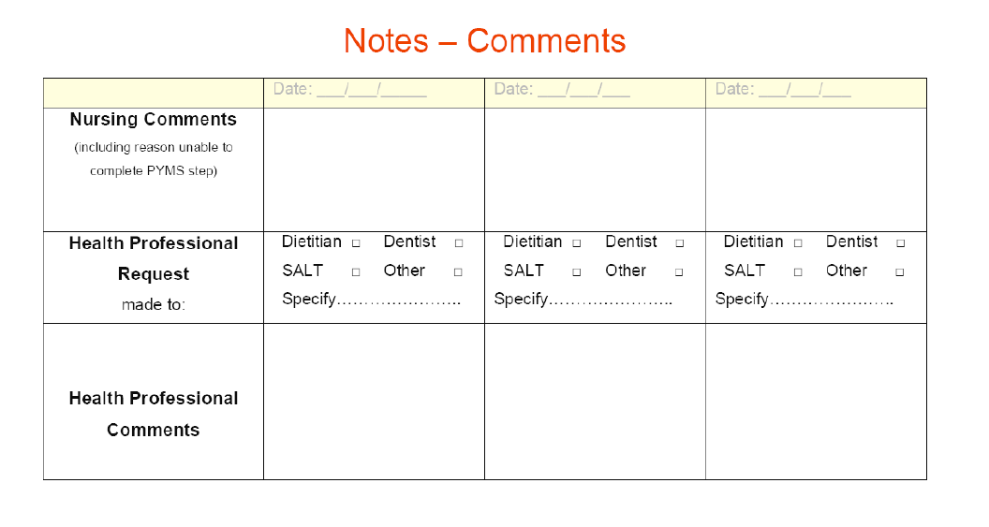
If you are unable to complete any steps give reasons why here.
If you are unable to obtain a height, the patient’s weight should be plotted on a growth chart and if < 2nd centile a score of 2 should be given for step 1.
Please document reason why a height could not be obtained i.e. cerebral palsy/scoliosis.

Slide 29
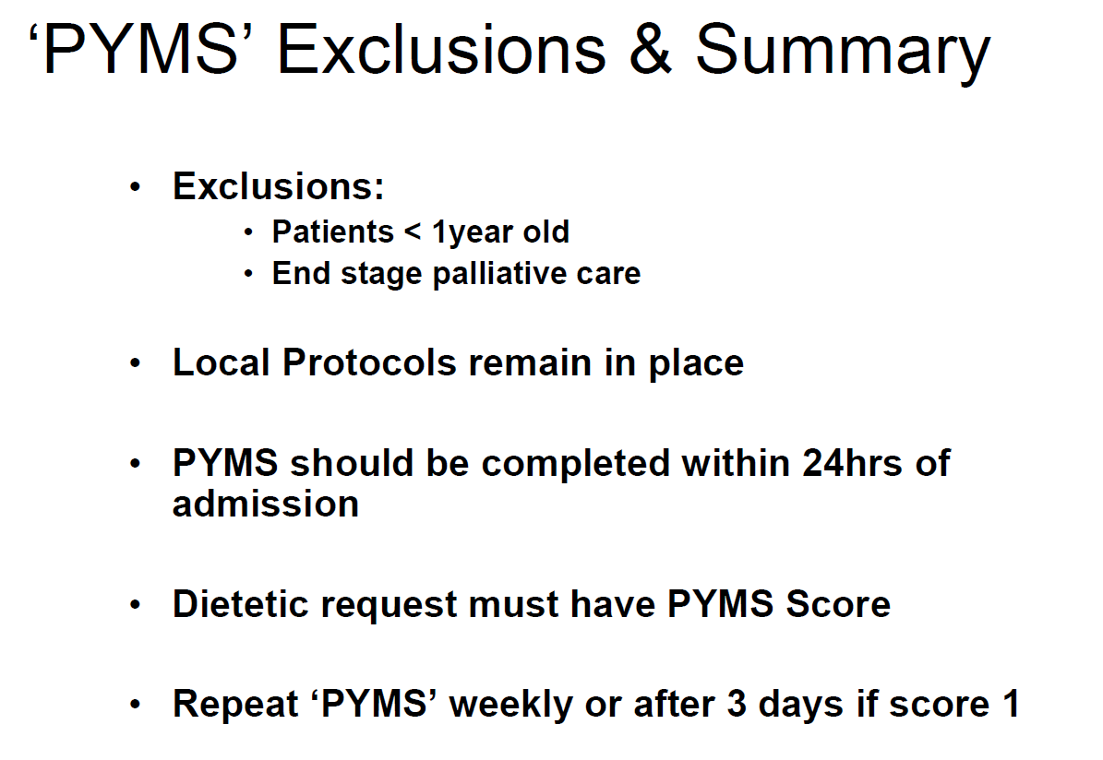
N.B. If there are clinical concerns about a patient’s nutritional status, a dietetic review MUST be requested and medical staff informed even if the child has scored less than 2.

Slide 30
Food Provision for Children
Royal Hospital for Children Glasgow

Slide 31
Food Provision
Breakfast 07:30-09:30
Trolley set up by catering staff, children have access to the following
Cereal | Milk | Bananas | Oranges
Toast | Butter | Jam | Yoghurt
Apple Juice | Orange Juice | Diluting Juice

Slide 32
Lunch and Dinner Service
Catering staff take meal orders in advance (please ensure catering staff are aware of any food allergies/ intolerances)
Lunch 12:00-12:30
  Some areas will provide snack boxes at lunch sandwich, yogurt, fruit & juice
  There are some additional items for children such as pizza, fish fingers, chicken nuggets etc.
Dinner 17:00-17:30
  Choice of hot meals with vegetables and potatoes or rice
  Spreads and sauces
  Hot or cold desserts and fruit

Slide 33
Hot Food Provision
Chefs use fresh ingredients, nutritionally analysed recipes, meals are cooked fresh and then blast frozen.
Food made in 2 CFPU’s (cook freeze production units) Paisley & Inverclyde
Food arrives at RHC frozen
Heated in Regeneration Oven in Kitchen Pods (takes 90 mins)
Kitchen Pods on levels 1, 2 & 3

Slide 34
Food Hygiene Legislation
All aspects of hospital catering in NHSGGC (including ward kitchens) must comply with Food Hygiene Laws
Each Food Handler is bound by the Food Hygiene Legislation
Premises can be inspected by enforcement officers at any time (including ward kitchens)
At ward level –food handlers must:
Maintain high standards of personal hygiene; wash hands, keep hair back
Be aware of the temperature controls for food
Ensure patient eating areas are clean and tidy
Ensure ward kitchens are kept clean and tidy
Ensure food is stored appropriately (staff food should be stored separately from patient food) and that there is good stock rotation
Ensure that monitoring and recording ward kitchen fridge temperatures is completed
Learn Pro GGC 146: Food Hygiene must be completed by all staff

Slide 35
Patients with special dietary requirements
We cater for: Halal, Kosher, Vegetarian, Vegan, Food Allergies/Intolerances, Patients with swallowing difficulties
Newly arrived – please speak with catering staff, if necessary ask for a Catering Supervisor
They will be able to access gluten free items/soya milk etc.
The more notice you give the catering staff the more options available

Slide 36
Allergies
Allergy aware menu available on all wards
Only refer to Dietitian if allergy not listed on the poster or child <12 months old

Slide 37
Provision in Ward Kitchens
Available 24hrs
Sandwiches (ham, cheese, tuna & egg mayo)
Bread
Butter
Jam
Fruit (bananas, apples & oranges
Biscuits
Custard pots
Rice pudding
Jelly
Apple juice
Orange juice
Diluting juice
Milk (green & blue)
Cold water
Please use these items for missed meals or contact Catering

Slide 38
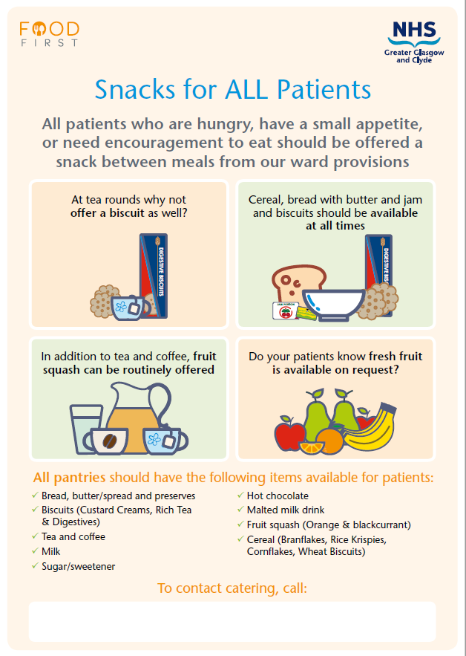
Snacks

Slide 40
What does ‘Food First’ mean?
Across NHSGGC we encourage staff to offer ‘food first’ where appropriate, to support patients to receive adequate nutrition to support recovery and rehabilitation. ​
Key interventions include
Supporting nutritionally vulnerable patients to select higher calorie choices at meals times
Use of ward provisions such as bread, cereals, biscuits, milk and drinks out with mealtimes
Offering additional snacks throughout the day, encouraging small portions regularly when they have a poor appetite
Offering full fat milk with and between meals
Regular provision of fresh water and drinks
Increasing the opportunities that patients have access to food and drinks through regular prompting can support the ‘little and often’ approach and may help reduce the number of patients who lose weight during their hospital stay.

Slide 41
Texture Modified Food and Fluid
International Diet Descriptor Standardisation Initative (IDDSI)

Slide 42
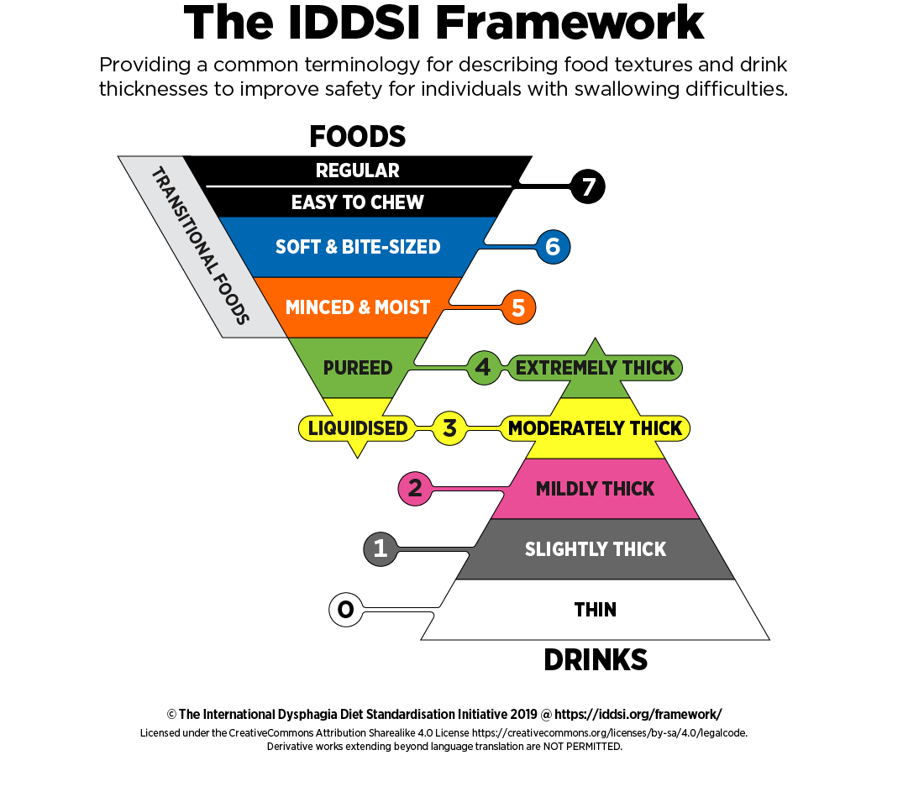
Texture Modified Food and Fluid
Texture Modified meals have had their normal texture altered
They are required by patients who have chewing or swallowing difficulties
The IDDSI framework is used to describe the consistency of modified food and fluids for people with dysphagia
There is NO Level 6 provided for Paediatric inpatients due to particle size. Level 5 to be commenced instead
Patients who are on a blended diet via PEG at home can order level 4 diet from catering. No dietetic referral required

Slide 43
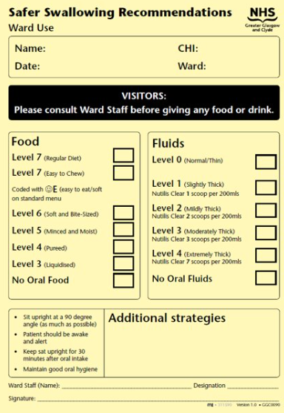
Safer Swallowing Recommendations
Patients admitted already on a Texture Modified Diet, the Nurse will need to complete the Ward Use page of the yellow Paediatric Safer Swallowing Recommendations form & display it at the bedside
Patients who are seen by SLT & commenced on TMD will have the completed Speech and Language Therapy Use page of the form completed & displayed at the bedside

Slide 44
IDDSI Level Descriptor

Slide 46
IDDSI Fluid Descriptor
The following drinks are easily thickened:
  Water
  Diluting juice
No thickeners can be added to Oral Nutritional Supplements for example PaediaSure
Patients on thickened fluids are at the risk of dehydration and should have their fluid intake monitored

Slide 47
The Mealtime Bundle
The following outlines the steps that should be taken to ensure that every patient receives a suitable meal that they enjoy & that it is delivered safely every time.
It is your responsibility to ensure that you are aware of the correct procedures & processes surrounding food provision & delivery.

Slide 48
The Mealtime Co-ordinator
The Mealtime Co-ordinator must be identified at beginning of each day shift . Their role is to:
Liaise with Catering about any special dietary requirements & food allergies
Identify patients who require assistance and what level of assistance
Patients must always be offered hand hygiene prior to eating
Patient table & surroundings must be cleaned prior to food being served
Ensure hand hygiene & aprons when handling any patient food
After meals, a full sweep to ensure patients have eaten and are satisfied with their mealtime experience
All food and fluid charts are updated

Slide 49
Enteral Feeding
You MUST have had the relevant training and be deemed competent BEFORE:
  Administering enteral feeds
  Insertion of enteral devices
  Caring for enteral devices
  Including nasogastric, gastrostomy or jejunal
Please familiarise yourself with the ‘Paediatric nasogastric feeding guideline for healthcare professionals’ access via rightdecisions.scot.nhs.uk

Slide 50
Further Information
If you would like to find out more information about food, fluid and nutrition as you settle into your new role in the RHC contact your paediatric dietitian or nutrition nurse

