Slide 1
Food, Fluid and Nutrition
NHSGGC Paediatric Nurse Induction

Slide 2
Contents
Overview of Nutrition
Weighing and Measuring / Height and Weight
Identification of Malnutrition
Food provision for children in the RHC
Texture Modified Food and Fluid
The Mealtime Bundle

Slide 3
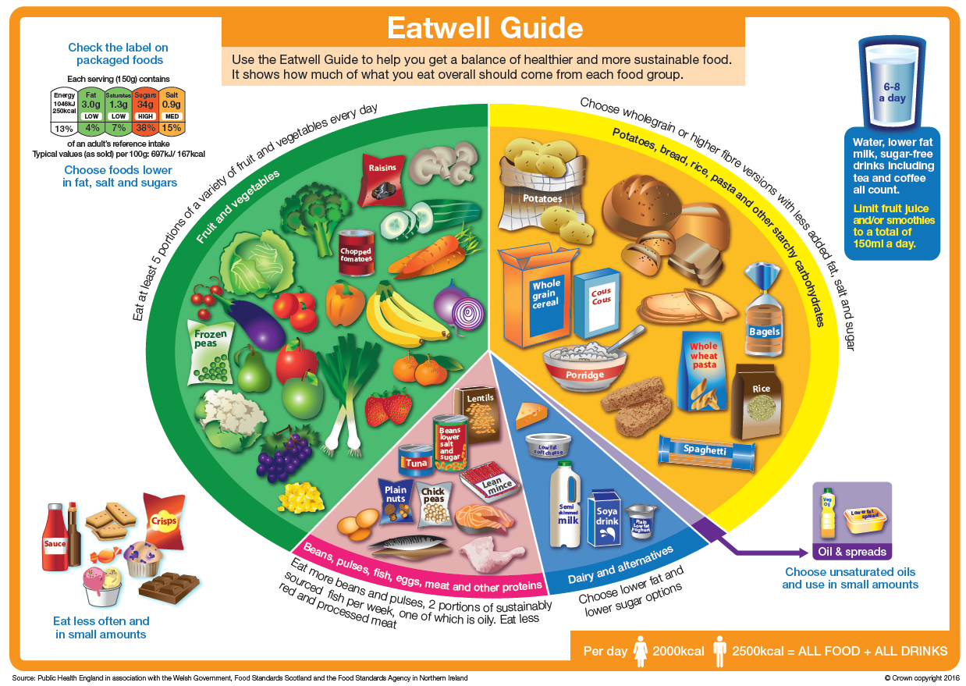
Nutrition – what’s the fuss?
Provides body with energy
Health and wellbeing
Everyone’s nutritional needs are different
Balanced diet is best
Imbalance in diet can result in malnutrition

Slide 4
What is malnutrition?
Malnutrition essentially means ‘bad nutrition’ i.e. deficiency, excess or imbalance of energy and protein relative to demands.
The term malnutrition does include obesity, however the focus is on “undernutrition”.
It can have short term or long term detrimental effects on the function of the body

Slide 5
Symptoms of Malnutrition
Loss of appetite
Weight loss
Loose clothing
Tiredness
Poor concentration/ altered mood
Reduced physical performance

Slide 6
Consequences of malnutrition
Delayed Growth
Impaired brain development
Life long health implications (e.g. bone health)
Impaired wound healing
Impaired temperature control
Reduced respiratory muscle function
Increased susceptibility to infections

Slide 7

Healthcare Improvement Scotland
Food, Fluid and Nutritional Care Standards (2014)
Standard 2
When a person is admitted to hospital, or to a community caseload, a nutritional care assessment is carried out. Screening for the risk of malnutrition is also carried out, both initially and on an ongoing basis. A person centred care plan is developed, implemented and evaluated

Slide 8
What is a nutritional care assessment?
An initial nutritional care assessment is an overall look at an individuals nutrition through a series of questions which can identify factors that may prevent the individual from eating and drinking enough to meet their nutritional requirements.
This assessment should be undertaken within 24 hours of admission to hospital or on first visit after being assigned onto a community nursing caseload.

Slide 9
Nutritional Care Assessment must include:-
  food allergies or intolerances
  eating and drinking likes and dislikes
  Therapeutic or texture-modified diets requirements
  cultural, ethnic or religious dietary requirements
  social and environmental mealtime requirements
  physical difficulties with eating and drinking, including swallowing difficulties
  the need for help and support with eating and drinking, for example prompting and encouragement, equipment or community meals,
  oral health status.

Slide 10
Weighing and Measuring
Height and Weight

Slide 11
Why do we need a height and weight?
Needed for accurate assessment of nutritional status and nutritional interventions
Important for medication doses
Must be recorded as part of PYMS on admission (within 24 hours of admission)
Height and weight should be plotted in age/ condition growth specific charts

Slide 12
Baby 0-2years
Good practice for 2 staff members to be present
Weigh baby (naked)
Electronic baby scales (ideally lying down, if child too big sit them in centre of scales)
Record to 3 decimal points e.g. 3.465kg

Slide 13
Length (supine)- essential for calculating surface area and monitoring growth.
Do on admission and every month
Lying down, naked and with no footwear
Length should be taken with flat feet rather than tip toes against measuring gauge
It is good practice to take 3 measurements and use the average

Slide 14
Child >2yrs
Weigh in light clothing (no shoes, <5yrs no socks)
Electronic sitting scales - ensure child is sitting in chair with bottom as far back on the seat as possible
Record to 2 decimal places e.g. 10.25kg

Slide 15
Measure height using a Stadiometer or rigid
upright measure with a T piece- No shoes
Heels, bottom, back and head must be touching the apparatus
Eye and ears at 90º
Make sure the child isn’t trying to stretch up
Measure on expiration

Slide 16
Recording of Measurements
Record weight every 7 days
Except:
  Patient on IV Fluids (weight daily)
  Nutritional screening tool indicates a weight in less than 7 days
  Dr/ Dietitian requests a weight in less than 7 days
Where to document?
  Cumulative Fluid Balance and Weight Chart
  Daily Fluid Balance Chart
  PYMS Chart

Slide 17
Videos
Please go to
http://www.rcpch.ac.uk/who-uk-growth-charts resources-videos
to familiarise yourself with the following:
How to measure height
How to measure length
How to weigh
How to weigh children who don’t want to be weighed

Slide 18
Identification of Malnutrition

Slide 19
iGrow
Used to identify malnutrition in children <1yr
Weight faltering defines a weight gain pattern rather than a diagnosis
A child is classed as weight faltering if dropped > 2 centiles or more
Assessment required if a child remains below 0.4th centile)

Slide 20
About PYMS
Developed in the Royal Hospital for Sick Children at Yorkhill in 2008
Designed to detect energy/protein under-nutrition in children over 1 year of age
Simple 5 step tool
identifying children who are at risk of malnutrition in order to aid dietetic referral

Slide 21
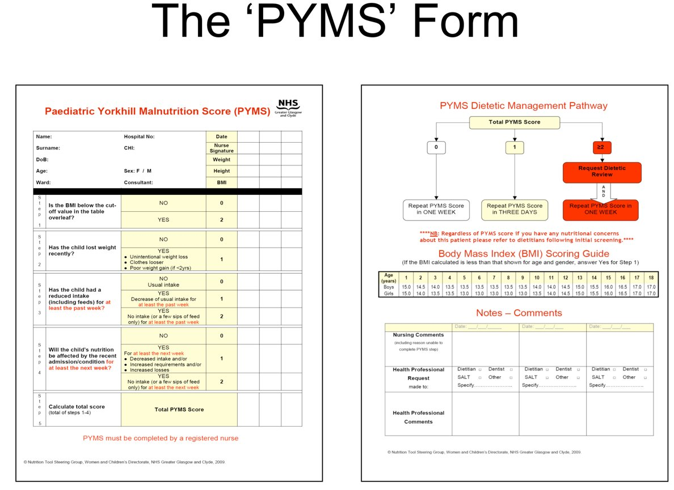

Slide 22
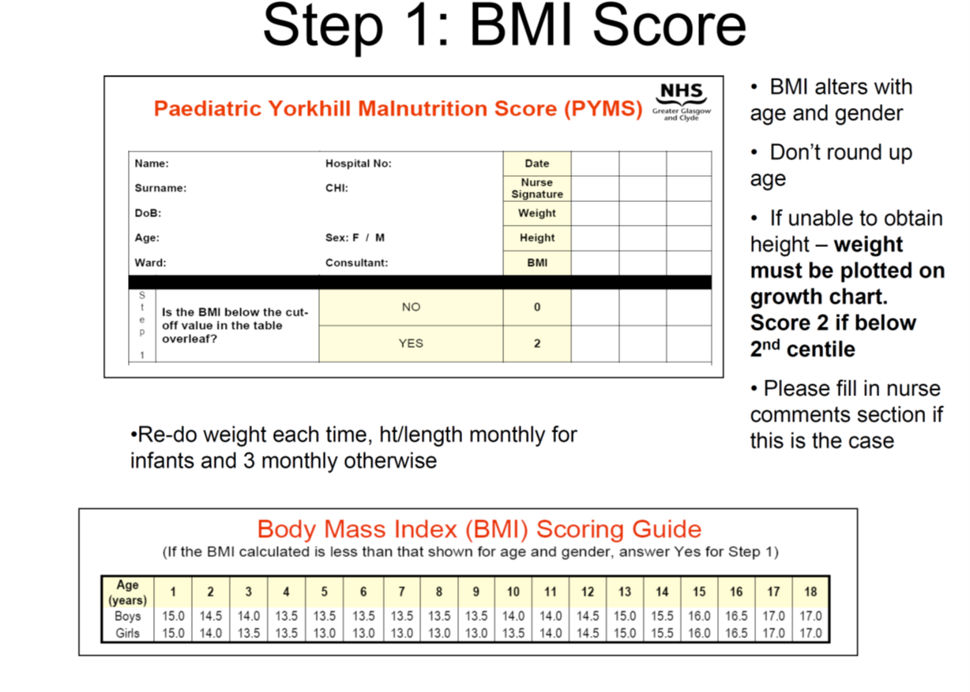

Slide 23
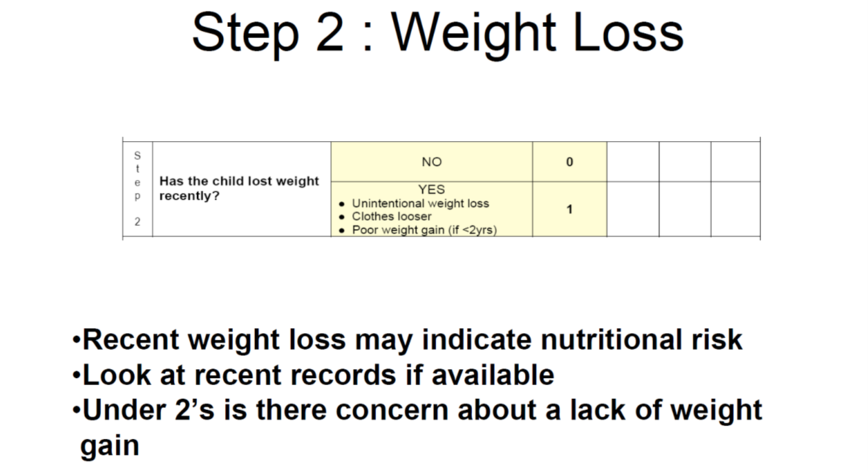

Slide 24
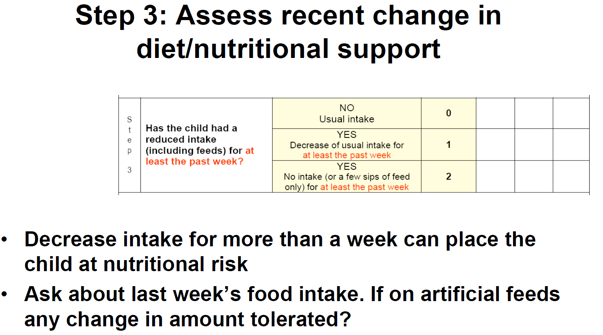

Slide 25
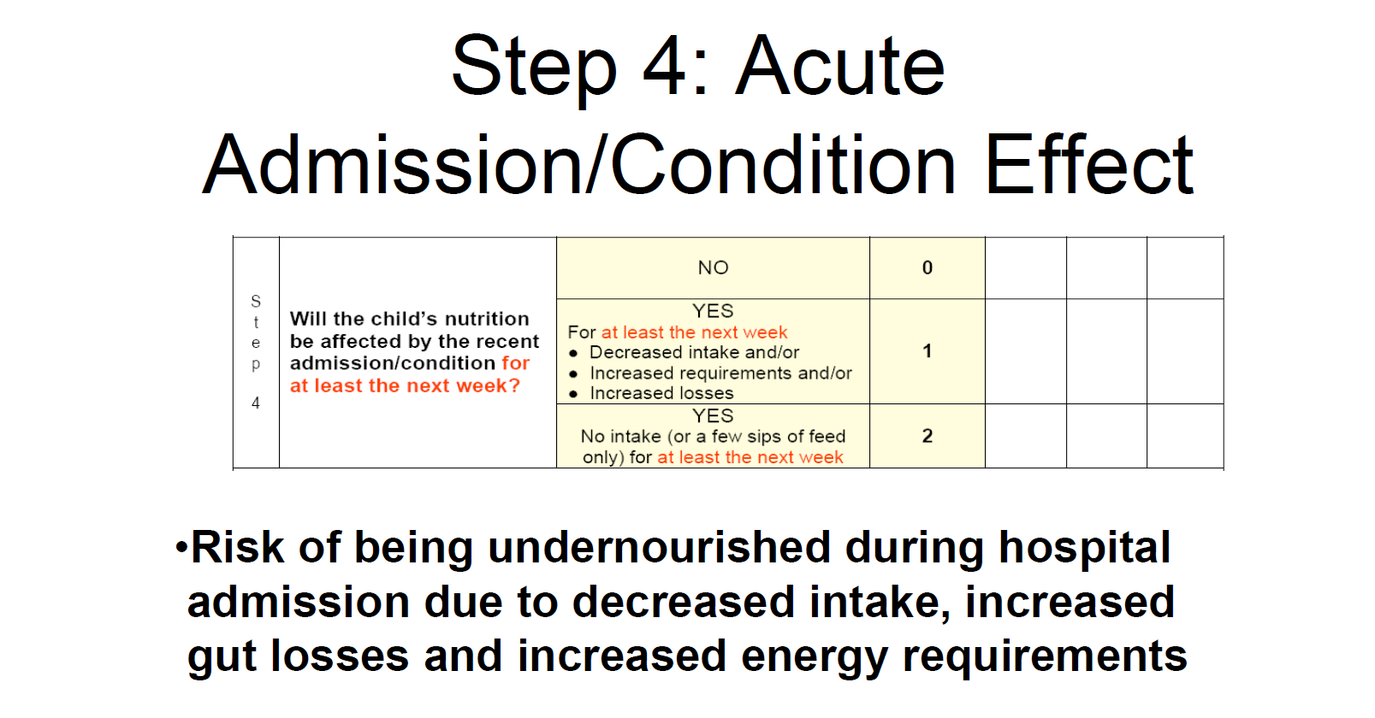

Slide 26
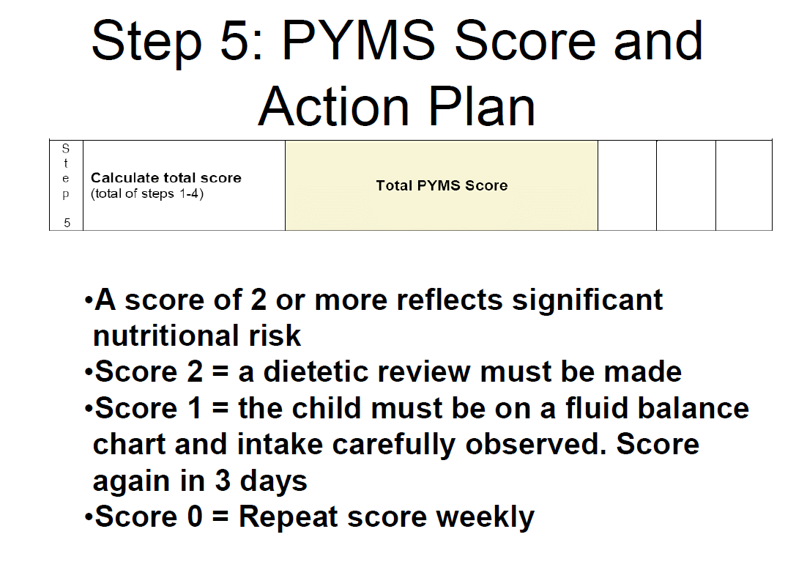

Slide 27
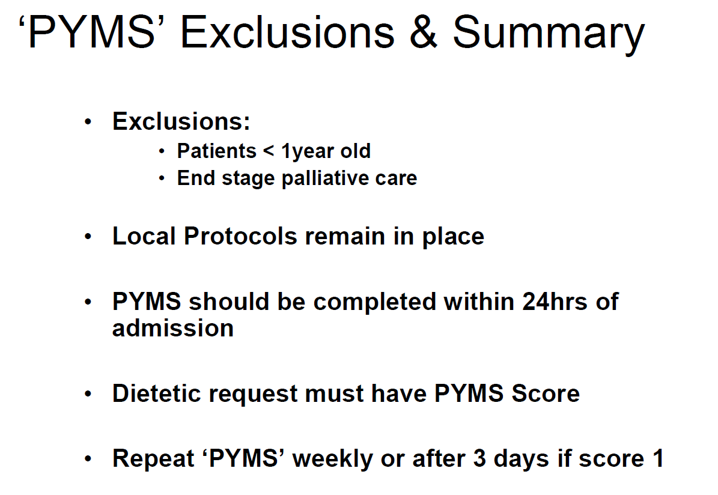

Slide 28
Food Provision for Children
Royal Hospital for Children Glasgow

Slide 29
Food Provision
Breakfast 07:30-09:30
Trolley set up by catering staff, children have access to the following
Cereal | Milk | Bananas | Oranges
Toast | Butter | Jam | Yoghurt
Apple Juice | Orange Juice | Diluting Juice

Slide 30
Lunch and Dinner Service
Lunch 12:00-12:30
Dinner 17:00-17:30
Catering staff take meal orders in advance (please ensure catering staff are aware of any food allergies/ intolerances)
Some areas will provide snack boxes at lunch sandwich, yogurt, fruit & juice
There are some additional items for children such as pizza, fish fingers, chicken nuggets etc.

Slide 31
Lunch Service 2C and 6A
Children choose their own lunch from the Deli Cart
Choices Available
  Soup
  Baked potato, bread, wrap or baguette
  Ham, Turkey, cheese, hummus, cocktail sausages
  Lettuce, Cucumber, tomatoes, sweetcorn, carrot sticks, peppers, beetroot, coleslaw
  Spreads and sauces
  Cold desserts and fruit

Slide 32
Hot Food Provision
Chefs use fresh ingredients, nutritionally analysed recipes, meals are cooked fresh and then blast frozen.
Food made in 2 CFPU’s (cook freeze production units) Paisley & Inverclyde
Food arrives at RHC frozen
Heated in Regeneration Oven in Kitchen Pods (takes 90 mins)
Kitchen Pods on levels 1, 2 & 3

Slide 33
Food Hygiene Legislation
All aspects of hospital catering in NHSGGC (including ward kitchens) must comply with Food Hygiene Laws
Each Food Handler is bound by the Food Hygiene Legislation
Premises can be inspected by enforcement officers at any time (including ward kitchens)
At ward level –food handlers must:
Maintain high standards of personal hygiene; wash hands, keep hair back
Be aware of the temperature controls for food
Ensure patient eating areas are clean and tidy
Ensure ward kitchens are kept clean and tidy
Ensure food is stored appropriately (staff food should be stored separately from patient food) and that there is good stock rotation
Ensure that monitoring and recording ward kitchen fridge temperatures is completed
Learn Pro GGC 146: Food Hygiene

Slide 34
Patients with special dietary requirements
We cater for: Halal, Kosher, Vegetarian, Vegan, Food Allergies/Intolerances, Patients with swallowing difficulties
Newly arrived – please speak with catering staff, if necessary ask for a Catering Supervisor
They will be able to access gluten free items/soya milk etc.
The more notice you give the catering staff the more options available

Slide 35
Allergies
Allergy aware menu available on all wards
Only refer to Dietitian if allergy not listed on the poster or child <12 months old

Slide 36
Provision in Ward Kitchens
Available 24hrs
Sandwiches (ham, cheese, tuna & egg mayo)
Bread
Butter
Jam
Fruit (bananas, apples & oranges
Biscuits
Custard pots
Rice pudding
Jelly
Apple juice
Orange juice
Diluting juice
Milk (green & blue)
Cold water
Please use these items for missed meals or contact Catering

Slide 37
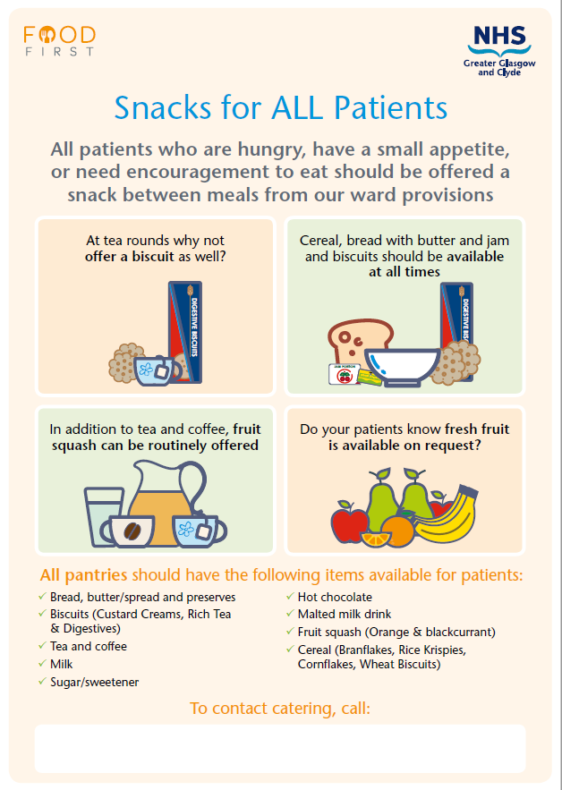
Snacks

Slide 39
What does ‘Food First’ mean?
Across NHSGGC we encourage staff to offer ‘food first’ where appropriate, to support patients to receive adequate nutrition to support recovery and rehabilitation. ​
Key interventions include
Supporting patients to select higher calorie choices at meals times
Offering regular snacks throughout the day
Offering full fat milk with and between meals
Increasing the opportunities that patients have access to food and drinks through regular prompting can support the ‘little and often’ approach and may help reduce the number of patients who lose weight during their hospital stay.

Slide 40
Texture Modified Food and Fluid
International Diet Descriptor Standardisation Initative (IDDSI)

Slide 41
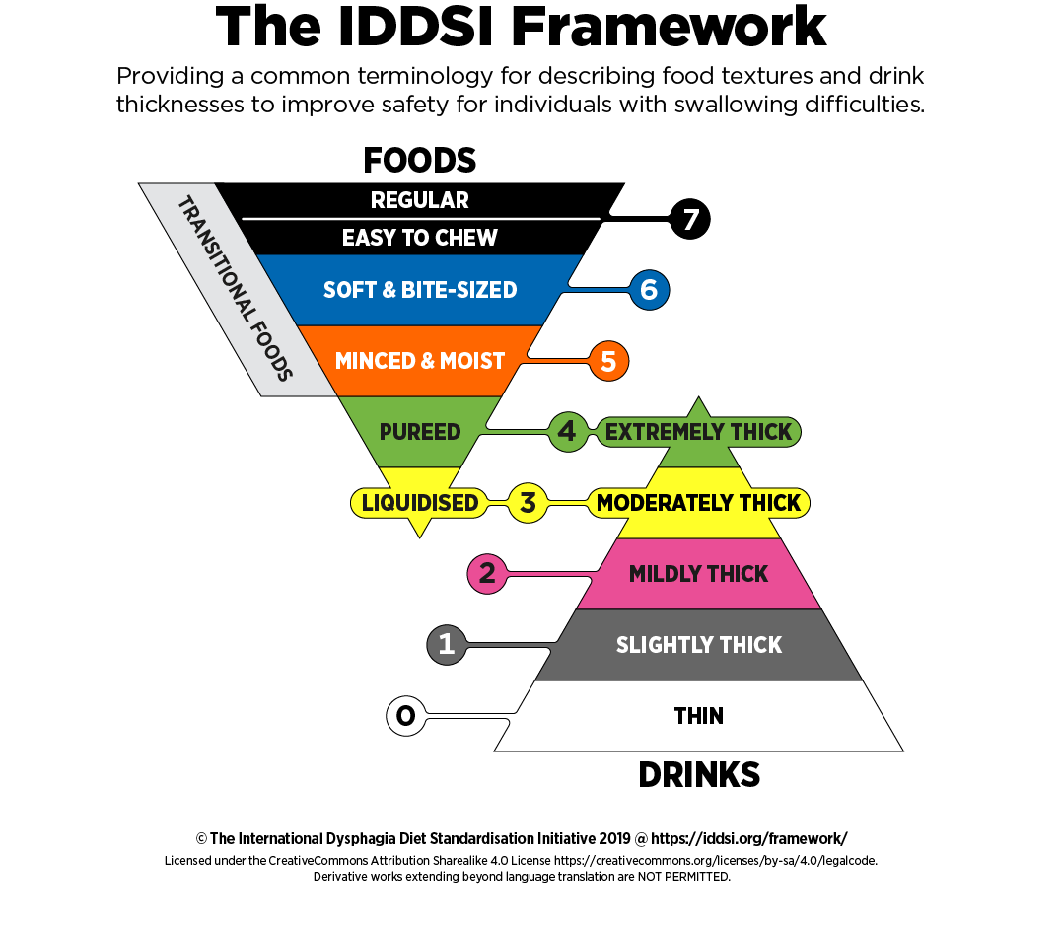
Texture Modified Food and Fluid
Texture Modified meals have had their normal texture altered. They are required by patients who have chewing or swallowing difficulties.
The IDDSI framework is used to describe the consistency of modified food and fluids for people with dysphagia

Slide 42
Familiarise yourself with the different diet levels
There is NO Level 6 provided for Paediatric inpatients due to particle size. Level 5 to be commenced instead
Patients admitted already on a Texture Modified Diet, the Nurse will need to complete the Ward Use page of the yellow Paediatric Safer Swallowing Recommendations form & display it at the bedside
Patients who are seen by SLT & commenced on TMD will have the completed Speech and Language Therapy Use page of the form completed & displayed at the bedside
Patients who are on a blended diet via NG tube or PEG at home can order level 4 diet from catering. No dietetic referral required.

Slide 46
The Mealtime Bundle
The following outlines the steps that should be taken to ensure that every patient receives a suitable meal that they enjoy & that it is delivered safely every time. It is your responsibility to ensure that you are aware of the correct procedures & processes surrounding food provision & delivery.

Slide 47
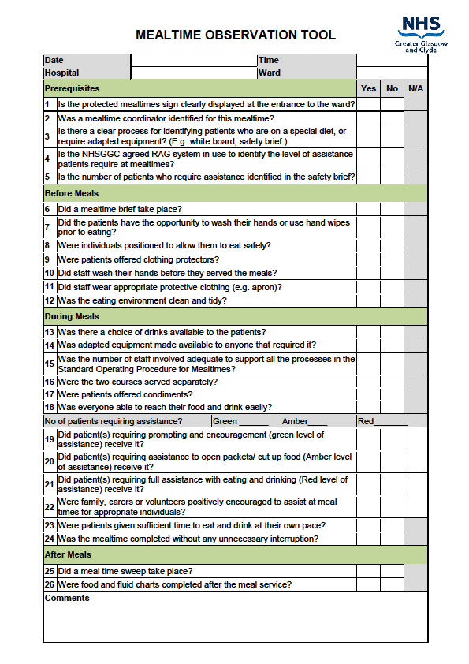
Important Points
A Mealtime Co-ordinator must be identified on day shift to liaise with Catering about any special dietary requirements & food allergies
Patients must always be offered hand hygiene prior to eating
Patient table & surroundings must be cleaned prior to food being served
Hand hygiene & aprons when handling any patient food

Slide 48
Enteral Feeding
BEFORE administering enteral feeds / insertion of enteral devices / caring for enteral devices (nasogastric, gastrostomy or jejunal), you MUST be deemed competent.
It is your responsibility to ensure that you are signed off as competent using the WoSPGHaN (West of Scotland Paediatric Gastroenterology, Heptology and Nutrition) Competency Packs.
Enteral Nutrition Competencies – WoSPGHaN West of Scotland Paediatric Gastroenterology Heptology and Nutrition Managed Clinical Network – http://www.wospghan.scot.nhs.uk

Slide 49
Further Information
If you would like to find out more information about food, fluid and nutrition as you settle into your new role in the RHC contact your paediatric dietitian or nutrition nurse

