Slide 1
Essential Skills for Managers

Slide 2
Programme Structure
Day 1
Communication
Day 2
Organising and Delegating
Day 3
Managing Change, Problem Solving and Decision Making
Some activities to help you understanding the concept better

Slide 3
Link to KSF
C1 Communication
C2 Personal and People Development
C3 Health, Safety and Security
C5 Quality
C6 Equality and Diversity
G6 People Management

Slide 4

Your Objectives
Key personal learning points
Impact of the programme
Action planning (proposed impact)
Workbook

Slide 5


“Tell me and I forget, teach me and I may remember, involve me and I learn.”
Benjamin Franklin

Slide 6
Essential Skills for Managers
Session 1
Communicating and Influencing

Slide 7
Learning Outcomes
Understand the communication process
Different methods of communication
How to assess your own communication effectiveness
How good communicators influence others
Your role in successful communication
Importance of employee voice
Communication planning and assessment

Slide 8
The Communication Cycle
BARRIERS
INTERFERENCE
BARRIERS
INTERFERENCE
BARRIERS
Sender
Message
Receiver
Transmission
Feedback

Slide 9

Barriers to Effective Communication
Workplace and Individual
  Physical barriers/environment
  Wrong methods of communication
  Psychological, emotional and behavioural
  Technological
  Organisational structure or culture
  Communication skills
  Cultural differences
  Clarity and consistency
  Trust
  Lack of active listening
  Perception

Slide 10
Barriers to Effective Communication
  Inequalities
  Language Barrier
  Physiological, Mental Health
  Learning Difficulties
  Cultural/Religious Needs
  Sensory Impairments
  Literacy, numeracy issues
  Digital Inequalities
  Neurodiversity

Slide 11

Making Communication Accessible for Everyone
Support needs can be situational
  Preferred language or interpretation support
  Hearing, sight or speech support needs
  Pain, fatigue, anxiety or distress
  Learning differences and accessible formats
  Cultural, religious or personal preferences
  Literacy, numeracy or health-literacy support
  Digital access, confidence or affordability
  Neurodiversity and different processing styles
Ask what helps
Do not assume

Slide 12

Self-Awareness
In the workplace:
  Clinical Governance
  HR policies and Staff Governance guidance
  Equality legislation
Personally:
  Be aware of influences on your communication
  Use the Accessible Information Policy
  Be a good role model

Slide 13

Active listening
Listen to understand
Show that you are listening
Suspend judgment
Feedback
Respond

Slide 14

Questioning Techniques
Questioning is the ability to organize our thinking around what we
do not know.
The Right Question Institute
Questions we ought to use:
  Open
  Closed
  Probing
  Reflective
  Comparative
Questions we ought to avoid:
  Leading
  Multiple
  Ambiguous
  Tricky

Slide 15

Non-Verbal Communication
Eye contact
Tone of voice
Facial expressions
Body language/posture
Gestures
Spatial distance
Touch
Deliberate silence

Slide 16
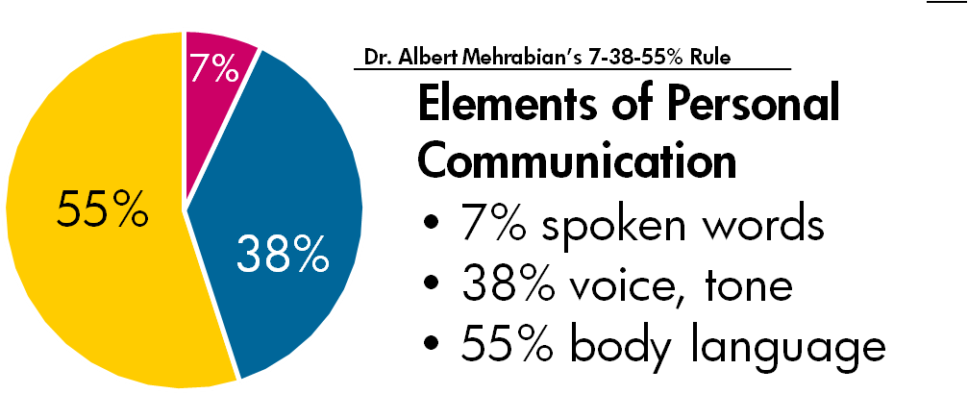

Slide 17

Activity
Are You Approachable at Work?

Slide 18
Communication Methods in Workplace
Face-to-Face
(individual, groups)
Written (letters, memos)
Email
Telephone, walkie-talkie
Pager, mobile
Noticeboards
Social media
e-Health platforms
(e.g. emis, eESS, Turas)

Slide 19
Communication Methods in Workplace
MS Teams
Zoom
Yammer
Team meetings
Huddles
Team/Core Brief
i-Matter
Small Change Matters

Slide 20
Principles of an Effective Communications Strategy
“An effective approach to internal communication
will be cohesive and strategic, and support a culture of
trust and openness”

Slide 21

Successful Communication
Builds a shared sense of purpose
Receives attention and support from all
Drives genuine dialogue
Good for people management
Supports equality and diversity
Supports the rights of people
Respects people’s ideas, values and principles
Ensures people’s dignity and rights

Slide 22

Role of Line Managers
  HR Agents
  Front line of communicating
  Responsible for effective communication
  Be communicative
  Confidentiality

Slide 23
Role of Employees
Sharing
Learning
Listening
Collaborating

Slide 24
Influence of Good Communication
In difficult times
Employee Engagement
Better Performance
Employee Retention
Wellbeing
Employee Voice

Slide 25


Power of Employee Voice
Resolves operational issues
Encourage staff to collaborate
Gives employees greater voice
Gains insight into issues

Slide 26
Activity
Think of something challenging (person/situation) that you need to address?
What would you say?

Slide 27
Think of something challenging that you need to address?
State the Situation
State why it is a problem
State your expectation/s
Listen to response/s
Repeat number 3 (If required)

Slide 28

4Ws + H Technique
A quick checklist for planning a clear communication
1
Who
needs to know or be involved?
2
What
is the message or action required?
3
Why
does it matter to them?
4
When
Timing and frequency?
5
How
Delivery method?
Use the sequence before choosing the channel or tailoring the message

Slide 29

Communication Planning
Make the right choice before the message goes out.
1
Communication strategy
Align the purpose, audience and timing.
2
Communication channel
Choose the route people will actually use.
3
Message selection
Decide what must be understood or done.
4
Tailor communications
Adapt language, tone and support needs.
Plan first; communicate second

Slide 30

Assessing Communications Effectiveness
Overall, within your team
Success against specific objectives

Slide 31
Activity
The Communication Quiz
How Good Are Your Communication Skills?

Slide 32

Self Assessment
Feedback
Reflective practice
Self-evaluation
Check with the policies and guidelines
Check with current development
Find out what is available
Workbook activities and resources

Slide 33

Our Organisational Goals and Values
We put patients first
We focus on outcomes
We take responsibility
We work as one team
We always try to do better
We treat each other with respect

Slide 34


Staff Health and Wellbeing
Your duty as a manager
Resources:
NHSGGC Health and Wellbeing Directory
A Healthier Place to Work
Your Health
Stress in the Workplace
Staff Resources and Support

Slide 35
Activities
Workbook

Slide 36
Essential Skills for Managers
Session 2
Organising and Delegating

Slide 37
Learning Outcomes
Leadership vs Management
Performance management and factors affecting it
Time management and principles of good time management
Key principles of delegation

Slide 38
Leadership vs Management
Management
Leadership
is concerned with planning, budgeting, organising, staffing, controlling and problem-solving
involves establishing direction, aligning people, motivating and inspiring
vs
Gets the job organised
Helps people to move toward the goal
(Kotter 1996)

Slide 39
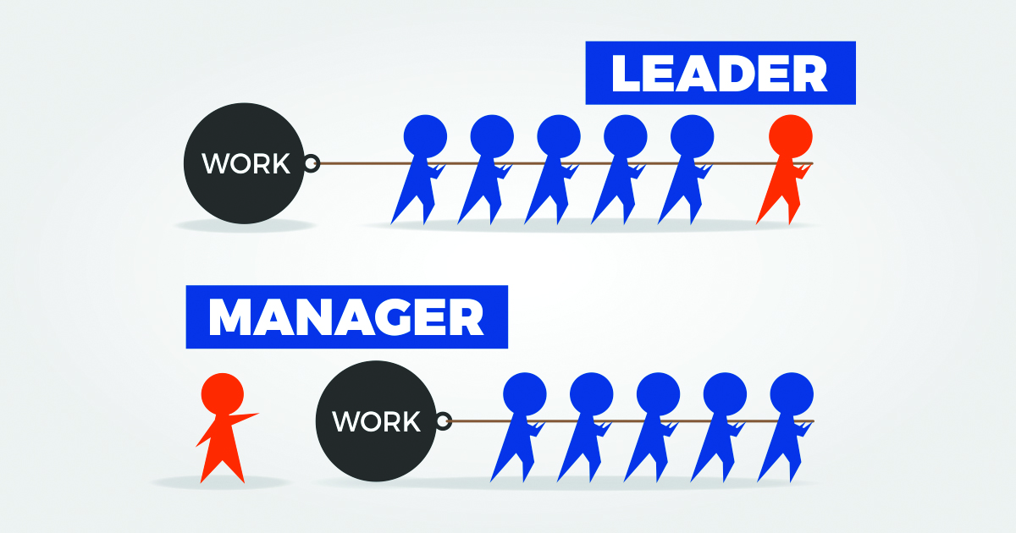

Slide 40


Slide 41
Spot the Behaviour
A quick way to make the leadership/management distinction practical
A
Sets the rota, clarifies deadlines, checks progress
B
Explains why the work matters and connects it to patient or service outcomes
C
Removes blockers and helps the team decide the best route
D
Monitors standards and follows up when delivery slips
Prompt: Type M for management, L for leadership — or B for both

Slide 42
Leadership is the art of motivating people toward a common goal or vision, and management is getting the job done
The King’s Fund Report (2011)
Management
Leadership
Focus: planning, organising, staffing, controlling and problem-solving
Creates: clarity, structure and reliable delivery
Question: What needs to be done, by whom, and by when?
Focus: direction, alignment, motivation and inspiration
Creates: meaning, energy and commitment
Question: Why does this matter, and how do we move together?
Both are needed, the skill is knowing which mode the moment needs
Great line managers switch between both modes intentionally

Slide 43

What Kind of Manager Are You?
Self-Assessment

Slide 44

Effective Teams
A four-lever model for turning individual effort into shared performance
Outcome
1
Purpose
Meaningful work
Clear objectives
Shared Direction
2
Role Clarity
Meaningful tasks
Clear team roles
3
Appraisal and feedback
Regular feedback
Reflect on achievements
Feedback
Use the model as a quick team check-in:
Which lever needs attention now?
4
Team Voice
Full participation
Effective communication
Source: Firth-Cozens, Jenny (1998)

Slide 45
Managing Former Peers
Reset the relationship without losing trust
1
Reset Early
Set your expectations early on and involve the team
2
Use Insight Well
Your knowledge of the team is an advantage
3
Move on
Focus forward on the team’s purpose

Slide 46
Managing Young People
Prompt: What did you wish someone had explained when you first started work?
Step 1: Introduce Them
Step 2: Provide Structure
Step 3: Develop & Support
Welcome pack & induction
Plan a structured first week
Pair with a buddy
Explain:
the world of work
local culture, values
expectations
Good, clear communication
Set expectations early
Give routines
Regular check-ins
Build trust
Start gradually, build up
Review objectives together
Mentor and give feedback
Coaching and career pathway
Why it matters
Many new workers are learning both the task and the norms of working life.
Clear support helps them contribute sooner and safely.

Slide 47
Performance Management
What it is
Why it matters
What gets in the way
Align
Review
Develop

Slide 48
What is Performance Management?
Performance management is the continuous process of improving performance by setting goals, reviewing progress and developing people.
Align goals
Set individual and team goals connect to organisational strategy
Plan and Implement
planning performance to
achieve the goals
Review progress
Managers and staff check evidence, barriers and standards
Develop people
Knowledge, skills, behaviours and abilities improve through support and feedback
Adapted from Michael Armstrong

Slide 49
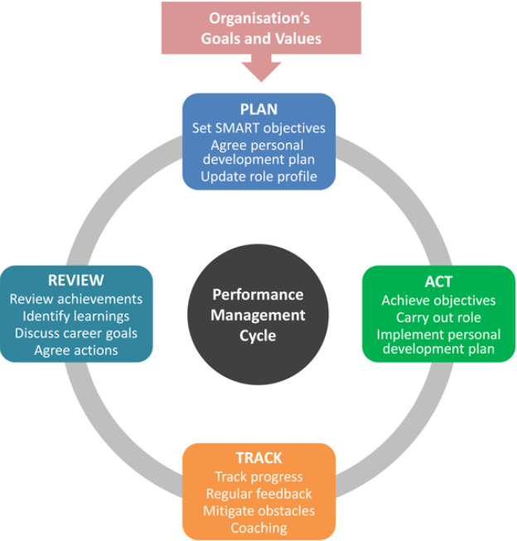
Performance Management Cycle

Slide 50

Importance of Performance Management
  Critical for success
  Employees know what is expected of them
  Motivates staff
  Checks staff contributions
  Recognises the good work of employees
  Delivers tasks quickly and to required standards
  Spot and improves poor performance
Clear expectations
Regular conversations
Better outcomes

Slide 51
Factors Affecting Performance
Individual | Organisational | Relational
Lack of awareness / understanding | Organisational change | Bullying or harassment
Personal circumstances | Recruitment & selection issues | Poor communication / social exchange
Lack of training & development | Discrimination, lack of praise or recognition | Hostility, misunderstanding,
Employee not feeling heard
A combination of more than one of the above factors

Slide 52
Identifying a Performance Issue
Poor Performance | Misconduct | Attendance
Productivity issues Performance issues Complaints Criticism Manager’s own observations Employee keeps requesting help | Rudeness Bullying and harassment | Attendance problems (short-term and long-term)

Slide 53
Addressing Performance Issues
A clear conversation flow helps keep the discussion factual, fair and focused on improvement.
Move from evidence → Impact → Agreed action
01
Diagnose
02
Understand
03
Agree and Review
Clarify the facts
Explore impact and response
Turn insight into action
1
What is the problem
4
Impact/s of the problem
7
Agree a course of action
2
What is the evidence
5
Employee’s response
8
Set a date for review
3
6
9
Summarise and check understanding
Why you are concerned
What improvement is needed
Outcome: shared understanding of the issue, the support needed, and the next review date

Slide 54

When Performance Management Falls Flat
Ineffective and uninspiring
14%
of organisations feel their current performance
management system is genuinely effective
When the process loses credibility, it stops improving performance, because:
1
Your system is not fair or accurate
2
It becomes a “box-ticking” exercise
3
You rely too much on paper
Make conversations feel fair, focused and useful

Slide 55

What Effective Performance Management Looks Like
  Genuine buy-in from staff
  A continuous cycle
  Meaningful performance conversations
  Honest performance reviews
  An easy to monitor process
  Skills and willingness

Slide 56

Team Knowledge and Skills
Know the capability you have and the capability you need
Four manager questions:
Know
What skills and strengths are already in the team?
Check
Where are the gaps, risks or single points of failure?
Discuss
What do 1:1s, team meetings and feedback tell us?
Develop
What training, coaching or delegation will build capability?
Useful Methods
KSF PDP&R
121 and Team Meetings
BALM Method
Skills Matrix
Training Needs Analysis
Competency Checklists
Regular Performance Reviews
180 and 360 Feedback
Regular Conversations
Events

Slide 57
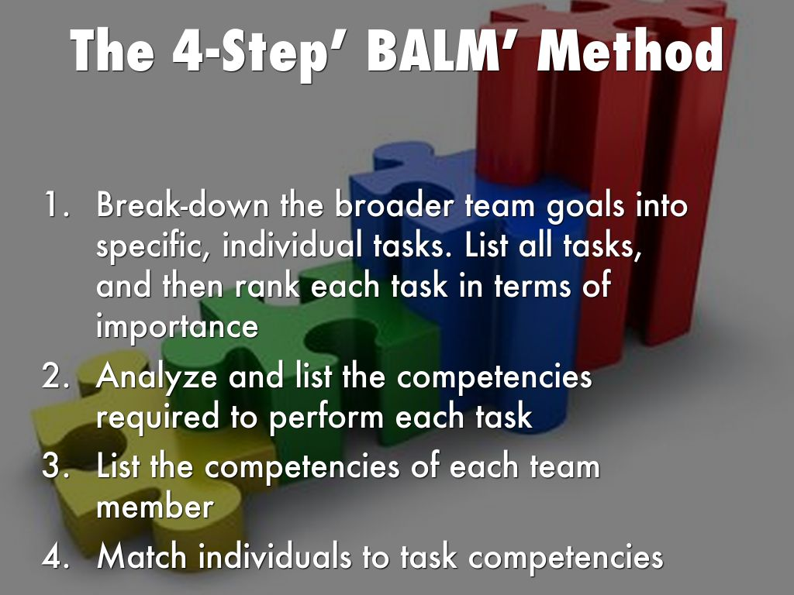

Slide 58
Skills Matrix
Make team capability visible and discussable
Task; Resolve Customer Service Problems
Team member | Skills | Product knowledge | Listening + Questioning | Problem solving | Current focus
Name 1
Name 2
Name 3
Name 4
Use it to identify
Training needs • coaching opportunities • resilience risks • better delegation choices

Slide 59
Skills Matrix Scoring
Score | Skill Level | Description
5 | Coach | Fully competent and experienced Needs no assistance to complete tasks Demonstrates ability to lead and train others Seen as a Subject Matter Expert
4 | Skilled | Capable and experienced Demonstrates proficiency Able to work independently with little help Will be able to Coach with more time
3 | Not yet skilled | Able to perform at a basic level Has some direct experience Needs help from time to time
2 | Learning | Limited in ability or knowledge Cannot perform for critical tasks Needs significant help from others
1 | None / Low | Unable to perform Little to no experience
Tip: score against the task, not against the person’s worth or potential

Slide 60
Skills Matrix
Make team capability visible and discussable
Task; Resolve Customer Service Problems
Team member | Skills | Product knowledge | Listening + questioning | Problem solving | Current focus
Name 1 |  | 4 | 3 | 4 | Can coach others
Name 2 |  | 2 | 4 | 3 | Needs product update
Name 3 |  | 3 | 2 | 2 | Needs practice calls
Name 4 |  | 5 | 4 | 5 | Can handle complex cases
Use it to identify
Training needs • coaching opportunities • resilience risks • better delegation choices

Slide 61
Training Needs Analysis
Example: Attendance Management
Topic | I would like refresher training | I feel competent (no further training needed) | I am confident in this area & can help others
Recognise our duty of care & Governance standards
Understand the absence reporting & recording requirements
Dealing with short- and long-term absences
Understand how to use attendance data & identify trigger points
Recognise formal & informal absence interviews
Making appropriate Occupational Health referrals

Slide 62
Developing Your Team
Everyday opportunities to build capability
Conversation
KSF/PDP&R, Regular Reviews, Feedback
Experience
shadowing, show-and-tell, sharing practice
Support
Coaching, Mentoring, e-Learning and Courses
Stretch
Delegation with clear support and review

Slide 63
Time Management

Slide 64
Time management is the process of organising and planning how to divide your time between different activities.
Remember
The highest achievers manage their time exceptionally well

Slide 65

Principles of Good Time Management

Slide 66

Prioritising
Tasks can be grouped into 4 categories:
  Urgent and important
  Not urgent, but important
  Urgent, but not important
  Neither urgent, nor important

Slide 67
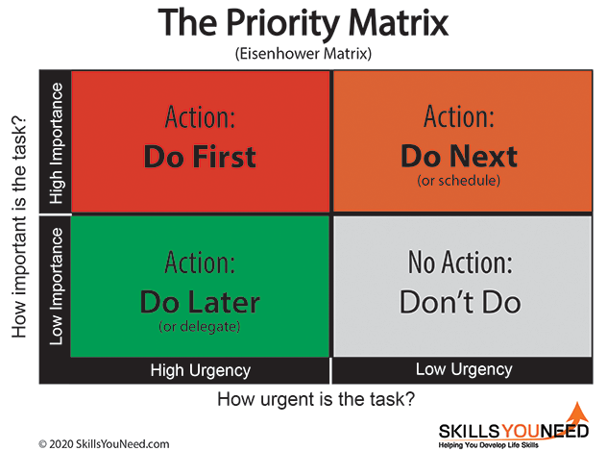

Slide 68
Time Management Tips
Use A ‘To Do’ List
Pick Your Moment
Do not Procrastinate, but Do Ask Why You are Tempted
Keep Tidy
Keep, if you need to keep it for your records
Give away, if you do not want it
Throw away, for things that have no value

Slide 69

Time Management Tips
Deadlines
  Know your deadlines
  Create a daily planner or to do list
  Give each task a time limit
  Block out distractions
  Establish routine
  Ask for help
  Ask for extension
  Delegate

Slide 70

Time Management Tips
Open door policy
  Have you got a minute?
  I know you are busy, but ...
  Can I ask about .....
  I know you are due to finish in 5 minutes, but ...

Slide 71

Time Management Tips
Multi-tasking
  When you ‘can’ single task ‘do it’
  Turn off Outlook, MS Teams
  Turn off all alerts
  Divert the phone
  Do not disturb sign on the door
  Only have the thing you are working on in front of you

Slide 72

Time Management Tips
Emails
Practice the '4 Ds‘:
Delete
Do
Delegate
Defer (Delay)

Slide 73
Time Management Tips
Using the Power of AI (Copilot)
A secure Microsoft 365 assistant that turns information overload into focused action.
Create & refine content
Prioritise & understand work
Draft
Start reports or notes from a blank page
Catch up
Review missed meetings or work after leave
Summarise
Condense long documents, text or email threads
Focus
Surface today's actions and upcoming deadlines
Tweak
Change tone, length or make writing concise
Analyse
Find patterns and insights in Word or Excel
Edit
Reformat text into tables, bullets or paragraphs
Discover
Pull relevant project knowledge together
Use Copilot when the next step is unclear: ask it to draft, summarise, prioritise or analyse.

Slide 74

Delegation is ….
when team members have responsibility and authority to act within the confines of their role; or as agreed between the manager and team member on a task not routinely performed by a team member in that role.
Ultimate accountability remains with the manager

Slide 75

Advantages of Delegation
Maintains trust
Relieves you of routine and less critical tasks
Allows you to plan for the future rather than organise for the present
Encourages decision-making
Increases motivation
Develops the capacity of staff
Empowers your staff

Slide 76

Barriers to Delegation
‘If you want a job done properly, do it yourself.’
It is my job
What to delegate?
Time to explain
Will it be done right?
They might do it better than me
Information is power
Personalities
It is too risky
But I enjoy doing it myself
I like to be on top of everything. If I delegate work I will lose some of this contact
They might not like me for giving them work

Slide 77

Activity
How Good is Your Delegation?

Slide 78

Elements of Delegation
What to Delegate
When to Delegate
How to Delegate
Who to Delegate to

Slide 79
What and When to Delegate
Use four filters before deciding how to delegate and to whom:
01
Time
Is there time to brief, support and correct the work if needed?
02
Expertise
Does someone have the skills or information to do it well?
03
Appropriateness
Is it fair, safe and not confidential, strategic or sensitive?
04
Priority Matrix
Map importance and urgency to decide what to delegate.
Remember
Delegate when it develops others and frees you for critical responsibilities, not simply because you dislike the task.

Slide 80
What to Delegate? Priority Matrix
High Importance
These jobs are likely to be too important and urgent for delegating
Plenty of scope for delegating here
High
Urgency
Low Urgency
Too little time to delegate?
Perhaps experienced team members could do these jobs
Do these jobs need to be done at all?
Low Importance

Slide 81

How to Delegate
  Agree expectations
  Delegate the results, not the process
  Provide required resources and knowledge
  Establish checkpoints
  Build motivation and commitment
  Talk about consequences
  Define your role

Slide 82

Who to Delegate to
  Organisational structure
  Staff buy-in
  Individual vs Team?
  Experience, knowledge and skills
  Individual's preferred work style
  Individual's workload

Slide 83

Reviewing
  Establish the process
  Review progress against set objectives
  Review a little and often
  Let team members come to you
  Avoid blame culture
  Set up one to one meetings
  Keep it simple and flexible

Slide 84
Giving and Receiving Feedback
Receiving Feedback​ | Providing Feedback​
Actively listen​ Accepting​ Ask for evidence​ Be open (not defensive)​ Discuss improvement ideas/recommendations​ Know it is their ‘perception’​ Openness​ Breathe​ Check for understanding​ Thank the provider​ | Own it!​ Specific and factual​ Non-emotional​ Balanced​ Easy to understand​ Positive intention​ Encouraging​ Describe the impact of…​ Check for understanding​ Thank for the opportunity

Slide 85
Delegation Summary
Take time to prepare (think ahead)
Find the right person
Consult first
Give time to support
Delegate whole tasks where possible
Specify expected outcomes
Delegate the good and the bad
Delegate, then trust
Notes:
85

Slide 86
Activities
(Workbook)

Slide 87
Session 3
Managing Change

Slide 88
Learning Outcomes
By the end of this session, you will be able to:
01
Reason/s for change
Understand the forces for change in an organisation
02
Barriers to implementing change
03
Key principles of change management
04
Tools and techniques

Slide 89
Reasons for Change (PESTLE)
Political Factors
Economic Influences
Sociological Trends
Technological Innovations
Legislative Requirements
Ecological Requirements

Slide 90
Barriers to Implementing Change
We’re not really clear why we’re doing this
We don’t really have sponsorship
More change! There’s too much going on
Our culture isn’t ready for this
Current
State
Desired
State
People seem to be resisting for no reason
Not sure about my change management role in this
The right people aren’t engaged
We’re not organised enough
Our communications aren’t working

Slide 91
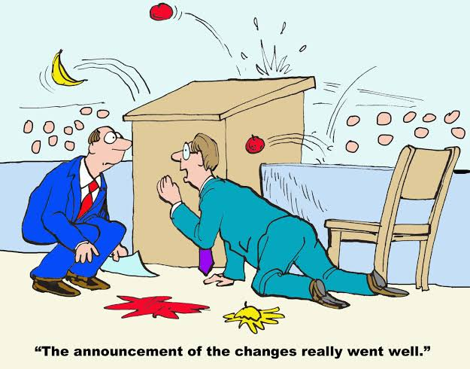
Staff Resistance to Change
Types:
  Resistance to the content
  Resistance to the process
Remember:
Regardless of current position and experience, you have responsibilities in respect of change.

Slide 92
Key Principles of Change Management
01
Define the change
Be clear about:
  Your vision
  Where you want to be or reach
  The outcomes and goals
  The impact on individuals, teams and organisation
  The benefits for individuals, teams and organisation
  Operational benefits
  Define the risks and barriers
  Identify communication methods, channels and frequency
02
Understand the culture and climate

Slide 93
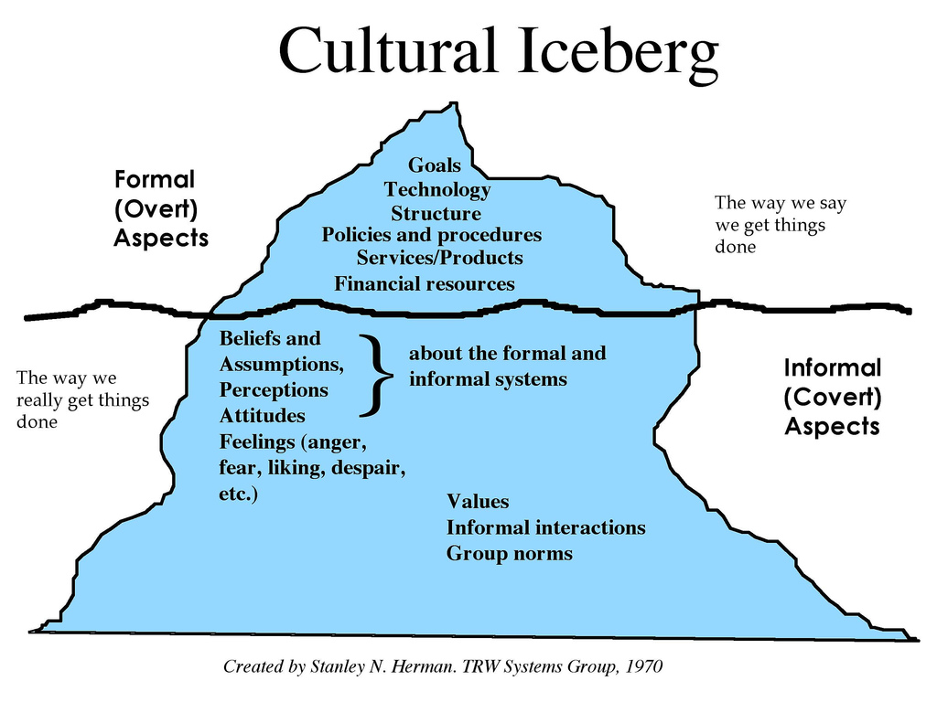

Slide 94
Key Principles of Change Management
Clarify the roles
Sponsors, stakeholders, agents and champions know their part
03
Get sponsorship in all levels
Secure visible support, especially from frontline teams
04
Get organised
Set steering groups, workstreams, milestones and KPIs
05
Get human
Understand reactions and remove resistance to change
06

Slide 95
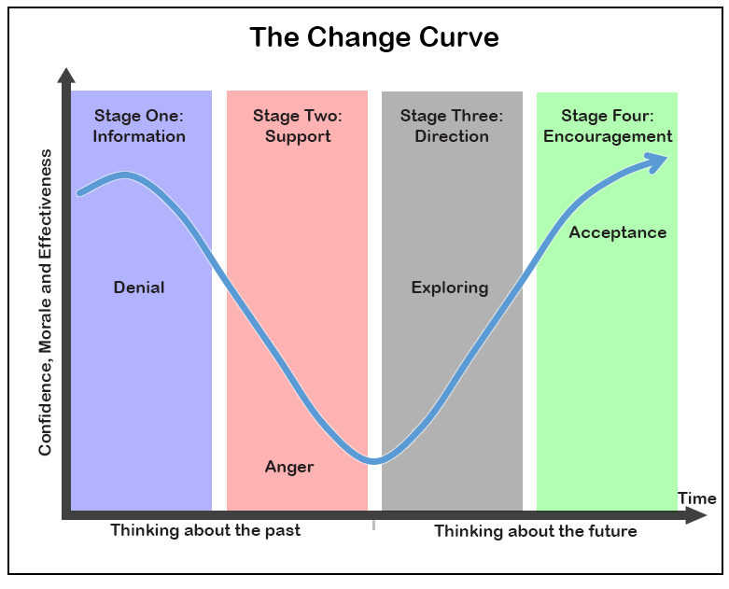

Slide 96
Key Principles of Change Management
  Measure, report and review
07
Outcomes
Communication Strategy
Methods Used
Close the loop by checking outcomes, communication and methods, then adjust the change plan.

Slide 97
Tools
SWOT Analysis
Stakeholder Analysis
Mind Maps
Gantt Chart

Slide 98
SWOT Analysis
Internal
S
W
Strengths
Weaknesses
O
T
Opportunities
Threats
Internal and/or external

Slide 99
Stakeholder Analysis
Opinion formers.
Keep them satisfied
with what is happening
and review your analysis
of their position regularly.
Key stakeholders who
should be fully engaged
through full communication
and consultation.
Keep Satisfied
Manage Closely
High Power
This group requires the least effort if time and
resources are stretched.
Patients often fall into this category. It may be helpful to take steps to increase their influence by organising them into groups or active consultative work.
Monitor
Keep Informed
Low Power
Low Interest
High Interest

Slide 100
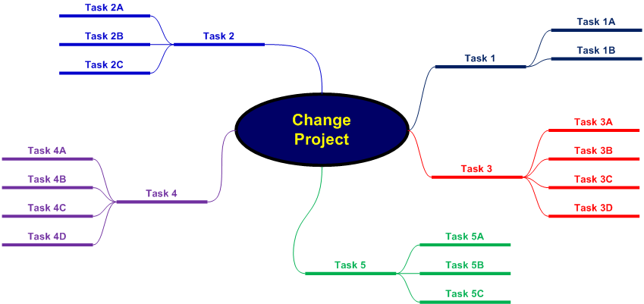
Mind Maps

Slide 101
Gantt Chart
Key Activity | Lead | Week Number
 |  | 1 | 2 | 3 | 4 | 5 | 6 | 7 | 8 | 9 | 10 | 11 | 12 | 13 | 14 | 15
01. Activity A | WS
02. Activity B | KH
03. Activity C | BO
04. Activity D | PL
05. Activity E | YW
06. Activity F | YW
07. Activity G | KH
08. Activity H | LS
09. Activity I | CM
10. Activity J | KH

Slide 102
Techniques
Lewin’s Change Model
Lewin’s Force-Field Model
Kotter's 8 Step Change Model

Slide 103
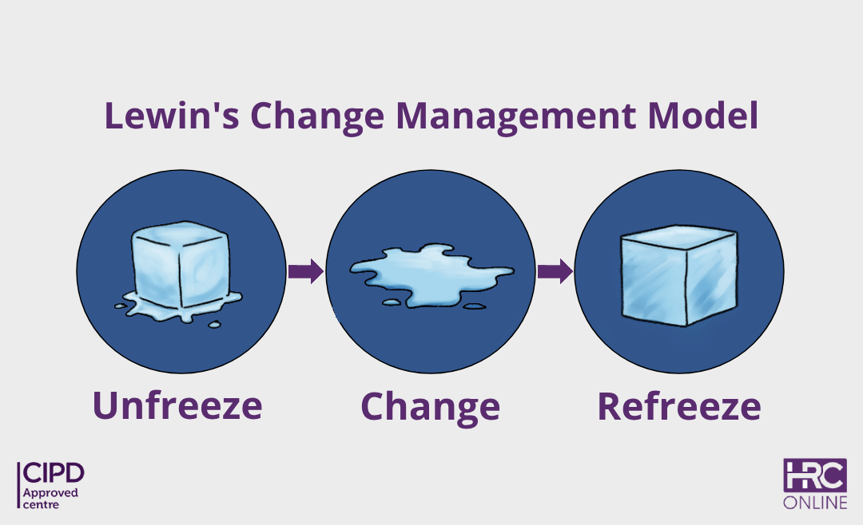

Slide 104
Lewin’s Force-Field Model
Competition
Skills deficit
R
E
S
I
S
T
I
N
G
F
O
R
C
E
S
D
R
I
V
I
N
G
F
O
R
C
E
S
New technology
Job insecurity
Incentives
Complacency
Managerial support (pressure)
New people
Established work patterns
Current State
Desired State

Slide 105
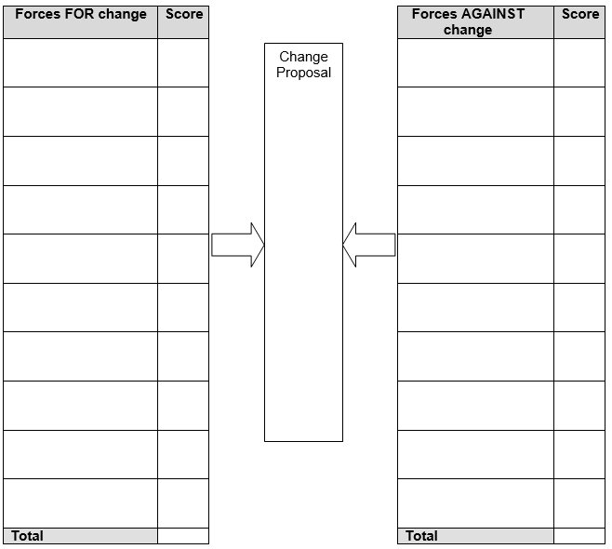
Force Field Analysis

Slide 106
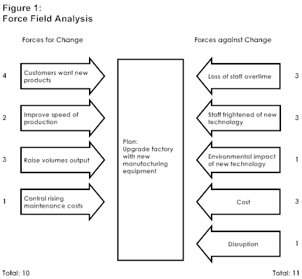
Example: You are a manager deciding whether to install new manufacturing equipment in your factory

Slide 107
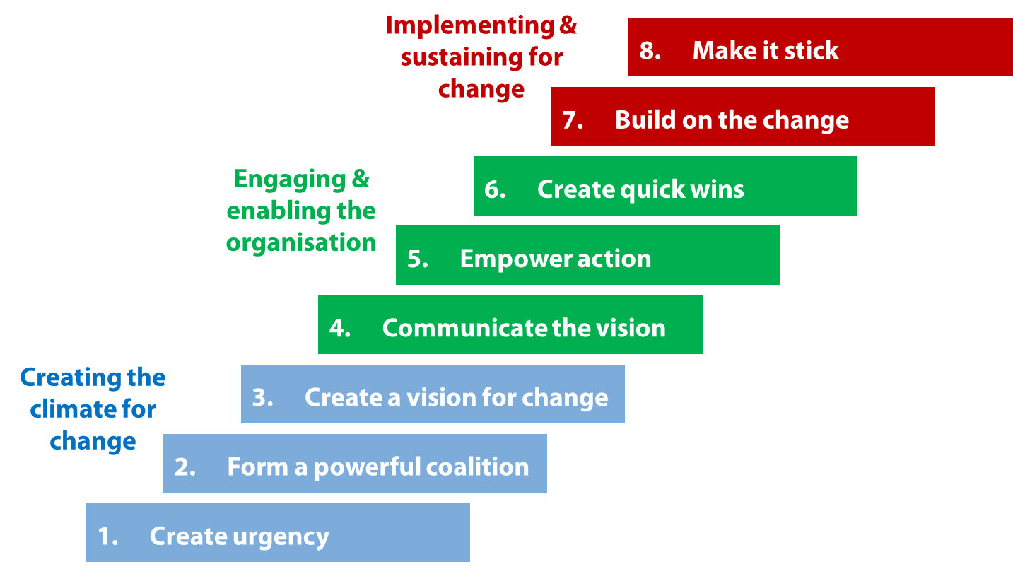
Kotter's 8 Step Change Model

Slide 108
Activities

Slide 109
Session 4
Problem Solving and Decision Making

Slide 110

Learning Outcomes
Value of adopting a culture of improvement
Problem solving and decision-making tools and techniques
Use the problem-solving steps

Slide 111

What counts as a problem?
Before acting, clarify whether the issue is a gap, a risk, or an opportunity.
01
Deviation — gap from expected standard
Potential — emerging risk or opportunity
Improvement — better way to deliver safe care
02
03
Problem solving starts with evidence, not assumptions.

Slide 112
Improvement in NHS
Quality Improvement
  Health; Better Patient Outcomes
  Care; Better System Performance
  Learning; Better Professional Development
Batalden and Davidoff, 2007
Continuous Improvement; is a method for identifying opportunities for streamlining work and reducing waste in all levels.

Slide 113

Common Mistakes
  Tackling the ‘wrong’ problem
  Making assumptions
  Jumping to solutions
  Failing to seek expert advice

Slide 114
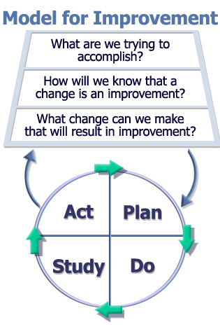
PDSA Model

Slide 115

Problem Solving Steps
Step 1: Identify the problem
Step 2: Define the problem
Step 3: Diagnose root causes
Step 4: Generate options/solutions
Step 5: Evaluate options and select the best
Step 6: Implement decision and evaluate

Slide 116

Step 1 - Identify the Problem
Use these prompts to confirm the issue before defining actions.
Key questions:
1. How do we know there is a problem?
2. What impact is it having?
3. Is the problem stated objectively?
4. What is in scope — and out of scope?
5. Is an implied solution hidden in the statement?

Slide 117
Step 2 - Define the Problem
Align on evidence before moving to causes or solutions.
Problem-definition checks
1
Involve stakeholders
INPUT
Gather & analyse evidence
2
INSIGHT
3
Talk to people close to it
SCOPE
DEFINE
4
Clarify what it is — and isn’t
A good definition narrows the focus without jumping to a solution.
Outcome: a clear problem statement everyone recognises and can act on

Slide 118
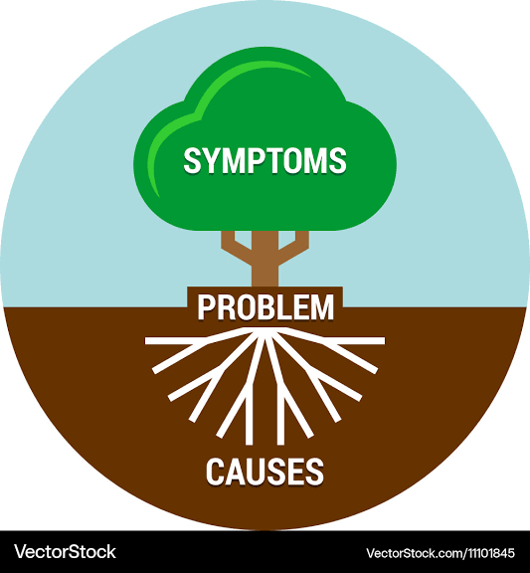
Step 3; Diagnose Root Causes
Root Cause Analysis Techniques:
  5 Whys
  Cause and Effect Diagram (Ishikawa/Fishbone)

Slide 119
5 Whys
Patient was late in theatre, causing a delay. Why?
There was a long wait for a trolley. Why?
A replacement trolley had to be found. Why?
The original trolley's safety rail was worn and had eventually broken. Why?
It had not been regularly checked for wear. Why?
There is no equipment maintenance schedule.

Slide 120
  Cause and Effect Diagram (Ishikawa/Fishbone)
Environment
Procedures
Not computerised
Transport arrives early
Not enough treatment rooms
Too much paperwork
Poor scheduling
Lengthy booking process
Clinics Running Late and lengthy waits for patients
Small inner-city environment
Not computerised
Poor maintenance
Unexpected patients
Broken lifts
Staff unavailable
Not enough wheelchairs
Queue jumping
Long term sickness absence
Equipment
People

Slide 121

Step 4; Generate Options/Solutions
Brainstorming
    Six to twelve people
    Lasts for a fixed period
    A chair to define the problem and maintain control
    A scribe to note and record all ideas
    Active participation is encouraged
    Do not discuss or criticise ideas
    Develop the maximum number of ideas
    Evaluate ideas after session (not during)

Slide 122

Brainstorming
Determining the best options:
Cluster similar or related ideas
Condense ideas
Refine/Improve ideas
Reduce your list of possible solutions

Slide 123

Step 5; Evaluate Options and Select the Best
Tools to use:
  Selection Matrix (Benefits vs Effort)
  Paired Comparison Analysis
  Weighting and Scoring

Slide 124
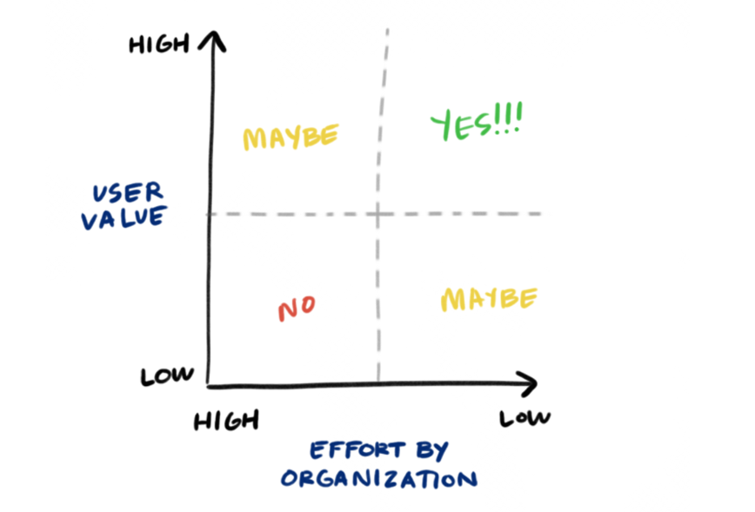
Selection Matrix (Benefits vs Effort)

Slide 125
Step 6
Implement Decision & Evaluate
IMPLEMENTATION SEQUENCE
Action planning
Contingency Planning
Communication Strategy
Monitor, Review & Evaluate
Move from selection to delivery:
  Plan the work
  Manage risks
  Communicate clearly, and
  Review impact
1
2
3
4
Decision → action → evidence
Implementation is only complete when progress is reviewed and learning is captured

Slide 126
Action Planning
Turn decisions into deliverable SMART actions with clear ownership and review.
Plan the work
Manage delivery
SMART ACTIONS
REVIEW & COMMUNICATE
1
Break tasks down
GO
1
Set review dates
Make actions manageable
Track progress regularly
2
Assign owners
2
Plan communication
Allocate responsibilities
Keep people informed
3
Agree timescales
3
Give warning
Prioritise what matters
Prepare teams for change
4
Check resources
4
Mobilise support
Identify implications early
Use enthusiasts and teams
Action plan = owners + timescales + resources + communication
Keep it practical: review progress, adjust early and maintain team momentum.

Slide 127
Contingency Planning
Key Risk | L (0 – 10) | I (0 – 10) | Mitigation
Key person goes off sick/leaves | 2 | 8 | Key person keeps detailed progress notes; has regular update meetings with identified colleague
L = Likelihood I = Impact

Slide 128
Monitor, Review & Evaluate
Use five checks to keep the action plan moving towards the desired goal.
ACTION PLAN
DESIRED GOAL
1
2
3
4
5
WHAT
WHO
WHEN
WHERE
HOW
SMART
Actions, Milestones and Targets
Clear
Owners
+
People Responsible
Target Dates
+
Regular Progress Reviews
Meetings
+
Forums
Success
Measures
Goal: milestones + targets + evidence of impact
Regular progress reviews turn plans into measurable improvement.

Slide 129


Activities & Workbook
Apply the learning together, then capture reflections and next steps.
&
ACTIVITIES
WORKBOOK
Discuss, practise, apply
Reflect, record, plan

Slide 130
New Resources for Managers
People Management Guide
Being a Manager of People in NHSGGC – Responsibilities and Guidance
  Staff Health, Safety and Wellbeing (ShaW)
  Staff Engagement
  Individual PDP&R
  Service Performance, Team Meetings and Communications
  Team Development and i-Matter
  General HR Policy Awareness and Application
  Equalities
  Partnership Working and Managing Change
  Attendance Management and SSTS
  Recruitment and Retention
  Leadership Skills

Slide 131

New Resources for Managers
New Induction Pathway for New People Managers and Supervisors
  People Management Guide
  Equality Law: A Manager’s Guide to Getting it Right in NHSGGC
  People Manager Self-Assessment Questionnaire
  Systems and Processes

