Slide 1
Essential Skills for Managers

Slide 2
Programme Structure
Day 1
AM; Communication
PM; Organising and Delegating
Day 2
AM; Managing Change , Problem Solving and Decision Making
Some activities to help you understanding the concept better

Slide 3
Link to KSF
C1 – Communication
C2 – Personal and People Development
C3 - Health, Safety and Security
C5 – Quality
C6 - Equality and Diversity
G6 – People Management

Slide 4
Your Objectives
Key personal learning points
Impact of the programme
Action planning (proposed impact)
Workbook

Slide 5
Evaluation
Post-programme survey
Feedback on how your learning has been applied

Slide 6
Essential Skills for Managers
Session 1
Communicating and Influencing

Slide 7
Learning Outcomes
Understand the communication process
Different methods of communication
How to assess your own communication effectiveness
How good communicators influence others
Your role in successful communication
Importance of employee voice
Communication Planning and assessment

Slide 8
The Communication Cycle
BARRIERS
INTERFERENCE
BARRIERS
INTERFERENCE
BARRIERS
CONTEXT / PURPOSE
Sender
Message
Receiver
Transmission
Feedback

Slide 9
Barriers to Effective Communication
Workplace and Individual
  Physical barriers
  Wrong methods of communication
  Psychological, emotional and behavioural
  Technological
  Organisational structure or culture
  Communication skills
  Cultural differences
  Clarity and consistency
  Trust
  Lack of active listening
  Perception

Slide 10
Barriers to Effective Communication
  Inequalities
  Language Barrier
  Physiological, Mental Health
  Learning Difficulties
  Cultural/Religious Needs
  Sensory Impairments
  Literacy, numeracy issues

Slide 11
Self-Awareness
In the workplace:
  Clinical Governance
  HR policies and Staff Governance guidance
  Equality legislation
Personally:
  Be aware of influences on your communication
  Use the Accessible Information Policy
  Be a good role model

Slide 12
Active listening
Listen to understand
Show that you are listening
Suspend judgment
Feedback
Respond

Slide 13
Questioning
Questioning is the ability to organize our thinking around what we
do not know. The Right Question Institute
Questions we ought to use:
  Open
  Closed
  Probing
  Reflective
  Comparative
Questions we ought to avoid:
  Leading
  Multiple
  Ambiguous
  Trick
Hypothetical

Slide 14
Non-Verbal Communication
Eye contact
Tone of voice
Facial expressions
Body language/posture
Gestures
Spatial distance
Touch
Deliberate silence

Slide 15
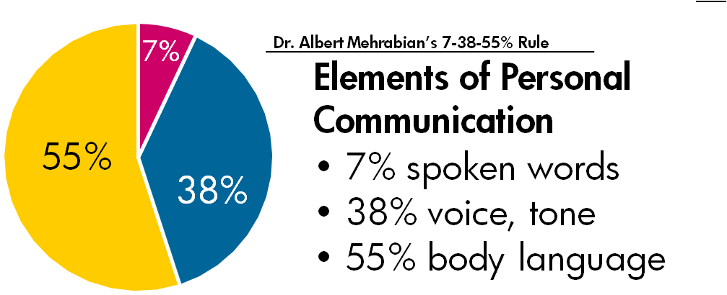

Slide 16
Activity
Are You Approachable at Work?

Slide 17
Communication Methods in Workplace
Face-to-Face (individual, groups)
Written (letters, memos)
Email
Telephone, walkie-talkie
Pager, mobile
Noticeboards
Social media
e-Health platforms (e.g. emis, eESS, Turas)

Slide 18
MS Teams
Zoom
Yammer
Team meetings
Huddles
Team/Core Brief
i-Matter
Small Change Matters

Slide 19
Principles of an Effective Communications Strategy
“An effective approach to internal communication
will be cohesive and strategic, and support a culture of
trust and openness”

Slide 20
Successful Communication
Builds a shared sense of purpose
Receives attention and support from all
Drives genuine dialogue
Good for people management
Supports equality and diversity
Supports the rights of people
Respects other people’s ideas, values and principles
Ensures people’s dignity and rights

Slide 21
Role of Line Managers
  HR Agents
  Front line of communicating
  Responsible for effective communication
  Be communicative
  Confidentiality

Slide 22
Role of Employees
  Sharing
  Learning
  Listening
  Collaborating

Slide 23
Influence of Good Communication
In difficult times
Employee Engagement
Better Performance
Employee Retention
Wellbeing
Employee Voice

Slide 24
Employee Voice
Resolves operational issues
Encourage staff to collaborate
Gives employees greater voice
Gains insight into issues

Slide 25
Activity
Think of something challenging (person/situation) that you need to address?
What would you say?

Slide 26
Think of something challenging that you need to address?
State the Situation
State why it is a problem
State your expectation/s
Listen to response/s
Repeat number 3 (If required)

Slide 27
4Ws+H Technique
Who
What
Why
When
How

Slide 28
Communication Planning
The right choose of:
  Communication strategy
  Communication channel
  Message selection
  Tailor communications

Slide 29
Assessing Communications Effectiveness
Overall within your team
Success against specific objectives

Slide 30
Activity
The Communication Quiz
How Good Are Your Communication Skills?

Slide 31
Self-assessment
  Feedback
  Reflective practice
  Self-evaluation
  Check with the policies and guidelines
  Check with current development
  Find out what is available
  Workbook activity and on-line resources

Slide 32
Our Organisational Goals and Values
We put patients first
We focus on outcomes
We take responsibility
We work as one team
We always try to do better
We treat each other with respect

Slide 33


Staff Health and Wellbeing
Your duty as a manager
Resources:
NHSGGC Health and Wellbeing Directory
A Healthier Place to Work
Your Health
Stress in the Workplace
Staff Resources and Support

Slide 34
Activities
(Workbook)

Slide 35
Essential Skills for Managers
Session 2
Organising and Delegating

Slide 36
Learning Outcomes
  Leadership vs Management
  Performance management and factors affecting it
  Time management and principles of good time management
  Key principles of delegation

Slide 37
Leadership vs Management
Management
is concerned with planning, budgeting, organising, staffing, controlling and problem-solving
Leadership
involves establishing direction, aligning people, motivating and inspiring
(Kotter 1996)

Slide 38
Leadership is the art of motivating people toward a common goal or vision, and management is getting the job done
The King’s Fund Report (2011)

Slide 39
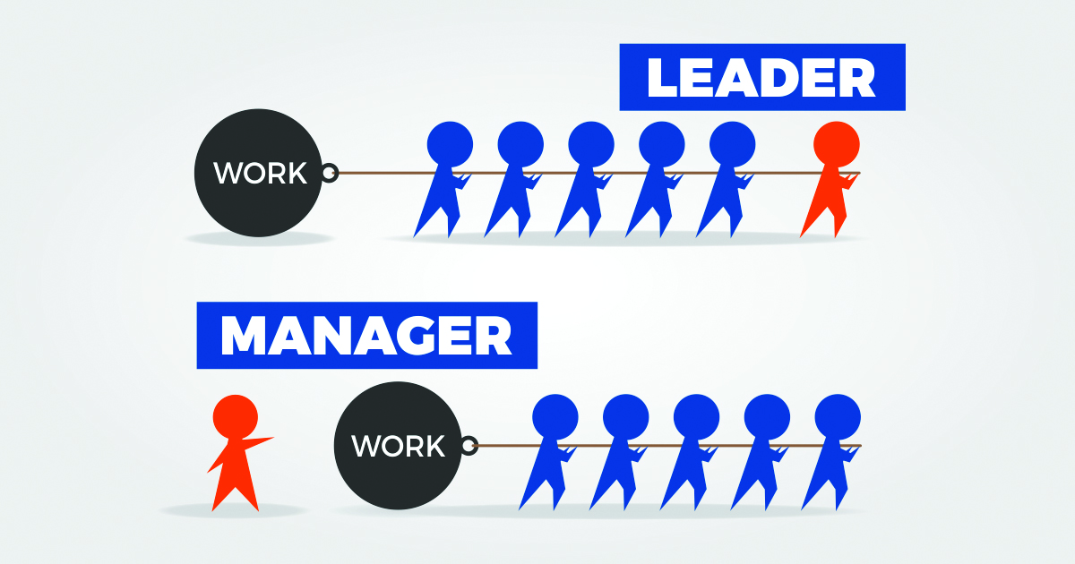

Slide 40


Slide 41
Self-assessment
What kind of manager are you?

Slide 42
Effective Teams
Meaningful
Clear set of objectives
Meaningful tasks/roles for team members
Performance appraisal and feedback for team members
Regular feedback on team’s Performance
Reflect on achievements
Full participation by team members
Effective communication
Firth-Cozens, Jenny, (1998)

Slide 43
Managing Former Peers
Set your expectations early on and involve the team
Use the knowledge you have to your advantage
Move on

Slide 44
Managing Young People
Step 1; Introduce them to the world of work
Step 2; Provide structure and good communication
Step 3; Develop and support them

Slide 45
Performance Management

Slide 46
Performance Management
“Per­for­mance man­age­ment is the con­tin­u­ous process of
improv­ing per­for­mance by set­ting indi­vid­ual and team goals which are aligned to the strate­gic goals of the organ­i­sa­tion,
plan­ning per­for­mance to achieve the goals, review­ing and
assess­ing progress, and devel­op­ing the knowl­edge, skills, and abil­i­ties of peo­ple.”
Michael Arm­strong

Slide 47
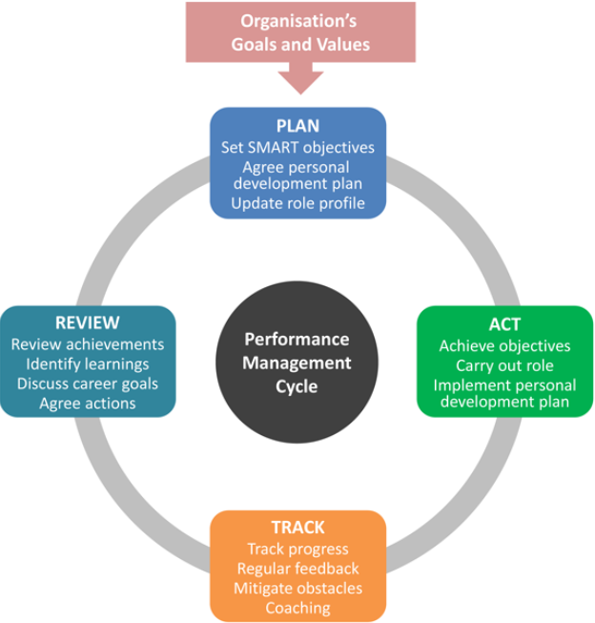
Performance Management Cycle

Slide 48
Importance of Performance Management
  Critical for success
  Employees know what is expected of them
  Motivates staff
  Checks staff contributions
  Recognises the good work of employees
  Delivers tasks quickly and to required standards
  Spot and improves poor performance

Slide 49
Factors Affecting Performance
Lack of awareness/understanding
Personal circumstances
Organisational Change
Bullying or harassment
Recruitment and selection issue
Lack of training and staff devel­op­ment
Lack of communication and social exchange
Hostility or/and misunderstanding
Employee voice
Discrimination, lack of praise or recognition
A combination of more than one of the above factors

Slide 50
Identifying a Performance Issue
Poor performance
  Productivity issues
  Performance issues
  Complaints
  Criticism
  Manager’s own observations
  Employee keeps requesting help
Misconduct
  Rudeness
  Bullying and harassment
Attendance problems

Slide 51
Addressing Performance Issues
  What is the problem
  What is the evidence
  Why you are concerned
  Impact/s of the problem
  Employee’s response
  What improvement is needed
  Agree a course of action
  Set a date for review
  Summarise and check understanding

Slide 52
Inef­fec­tive and Uninspiring
Per­for­mance Man­age­ment
  Your sys­tem is not fair or accu­rate
  Treat it as a ​“box-tick­ing” exer­cise
  Rely too much on paper

Slide 53
Effec­tive Employ­ee Per­for­mance Management
  Buy-in
  Con­tin­u­ous per­for­mance man­age­ment cycle
  Mean­ing­ful per­for­mance con­ver­sa­tions
  Mean­ing­ful per­for­mance reviews
  Easy to monitor process
  Skills and will­ing­ness

Slide 54

Team knowledge and skills
KSF PDP
121 meetings
Team meetings
BALM method
Skills Matrix
Training Needs Analysis
Competency checklists
NHS People Performance Management Toolkit
Regular Performance Reviews
180 and 360 feedback
Regular Conversations

Slide 55
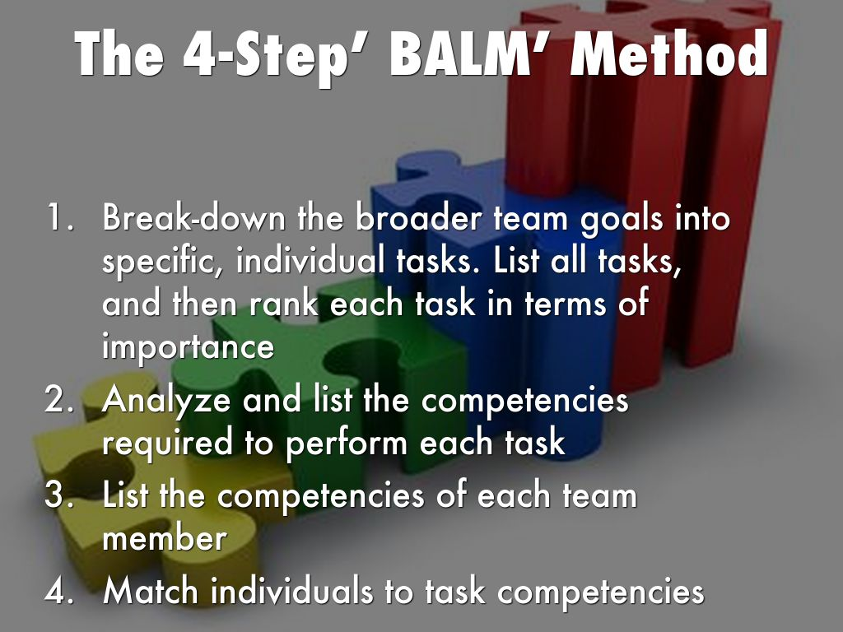

Slide 56
Skills Matrix
Task | Resolve Customer Service Problems
Skill Team member | Detailed knowledge of products | Questioning and listening skills | Problem solving skills
Name 1
Name 2
Name 3

Slide 57
Skills Matrix (Scoring)
Scoring
Score | Skill Level | Description
5 | Coach | Fully competent and experienced Needs no assistance to complete tasks Demonstrates ability to lead and train others Seen as a Subject Matter Expert
4 | Skilled | Capable and experienced Demonstrates proficiency Able to work independently with little help Will be able to Coach with more time
3 | Not yet skilled | Able to perform at a basic level Has some direct experience Needs help from time to time
2 | Learning | Limited in ability or knowledge Cannot perform for critical tasks Needs significant help from others
1 | None / Low | Unable to perform Little to no experience

Slide 58
Training Needs Analysis
(Attendance Management)
Topic | I would like refresher training | I feel competent in this area (No further training needed) | I am confident in this area and can help others learn
Recognise our duty of care and Staff Governance standards
Understand the absence reporting and recording requirements
Dealing with short-term and long-term absences
Understand how to use attendance data and its use to identify trigger points
Recognise formal and informal approaches and interventions
Return to Work interviews
Making appropriate Occupational Health referrals

Slide 59
NHS People Performance Management Toolkit
  How to review performance on an ongoing basis
  What to do if a member of your team is underperforming
  How to give constructive feedback
  How to support staff who are high achieving

Slide 60
Developing Your Team
  KSF/PDP&R
  Show and Tell
  Coaching, mentoring
  Sharing experience and knowledge
  Shadowing
  Training courses
  e-Learning (LearnPro, TURAS Learn)
  Delegation
9

Slide 61
Time Management

Slide 62
Time management is the process of organising and planning how to divide your time between different activities.
Remember
The highest achievers manage their time exceptionally well

Slide 63
Principles of Good Time Management

Slide 64
Prioritising
Tasks can be grouped into 4 categories:
  Urgent and important
  Not urgent, but important
  Urgent, but not important
  Neither urgent, nor important

Slide 65
Prioritising
  By the end of the year I must, should, could…
  By the end of the month I must, should, could….
  By the end of the week I must, should, could….
  By the end of the day I must, should, could…..
We tend to focus on the bottom 2 sometimes having to include an extra bullet
  before lunch time I must do….

Slide 66
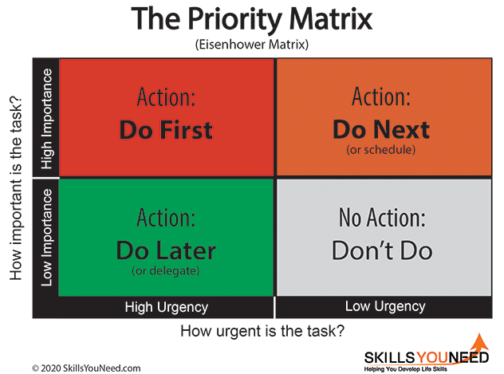
Priority Matrix

Slide 67
Time Management Tips
Use A ‘To Do’ List
Pick Your Moment
Do not Procrastinate, but Do Ask Why You are Tempted
Keep Tidy
  Keep, if you need to keep it for your records
  Give away, if you do not want it
  Throw away, for things that have no value

Slide 68
Time Management Tips
Deadlines
  Know your deadlines
  Create a daily planner or to do list
  Give each task a time limit
  Block out distractions
  Establish routine
  Ask for help
  Ask for an extension
  Delegate

Slide 69
Time Management Tips
Open door policy
  Have you got a minute?
  I know you are busy, but ...
  Can I ask about .....
  I know you are due to finish in 5 minutes, but ...

Slide 70
Time Management Tips
Multi-tasking
  When you ‘can’ single task ‘do it’
  Turn off Outlook, MS Teams
  Turn off all alerts
  Divert the phone
  Do not disturb sign on the door
  Only have the thing you are working on in front of you

Slide 71
Emails
  Practise the '4 Ds‘:
    Delete
    Do
    Delegate
    Defer (Delay)

Slide 72

Delegation is ….
when team members have responsibility and authority to act within the confines of their role; or as agreed between the manager and team member on a task not routinely performed by a team member in that role.
Ultimate accountability remains with the manager.
Notes:
72
Throughout this session we will discuss delegation, what it means and how managers can decide what level of delegation is appropriate to use.
Emphasise how this differs from Work Allocation i.e. on tasks routinely performed by a team member in that role.

Slide 73

Delegation
What are the advantages of delegation?
What are the barriers to delegation?
15

Slide 74
Advantages of Delegation
Maintains trust
Relieves you of routine and less critical tasks
Allows you to plan for the future rather than organise for the present
Encourages decision-making
Increases motivation
Develops the capacity of staff
Empowers your staff

Slide 75
Barriers to Delegation
‘If you want a job done properly, do it yourself.’
It is my job
What to delegate?
Time to explain
Will it be done right?
They might do it better than me
Information is power
Personalities
It is too risky
But I enjoy doing it myself
I like to be on top of everything. If I delegate work I will lose some of this contact
They might not like me for giving them work

Slide 76
Activity
How Good is Your Delegation?

Slide 77
Elements of Delegation
What to Delegate
When to Delegate
How to Delegate
Who to Delegate to

Slide 78
What and When to Delegate...
Consider these factors when you decide whether or not to delegate:
  Time (The project's timelines/deadlines)
  Expertise
  Appropriacy
  Use Priority Matrix to delegate

Slide 79
What to Delegate? Priority Matrix
High Importance
These jobs are likely to be too important and urgent for delegating
Plenty of scope for delegating here
High
Urgency
Low Urgency
Too little time to delegate?
Perhaps experienced team members could do these jobs
Do these jobs need to be done at all?
Low Importance

Slide 80
How to Delegate
  Agree expectations
  Delegate the results, not the process
  Provide required resources and knowledge
  Establish checkpoints
  Build motivation and commitment
  Talk about consequences
  Define your role

Slide 81
Who to Delegate to
  Organizational structure
  Staff buy-in
  Individual versus team
  Experience, knowledge and skills
  Individual's preferred work style
  Individual's workload

Slide 82
Reviewing
  Establish the process
  Review progress against set objectives
  Review a little and often
  Let team members come to you
  Avoid blame culture
  Set up one to one meetings
  Keep it simple and flexible
Notes:
Why is reviewing important?
Not interfering/surveillance
support in meeting objectives and addressing issues as they arise
promotes learning for you and your team
Process;
Establish WHY and HOW – be clear on expectations, processes and communication
Balance control and avoid conveying the impression that you think they are not handling the task with the perception that they are left high and dry and under supported.
Review = Evaluate progress + take action
Corrective action may not always be needed
Celebration of job well done and recognition of strengths is as important as
identifying how else it might have been done
Use the objectives you agreed at the start of delegation to set review targets
TIME - on time? QUALITY – met necessary quality targets? RESOURCES - job well done with only resources agreed
Review a little and often – to improve the team member’s feeling of support and give you a chance to take any remedial action needed before the deadline becomes compromised
Let staff come to you – this can avoid feeling ‘checked up on’
‘No blame’ – constructive feedback
1:1 vs team meetings – when you give feedback reflects your knowledge of the individuals
Keep it simple - Not lengthy meetings or complex paperwork rather informal meeting or regular emails
Signpost to assignment ‘monitoring the outcomes of delegation in the work place’

Slide 83
Giving and Receiving Feedback
Receiving Feedback​ | Providing Feedback​
Actively listen​ Accepting​ Ask for evidence​ Be open (not defensive)​ Discuss improvement ideas/recommendations​ Know it is their ‘perception’​ Openness​ Breathe​ Check for understanding​ Thank the provider​ | Own it!​ Specific and factual​ Non-emotional​ Balanced​ Easy to understand​ Positive intention​ Encouraging​ Performer-led​ Describe the impact of…​ Check for understanding​ Thank for the opportunity

Slide 84
Delegation Summary
  Take time to prepare (think ahead)
  Find the right person
  Consult first
  Give time to support
  Delegate whole tasks where possible
  Specify expected outcomes
  Delegate the good and the bad
  Delegate, then trust
Notes:
84

Slide 85
Activities
(Workbook)

Slide 86
Essential Skills for Managers
Day 2
You and the service you manage

Slide 87
Session 3
Managing Change

Slide 88
Learning Outcomes
  Reason/s for change
  Barriers to implementing change
  Key principles of change management
  Tools and techniques

Slide 89
Reasons for Change (PESTLE)
Political Factors
Economic Influences
Sociological Trends
Technological Innovations
Legislative Requirements
Ecological Requirements

Slide 90
Barriers to Implementing Change
We’re not really clear why we’re doing this
We don’t really have sponsorship
More change! There’s too much going on
Our culture isn’t ready for this
Current
State
Desired
State
People seem to be resisting for no reason
Not sure about my change management role in this
The right people aren’t engaged
We’re not organised enough
Our communications aren’t working

Slide 91
Staff Resistance to Change
Types:
  Resistance to the content of change
  Resistance to the process of change
Remember:
Regardless of current position and experience you have responsibilities in respect of change

Slide 92
Key Principles of Change Management
Define the change
Understand the culture and climate

Slide 93
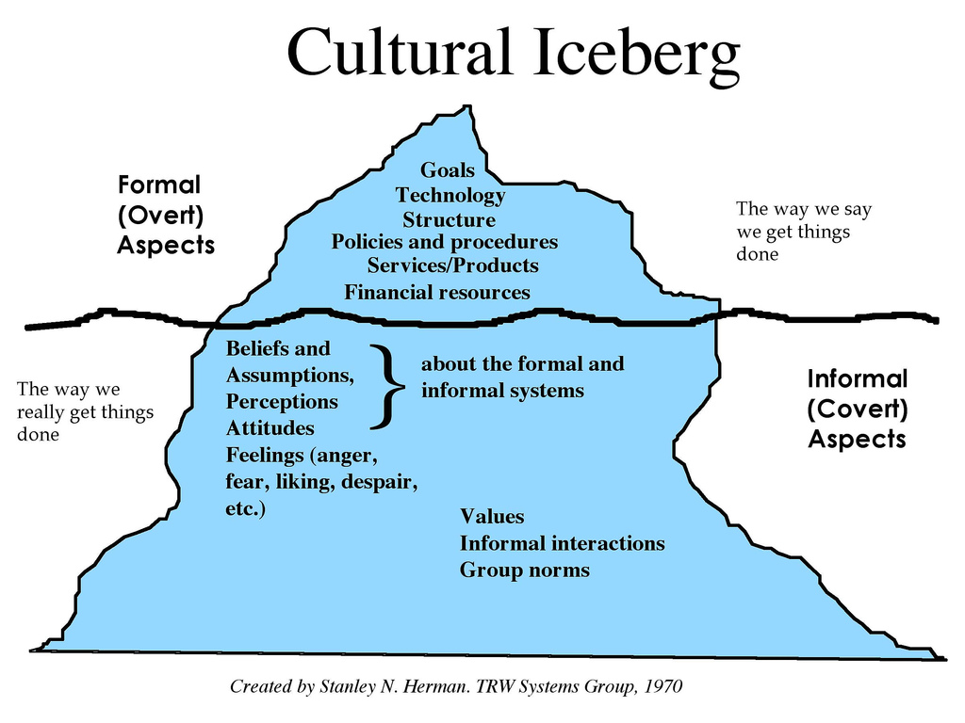

Slide 94
Key Principles of Change Management
3. Clarify the roles
4. Get sponsorship
Get organised
Get Human

Slide 95
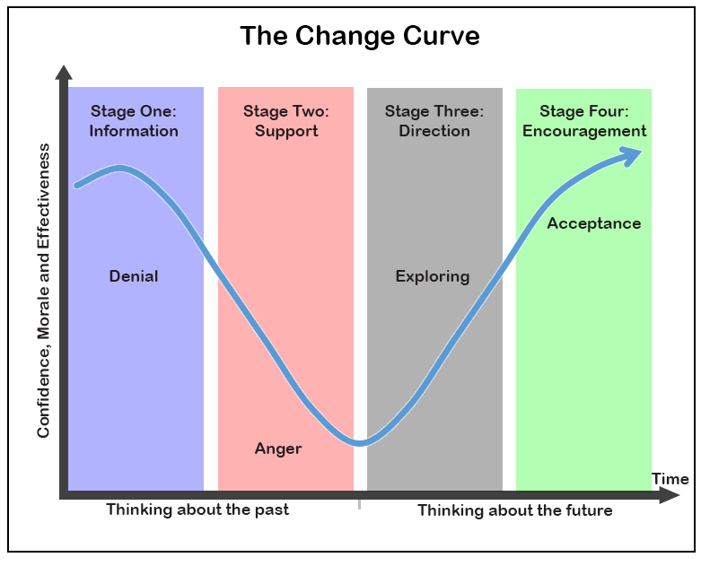
Past focus
Future focus
based on Elisabeth
Notes:
95

Slide 96
Key Principles of Change Management
7. Measure, report and review

Slide 97
Tools
SWOT Analysis
Stakeholder Analysis
Mind Maps
Gantt Chart

Slide 98
SWOT Analysis
Internal
S
W
Strengths
Weaknesses
O
T
Opportunities
Threats
Internal and/or external

Slide 99
Stakeholder Analysis
Opinion formers.
Keep them satisfied
with what is happening
and review your analysis
of their position regularly.
Key stakeholders who
should be fully engaged
through full communication
and consultation.
Keep Satisfied
Manage Closely
High Power
This group requires the least effort if time and
resources are stretched.
Patients often fall into this category. It may be helpful to take steps to increase their influence by organising them into groups or active consultative work.
Monitor
Keep Informed
Low Power
Low Interest
High Interest

Slide 100
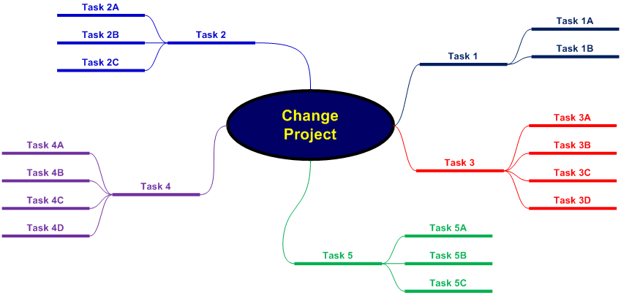
Mind Maps

Slide 101
Gantt Chart
Key Activity | Lead | Week Number
 |  | 1 | 2 | 3 | 4 | 5 | 6 | 7 | 8 | 9 | 10 | 11 | 12 | 13 | 14 | 15
01. Activity A | WS
02. Activity B | KH
03. Activity C | BO
04. Activity D | PL
05. Activity E | YW
06. Activity F | YW
07. Activity G | KH
08. Activity H | LS
09. Activity I | CM
10. Activity J | KH

Slide 102
Techniques
Lewin’s Change Model
Lewin’s Force-Field Model
Kotter's 8 Step Change Model

Slide 103
Lewin’s Change Model
UNFREEZING
CHANGING
REFREEZING

Slide 104
Lewin’s Force-Field Model
Competition
Skills deficit
R
E
S
I
S
T
I
N
G
F
O
R
C
E
S
D
R
I
V
I
N
G
F
O
R
C
E
S
New technology
Job insecurity
Incentives
Complacency
Managerial support (pressure)
New people
Established work patterns
Current State
Desired State

Slide 105
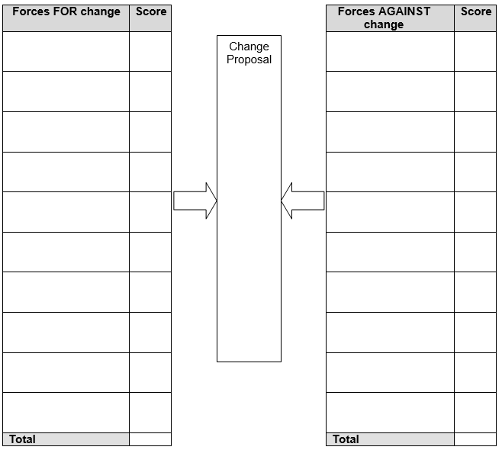
Force Field Analysis

Slide 106
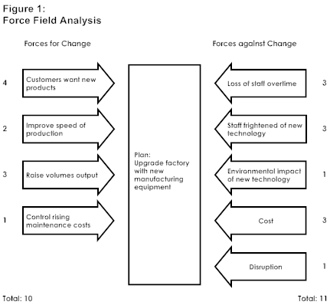
Example: You are a manager deciding whether to install new manufacturing equipment in your factory

Slide 107
Kotter's 8 Step Change Model
  Step 1: Create Urgency
  Step 2: Form a Powerful Coalition
  Step 3: Create a Vision for Change
  Step 4: Communicate the Vision
  Step 5: Remove Obstacles
  Step 6: Create Short-Term Wins
  Step 7: Build on the Change
  Step 8: Anchor the Changes in Culture

Slide 108

Activities
(Workbook)

Slide 109
Session 4
Problem Solving and Decision Making

Slide 110
Learning Outcomes
Value of adopting a culture of improvement
Problem solving and decision making tools and techniques
Use the problem solving steps

Slide 111
What counts as a problem?
Deviation
Potential
Improvement

Slide 112
Improvement in NHS
Quality Improvement
  Health; Better patient outcomes
  Care; Better system performance
  Learning; Better professional development
Continuous Improvement

Slide 113
Common Mistakes
  Tackling the ‘wrong’ problem
  Making assumptions
  Jumping to solutions
  Failing to seek expert advice

Slide 114
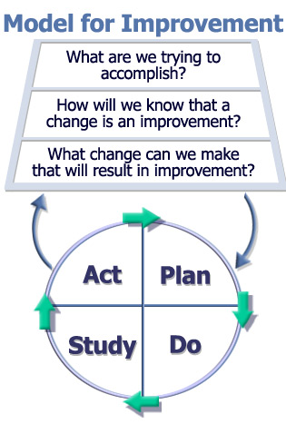
PDSA Model
The Improvement Guide, API

Slide 115
Problem Solving Steps
Step 1: Identify the problem
Step 2: Define the problem
Step 3: Diagnose root causes
Step 4: Generate options/solutions
Step 5: Evaluate options and select the best
Step 6: Implement decision and evaluate

Slide 116
Step 1; Identify the Problem
How do you know there is a problem?
What is the impact of the problem?
Is the problem stated objectively?
What is the scope of the problem?
Is there an implied solution in your problem or goal statement that you need to remove?

Slide 117
Step 2; Define the Problem
Involve stakeholders
Gather and analyse information
Talk with people who are familiar with the problem
Clarify what it is/is not (Problem Definition Tool)

Slide 118
Step 3; Diagnose Root Causes
Root Cause Analysis Techniques:
  5 Whys
  Cause and Effect Diagram (Ishikawa/Fishbone)

Slide 119
5 Whys
Example of 5 Whys:
Patient was late in theatre, causing a delay. Why?
There was a long wait for a trolley. Why?
A replacement trolley had to be found. Why?
The original trolley's safety rail was worn and had eventually broken. Why?
It had not been regularly checked for wear. Why?
There is no equipment maintenance schedule.

Slide 120
  Cause and Effect Diagram (Ishikawa/Fishbone)
Environment
Procedures
Not computerised
Transport arrives early
Not enough treatment rooms
Too much paperwork
Poor scheduling
Clinics Running Late and lengthy waits for patients
Lengthy booking process
Small inner-city environment
Not computerised
Poor maintenance
Unexpected patients
Broken lifts
Staff unavailable
Not enough wheelchairs
Queue jumping
Long term sickness absence
Equipment
People

Slide 121
Step 4; Generate Options/Solutions
Brainstorming
    Six to twelve people
    Lasts for a fixed period
    A chair to define the problem and maintain control
    A scribe to note and record all ideas
    Active participation is encouraged
    Do not discuss or criticise ideas
    Develop the maximum number of ideas
    Evaluate ideas after session (not during)

Slide 122
Brainstorming
Determining the best options:
Cluster similar or related ideas
Condense ideas
Refine/Improve ideas
Reduce your list of possible solutions

Slide 123
Step 5; Evaluate Options and Select the Best
Tools to use:
  Selection Matrix (Benefits vs Effort)
  Paired Comparison Analysis
  Weighting and Scoring

Slide 124
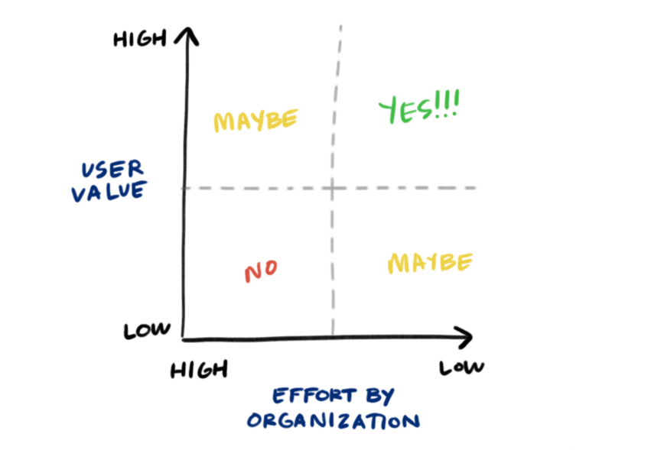
Selection Matrix (Benefits vs Effort)

Slide 125
Step 6; Implement Decision and Evaluate
Key elements:
Steps:
  Action planning
  Communication strategy
  Contingency planning (Risk Management)
  Monitoring, review and evaluation

Slide 126
Action Planning
SMART actions
Break tasks down
Allocate responsibilities
Agree timescales
Prioritise
Identify resource implications
Set review dates
Plan communication
Give adequate warning
Realistic timescales
Maintain effective teams
Enlist help of enthusiasts

Slide 127
Contingency Planning
Step 6 – Implement decision
Risk | L (0 – 10) | I (0 – 10) | Mitigation
Key person goes off sick/leaves | 2 | 8 | Key person keeps detailed progress notes; has regular update meetings with identified colleague
L = Likelihood I = Impact

Slide 128
Monitoring, Reviewing and Evaluating
Evaluate the progress
 | Action Plan |  | ‘Desired goal’
What | SMART actions |  | Milestones, targets
Who | Person(s) responsible | Forum(s)?
When | Target dates | Regular progress reviews?
Where | Team meetings? Forum(s)?
How | Success measures

Slide 129
Activities
(Workbook)

Slide 130
New Resources for Managers
People Management Guide
Being a Manager of People in NHSGGC – Responsibilities and Guidance
  Staff Health, Safety and Wellbeing (ShaW)
  Staff Engagement
  Individual PDP&R
  Service Performance, Team Meetings and Communications
  Team Development and i-Matter
  General HR Policy Awareness and Application
  Equalities
  Partnership Working and Managing Change
  Attendance Management and SSTS
  Recruitment and Retention
  Leadership Skills

Slide 131
New Resources for Managers
New Induction Pathway for New People Managers and Supervisors
  People Management Guide
  Equality Law: A Manager’s Guide to Getting it Right in NHSGGC
  People Manager Self-Assessment Questionnaire
  Systems and Processes

