Slide 1


ePAD: Electronic Practice Assessment Documentation
Resource for Practice Supervisors and Practice Assessors
Version adapted as a 12 minute narrated presentation. The original authors were NHS Tayside.
Notes:
Introduction and welcome
Expectations, ground rules and housekeeping / teams etiquette.
This is a national resource for Practice Supervisors and Practice Assessors, based on the original resource developed by NHS Tayside who were the first NHS board to use the ePAD alongside their partner Universities.

Slide 2
Aims and Outcomes
Aim:
To provide Practice Supervisors and Practice Assessors (PS/PAs) with an overview of the ePAD
Outcomes:
Share knowledge with colleagues around the ePAD
Can describe ePAD functionality on TURAS
Identify avenues of support and further information
Notes:
The aims and outcomes of the session are shown on this slide. By the end of this session you should have an overview of the ePAD, how to access your student's ePAD, how to complete and where to seek further support.

Slide 3
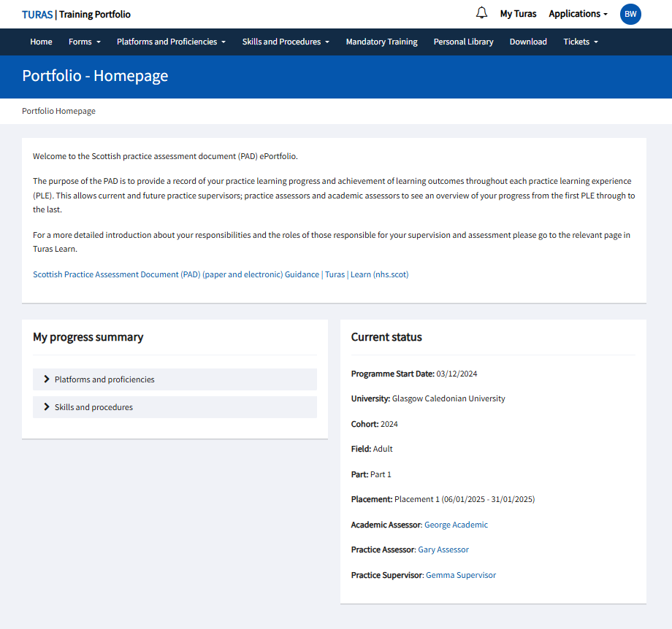
ePAD
Hosted on TURAS platform
Student has TURAS account
PS/PA require a TURAS account to access
Accessible via phone, tablet or computer
Notes:
The ePAD is hosted on the TURAS platform for which all health and social care staff can register for an account. Where possible the PS/PA's organisational email address should be used to register for TURAS; however a personal email login could be used where there is no work email available or accessible.
The PS/PA will provide student with their TURAS email login address, and confirm whether they are a nominated PS or PA for this student. The student inserts this information and adds an access end date (normally 1 week after PLE end). All PS/PA for each practice learning environment are added in this way.
HINT - Students must only have 1 TURAS account. At a later date, a student can merge their other (e.g. HCSW account) into their student account.
If a student is off sick there is an over ride function that the university can utilise in order to allow access.

Slide 4
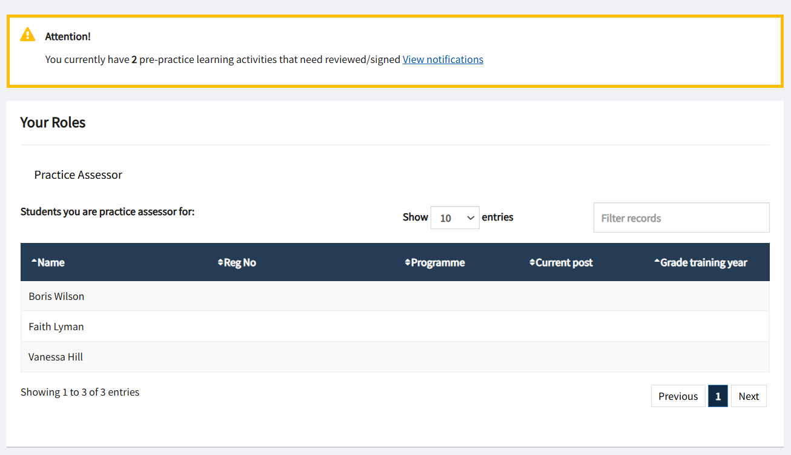
Accessing ePAD
PS/PAs receives an email to confirm access and a prompt to log in via the TURAS Training Portfolio
Select student from the list
Notes:
A PS/PA is sent an email alert outlining they have access and are prompted to log into TURAS account to link up with student’s portfolio. The PS/PA accesses the student portfolio using the Training Portfolio application on their own TURAS dashboard.
Once in the training portfolio homepage, the PS/PA will see a list of all students allocated to them past and present, so should select the appropriate student.
As with the paper PAD, there is a requirement that each student is allocated at least one Practice Supervisor and a Practice Assessor. Within the ePAD, the PS/PA status restricts access – for example, the PS cannot complete the final assessment; only a PA can complete this section.

Slide 5
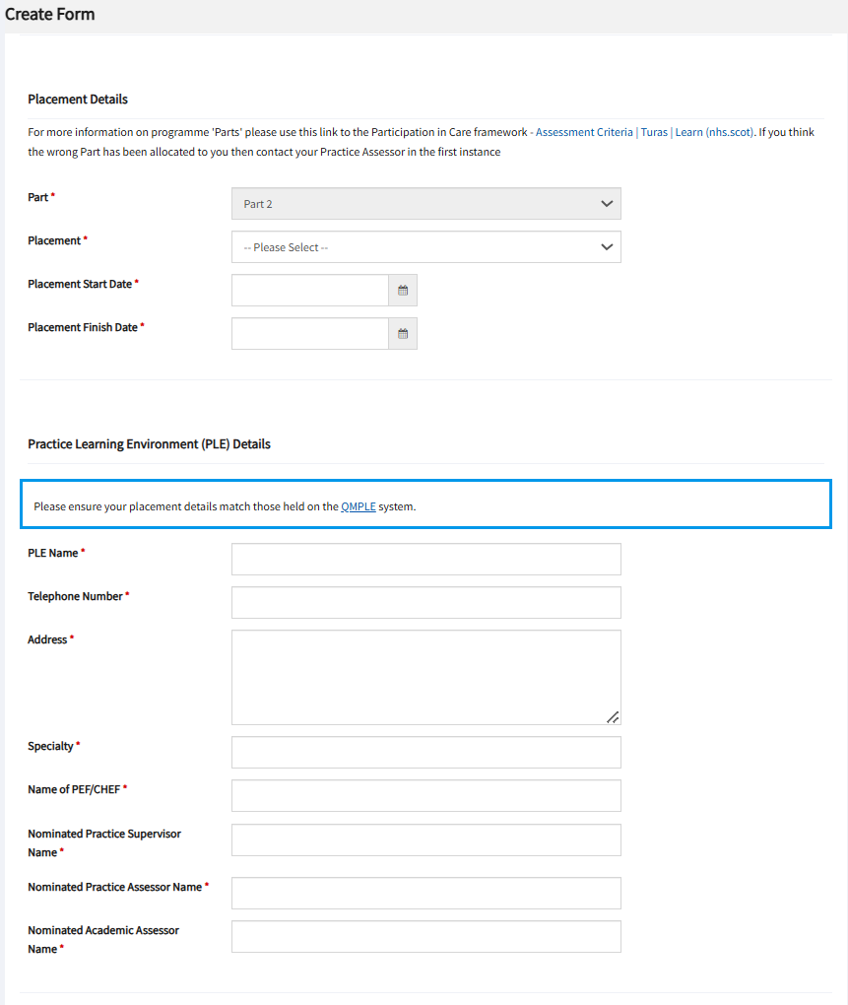
Forms: Students
Students need to complete the pre-placement activities in order for the ePAD to be completed.
The student adds PS/PA email address and role to the access management page
This generates the access email to the PS/PA
Students generate the Attendance Record which is submitted to the PS/PA for approval
Students create feedback from additional learning opportunities for selected PS
Notes:
All forms are electronic apart from Risk Assessments.
Students need to complete pre-placement activities before the other forms in the PAD can be created, this is to ensure that the students have completed the appropriate learning prior to placement.
The students also create their own Attendance Record which should be submitted each week to the PS/PA for confirmation and sign off.
The PA also needs to ensure that the final practice hours for the placement have been met or those for the end of year sign-off, prior to signing off.
Any form that has been signed off cannot be amended so always save drafts if needing to update.
How to create these forms will be shown in the live demonstration of the ePAD and flow charts are available on how to create the forms if needed.

Slide 6
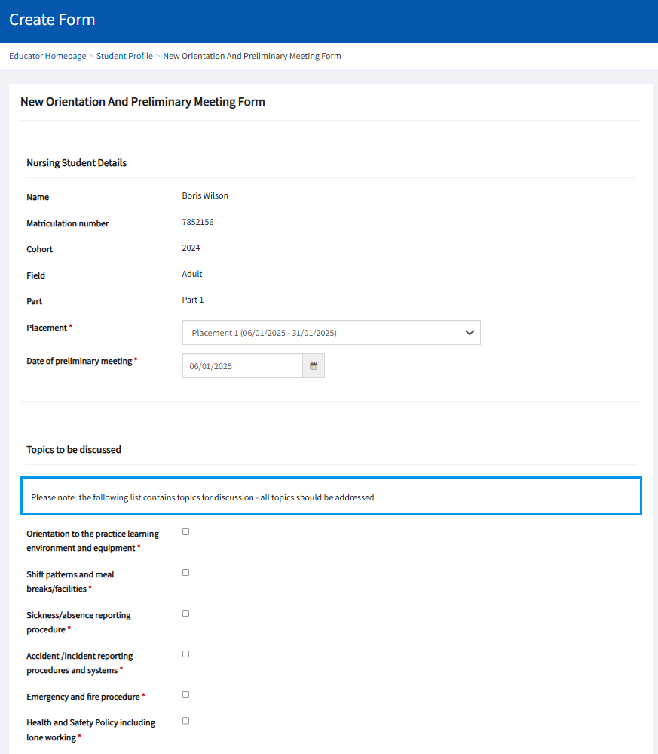
Forms: PS/PA
PS/PAs create the following forms:
Orientation and preliminary meeting
Interim feedback meeting
Service-User feedback
Final Performance Assessment
Confirmation of Completion
Development Support Plan
Additional notes
Risk Assessments still to be completed on paper (with PEF support).
Notes:
Once the pre-placement form has been completed and signed off, the assessor and supervisor have access to the portfolio to create the forms for the placement.
Forms can be saved as draft, once submitted they become a read only document.
If PS/PA add comments and saves, the form is then accessed by the student, once they have added their comments and saved them, the PS/PA will have to save the document again for it to be completed.
Please note that a form may only be signed off by the person who created it.
If a person who commences the form is off and unable to complete e.g. long term sickness absence, the admin team can be contacted to delete the form to allow a new version to be created.
Only Practice Assessors can create the Final Performance Assessment.
Good practice is to back up content on a word document to ensure any information can be replicated.

Slide 7
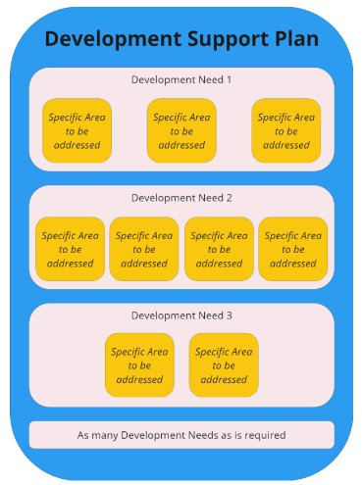
Forms: Development Support Plan
Development Support Plan (DSP)created by PEF/CHEF/PS/PA/AA in 'Create Forms'
The DSP lasts for the entire Part
Development needs and specific area(s) can be added by PEF/CHEF/PS/PA/AA
Creator of DSP sends to student to 'acknowledge'
Once acknowledged by student a development need cannot be amended
Notes:
The Development Support Plan is created in the 'Create Forms' section.
It is important to note that the DSP lasts for the entire Part (or year) of the programme.
Development needs and specific areas to be addressed can be created by any person in the student support team (PEF/CHEF/PS/PS/AA)
Each specific development need has to be acknowledged by the student and is sent to the student for sign off by the person who created it
Once acknowledged the specific development need cannot be amended.
The existing DSP can be viewed in the Forms section on the student profile

Slide 8
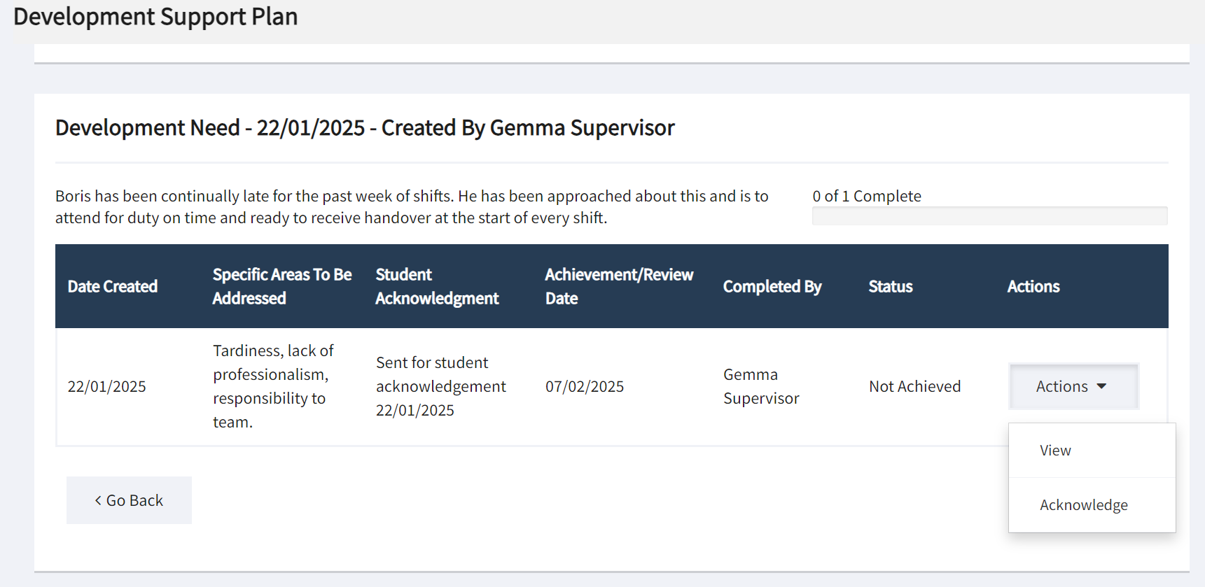
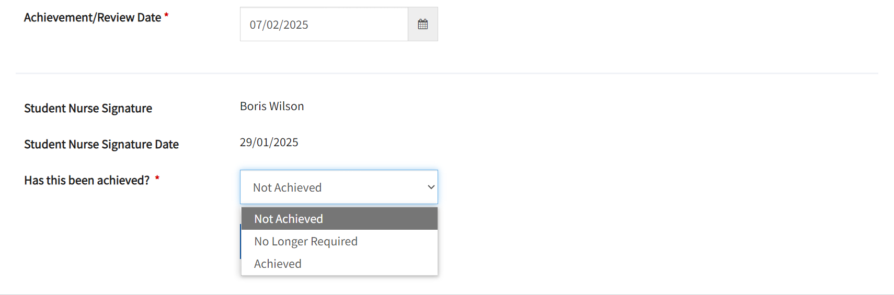
Forms: Development Support Plan-sign off
Additional development needs may be added by PEF/CHEF/PS/PA/AA
Learning Resources/Actions, evidence of achievement and review date may all be amended until achieved
Once achievement is attained the development need can be signed off
Best practice is to ensure DSP is signed as 'acknowledged' by student prior to leaving placement
Notes:
Additional development needs may be added at any time by PEF/CHEF/PS/PS/AA
Each additional development need needs to be sent to the student for acknowledgement.
The Learning Resources/Actions, evidence of achievement and achievement/review date may all be amended until achieved by the student.
Additional progress review can also be added in the 'View', 'Add/View Progress' part of the DSP
Once the student has attained achievement it can be signed off as 'Achieved' in the 'Update' tab
The development need can be on-going from one placement to the next however, it is best practice to ensure that any development need is 'acknowledged' by the student, prior to the student moving placement.
Any educator can 'Update' a specific area for development once they feel that the student has achieved it.
The DSP is classed as in progress for the entire part. When the AA signs off confirmation of completion of the part, the DSP becomes read only
If any outstanding or 'Not achieved' development needs exist, a new DSP is created to carry over into the next Part.

Slide 9
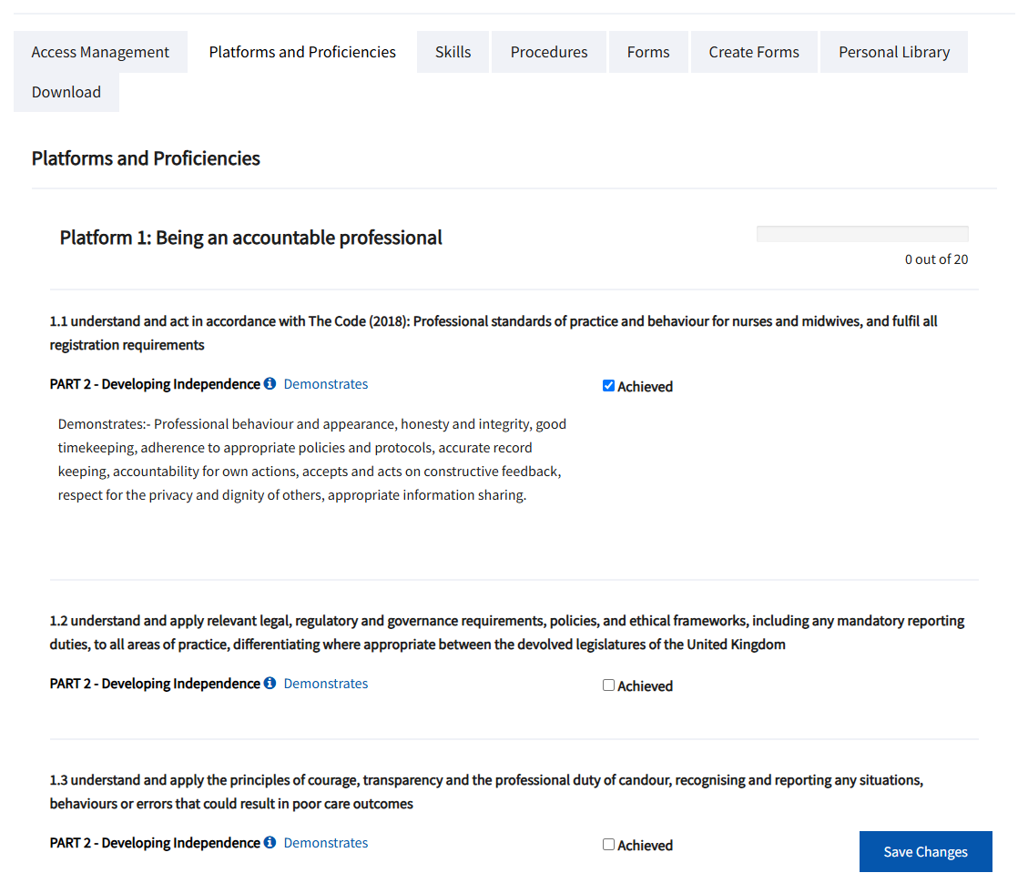
Platforms and Proficiencies
NMC Platform and proficiencies listed; and progress bar
Hover on "Demonstrates" to reveal examples of evidence
Click "Achieved", "Save Changes" and "Confirm"
Notes:
The NMC Platforms and proficiencies are unchanged from the paper PAD. The student progress through each Part of the programme. In part 1, the student is working at dependent level. In part 2 the students should be developing independence, and in Part 3 of the programme, the student should be working towards independence or requiring minimal supervision.
On the screen the progress bar illustrates a summary of progression through the proficiencies and platforms.
Hovering the mouse over the Demonstrate reveals examples of how a student may could demonstrate the NMC proficiency in practice.
Once the PS/PA is satisfied that the student has achieved the proficiency, they click achieved, save and confirm.

Slide 10
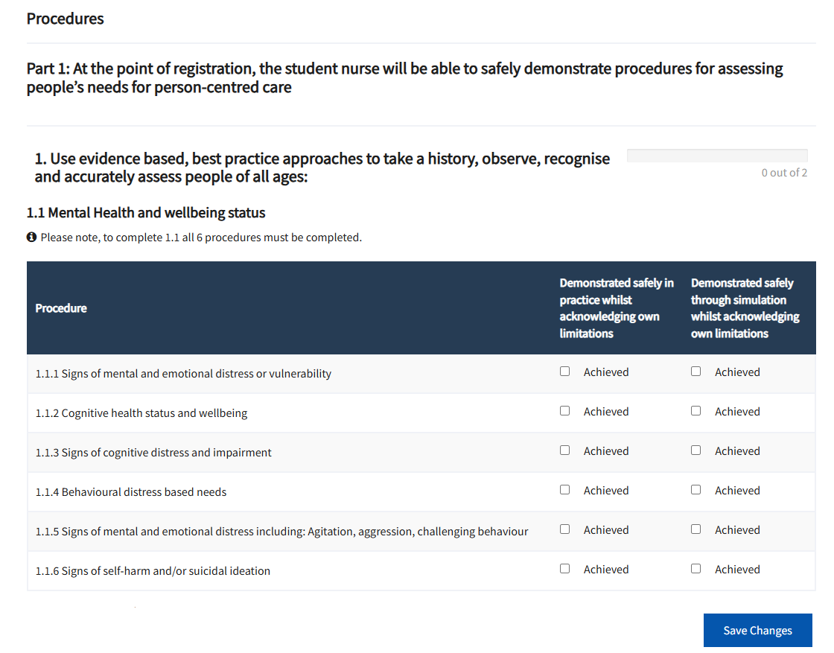
Evidencing Achievement:
Skills & Procedures
NMC skills and procedures are listed
Click "Achieved" to indicate the student has safely demonstrated in practice (or in targeted discussion)
Then "Save Changes"
Notes:
In discussion with the student you can sign off NMC skills and competencies that you feel have been achieved. It is then up to you as their PS/PA to determine whether this has been achieved by demonstration through simulation or demonstrated safely in practice.
Simulation should only be used in exceptional circumstances. Targeted discussions may allow evidence of achievement in practice for skills which a student has not had the opportunity to demonstrate safely in practice, whilst recognising limitations.
By the end of the programme, at the point of registration, all skills and procedures must be evidenced as achieved, for all students across their field of practice.

Slide 11
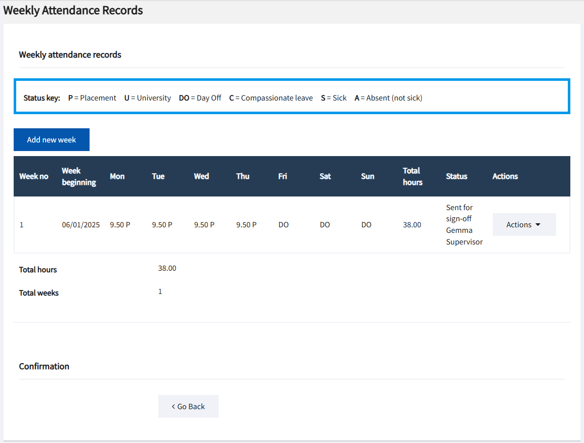
Weekly Attendance Record
Form generated by student
Minutes inserted as decimals (e.g. 30 mins is 0.5hrs)
PS/PA confirms hours worked each week
Confirm completion of total placement hours at end of PLE
Notes:
Students:
Can only create an Attendance Record if a pre-practice activity form is submitted for that placement
Can only submit one Attendance Record per placement.
Should send to their PS/PA for confirmation of hours worked each week, on their last working day of that week.
Governance:
Weekly hours can be amended, but will need re-signed by PS/PA.
No updates can be made once the Attendance Record is signed off for the placement. A new form would need generated.

Slide 12

Support
Practice Education Facilitators (PEFs)
Care Home Education Facilitators (CHEFs)
Colleagues
University administration team – student-led
TURAS digital support
    Green ‘helpdesk’ button function in TURAS
Notes:
The PEF and CHEF teams will provide ongoing support to PS/PA and PLE leads on ePAD functionality.
The student can also access support through the university administration team.
For digital support press the ‘green help desk’ icon in TURAS.

Slide 13
NHS Education for Scotland TURAS Resources
Frequently Asked Questions – TURAS learn
ePad Frequently Asked Questions | Turas | Learn
ePAD forms flow – TURAS learn
ePAD Form Flows Updated 28 01 24 | Turas | Learn
Scottish PAD guidance – TURAS learn
Scottish Practice Assessment Document (PAD) (paper and electronic) Guidance | Turas | Learn
Notes:
There are various avenues of support for student and staff.
Use the task sheets to guide attendees through the functions
Students have control
There is a over ride function that the university can use for absence, uncooperative students etc.

