Slide 1


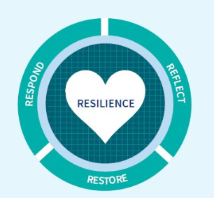
Restorative Clinical Supervisor Preparation Programme
for Nurses and Senior Health Care Assistants within Care Homes – Cohort C Glasgow
An opportunity to develop your knowledge, skills and confidence to effectively facilitate restorative clinical supervision.​
What is clinical supervision?
A regular process of facilitated reflection on practice, in a safe space, with the intention of support and development to promote high quality care. It is not performance or line management, nor part of a yearly appraisal..
Why is restorative clinical supervision important?
Clinical supervision is evidence based and considered essential to support the Health and Social Care workforce with the emotional challenges of their role, develop their reflective capabilities, and enable them to address professional challenges in new and innovative ways, thus contributing towards a healthy workplace culture.
Completing the programme will offer you:
An opportunity to participate in a programme using a blended learning approach which builds on the theoretical foundation provided by the self-directed online learning units. The programme will also provide you with an opportunity to practice and develop the knowledge and skills for the role of clinical supervisor.
Programme structure:
Self-directed online learning units: https://learn.nes.nhs.scot/3580/clinical-supervision x 4 (approx. 5hrs)
Facilitated skills development workshops x 2 days (approx.12hrs)
Skills development workshop dates: Day 1: TBC Day 2: TBC Venue: Requirements: Completion of all 4 self-directed online learning units via TURAS Learn Attendance at BOTH of the skills development workshops
For further information please contact: Allan Dickins, Care Home Education Facilitator allan.dickins@ggc.scot.nhs.uk To register for a free Turas Learn account - search for turas And click the register button at the top of the home page.

