Slide 1

Civility Saves Lives
Notes:
Civility saves lives – this starter pack has been designed in collaboration with NHS Greater Glasgow and Clyde and NHS Lanarkshire and Dr Chris Turner – lead for Civility Saves Lives.
The aim of the starter pack is to raise the awareness of how behaviours impact on our abilities and cognitive function.
The slides define civility, looks at the impact of rudeness within all healthcare workers on the recipient, witnesses, patients and relatives.
At the end the slides outline further work within the Board.

Slide 2
Civility Saves Lives
Starter pack slide set
The aim of the starter pack is to -
Raise the awareness of how behaviours impact on our abilities to perform and our cognitive function.
Define civility and what it means at work.
Explore the impact of rudeness on:
  The recipient
  The witness
  The relative / patient
Outline further Civility Saves Lives work within NHSGGC.
Notes:
Aims of the pack

Slide 3
Civility – definition
The sum of the many sacrifices we make for the sake of living together
The sum of the many sacrifices we make for the sake of working together
The requirement for civility increases when the interactions amongst people increase in the complexity and frequency
Is incivility a precursor to undermining and bullying behaviours?
Notes:
Definition of civility
Healthcare often has complex and complicated interactions. Being aware of how rudeness affects individuals, hopefully decreases undermining and bullying behaviours.

Slide 4
Unprofessional behaviours
A spectrum of behaviours
Passive
Inadequate notes
Doesn’t answer pagers etc.
Passive/Aggressive
Derogatory comments
Hostile notes
Aggressive
Verbal outbursts
Throwing instruments etc.
Avoiding meetings
Sexual harassment
Non compliance of policies etc.
Assaults
Persistent lateness
Non-participation in meetings
Complaining
Inappropriate jokes
Threats
Swearing
Intimidating colleagues, patients
Publicly degrading team members
Notes:
There is a spectrum of unprofessional behaviours.
Civility saves lives works at the end of the spectrum where behaviours may be found to be rude and offensive but would probably not involve formal procedures.

Slide 5
Anyone witnessed rudeness in the last year?
To you
In front of you
By you
Notes:
This slide is ideal for reflection and discussion amongst the group. Plan a bit of time for discussion at this point.
Reflecting on how rudeness and incivility affected the individual but also what situation led an individual to be uncivil towards a colleague.
When presenting the starter pack slide set this is an excellent slide to ask the audience to reflect on how they felt if they experienced rudeness, witnessed rudeness or were rude to others.

Slide 6
IMPACT
Do negative behaviours really matter?
Notes:
This is a transition slide to take the presenter into the next part of the presentation – why negative behaviours do matter.

Slide 7
IMPACT
The recipient
80% lose time worrying
78% reduce their commitment to work
63% lose time avoiding the offender
48% reduce their time at work
38% reduce the quality of their work
25% take it out on others
12% leave
Notes:
Negative behaviours do matter
As the recipient – the following may occur
80% lose time worrying
78% reduce their commitment to work
63% lose time avoiding the offender
48% reduce their time at work
38% reduce the quality of their work
25% take it out on others
12% leave
The price of incivility. Porath C, Pearson C. Harv Bus Rev. 2013 Jan-Feb;91(1-2):114-21, 146.

Slide 8
IMPACT
The recipient
60% reduction in cognitive function
Decrease in patient care = clinical risk
Notes:
Key message – patient safety issue.
https://thepsychologist.bps.org.uk/volume-24/edition-7/how-rudeness-takes-its-toll

Slide 9
IMPACT
Witness(s)
20% decrease in performance
50% shown to make a drug calculation error
50% reduction in willingness to help others
Decrease in patient care = clinical risk
Notes:
Rudeness affects the onlookers
Porath C, Erez A. Overlooked but not untouched. How rudeness reduces onlookers’ performance on routine and creative tasks. Organ Behav Hum Decis Process 2009;109:29-44.

Slide 10
IMPACT
Patients / Relatives
75% less supportive of the organisation
66% feel anxious dealing with the staff
Organisational reputational risk
Notes:
Key issue – organisational risk
The price of incivility. Porath C, Pearson C. Harv Bus Rev. 2013 Jan-Feb;91(1-2):114-21, 146.
https://thepsychologist.bps.org.uk/volume-24/edition-7/how-rudeness-takes-its-toll

Slide 11
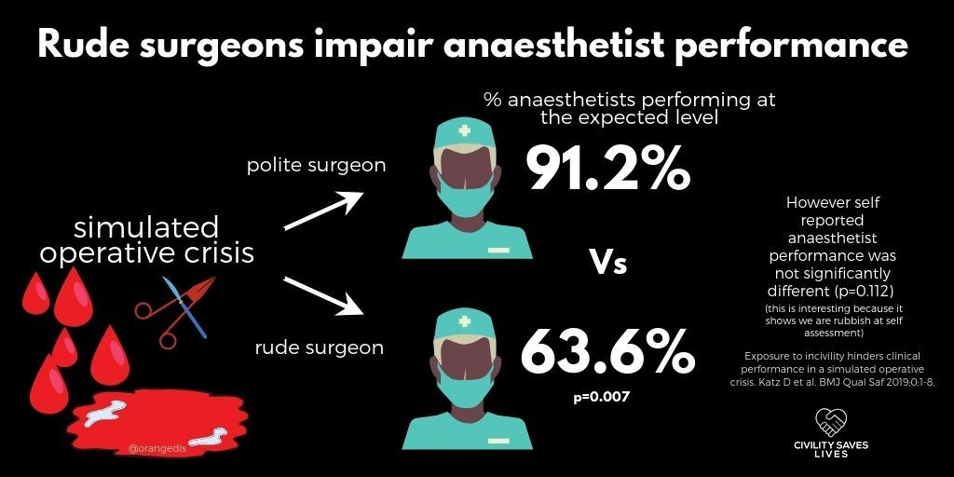
Are we all affected?
Notes:
A common response from staff when talking about the importance of civility is that it doesn’t affect them, they can still do their job ok.
This study shows that whether we realise it or not it does affect them/us.
It decreases our performance markedly and we don’t even realise it.
Of interest in this study is that the incivility displayed was ‘mild’ and not all were aware of the impact as the self reported scores were not as different as the actual scores.
https://qualitysafety.bmj.com/content/28/9/750 - Exposure to incivility hinders clinical performance in a simulated operative crisis

Slide 12
Performance
Single biggest factor in how we perform is how we treat each other
Notes:
Prompt discussion if appropriate

Slide 13
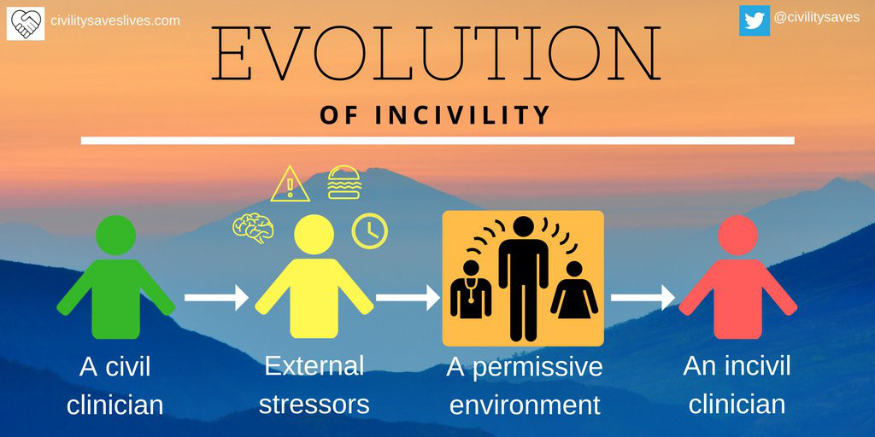
Evolution of incivility
Notes:
Some assumptions
Everyone comes to work aiming to do a good job
All competent clinicians / managers
What makes the difference
Why do we perform below our norm – is it all about process?
If only everyone did what they were supposed to ……..
Competent people –
why do we not do what we should do
Process occurs within an environment -
it is this environment which impacts on our performance
In the moment when someone is rude – you are less than you

Slide 14
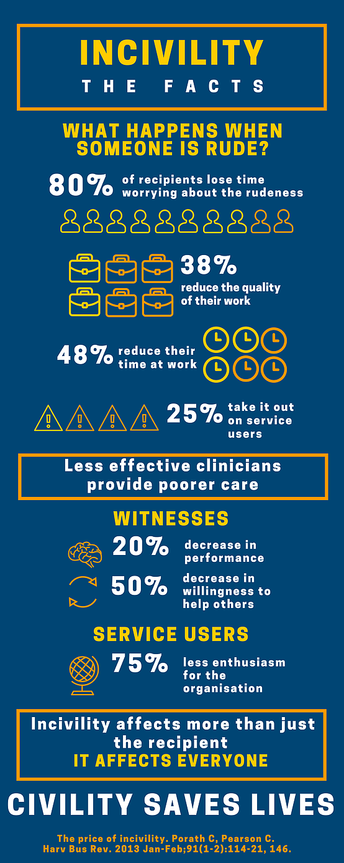
IMPACT
Summary
Notes:
Summary of impact

Slide 15
NHSGGC - further work
Raising awareness across the Board
Leads within each clinical unit forming a civility community
Next steps -
  Collaboration with GMC with Professional Behaviour: Patient Safety workshops

Slide 16
Rudeness impacts on patient outcomes

