Slide 1

Civility Saves Lives
Setting the Scene for Civility… in your Department

Slide 2
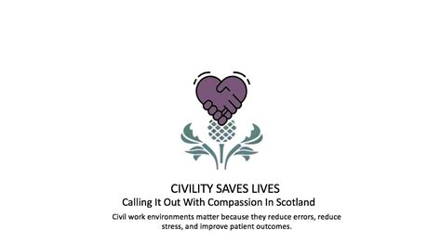

Slide 3
Welcome, Introduction and Aims
Introduce Civility Saves Lives and the impact of incivility on patient safety as well as day to day performance and culture in the workplace.
Engaging, discussing and getting commitment to the approach in your own service.
Cascading the key messages & learning
Identifying ways of creating and promoting positive workplaces and experiences
To explore the nature of informal one-to-one 'calling it out with compassion' conversations, aimed at reducing rude and damaging behaviour in the workplace and clarifying the wider processes in which these conversations sit.
Notes:
Why Civility / and Incivility are important to pay attention to
Consider how we spread and grow awareness & understanding of CSL through yourselves & others as champions/ advocates in local areas – this is how it will work best, by organically growing within teams, services, sites
How we build a robust & supportive approach to address rudeness and incivility
And key things we need to consider around training & other support

Slide 4

Background
CSL Founder - Dr Chris Turner, Consultant, Emergency Med, West Midlands
CSL – self-funded collaborative project, promoting positive behaviours & sharing the evidence
Raising the power of civility in healthcare
Importance of respect, professional courtesy, valuing others; and calling out rude behaviours with compassion and respect
Growing the movement & ethos
Origins in clinical settings, but relevant to all settings and staff groups
CSL website : https://www.civilitysaveslives.com/
Notes:
Chris Turner – co-founder and developer of CSL
Has contributed to a number of sessions and events in GGC, and provided support in helping us develop our way forward
Dr Turner – developed CSL based on his experiences & observations in his own workplace, seeing the impact of rudeness/ incivility and the need to do something about it – he and others have worked on this over a number of years
Whilst it originated with Clinicians – the Principles have a broad reach - ethos is relevant in all areas/ with all groups of staff
CSL Collaborative Project was established – members from across a number of Trusts.
MISSION – to grow the movement/ spread the word, raise power of civility, respect; call out rudeness with compassion
Grow it organically. Preventative & restorative approach
Really useful website with a range of resources, including videos, podcasts, articles, experiences in other organisations.
Also several TED Talks and other presentations available if you Google Chris Turner

Slide 5
Civility in NHSGGC
A deliverable on Workforce Strategy Action Plan
Two part Vision:
Awareness - That all staff are aware of the benefits and initiatives they can agree in their own departments that promote encouragement and support between colleagues, and that they are also aware of the impact of incivility on patient safety, staff wellbeing and performance.
Agency - That we have an established approach (completely independent of formal HR process) to address incivility when it happens, that is available to all staff and is compassionate and positive, recognising we are all human and can make mistakes with our behaviour.
Notes:
CSL is a Board priority as part of workforce & culture aims
Focus on creating positive workplaces and staff experiences to support effective working, patient care & outcomes

Slide 6
Delivered so far…
NHS Civility Scotland event
Presentations to SMTs
Staff engagement workshops
Support to particular teams
Part of Leadership programmes and FY1 induction.
Part of Investors in People (IiP) cluster development plans
Civility Saves Lives webpage and links to materials.

Slide 7
GGC CSL Group & board-wide campaign & promotion activities
Local Champions Groups – Awareness raising & campaigns
Teams focus on positive actions to create kind, compassionate workplaces
Calling it out with Compassion
Civility Leads identification & training
Tie in to other priorities/ initiatives eg GGC objectives/ strategies, Investors in People, team effectiveness, Peer support
Notes:
Overarching GGC CSL group consists of members from local Champions groups, plus reps from corporate, HSCPs, and other interested colleagues.

Slide 8
Approach for 2023-24
Further communications and engagement to raise general awareness across GGC
Champions Groups in each IiP Cluster – for sharing practice, learning and input from across different levels and professions on each location. All areas, clinical and non-clinical.
Test and develop Civility Leads role and approach and design the training
Start small - referrals/pilot areas that would benefit now
Engage staff in these areas, explore and agree development actions and if appropriate identify and train Civility Leads
Evaluate, learn and grow the approach based on results

Slide 9

Civility – definition
Civility is demonstrating respect, care, kindness, compassion, positive behaviours and awareness
The sum of the many sacrifices we make for the sake of living together
The sum of the many sacrifices we make for the sake of working together
The requirement for civility increases when the interactions amongst people increase in complexity and frequency
Is incivility a precursor to undermining and bullying behaviours?
Notes:
Definition of civility
We all make sacrifices in life – but probably more so in our worklife/ & with colleagues than we do in our home life
Healthcare, in whatever shape or form, often has complex and complicated interactions, therefore heightens the need for civility .
Being aware of how rudeness affects individuals, hopefully decreases undermining and bullying behaviours.
Civility is respect, care, kindness, positive behaviours and awareness of self and others
​

Slide 10
Unprofessional behaviours
A spectrum of behaviours
Passive
Inadequate notes
Doesn’t answer pagers etc.
Micro Behaviours
Ignoring or dismissing
Hostile notes
Aggressive
Verbal outbursts
Throwing instruments etc.
Avoiding meetings
Non compliance of policies etc.
Persistent lateness
Non-participation in meetings
Inappropriate jokes
Threats and bullying
Swearing
Intimidating colleagues, patients
Publicly degrading team members
Harassment
Not recognising or thanking
Interrupting or talking over
Negative posture/ body language
Notes:
There is a recognised spectrum of unprofessional behaviours.
CSL works at the end of the spectrum where behaviours may be found to be rude and offensive but would probably not involve formal procedures.
We all recognise at least some of these behaviours, and how they make us feel
‘Civility costs nothing and buys everything so why do we ‘lose it’?’.
without civility, we will never have good staff experience at work.
​What is incivility?
Incivility can be anything ranging from rude or unsociable speech or behaviour.
Things said/ done (which might seem of little consequence) which go against the norms of respect & workplace conduct, and the intent to ‘harm’ might seem ambiguous
There are many examples:
​
Shouting at someone, swearing, aggression (not necessarily towards someone), belittling someone, sending emails while in meetings, talking over others, being difficult over the phone, rolling eyes or tutting at someone. The list goes on!

Slide 11
IMPACT
Do negative behaviours really matter?
Notes:
So, we recognize many of those behaviours, and have we become ‘used’ to them – do they really matter/ have a notable impact?.....

Slide 12
IMPACT
The Recipient
80% lose time worrying
78% reduce their commitment to work
63% lose time avoiding the offender
48% reduce their time at work
38% reduce the quality of their work
25% take it out on others
12% leave
Notes:
Negative behaviours have a cost & they do matter, as robust research indicates -
Dr Turner highlights the following Research findings (conducted by Christine Porath)in his presentations, and further info can be found on the CSL website
Importantly, the impact is how it is interpreted by the recipient – it is founded in how people feel about the actions/ words of another, regardless of the intention of the other party.
​
People can feel incivility deeply – many may hide their responses (fear of repercussions) ; Sense of hopelessness ; Cut back effort, quality, time
They may mirror that behaviour with others
End result may be that they leave, which affects all we try to do to retain our staff
As the recipient – the following may occur
80% lose time worrying
78% reduce their commitment to work
63% lose time avoiding the offender
48% reduce their time at work
38% reduce the quality of their work
25% take it out on others
12% leave
In a recent survey up to 90 % had personal experience of incivility and 98% had witnessed it as part of a team.
As a consequence the impacts were people spent less time at work, more time avoiding people, were less productive and around 12% left their job. It reduces team performance by around 25% and enthusiasm for staying on by around 50%. If staff are in an educational capacity the ability to learn is significantly reduced if they are stressed.
The price of incivility. Porath C, Pearson C. Harv Bus Rev. 2013 Jan-Feb;91(1-2):114-21, 146.

Slide 13
IMPACT
The Recipient
61% reduction in cognitive function
Decrease in patient care = clinical risk
Notes:
Key message – it is a patient safety issue.
Direct impact on the recipient, and this has been measured in the office place by Christine Porath[2]. She found: 61% reduction in cognitive ability
Lack of cognitive ability results in poorer healthcare and ability to work effectively
In critical incidents, around 70% of fatal/ near fatal events have a preceding incidence of incivility in the previous few hours
When someone is rude to us, it reduces our bandwidth; our ability to effectively juggle multiple tasks and conscious thoughts.
It affects how we think in that moment
​
For example, on a good day, we can actively juggle 6-8 things – some of these may be simple things or tasks, but could also be important tasks or process involving care for/ decisions about patients/ or other actions required to perform our roles
​
​Therefore, rudeness reduces our ability to do our jobs, until all we can focus on is the rudeness/ negativity, impeding clear thought, focus, attention, effort & energy. IMPACT ON PATIENT CARE – CLINICAL RISK
https://thepsychologist.bps.org.uk/volume-24/edition-7/how-rudeness-takes-its-toll

Slide 14
IMPACT
Witness(s)
20% decrease in performance
50% shown to make a drug calculation error
50% reduction in willingness to help others
Decrease in patient care = clinical risk
Notes:
Rudeness not only impacts the recipient, but also has a ripple affect on others, spreading to impact those who observe it
May result in fear, lack of confidence to ask questions, raise issues, offer help
​Costs of incivility might be seen in areas such as decline in work effort, performance, commitment and even having effects on service users.
For recipients of incivility, harm is compounded if onlookers are impacted or have not challenged the behaviour.
Others can also feel guilty or complicit if they have not challenged the behaviour themselves.
A person could be the victim, onlooker or perpetrator of rudeness on any given day.
As a perpetrator of incivility, you might have a ‘fight or flight’ response to a perceived threat and show incivility as a reactive stress response.
Because the behaviour of incivility is ingrained and remains unchallenged, we operate in a culture that sometimes rewards this behaviour or we see it as ‘survival mode’.
​
Porath C, Erez A. Overlooked but not untouched. How rudeness reduces onlookers’ performance on routine and creative tasks. Organ Behav Hum Decis Process 2009;109:29-44.

Slide 15
IMPACT
Patients / Relatives
75% less supportive of the organisation
66% feel anxious dealing with the staff
More likely to complain, litigate, not trust
Organisational reputational risk
Notes:
Subsequent impact on patients/ relatives. Key issue – organisational risk
May prevent a patient asking for help or not mentioning symptoms. Patient view of the organisation and their care can be affected
The price of incivility. Porath C, Pearson C. Harv Bus Rev. 2013 Jan-Feb;91(1-2):114-21, 146.
https://thepsychologist.bps.org.uk/volume-24/edition-7/how-rudeness-takes-its-toll

Slide 16
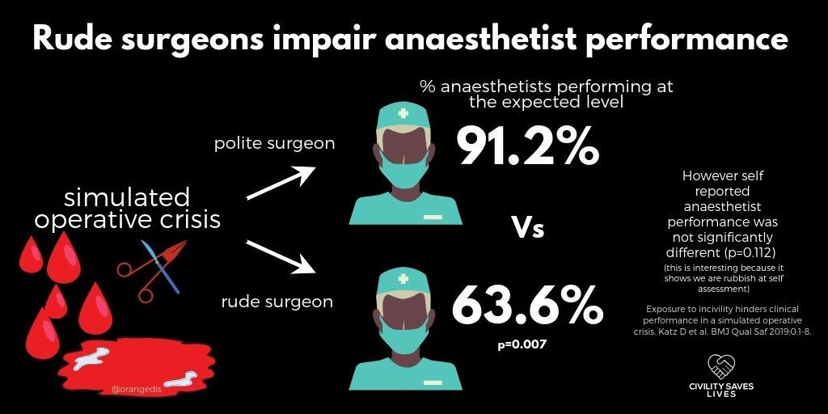
Are we all affected?
Notes:
A common response from staff when talking about the importance of civility is that it doesn’t affect them, they can still do their job ok.
This study shows that whether we realise it or not, it does affect them/us.
Simulation shows that working with Polite Surgeon results in Anaesthetists performing at expected level of 91.2%
Working with surgeon who is rude, brings this down to 63.6%, - a decrease of almost 30%
It decreases our performance markedly and we don’t even realise it (thinking that we still perform well).
Of interest in this study is that the incivility displayed was ‘mild’ and not all were aware of the impact as the self reported scores were not as different as the actual scores.
So, they did not recognise the impact or reduction in their own performance
Re-iterate CSL relevant in all settings, staff groups etc
https://qualitysafety.bmj.com/content/28/9/750 - Exposure to incivility hinders clinical performance in a simulated operative crisis

Slide 17
Performance
Single biggest factor in how we perform is how we treat each other
Notes:
There is a direct link with research into Effective Teams by Prof Michael West & some of this was part of the inspiration behind CSL – impact on patient care/ outcomes/ staff wellbeing & experience
We all have a responsibility to create and maintain a healthy & positive work environment.
In past number of years in GGC, we have placed more focus & support on Mental Health & Wellbeing, Psychological Safety, Resilience.
Taking a compassion-focused approach, Looking at behaviours (our own & others)/ how we interact is a crucial element in supporting ourselves & others
How we work within Teams is crucial – everything we do requires Team work in some shape or form
The CSL work ties in closely to TEAM EFFECTIVENESS and the research undertaken by Prof Michael West, Lancaster Uni – looked at the core ingredients for effective team working in healthcare environments.
Excellence in Healthcare is dependent on Teams & how effectively they work.
The research demonstrated a positive correlation between quality & effectiveness of team work and the optimising of Patient outcomes.
Ineffective team working impacts patient care, patient outcomes, error rates, staff wellbeing & experience
This is optimised when team members feel psychologically safe & confident.
Incivility has been shown to erode safety, diminish team functioning, decision making etc, and impact
The learning from this work has been well established in GGC over the past 6 or so years and we have worked through the methodology and approaches for improvement with a wide range of teams across the organisation

Slide 18
Why it’s important
“ The safety of patients is dependent on the members of the staff who interact with them being physically, psychologically and emotionally well, and able to cope with the complexity of their day to day work.
Staff wellbeing is increasingly being understood as the most important aspect of preventing error and harm, and the time has come to apply these insights to the way we approach patient safety in the NHS”
      Professor Michael West
Notes:
Prof West quotes underpinning the need to pay attention to teams & civility

Slide 19
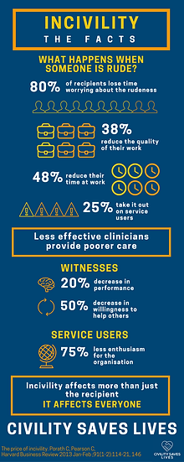
Impact Summary
Notes:
Summary of impact
Highlight the importance of looking through a compassionate lens when talking about those who display incivility.
Change the culture and think about what we can do to help people to spread a culture of civility and kindness and to help everyone to meet incivility and unkindness with compassion.
Important to understand that Incivility/ rudeness and its impact is relevant across all settings and all staff groups, clinical and non-clinical
A person could be the victim, onlooker or perpetrator of rudeness on any given day.
As a perpetrator of incivility, you might have a ‘fight or flight’ response to a perceived threat and show incivility as a reactive stress response.
Because the behaviour of incivility is ingrained and remains unchallenged, we operate in a culture that sometimes rewards this behaviour or we see it as ‘survival mode’. ​
Quote from CSL website : “When we condone rudeness in our teams, we accept poorer outcomes for our patients.”

Slide 20
Reflect on your experiences
What type of incivility/ rudeness do you encounter (whether intended or not)
Is it allowed to go unchecked in your department?
Do you think colleagues know the impact that being subjected to rudeness has on performance and service?
What is done to tackle it, or what do you think should happen? (In a way that ensures trust and relationships stay healthy).
Notes:
Questions to explore within teams:
What examples do you see, what is the ‘pebble in your shoe’?
At what point do things breakdown?
Notes:
Being only human we can all make mistakes with our behaviour, especially under pressure.
We sometimes say things that land badly, perhaps not intentionally, and often we are not even aware.
Intentional or casual rudeness can be a pattern for some people to get what they want and is often allowed to go unchecked, usually when power is unequal.

Slide 21
How can we take Civility forward?
What would good look like in your area; How might this model work if applied in your own department?
How will you start to set the scene for civility and spread awareness in your area? Who would you involve?
What support might you need?
Notes:
Questions to explore within teams

Slide 22
Promoting Positive Workplace Cultures
Exploring what teams/ departments can do to make things better, less stressful, create positive experiences
Focus on the positives, not just the things that go wrong
Encourage ideas from colleagues – boost morale, motivation
Awareness of mental health & wellbeing and access to resources
Acts of Kindness, Compassion
Low or no cost positive actions
Express gratitude, smile, say hello, make people feel good
Ensuring everyone has breaks, food, hydration, fresh air
Welcome pack for new staff
Cake/ sweetie Fridays
Staff recognition & appreciation – eg ‘Mug of the month’, Greatix, Thank you cards, Praise app
Bring a bit of fun, eg Photoboards (people, pets, holidays)
Notes:
Civility is not just a focus on the negative/ addressing poor behaviours.
Switch the narrative to explore what local teams can do to make their workplace experiences even better.
The brain works better if it is full of dopamine rather than cortisol and simple measures can be carried out to do this. Industries have invested massively in this as low mood equals low productivity equals low profits.
Simple measures like saying hello, welcoming people and thanking people are costless norms that should be aimed to be established.
Encouraging people to remain hydrated and the promotion of breaks as chance to restore efficiency rather than just eating something
Staff need to be encouraged as to the benefits of simple activities – a walk at lunchtime, a Pet board for photos, random emails of thanks, a packet of biscuits, using Greatix - or a Bake off at the end of the month. We spend a great deal of time at work and the best situation is when it doesn’t feel like work.

Slide 23
Calling it out with Compassion
What can we do when there is rude/ uncivil behaviour?
Pilot areas – specific needs & targeted support
Potential for teams to nominate local Civility Leads
Training for Civility Leads
Civility Leads Principles and role
Calling out rude/ uncivil behaviours with compassion
Notes:
** Refer to Civility Leads Principles paper and CSL Intro paper for an outline of the Civility Leads role, purpose, how it is anticipated they would be identified / nominated by peers in local areas
Work is currently underway to develop a 1 day robust training package for Civility Leads.
Where some teams require additional support to address issues around civility, it is suggested they could identify Civility Lead as part of a pilot/ trial.
The potential for this would be discussed with OD in the first instance

Slide 24
Developing our approach to support Civility
An Approach that…
Works in both clinical and non-clinical settings.
Engages all staff and is developed with wide input and commitment.
Develops a language that people can use and relate to that encourages awareness and confidence.
Builds momentum naturally and grows in a sustainable way that really works.
Helps us all to maintain civility but also to be proactive and compassionate when things do go wrong, in a way that is helpful and supportive to colleagues.
Resolves most issues informally, more effectively and avoids formal HR process whenever possible.
Helps us maintain a positive work environment where people can be at their best, to the benefit of patient safety and care.
Notes:
Build the movement & ethos across GGC
Not ‘sheep dip’ approach done to everyone.
The research & awareness raising needs to be considered and shared at local level, grow organically
1st step : Recognising & acknowledging that rudeness & incivility DO matter, they have an impact (& ultimately that’s in our patient care)
Next : Take steps to change & improve
Self awareness – encouraging us all to consider our own behaviours & how we interact
Taking the approach of compassionate empathy & challenge

Slide 25
Resource Links
CSL website : Home | Civility Saves Lives
Ted talks – Chris Turner : https://www.youtube.com/watch?v=4RUIhjwCDO0
Notes:
The GGC CSL webpage is in development & a range of resources, presentations will be made available
Posters & other promotional materials are also being developed for distribution across GGC.
Ideas for these are welcome

Slide 26
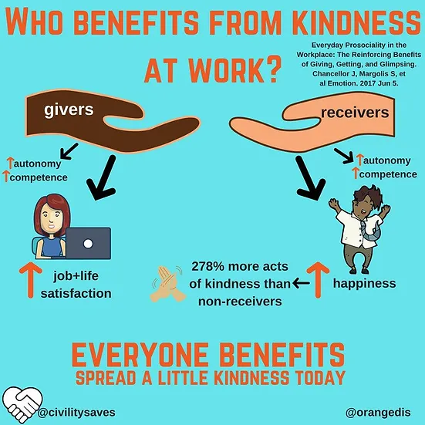

Slide 27
