Slide 1


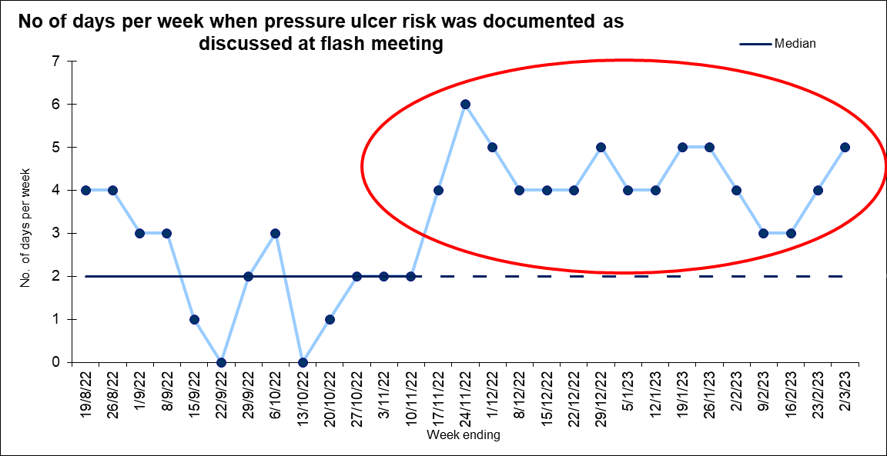
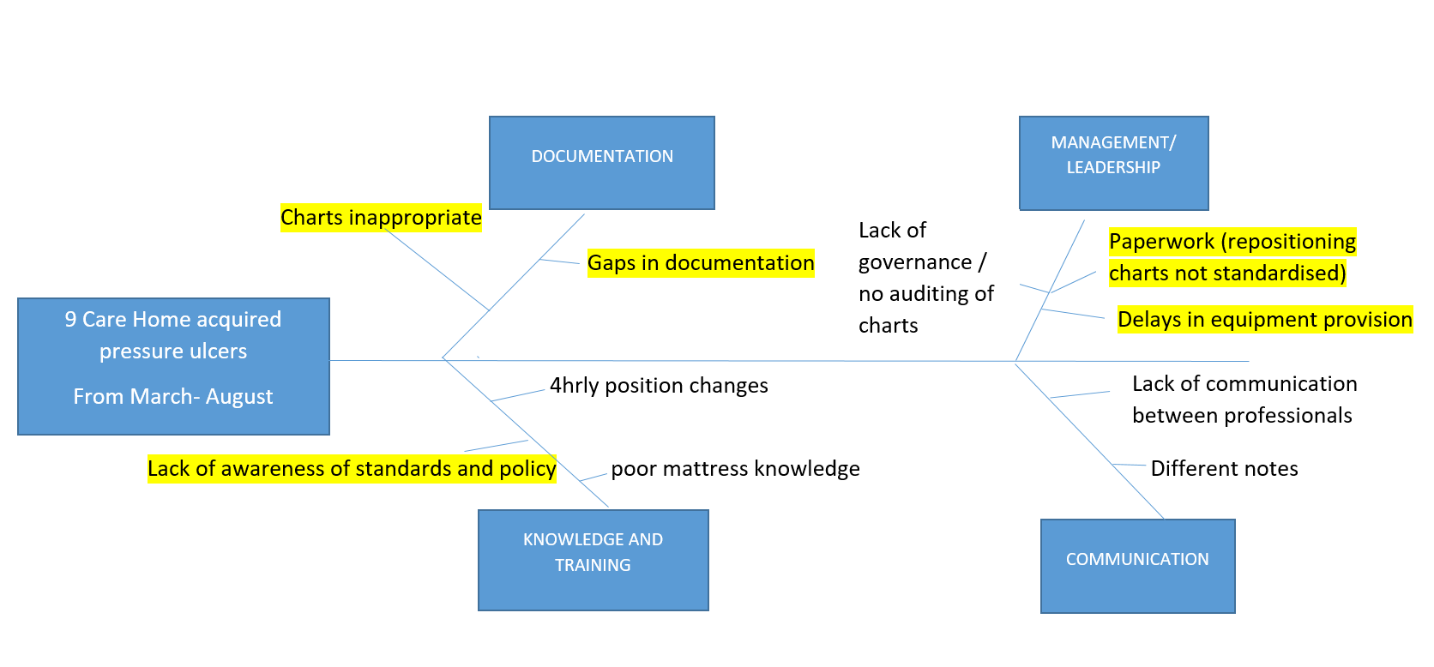
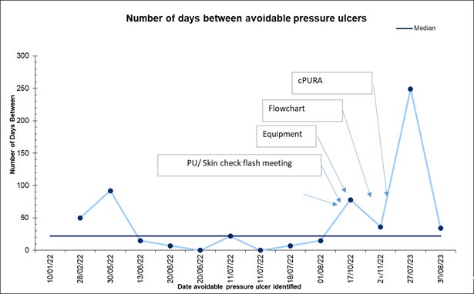
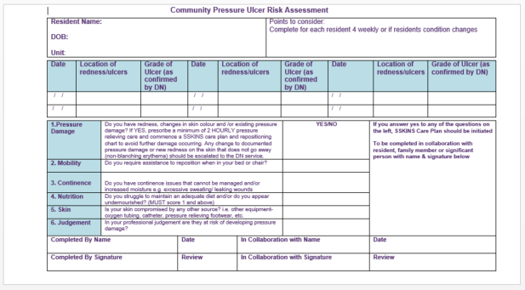
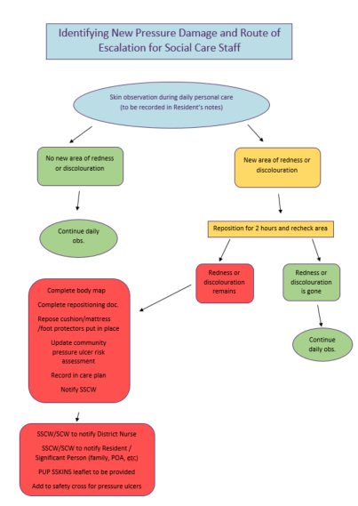
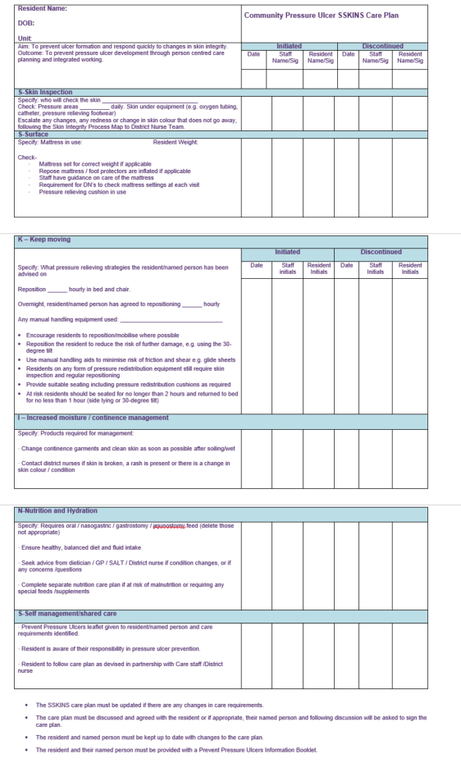
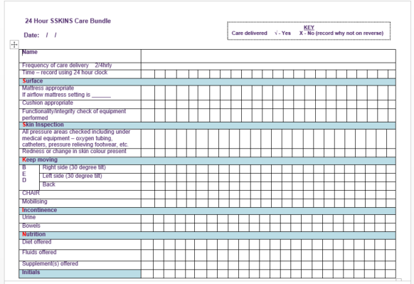

Reduction in Pressure Ulcer Incidence in a Glasgow Residential Care Home
Authors: Caroline Elsegood, Tissue Viability Nurse Specialist, Care Home Collaborative
Patricia Donnelly, Operations Manager, Glasgow City HSCP Residential Home
Fiona Cowan, Quality Improvement Advisor, Care Home Collaborative
Introduction:
Older people living in care homes have various conditions and illnesses that can increase their risk of developing pressure ulcers. Pressure ulcers are recognised as an unwanted complication of illness, severe physical disability or increasing frailty.² Pressure ulcer prevention (PUP) is a priority work stream for the NHS Greater Glasgow and Clyde (NHSGGC) Care Home Collaborative. An increase in pressure ulcers within a care home and a local review of records identified an opportunity for improvement.
Measures:
Figure 4:
Aim:
By July 2023 there will be a 50% increase in the days between identification of avoidable Grade 2 and above pressure ulcers in line with Health Improvement Scotland Standards for Prevention and Management of Pressure Ulcers.
Methods:
Using the fish bone analysis tool (Figure 1) staff came together to discuss the challenges and complexities of the increased incidence of pressure ulcers. Being involved in identifying changes that could lead to improvement staff felt listened to and engaged with the process.
Figure 4 demonstrates that initially there was an inconsistent approach to the inclusion of a PUP section within the flash meetings.
As staff became familiar with the process, an increase was noted in the number of days each week where PUP was discussed as part of their flash meetings.
Figure 1:
Figure 5:
Process Changes:
A driver diagram was developed to help the team identify and communicate the change ideas and how the improvement goal could be achieved. The project team selected the change ideas in yellow below.
Education
Education
Figure 2:
Change Concepts –To make this happen we will…
Aim – how much, by when?
Primary Drivers -To achieve this we need…
Secondary Drivers -To make this happen we need to maximise...
Handover communication tool
Systems and process to communicate risk and skin damage
Handover of Information within the home and between services
DN Attending Flash Meeting
Figure 5 highlights an increase in days between the incidence of pressure ulcers following the introduction of the change ideas.
From Nov 2022 through to July 2023 there were no grade 2 and above avoidable pressure ulcers. In the 6 months prior to the project, 9 care home acquired pressure ulcers were recorded, the average number of days between the ulcers was 20.
Following testing of the change ideas the home had no grade 2 and above avoidable pressure ulcers for 248 days.
Pressure ulcers that did occur were recognised early, reported immediately and resolved quickly
By July 2023 there will be a 50% increase in the days between identification of avoidable Grade 2 and above pressure ulcers
Communication to residents and families
Figure 3d
SSKINS Bundle
Clear care planning and recording of care delivery
Care planning
Identification and management of early signs of pressure damage
Figure 3c
Repositioning Chart
Meaningful activities/maximize mobilisation
Figure 3a
Flow chart to react to early signs of pressure damage
Knowledgeable, educated staff
Educational Opportunities
Figure 3b
CPURA Risk Assessment Documentation
Ongoing education/updates
Program of Education and Training
Good governance process
Access expertise eg district nurses
Monitoring of Pressure Ulcer Safety Cross
Use of specialist equipment for those at risk
Pressure relieving Equipment in stock
Staff Feedback:
Data collection and monitoring
Feedback from District Nurses and the Tissue Viability Team described an improvement in record keeping: accuracy and detail, timely identification, healing rates and a reduction in incidence of pressure ulcers.
A senior carer commented at the start it felt negative when there was an increased number of pressure ulcers, now it feels much more positive as we can see the changes that we have made and the impact they have had.
Examples of documentation developed to support improvements:
Figure 3b:
Figure 3a:
Figure 3d:
Figure 3c:
Conclusion:
Improving communication, an evidenced based standardised approach, a clear process for escalation and availability of pressure relieving equipment has resulted in an increase in days between pressure ulcer incidence.
Next Steps:
Development of Change Package to spread learning to residential care homes within NHSGGC
References:
1.Healthcare Improvement Scotland, Prevention and Management of Pressure Ulcers, Standards October 2020
2. Barry, Maree, Nugent, Linda, Pressure Ulcer Prevention in Frail Older People, Nursing Standard, Dec 2015 30,
16, 50-60. doi: 10.7748/ns.30.16.50.s46
Acknowledgements:
All staff, seniors and managers at Hawthorn House. The Glasgow City Care Home Nursing Team for providing education
and training. The Glasgow City HSCP Improvement, Development, and Innovation Team for their support and collaboration.
Caroline Elsegood
TVN Specialist Nurse, Care Home Collaborative, NHSGGC
caroline.elsegood@ggc.scot.nhs.uk
Website: Care Home Collaborative – NHSGGC

