Slide 1
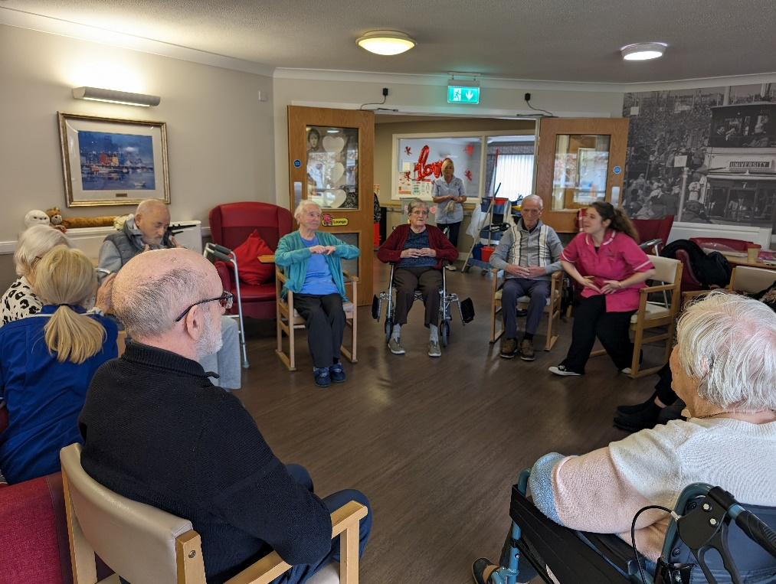
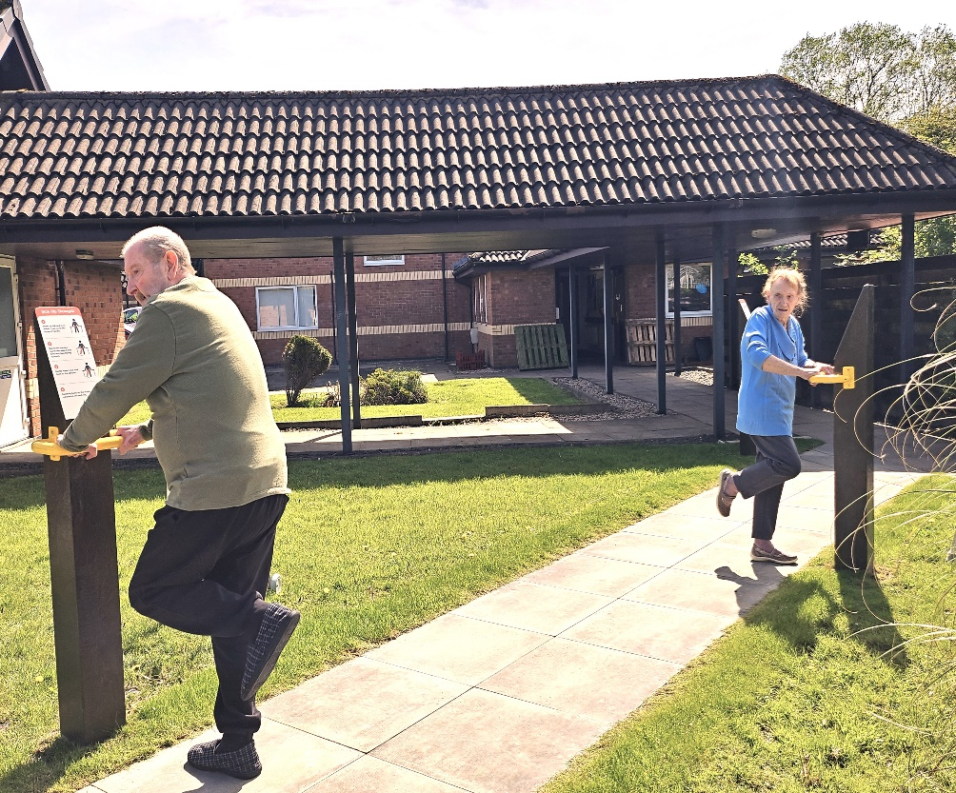
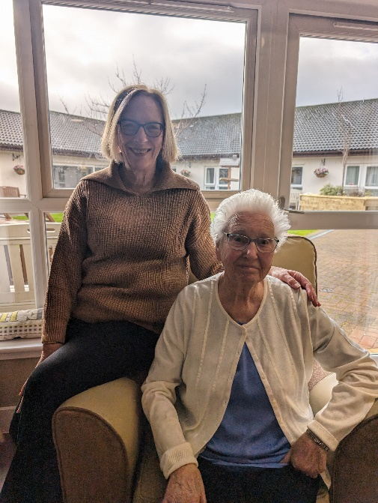
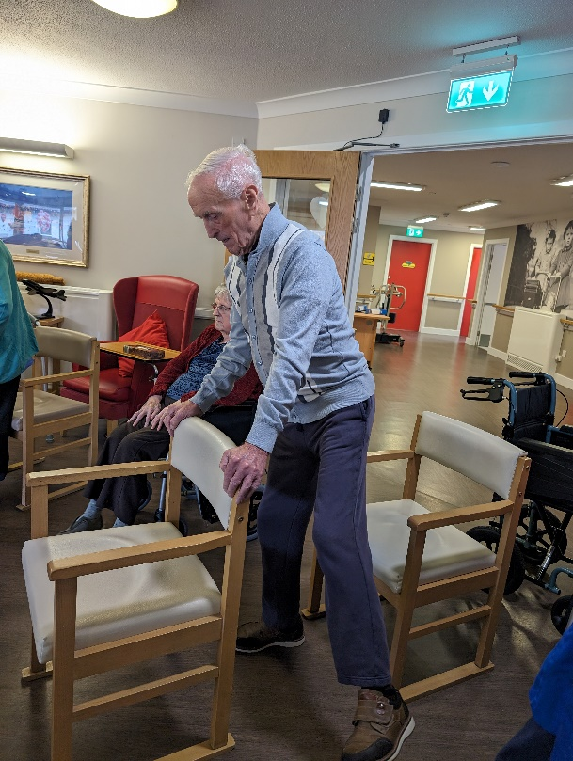
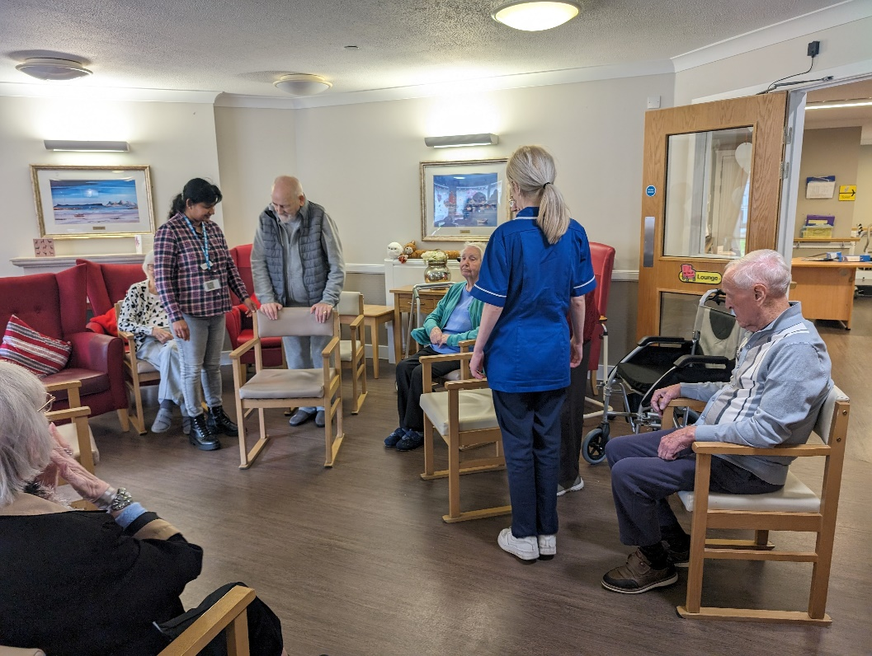
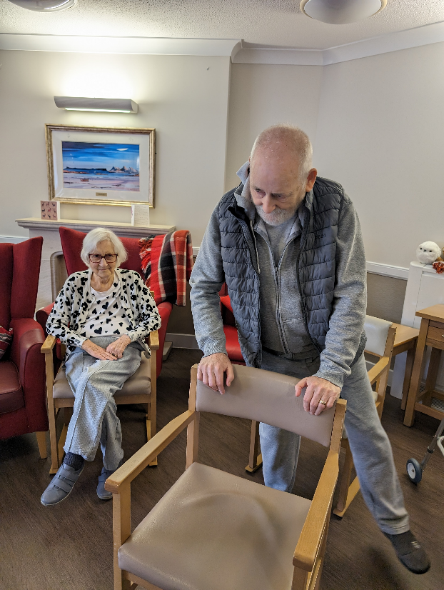
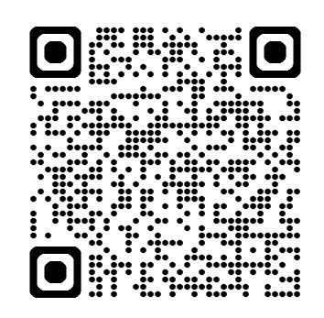
Improving physical activity levels and reducing falls using Strength and Balance
Programme in a care home setting
Pooja Gupta
Care Home Collaborative, NHS Greater Glasgow and Clyde (NHSGGC)
Why is this needed?
What did we find?
An estimated 430,000 people live in UK care homes, with this figure expected to rise in line with an ageing population.
Physical inactivity is associated with higher frailty and is a well-known health risk among care home residents.
Chart 1 highlights an improvement in a resident’s Berg score which was sustained between weeks 15 – 20.
Chart 2 demonstrates that over a 20 week period, the number of sit - to - stands completed by one resident in 30 seconds increased from 0 – 5. There is a positive change from weeks 16 – 20, showing an improvement in the resident’s functional ability.
Falls
Chart 3 highlights that prior to starting the
project there were 22 falls recorded for the
participating residents over a 4 month period.
In the 4 months since the project commenced
this has reduced to 10.
Chart 1: Berg score
Chart 2: Number of sit to stands in 30 seconds
Care home residents (on average) spend 90% of their time sedentary.
Falls incidence in care homes is reported to be about three times that in the community
Who are we working with?
Paths for All is a Scottish charity with a vision to give everyone an opportunity to be active. The aim of their Active Health and Social Care programme is to collaborate with and support health and social care professionals to increase physical activity opportunities for people receiving care.
The NHSGGC Care Home Collaborative has been working with Paths for All since Feb 2023 to develop a strength and balance programme within care homes.
Chart 3: Monthly falls
Aim
By March 2024, 10 residents at two care homes will increase their physical activity levels and reduce falls by 25%, in line with the health and social care standards and principles of Caring about Physical Activity (CAPA).
What did we do?
Improvement team set up including staff from 2 care homes, Paths for All and the Care Home Collaborative
Feedback
Resident J’s daughter noticed a significant improvement in her dad’s mobility and mood.
Staff reported a positive impact on the mood of the residents who attended regularly.
Residents enjoyed the social aspect of the activity
Staff reported seeing a difference in resident’s mobility and strength
Family members enjoyed participating in the classes with their relatives
Strength and Balance resources introduced in both care homes e.g. posters, cue cards and recording charts
Workshop delivered by Paths for All to train staff on walking with Strength and Balance exercises that would be used in the sessions. This included practical examples of how to incorporate physical activity, particularly more walking, in residents’ daily life
Implementation of Strength and Balance classes 3 times per week for 20 weeks with support from the Care Home Collaborative team
Irene’s story
Irene returned home after a 6 week admission to hospital following a stroke in Sept 2023. Her daughter stated “when she returned home she struggled to get up out of a chair and walk”.
Mum loved going to the strength and balance classes three times per week. “She still walks with a zimmer but her balance is much better …I believe she walks better now than she did before her stroke. Thank you for helping her get some independence back” (Alyson Craig, Irene’s daughter)
Regular support / check-in with staff to help embed the change in physical activity culture
With funding from Paths for All, outdoor panels were installed to allow residents to exercise safely in the garden
What did we collect?
Baseline data including the number of sit to stands in 30 secs and the part of Berg score gauging the quality of sit to stand and stand to sit were collected weekly for each participating resident. Increases in these two measures can indicate an improvement in functional mobility and a reduction in the risk of falls
Focus groups were conducted and feedback collected to capture impact stories from residents, family and staff
What is next?
Targeted workshops for interested care homes
Support to care homes to implement strength and balance exercise classes
Continue to measure impact and spread to more care homes in NHSGGC whilst scoping options to embed programme to ensure sustainability
Acknowledgements:
Staff and residents of Braemount Care Home and Mosswood Care Home
CHC staff – Elaine Hamilton (Lead Nurse, CHC), Fiona Cowan (Quality Improvement Advisor), Sheeja Jacobs (RN), Lavinia Mclaughlin-Todd (Care Support Worker) and Stuart Wilson (Care Support Worker)
Pooja Gupta
AHP CAPA Lead, Care Home Collaborative, NHSGGC
PhD Researcher, Strathclyde University
Website: Care Home Collaborative – NHSGGC
Pooja.gupta@ggc.scot.nhs.uk
X/Twitter: @nhsggcchc

