Slide 1


What is type 2 diabetes?

Slide 2

What we will cover today
Types of diabetes
What is type 2 diabetes?
Long term complications or problems associated with diabetes
How to manage diabetes and prevent/reduce the risk of these complications.

Slide 3

Types of Diabetes
Type 2 Diabetes
- Regardless of the treatment
Other types of diabetes:
Type 1 Diabetes
Gestational Diabetes
Secondary Diabetes
Notes:
No matter what treatment you are on you will always have Type 2 diabetes.
There are other types of Diabetes, you may have heard of them.
Type 1 diabetes is when the pancreas stops making any insulin and the person needs insulin injections to control blood glucose levels.
Gestational Diabetes is a type of diabetes pregnant women can get because hormone changes during pregnancy make it difficult for the body to use insulin properly. This usually goes away once the baby is delivered but makes the woman more likely to develop T2 diabetes in later life.
Secondary Diabetes is caused by disease or damage to the pancreas. This destroys the part of the pancreas which makes insulin. For example in the West of Scotland the most common cause of secondary diabetes is excess alcohol consumption, but can be caused by medical conditions too. E.g. Cancer of the pancreas.

Slide 4
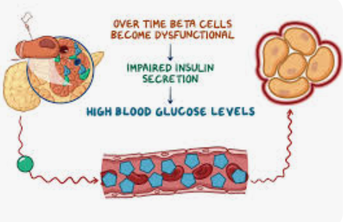
Type 2 diabetes- how does it develop?

Slide 5
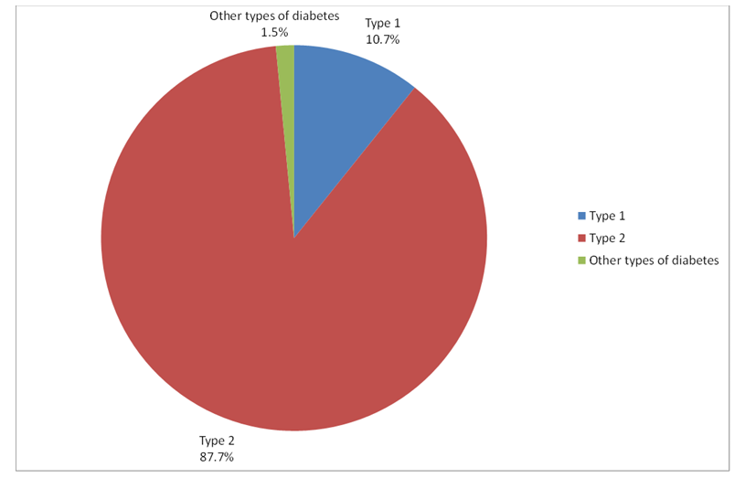
How many people have diabetes in
Scotland?

Slide 6
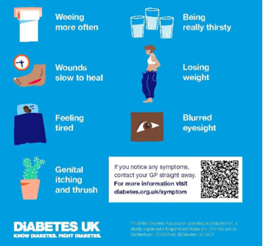
Symptoms of type 2 diabetes

Slide 7
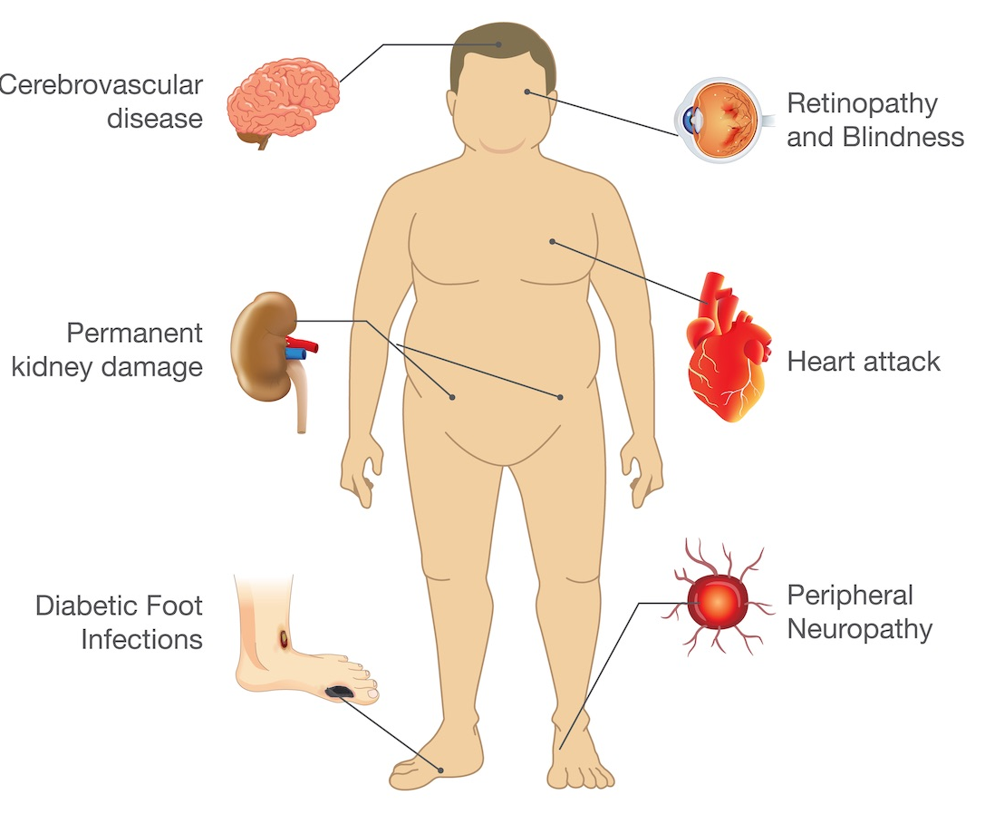
Complications of type 2 diabetes
Notes:
Diabetes can affect various parts of the body if poorly controlled
Damage is caused by high blood glucose levels, high blood pressure and high cholesterol.
Damage to blood vessels can increase the risk of a heart attack & stroke and can affect the eyes, kidneys and feet. Feet can be affected by nerve damage too.

Slide 8

Diabetes and feet
Keep feet clean and dry to avoid infection
Avoid walking barefoot
Wear shoes that fit well
Usual diabetes team should be informed of any:
cuts, cracks or blisters
pain or tingling
numb toes and feet

Slide 9
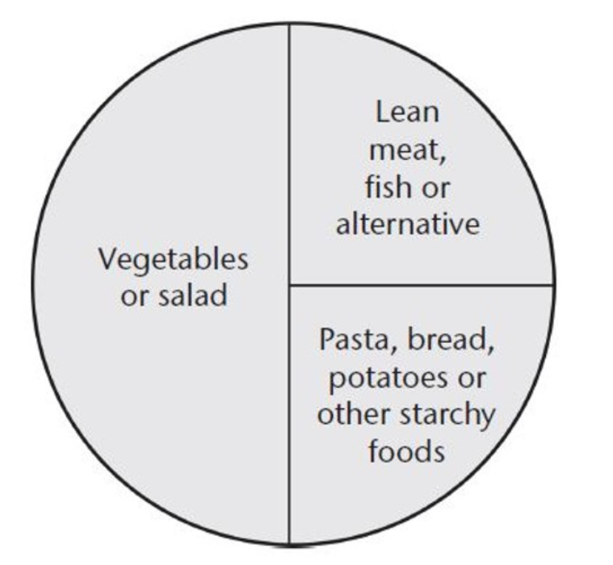
Managing diabetes-portion sizes

Slide 10
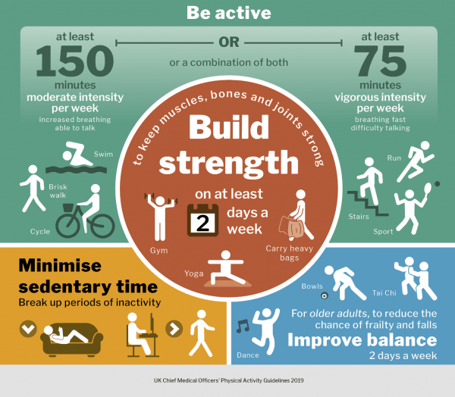
Managing diabetes-exercise

Slide 11
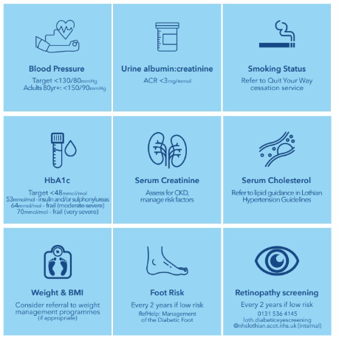
Annual Review

