Slide 1


Oral and non insulin medicines used in the management of type 2 diabetes

Slide 2
This podcast will cover
Oral medicines used in the management of type 2 diabetes
Non- insulin injections that are used in the management of type 2 diabetes

Slide 3
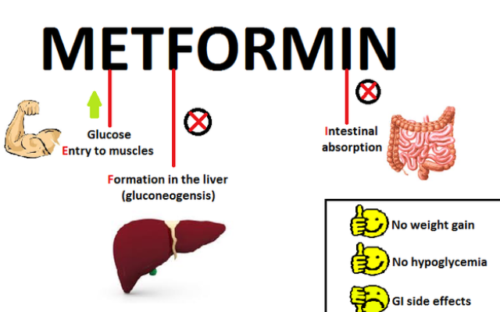
Metformin

Slide 4
Metformin: what to look out for
Needs to be taken with meals
Main side effects-feeling and being sick, diarrhoea and stomach ache
Metformin should be paused when person living with diabetes is unwell and not eating and drinking normally. Restart metformin 24-48 hours after the person is feeling better and eating and drinking normally.

Slide 5

Sulfonylureas e.g. Gliclazide
More
Insulin
battery
Beta cell in the pancreas
Sulphonylureas
Behave a bit like jump leads for the pancreas – stimulating the beta cell to produce insulin and must be taken BEFORE FOOD to be absorbed correctly.

Slide 6
Sulfonylureas e.g. Gliclazide what to look out for
Can cause weight gain
High risk of low blood sugars:
Ensure the resident eats regular meals
Take Gliclazide at least 15 minutes before meals
Monitor blood sugars regularly especially if starting this treatment or if their dose has been increased
Are you and the resident aware of the symptoms of low blood sugars and how to treat it?

Slide 7
Pioglitazone
Come on Fat cells;
obey your Insulin!
pioglitazone
Re-trains the fat cells,
so insulin is more effective.
Helps muscles to utilize or use up glucose (sugar).

Slide 8
Pioglitazone
What to look out for
Once daily, can take at any time of day
Doesn’t cause low blood sugar, but this can occur if taken with Gliclazide and/or insulin

Slide 9
Pioglitazone
Some side effects:
Blurred vision: if resident experiences this, report to their GP
Can cause weight gain- ensure resident stick to a healthy balanced diet where possible
Increase risk of fractures, especially in women
Associated with bladder cancer – report any blood in the urine to the resident’s urine
Not to be taken if resident’s heart is not working as well as it should, a condition called heart failure.

Slide 10
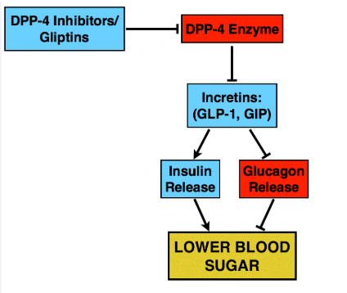
Gliptins e.g. Alogliptin, Linagliptin, Sitagliptin

Slide 11
Gliptins e.g. Alogliptin, Linagliptin, Sitagliptin- What to look out for
Take at any time of the day
Risk of hypo if on gliclazide and/or insulin
Minimal side effects
Low risk of Pancreatitis –i.e., severe, persistent abdominal pain sometimes radiating to the back. Seek medical advice if this is suspected.

Slide 12
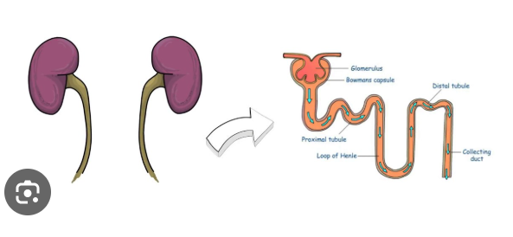
SGLT2i e.g. Canagliflozin, Dapagliflozin, Empagliflozin

Slide 13
SGLT2i e.g. Canagliflozin, Dapagliflozin, Empagliflozin- What to look out for
Once daily, ideally in the morning
Hydration is key as person may urinate more often
Increase risk of thrush and urinary tract infections, most common in women
Doesn’t cause low blood sugar, but this can occur if taken with Gliclazide and/or insulin
Can cause some weight loss and slight improvement in blood pressure

Slide 14
SGLT2i e.g. Canagliflozin, Dapagliflozin, Empagliflozin- What to look out for
SGLT2i can in rare cases lead to a dangerous condition called diabetic ketoacidosis. This may occur whether sugar levels are high or healthy, so it is important to know the symptoms…
SGLT2i should be paused when person living with diabetes is unwell and not eating and drinking normally. Restart SGLT2i 24-48 hours after the person is feeling better and eating and drinking normally.

Slide 15
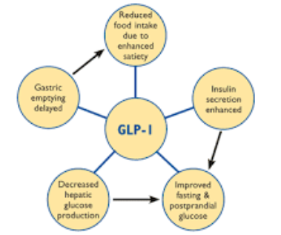
Incretin mimetics e.g. Dulaglutide, Semaglutide, Tirzepatide

Slide 16
Incretin mimetics e.g. Dulaglutide, Semaglutide, Tirzepatide
Step before insulin or in combination with insulin
Bydureon (Exenatide) – injected once weekly
Trulicity (Dulaglutide) – injected once weekly
Ozempic (Semaglutide) – injected once weekly
Rybelsus (Semaglutide) –orally once daily
Liraglutide – injected once daily
Mounjaro (Tirzepatide)- injected once weekly
Xultophy (combination of insulin and Liraglutide)- injected once daily

Slide 17
Incretin mimetics e.g. Dulaglutide,
Semaglutide, Tirzepatide
Benefits:
Reduce weight
Improve blood sugar levels
Low risk of Pancreatitis –i.e., severe, persistent abdominal pain sometimes radiating to the back. Seek medical advice if this is suspected.

Slide 18
Incretin mimetics e.g. Dulaglutide,
Semaglutide, Tirzepatide
Side effects:
Nausea, vomiting, diarrhoea- mostly mild-moderate in severity
Likely transient
Symptomatic treatment is allowed
Eating patterns- smaller portions, eat slowly, stop at the first sign of fullness
X large portions
X fatty or fried foods
X overly sweet or spicy foods
X drinking alcohol and smoking cigarettes

