Slide 1


Glucose Monitoring

Slide 2
This podcast will cover
Blood Glucose Monitoring
Continous blood glucose monitoring (CGM)
-Freestyle Libre
-Dexcom

Slide 3
Glucose monitoring
Keep blood glucose close to normal as it is safely possible
Stable glucose levels reduces the risk of:
High blood sugars (Hyperglycaemia)
Low blood sugars (Hypoglycaemia)
Diabetes related complications

Slide 4
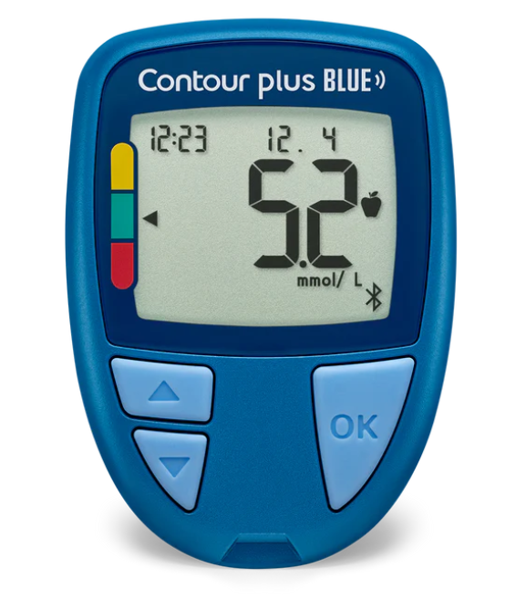
Blood Glucose Meter (BGM)
Who is eligible for a BGM?
Anyone is on sulfonylurea (e.g. gliclazide) and/or insulin
When is the best time to monitor blood glucose levels?
Before meals and bed
Checking for hypoglycaemia
Driving

Slide 5
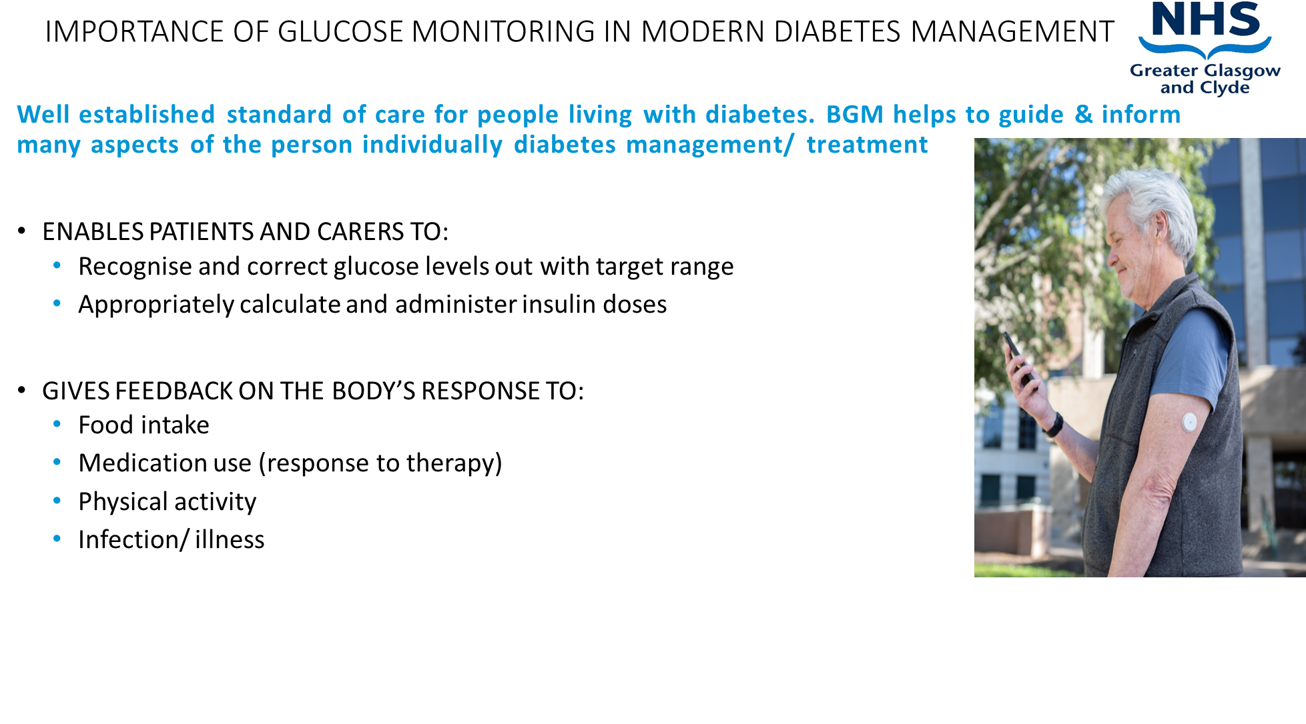

Slide 6
HbA1c and glucose level targets
Are individualised and depends on:
Age
Frailty
Medication
Occupation
Life expectancy
Motivation
Family/friends/carer support

Slide 7
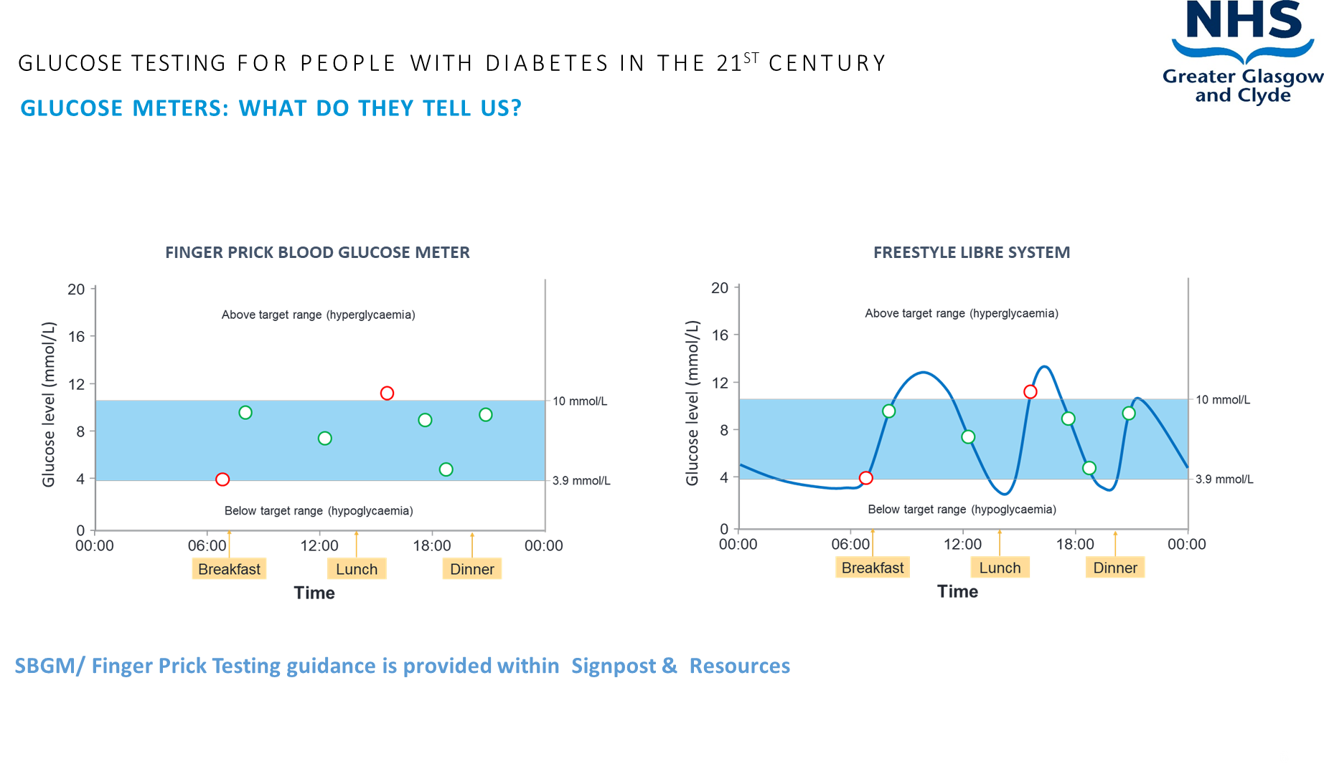

Slide 8
Continous/Flash Glucose Monitoring (CGM)
Who is eligible?
Those with type 1 diabetes
Some people with type 2 diabetes who are on insulin ( usually more than 2 insulin injections/day)

Slide 9
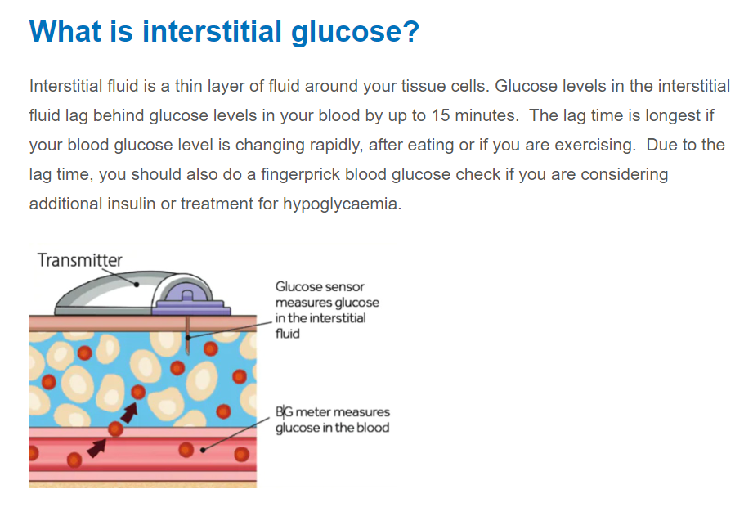

Slide 10

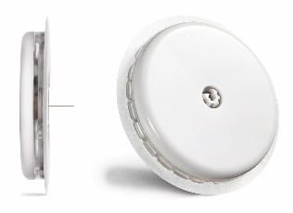



The FreeStyle Libre 2 system features
Real-time glucose readings sent straight
to your smartphone^{1,2}
Calibration-free – no need to enter a code,
no finger prick for calibration
Optional, real-time glucose alarms³
Images are for illustrative purposes only. Not real patient.
1. The FreeStyle LibreLink app is only compatible with certain mobile devices and operating systems. Please check the website for more information about device compatibility before using the app. Use of FreeStyle LibreLink may require registration with LibreView. 2. Glucose readings are automatically displayed in the app only when the smartphone and sensor are connected and in range. 3. Notifications will only be received when alarms are turned on and the sensor is within 6 metres unobstructed of the reading device.
| 10

Slide 11
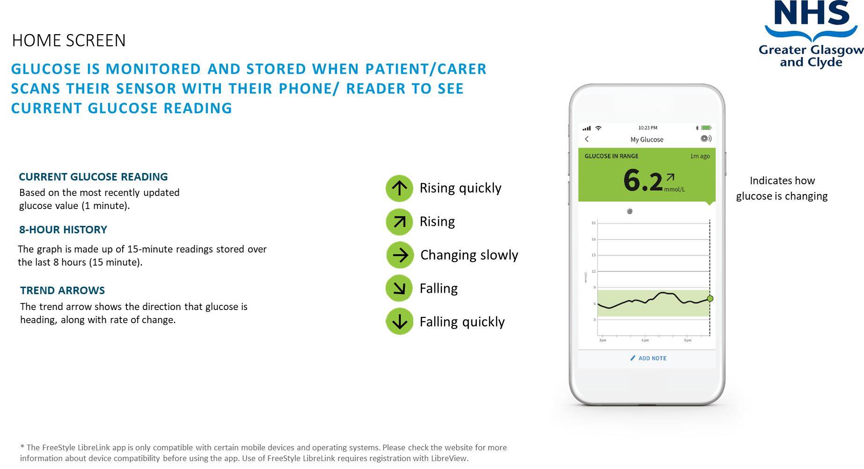

Slide 12
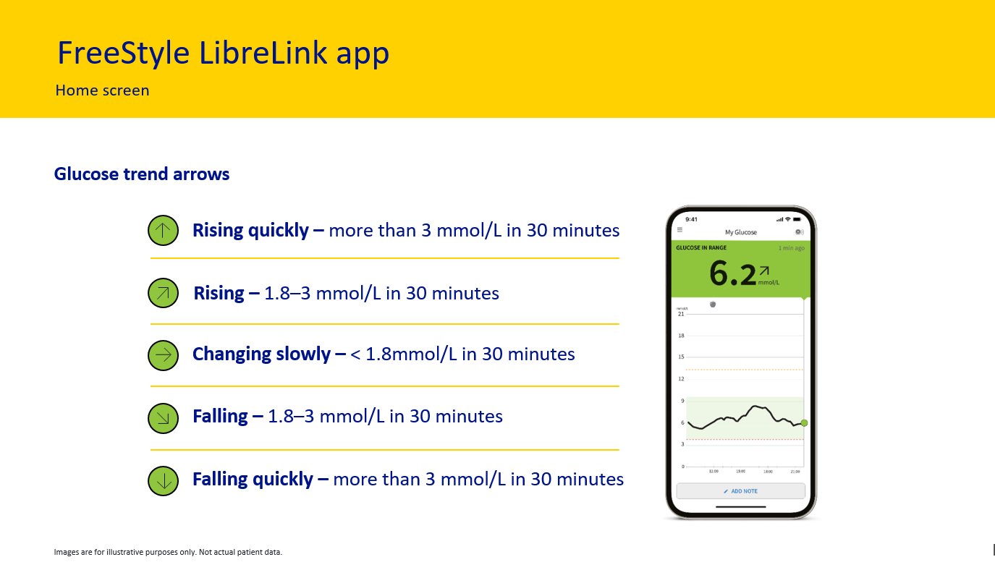

Slide 13
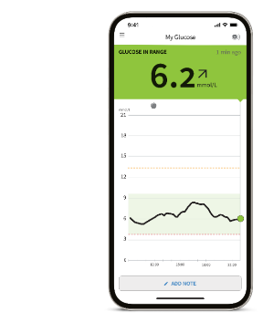
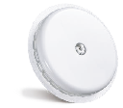

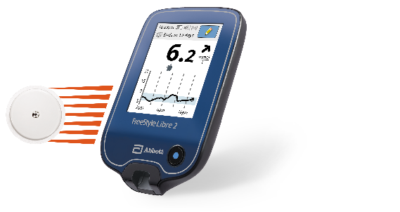
Difference between using app and reader
Automatic glucose readings on the app¹
Start the FreeStyle Libre 2 sensor with the FreeStyle LibreLink app
Provides alarms and glucose readings automatically² on the app
Note: you can still scan for glucose readings anytime³, even during a signal loss.
Scanning experience
with reader
Start the FreeStyle Libre 2
sensor with the reader
Provides alarms and glucose readings with a scan on the
FreeStyle Libre 2 reader
1. The FreeStyle LibreLink app is only compatible with certain mobile devices and operating systems. Please check the website for more information about device compatibility before using the app. Use of FreeStyle LibreLink may require registration with LibreView. 2. Glucose readings are automatically displayed in the FreeStyle LibreLink app only when your smartphone and sensor are connected and in range. 3. 60 minutes warm-up required when starting the sensor.
Images are for illustrative purposes only. Not actual patient data.
| 13

Slide 14
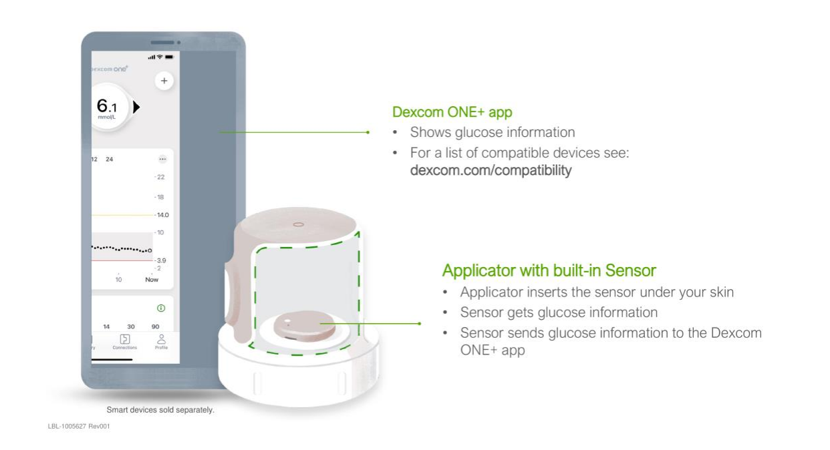


Slide 15
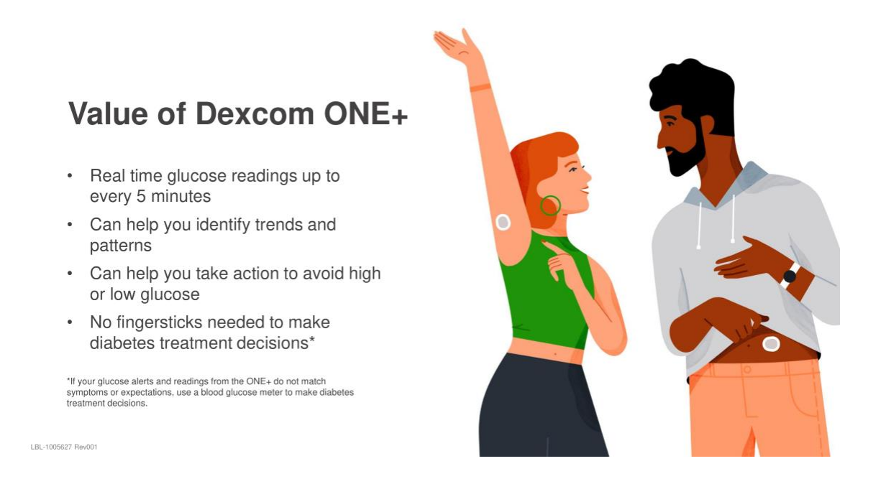

Slide 16
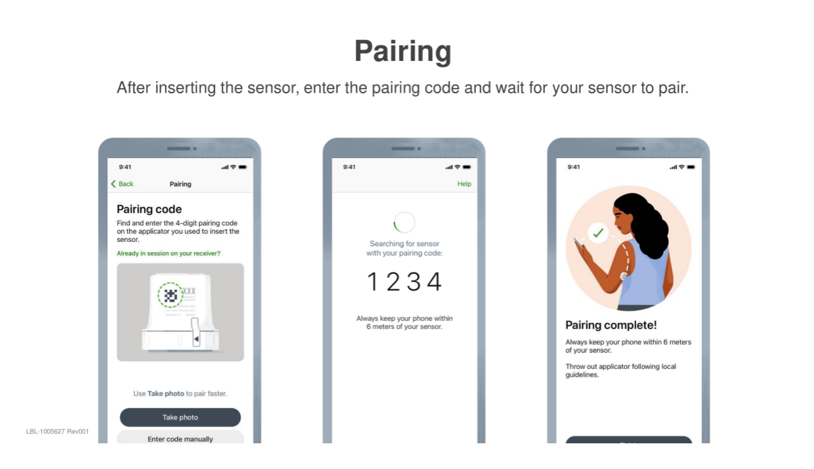
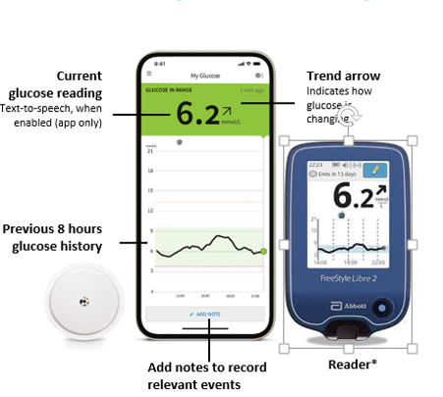
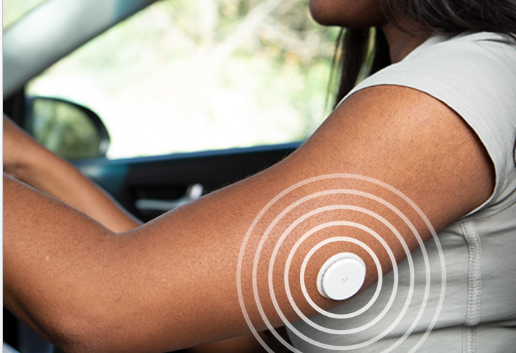
Freestyle Libre 2 plus system

Slide 17
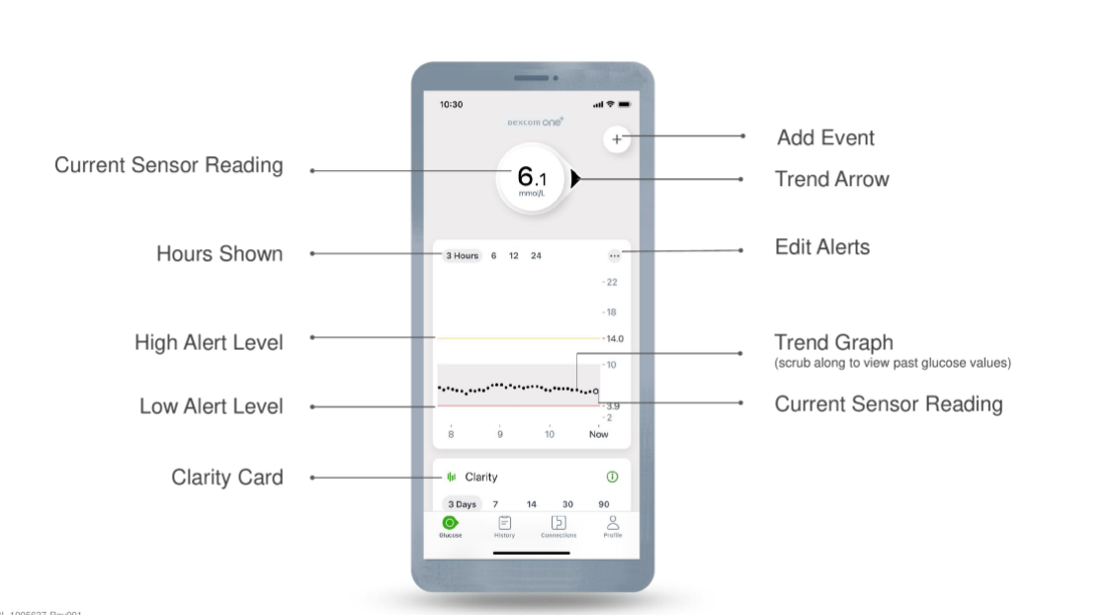

Slide 18
