Slide 1


Diabetic emergencies

Slide 2
The podcast will cover
Acute / Short-term Complications
Hyperglycaemia:
Diabetic ketoacidosis (DKA)
Hyperglycaemic Hyperosmolar State (HHS)
Hypoglycaemia

Slide 3
Diabetic ketoacidosis (DKA)
Mainly type 1 diabetes but now recognise ketosis prone type 2 diabetes
Euglycaemic DKA can sometimes occur in those with type 2 diabetes taking SGLT2i
4.6 to 8 episodes per 1000 people with diabetes
Mortality rate has fallen from 7.96% to 0.67% in UK

Slide 4
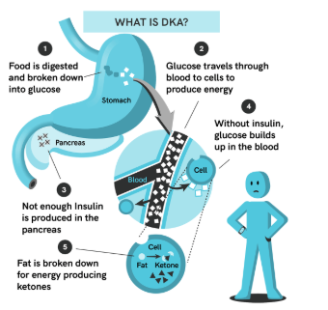
How does DKA develop?

Slide 5
People develop DKA for a number of reasons such as:
Serious illness: infection, vomiting & diarrhoea
Stopping, forgetting or missing insulin injections
Lack of insulin and high blood glucose leads to a build- up of ketones

Slide 6
Testing for blood ketones helps to spot the signs of DKA
Treat the condition before it becomes too serious
Prevent hospital admission

Slide 7
When to test for blood ketones?
When prompted by Blood Glucose Meter or if Blood Glucose Level is greater than 14mmol/l
During Illness, especially infection, temperature or vomiting
If there are symptoms of DKA

Slide 8
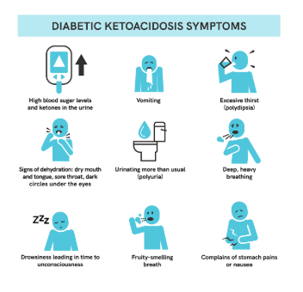
Symptoms of DKA

Slide 9
Interpreting blood ketone results
Blood ketone level | Advice
Below 0.6mmol/L | Normal. Continue with usual blood glucose testing
Between 0.6 and 1.5mmol/L | Continue regular insulin regime. Test blood sugar and ketones after 2 hours. Consider increasing insulin. If blood glucose and ketones are falling retest 2 hourly till ketones below 1.1mmol/L
1.5mmol/L or above | MAY BE AT RISK OF DEVELOPING DKA. SEEK SPECIALIST ADVICE IMMEDIATLEY

Slide 10
Hyperglycaemic Hyperosmolar State (HHS)
Less than 1% diabetes related admissions annually
Mortality rates 15-35%
Elderly (55-70yrs), first presentation T2DM in 30%
Insidious onset
Precipitating factors: Infection – 60%
Poor compliance – 30%

Slide 11
Symptoms of HHS
Increased urination
Increased thirst
Nausea
Dry skin
Disorientation and, in later stages, drowsiness and a gradual loss of consciousness.
Blood glucose levels >30mmol/l

Slide 12
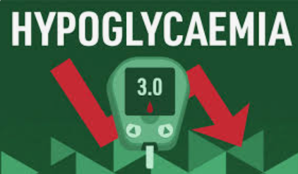
Hypoglycaemia
Low blood sugar (or a hypo) is usually where blood glucose level is below 4mmol/L

Slide 13
Hypoglycaemia –causes
missing or delaying a meal or snack
not having enough carbohydrate at last meal
doing a lot of exercise without having extra carbohydrate or without reducing insulin dose (if on take insulin)
taking more insulin (or certain diabetes medication) than needed
drinking alcohol
being unwell
experiencing stress or anxiety
extreme changes in weather.

Slide 14
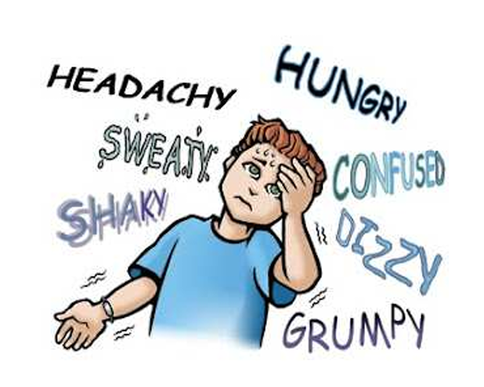
Symptoms of hypoglycaemia

Slide 15
Management of Hypoglycaemia : glucose levels<4mmol/L
Person conscious (orientated & able to swallow)
Small glass of fruit juice or fully sugar fizzy drink:
200ml of orange juice (not sugar free)
150ml full sugar cola
60ml glucojuice
3-4 heaped teaspoonfuls of sugar added to a cup of water
Glucose tablets or gel:
Five glucose tablets
Six dextrose tablets
Two tubes of glucose 40% gel (such as Glucogel®, Dextrogel® or Rapilose gel®)
Hard candies or jellybeans
Five large jelly babies, or 7 small jelly babies
Wait 10-15minutes & recheck glucose levels
-If glucose levels >4mmol/L give a long acting carbohydrate to maintain glucose levels e.g slice bread or 2 plain biscuits or next meal
-If glucose levels remains <4mmol/L repeat treatment x 2
-If glucose levels remains<4mmol/L call ambulance

Slide 16
Management of Hypoglycaemia : glucose levels<4mmol/L
Person is unconscious, fitting or very aggressive
-Check ABC & place in recovery position
-Call for ambulance
-If Glucagon available- administer 1mg IM, recheck glucose levels after 15 minutes- if > 4mmol/L & conscious, give long acting carbohydrate e.g 2 slices of bread or 4 plain biscuits

