Slide 1
Mental Health Services – Community Engagement Sessions 2024
Redesigning inpatient service provision and expanding community mental health service provision

Slide 2
What is the Mental Health Strategy 2023-2028?
It's part of a wider health board change programme: Moving Forward Together
It sets out a shared vision for the future of mental health services
It describes the ways in which mental health services are adapting to meet changing healthcare needs.
Notes:
Context
It’s not new – it’s been around since 2018 but the Strategy has been refreshed
Transforming services for the future – part of the overall MFT vision – this includes mental health services

Slide 3
What is the purpose of this Strategy?
Deliver prevention and early intervention
Improve the effectiveness of community services
Develop Unscheduled Care
Support the focus on Recovery.
Notes:
4 key aims:
Deliver prevention and early intervention; identify and prevent conditions / issues from escalating where possible
Improve the effectiveness of community services; expand and introduce new community services, and reduce duplication and variation across the board area
Develop Unscheduled Care; provide urgent and crisis care for people that don’t need physical treatment in an emergency department through intense support, instead of admitting to hospital where safe, and giving appropriate support where a clinical response wouldn’t really help
Develop the focus on Recovery; recognise the importance of recovery-based approaches and peer support across community teams and inpatient settings

Slide 4
How will the Strategy make a difference?
Providing more mental health treatment and care in a community setting rather than hospital leads to better outcomes for people using mental health services
People can receive their treatment and care locally, close to their personal and community support networks
It can help prevent hospital admission​
It can reduce the length of stay when a hospital stay is needed, and speed up discharge.​
Notes:
What is the case for change – how will the vision and actions set out in this strategy be better than the way we do things now?

Slide 5
Why are we reviewing inpatient provision now?
The public, and particularly people who use mental health services tell us they want to see community services expanded​​ and improved
Reviewing and reducing inpatient beds where appropriate, means we can fund more community services going forward
Currently there are approx. 1,000 mental health inpatient beds across NHSGGC
Over time, and with planned expansion of community services, we could reduce this to approx. 800, with an increase in inpatient care for some specialties.
Notes:
Reviewing inpatient provision is one of the ways to help us get from where we are now to where we need to be to make mental health services fit for purpose for the future

Slide 6
What we have heard so far?*
40% of people said they had used mental health services in the past 12 months
Your top priorities were: increasing community based mental health services, improving support for self-management and providing more community and third sector services
Overall satisfaction rating for current service provision was low at 4/10
The things that you felt needed most improvement were: waiting times and access to community services, better support for self-management, reducing stigma for all NHS staff and specialist services for specific conditions
*2024 Public Survey
Notes:
March/April 2024 public survey
500 responses – 40% identified as service users so we are hearing from a lot of people with lived experience
Clear message that expanding and improving community services was the top priority

Slide 7
Where are we already making progress?
On prevention, early intervention and health improvement
On recovery
On mental health rehabilitation
On providing Community Mental Health Services
On urgent/unplanned care
On reviewing older adults mental health beds
Notes:
Give one or two (max) examples to illustrate progress being made under the Strategy (speak to where able) e.g.
On prevention and early intervention: staff training
On rehabilitation: Expanding community rehabilitation
On reviewing Adult and Older Adult Mental Health beds (particularly continuing care / rehabilitation) linked to the expansion and enhancement of community services or additional beds for some care groups
On providing Community Mental Health Services:
Patient Initiated Follow Up (PIFU)
Standardised Assessment
Borderline Personality Disorder Network – matched care
Psychological Therapies Group Service
On urgent/unplanned care: MHAU’s, Board-wide community liaison psychiatry

Slide 8
What are we prioritising next?
Community rehabilitation
Enhanced Care Home Liaison
Expanded Borderline Personality Disorder Pathway
Community Mental Health Acute Care Services (adults and older people)
Expanded Dementia Post Diagnostic Support services.

Slide 9
How will reviewing inpatient provision help us deliver these priorities?
Review inpatient provision and agree action to take
Investment in new or enhanced community mental health services
Any reduction in inpatient provision releases more funding
Notes:
Describes the phasing approach to reducing inpatient provision in order to reinvest resources in community provision

Slide 10
Will access to inpatient care change?
Access for those who need it will be the same (by self-referral, GP or hospital, depending on the service)
Where we are now
Where we want to be
Inpatient Mental Health
Reduced Inpatient Mental Health
Always available for those who need it
Community Mental Health
Expanded Community Mental Health Services
Notes:
Explain that access to inpatient provision will still be there for those who need it – but in the future there will be a shift in the balance – less inpatient and increased/better community provision

Slide 11
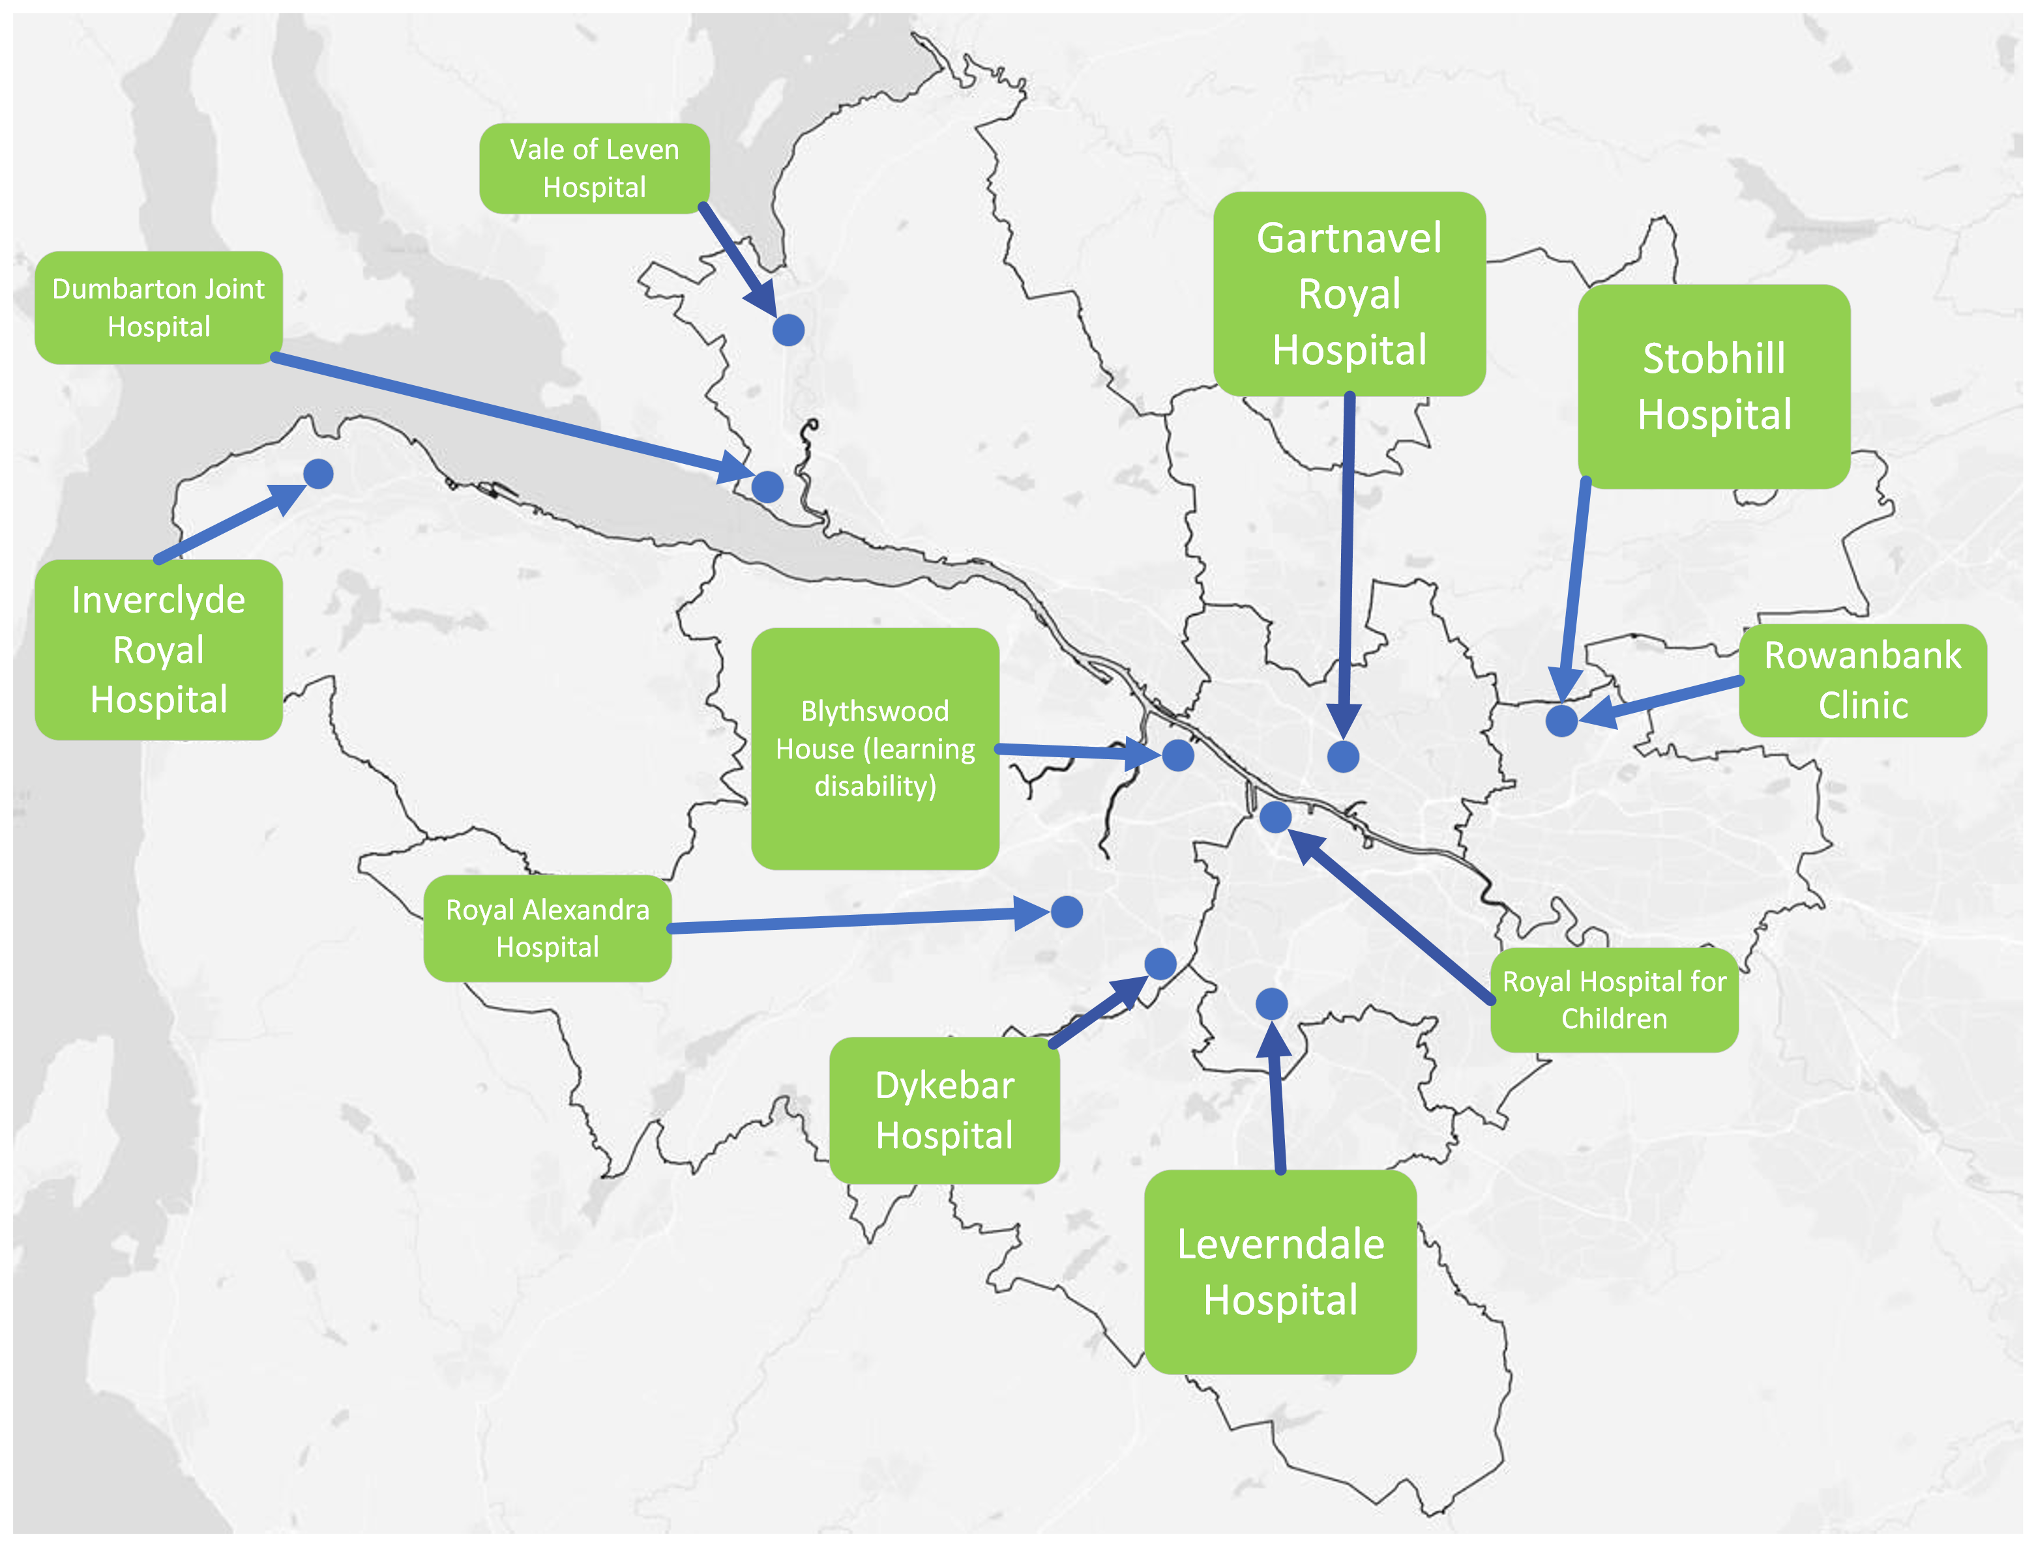
Current Inpatient Locations
Vale of Leven Hospital
Gartnavel Royal Hospital
Dumbarton Joint Hospital
Stobhill Hospital
Inverclyde Royal Hospital
Blythswood House (learning disability)
Rowanbank Clinic
Royal Alexandra Hospital
Royal Hospital for Children
Dykebar Hospital
Leverndale Hospital
Notes:
Just for information, if anyone in room isn’t familiar with the main locations of current inpatient bed provision
Stress that this is just a map of current sites – at present people are admitted to/receive treatment and care at sites across the board area and not necessarily the site closest to where they live
That’s why its important when looking at any changes to inpatient provision we look at it as a whole – across the board

Slide 12
What happens next?
Public, patient and service user feedback will help us identify the important questions to ask when we are reviewing inpatient provision
A number of possible options will be discussed, and there will be public and service user involvement in this process
A preferred option will be chosen and there will be more consultation before any final decision is made

Slide 13
Reviewing Inpatient Services - Discussion Questions
What is important when planning where inpatient services should be in the future?
Notes:
This could be:
Services being close/co-located (in the same hospital) to each other?
Services in a convenient location (thinking about transport options/parking/access etc)
Meet different needs of people with protected characteristics (e.g. age, disability)?
Be welcoming, well equipped and homely spaces (e.g. facilities to let me make a cup of tea, have privacy, option to do activities I enjoy)?
Located in a place where people can go out to walk, or to the shops?

Slide 14
Other things we need to think about
All our services need to be:
Safe (staffing/estates/buildings)
Effective (equitable access to treatment across different areas)
Efficient (what options will make best use of our limited resources?)
Notes:
Public and patient/user/carer contribution is one part – there are also other factors that need to be considered when discussing what the way forward is

Slide 15
What other information would be useful for planning the future of inpatient services provision?
Notes:
Any gaps/things we have missed

Slide 16
Help and Support
Mind to Mind – If you’re feeling anxious, stressed or low, or having problems sleeping or dealing with grief, find out how you can improve your mental wellbeing by hearing what others have found helpful by visiting the NHS Inform Mind to Mind webpage.
Breathing Space is Scotland’s free, confidential listening service for individuals over 16 experiencing symptoms of low mood, depression or anxiety. You can contact them on 0800 83 85 87 Monday to Thursday from 6.00pm to 2.00am and 24 hours a day at weekends (from 6.00pm Friday to 6.00am Monday).
Samaritans provide confidential, non-judgmental emotional support 24/7 for people who are experiencing feelings of distress or despair. You can contact Samaritans free by phoning 116 123 or emailing jo@samaritans.org
NHS 24 Mental Health Hub services are available to everyone in Scotland. The services available include listening, offering advice and guiding you to further help if required. The Mental Health Hub is open 24/7 and you can contact them on 111.
Childline is a free service for children and young people for when they need support or advice. It is open 24/7, and there are many ways to get help. You can call 0800 1111 or visit the Childline website.
Notes:
Resources and signposting

Slide 17
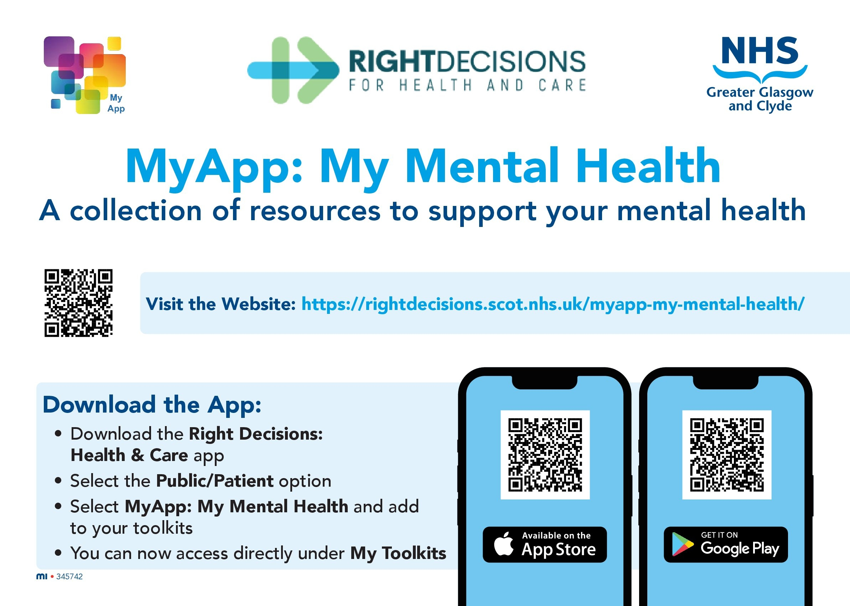
Help and Support

Slide 18
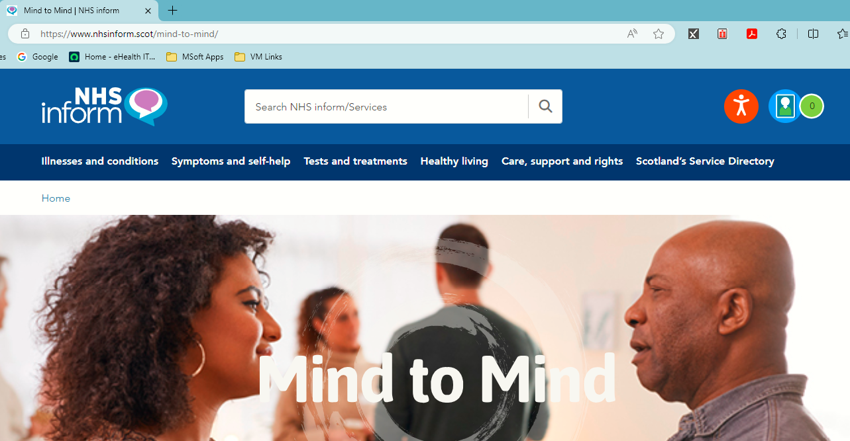
www.nhsinform.scot/mind-to-mind

