Slide 1



Disability
Services
Access to Work
Please stay on mute during the presentation
Please use the chat facility for questions
We cannot discuss specific cases
Slides will be shared following the call
To turn on live captions, click the 3 dots at the top of your screen, then the language and speech

Slide 2
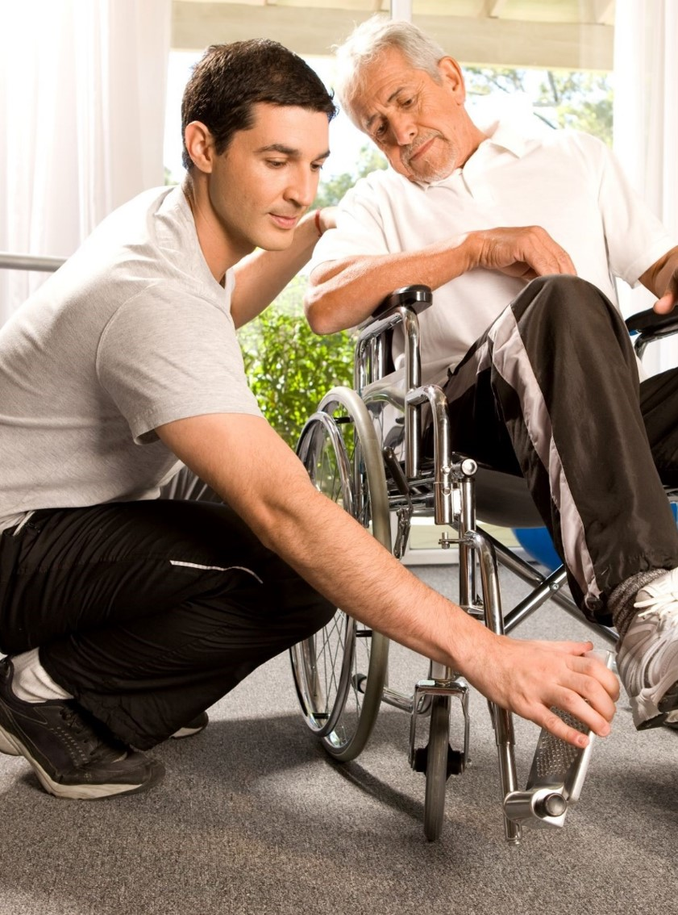
Welcome
Disability Services Advocacy Team
Established in 2019 to raise awareness of Disability Services with stakeholders
To build relationships with Employer & Partnership colleagues and external organisations
To gather feedback to help shape and improve our services
To underpin the governments aspiration to support additional disabled customers into work
Disability Services
We are responsible for delivering services to over 4.6 million disabled customers, often those who are extremely vulnerable. Our services are delivered through:
Access to Work
Disability Living Allowance
Industrial Injuries and Disablement Benefit
Personal Independence Payment

Slide 3

Disability Confident
The Disability Confident Scheme is about encouraging long-term behavioural change, making the business case for employing disabled people and ensuring that they have the opportunities to fulfil their potential.
The aim of Disability Confident is to:
Make a substantial contribution towards the government’s commitment to getting more disabled people into work
Challenge attitudes towards disability;
Increase understanding of disability;
Remove barriers to disabled people and those with long-term health conditions;
Ensure that disabled people have the opportunity to fulfil their potential and realise their aspirations.
Useful Links
Disability Confident scheme - YouTube
Disability Confident employer scheme - GOV.UK (www.gov.uk)

Slide 4
Equality Act 2010
The Equality Act 2010 requires employers and service providers to make 'reasonable adjustments' that will allow disabled people to access the same opportunities and services as non-disabled people.
Employers must make reasonable adjustments to make sure workers with disabilities, or physical or mental health conditions, are not substantially disadvantaged when doing their jobs.
This applies to all workers, including trainees, apprentices, contract workers and business partners in England, Scotland and Wales.
Employers must make reasonable adjustments when
They know, or could reasonably be expected to know, someone is disabled
A disabled staff member or job applicant asks for adjustments
Someone who's disabled is having difficulty with any part of their job
Someone's absence record, sickness record or delay in returning to work is because of, or linked to, their disability

Slide 5

What are Reasonable Adjustments
Reasonable adjustments are changes an employer makes to remove or reduce a disadvantage related to someone's disability.
For example:
Making changes to the workplace
Changing someone's working arrangements
Finding a different way to do something
Providing equipment, services or support
Reasonable adjustments are specific to an individual person and cover any area of work. Employers must make reasonable adjustments by law.
What 'reasonable' means
What is reasonable depends on each situation. The employer must consider carefully if the adjustment:
Will remove or reduce the disadvantage
Is the reasonable adjustment practical to make
Is the reasonable adjustment affordable
Could the reasonable adjustment harm the health and safety of others

Slide 6

Are Reasonable Adjustments permanent
Reasonable adjustments made in the workplace are not necessarily permanent and may need to be reviewed and updated over time to ensure that they remain relevant and effective in meeting the worker’s needs.
For example, changes in an employee’s health condition, job role, or working environment may necessitate a review of existing adjustments.
Similarly, changes in technology or other circumstances may provide new opportunities for adjustments that were not previously available.
Who pays for Reasonable Adjustments
The employer is responsible for paying for any reasonable adjustments.
Many adjustments will be simple and affordable. However, a small employer might not be able to afford as much as a large organisation.
The cost of an adjustment can be considered in deciding if it is reasonable or not.

Slide 7
Introduction to Access to Work
Access to Work – Making Work Possible
What is Access to Work (ATW)?
Access to Work is a grant that supports people with a health condition or disability
It provides individual practical support and advice to help to overcome barriers at work
It helps people with all types of disabilities, including Mental Health conditions
Access to Work grants may help with additional costs beyond “Reasonable Adjustments”
Employers may be asked to contribute towards the cost of one off support

Slide 8
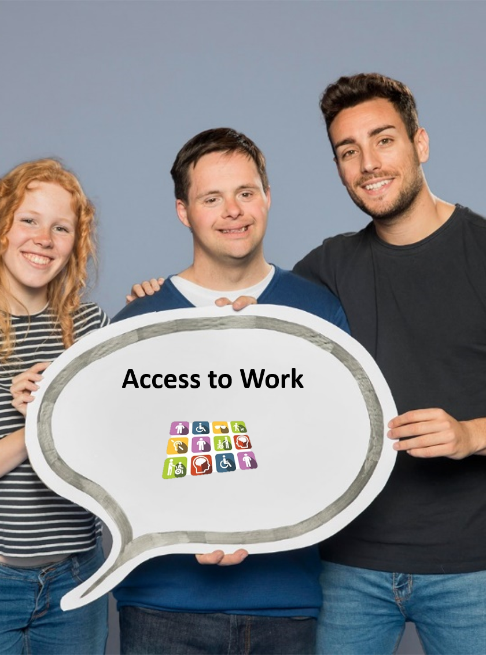

What could Access to Work pay for?
Special equipment or adaptations
A support worker or job coach to help in the workplace
Disability awareness training for colleagues
Communication support at a job interview or in the workplace
The cost of moving equipment following a change in location/job
Travel to work support for those who cannot use public transport or drive which may include taxis
An Access to Work Mental Health Support Service for people who are absent from work or experiencing difficulties with their wellbeing

Slide 9
Eligibility
Who can get help?
To be eligible for Access to Work, people can apply who:
Have a disability or health condition that affects their ability to work
Have to pay work-related costs e.g. specialist equipment/travel costs
Are aged 16 or over
Are in or about to start paid work in England, Scotland or Wales
Work
One of the following must apply:
Have a paid job
Be self-employed
Have a job interview
About to start a job or work trial
Starting work experience

Slide 10

How to apply
Apply for Access to Work online or by phone;
https://www.get-disability-work-support.service.gov.uk/apply/condition
Access to Work helpline
Telephone: 0800 121 7479
Textphone: 0800 121 7579
Relay UK (for customers who cannot hear or speak on the phone):
18001 then 0800 121 7479
Monday to Friday, 9am to 5pm
British Sign Language (BSL) video relay service
To use this, first check you can use the service
go to the video relay service

Slide 11
What to expect
During the application, the Customer will need to provide:
Their workplace address and postcode
The name of a workplace contact who can authorise Access to Work payments
Their workplace contacts email address or telephone number
Their unique tax reference number (if self-employed)
There may be an element of cost share depending on the size of the company
The Customer will also need to explain:
How their condition affects them at work/getting to work
What help they are already receiving
What else could help them

Slide 12

After the application is made
Once the customer’s applied, a case manager will contact them to discuss what reasonable adjustments they already have and what further support they may need to help them in their role.
A case manager may also contact their employer to discuss how Access to Work can help support them, and what reasonable adjustments have already been put in place/ considered/ or could be put in place however, they will not contact their employer until they’ve agreed this with the customer.
A specialist assessor may contact the customer to assess their needs and discuss appropriate support before providing a detailed report.
A customer may get an offer of support. If an award is made, they will be told how much they will get and for how long for.
Grants are awarded depending on the needs of the individual for a maximum of three years and are reviewed annually.

Slide 13

Employer Cost Share
For special aids and equipment there can be an employer cost share:
  Small Employer (0-49): Zero Cost Share
  Medium Employer (50 to 249): First £500 and 20%
  Large Employer (250+): First £1000 and 20%
  Any costs above £10,000 met by Access to Work
There will be no cost share if the application to Access to Work is made within 6 weeks of a customer starting employment.
General Business Benefit
There may be a 20% cost share if there is a general business benefit, e.g. the business can now earn more money because of the equipment AtW has funded or the equipment can be used by other none disabled colleagues.

Slide 14
Customer Cost Share
Social & Domestic
If special aids or equipment could benefit a customer in their personal time they may be asked to contribute i.e. a roger pen/ specialist wheelchair that could be used when not in work.
Travel to Work
Customers will be expected to contribute their usual travel costs to any travel to work support i.e. 25p per mile for fuel, or their usual Public transport expenses.

Slide 15

Renewals
If your Access to Work grant is ending soon, you need to apply to renew it. You can apply up to 12 weeks before the date it ends.
You can apply online or by phone.
You’ll need to provide your:
Name
Address
Date of birth
Unique reference number (if you know it)
After you apply, an Access to Work adviser will contact you. They may request further information about your condition.
They’ll also contact your employer.
If you’re offered a new grant, you’ll be told how much you’ll get and for how long.
.

Slide 16

Change of Circumstances
If receiving support from Access to Work, the Customer must report any changes, including:
Their disability or health condition
Home or work address
Changes in employer, job role or working pattern
Changes in personal contact details
Any changes can be reported to the Access to Work helpline

Slide 17
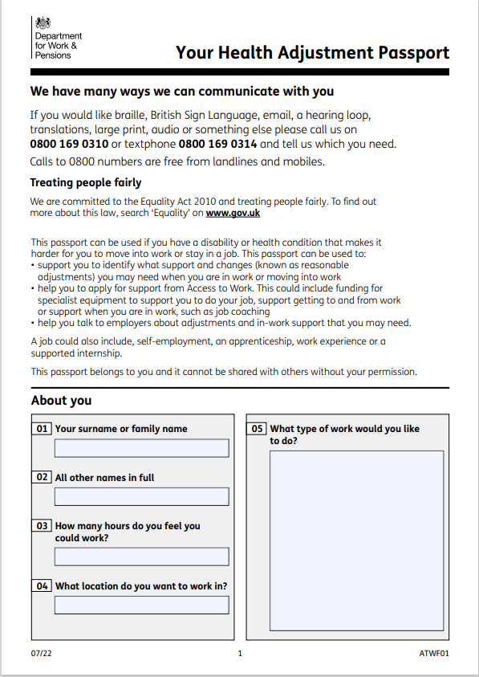
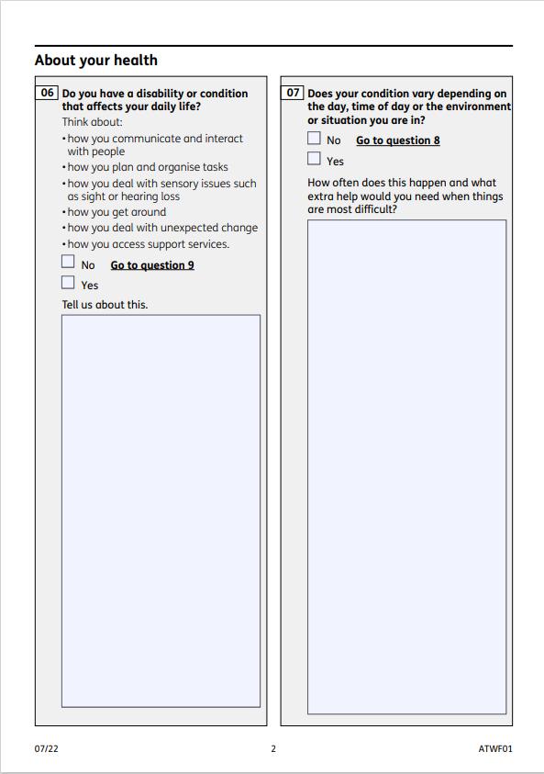
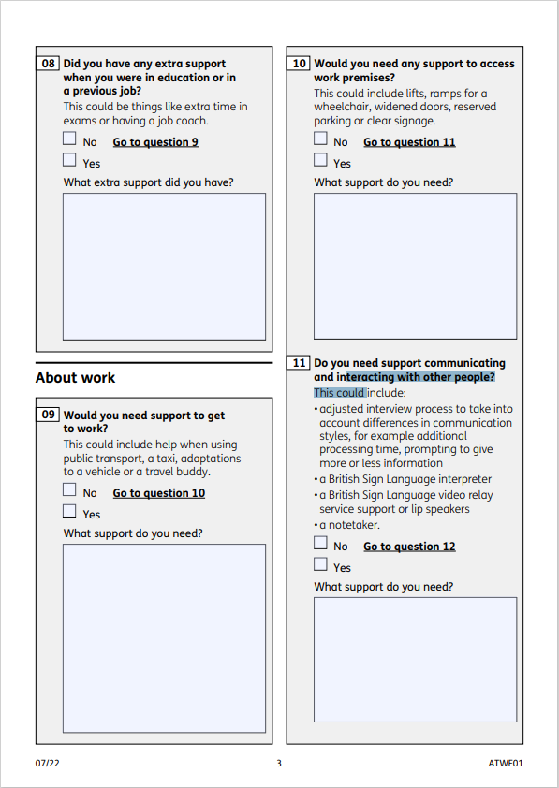
Health Adjustment Passport (HAP)
The Health Adjustment Passport is a document that can help a customer to identify support or reasonable adjustments that they may require in the workplace due to a health condition or disability. It covers several aspects of support including travel to work, accessing work premises, the need for specialist equipment or IT and various types of support worker. The HAP provides information on how to apply for an Access to Work grant, if a customer identifies they may need support in the workplace. We have been rolling it out across all Job Centres since April 2022 and it was published on gov.uk in July 2022.
How can it help?
The HAP can support an employee/ potential employee to have an informed conversation with their employer about the support they may require in the workplace. It can also encourage employers to think about the job roles they advertise, and if they can be adapted to meet the needs of a potential employee.
Where can I find it?
Health Adjustment Passport - gov.uk

Slide 18
10 Top Tips
Complete a Health Adjustment Passport
Research Reasonable Adjustments
Speak to your employer about what part of your role is causing barriers
Apply early – before starting a new role will mean no waiting
Put all methods of communication on application (email, telephone number etc.)
If you know what you need:
If you know what you need, tell us what this is on the application
If your application is relating to specialist computer software speak to your IT department
Complete a support worker record of tasks​
​For taxis, ask firms if they are willing to set up an ​account​
Start gathering quotes from different suppliers

Slide 19

Case study of support provided through reasonable adjustments
Kim completed a Health Adjustment Passport (HAP) as she is autistic and was attending an interview with a potential employer.
The employer was disability confident level 2 and made reasonable adjustments for her interview by allowing pre questions and letting her mum attend the interview with her.
Kim was offered a data inputting role, and the HAP was used to see what other support was needed.
The employer made sure Kim was happy with her seating arrangements, the lighting and noise levels in the office. Kim was able to work from home if she felt overwhelmed and had a workplace buddy who was also neurodivergent. Kim was given noise cancelling headphones and fidget gadgets on her desk.
The employer completed a communication preferences document with Kim which showed that she preferred written instructions, email feedback and clear rules for her to be able to perform well. Kim found smart clothing uncomfortable and so was encouraged to wear whatever she felt comfortable in.
Kim did not need to apply to ATW as she did not feel like her work environment was disabling for her.

Slide 20
Case study of support provided by ATW
James made an application as he is starting a new job in 3 weeks. James is Deaf and BSL is his first language. James was previously in full time education, and this is his first job.
The adviser that was allocated the case emailed James to gather further information, James advised he required a BSL interpreter.
The adviser sent James a Support Worker Record of Tasks document to complete. This document allows a standard working week to be broken down showing the tasks he can undertake independently, and those he feels support are required with.
James was also advised to source 3 quotes for interpreters
James initially requested 15 hours support per week, following discussions with his employer this was reduced to 12 hours due to additional support from the employer. The hourly rate agreed was £45 per hour and the support was input for 3 years which meant an award for support for James of over £28,000.

Slide 21
Case study of support rejected by ATW
Alliah applied to ATW as she had started her own business as a graphic designer where she will be working from home.
Her case was allocated to a case manager who requested a business plan and 3 year expected forecast. Her business was expected to turnover £10,000 per year which showed she was eligible for ATW.
Alliah had a slipped disc in her spine meaning sitting in a standard chair was causing her discomfort.
Alliah requested a sit stand desk, an ergonomic chair, a laptop, filing draws, mobile phone and printer.
After asking questions, the case manager deemed the sit stand desk and chair were disability related and agreed to fund. All other items were rejected for funding, as these items were standard business equipment and not disability related.

Slide 22
Useful Links
What are RAs - reasonable adjustments
Access to Work - Access to Work: get support if you have a disability or health condition - GOV.UK
Easy Read - Easy read: Access to Work – get support if you have a disability or health condition - GOV.UK
Communication support for job interviews - communication support at a job interview - GOV.UK.
Permitted Work - Permitted work: factsheet - GOV.UK
To speak to a DEA - jobcentre contact

Slide 23


